Slide 1
Tekstcollecties in Nederlab
Hennie Brugman
hennie.brugman@meertens.knaw.nl
Meertens Instituut
Workshop ‘morfosyntactisch verrijken van historische teksten’, Utrecht, 16 november 2015

Slide 2
Introduction to nederlab
Started: 2013 – ends: 2017
Aims:
Bring ‘full text production’ together
Detect and analyze historical changes in digitized Dutch and Flemish texts (800 – present)
User-friendly and tool-enriched web interface for scholars
History, literature, culture, linguistics
Most important metadata: time, place, author, genre
Enrichment of data by team and by scholarly users
Focus on data quality by including an editorial staff

Slide 3
Introduction to nederlab
Meertens, Huygens ING, Instituut voor Nederlandse Lexicologie (INL), Radboud Universiteit- Centre for Language Studies
Track 1: Scientific embedding
Nicoline van der Sijs
Track 2a: Infrastructure
Hennie Brugman, Jan Pieter Kunst, Rob Zeeman, Matthijs Brouwer
Huygens ING team
Track 2b:Tools track
Antal van den Bosch, Martin Reynaert, Erik Tjong-Kim-Sang
Track 3: Data curation
René van Stipriaan, Ineke Brussee, Dieuwertje Kooij
INL team

Slide 4
Introduction to nederlab
Currently available through Nederlab
13.5 million titles (articles up to books), 100k persons (mainly authors)
Digitale Bibliotheek voor de Nederlandse Letteren (DBNL)
High quality metadata and transcribed texts
Fully annotated with lemma, pos and entities
Complex IPR situation
Early Dutch Books Online (EDBO, 1780-1800)
OCR text and additional automatically spell-corrected text layer
KB newspaper collection, up to 1900
Also used to test scale

Slide 5
Collection workflow
Arrangement with collection provider
Quality Assessment
Specification of mappings
Scripting and processing
Thesaurus linking
Manual curation
Automatic spelling correction/normalization
Add modern Dutch
Standard annotation with frog
Indexing and search
Make available to end users

Slide 6
1. Arrangement with collection provider
Simple, model contract(s)
Assisted by KNAW legal department
Agreement on technical implementation of this contract
Two types of users: ‘anonymous’ and authenticated academic user

Slide 7
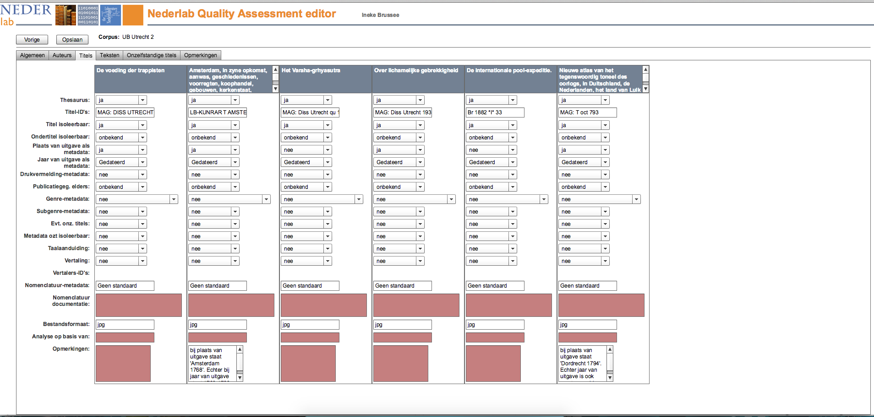
2. Quality Assessment
Systematic acquisition of collection information
Judgments about quality
Based on analysis of document samples
QA information is used for
Editorial and technical nederlab processes
Scientific end users
QA Editor

Slide 8
3. Mapping - 1
Nederlab metadata specification
Central for our processes, curation efforts and tooling
Fully CMDI compliant and documented with CLARIN services
Source metadata is mapped to Nederlab metadata, copied or ignored
Core Nederlab objects
Titles
Dependent titles
Series titles
Persons

Slide 9
3. Mapping - 2
Metadata contains, a.o.:
Bundle of identifiers
Time, location, authors, genre
publication dates, life years, exact or approximated
name variations of authors
Fields for text and author identification
Author and title thesaurus and links
contains, series title
Availability information per resource
text, ticcl, availability of specific annotation layers, ocr-ed or not, etc.

Slide 10
3. Mapping - 3
For text documents
Adapt segmentation to nederlab title granularity
Extract segments of text to the paragraph level
Maintain hierarchical structure
Construct FoLiA XML

Slide 11
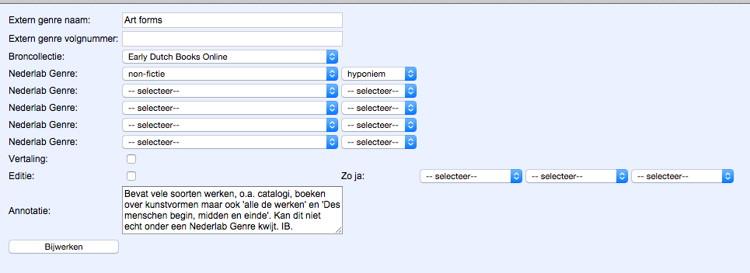
3. Mapping - 4
Nederlab vocabularies
Genres: mapped to Nederlab genre vocabulary, per collection

Slide 12
4. Scripting and processing
De facto: custom scripting and processing per collection
Labour-intensive
Output:
Metadata in relational database
Text and text annotations in FoLiA store
Linked by nederlab identifiers
Used for internal tools and indexing proces

Slide 13
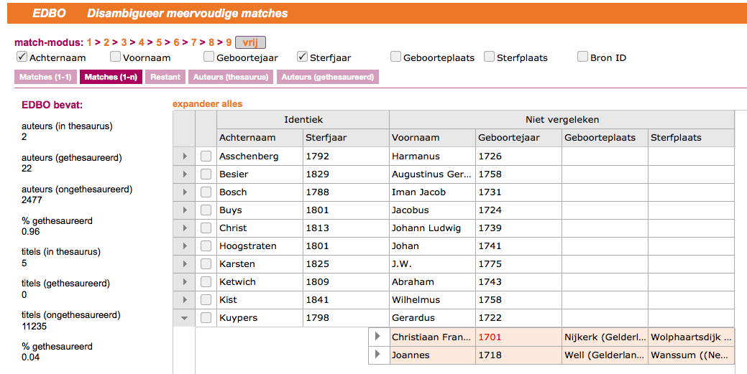
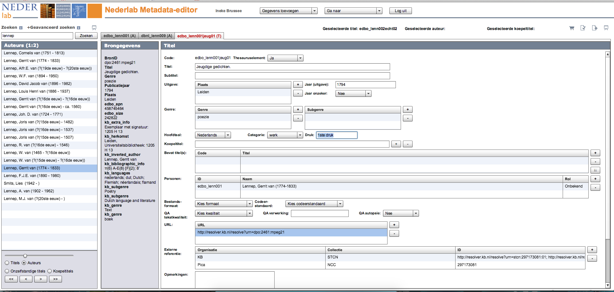
5. Thesaurus linking 6. Manual curation

Slide 14
7. Spelling correction/normalization
TiCCL – Text Induced Corpus Cleanup
Improved to better deal with historical texts
Tested on sample EDBO documents, see
Reynaert, M. (2014), ‘Synergy of Nederlab and @PhilosTEI: diachronic and multilingual Text-Induced Corpus Clean-up‘, in: Proceedings of the Ninth International Language Resources and Evaluation Conference (LREC 2014), Reykjavik, IJsland.
and on the complete EDBO (2015)
Conclusions
Many old OCR texts are of very bad quality
TiCCL improves on this, but quality stays mediocre at best
TiCCL works better for more recent texts

Slide 15
8. Add modern Dutch

Slide 16
9. Standard annotation with frog
http://ilk.uvt.nl/frog
Tilburg University, Radboud University
We restrict ourselves to sentence splitting, tokenization, lemma, part-of-speech, named entities
Added to FoLiA XML in our store
Quality
Depends on quality of base text
‘mediocre’ to ‘reasonable’

Slide 17
10. Indexing and search
Search requirements
Aggregation in one (virtual) central index, federated is not feasible
Metadata plus full text plus complex patterns over annotation layers, refine in any order
Document counts, term counts, pattern counts, facet counts (over large result sets)
Statistics
Term vectors over arbitrary result sets
Scalable to VERY large numbers
Multiple cores, sharding

Slide 18
10. Indexing and search - 2
Current online version
Lucene and SOLR based
Metadata and full text
No annotation search, no term counts over result sets yet
‘Web API’: search broker
Mix in additional services (historical lexicon service), ‘join’ functionality
Results filtered to implement IPR policy

Slide 19
10. Indexing and search - 3
Annotation search
BlackLab (INL)
WhiteLab (OpenSoNar, OpenCGN)
MTAS (multi-tier annotation search, CLARIAH project)
We exchange information, knowledge and code, and aim for cooperation and alignment where possible

Slide 20
11. Make available to end users
Virtual Research Environment
- Virtual research collections
Two user roles: general and authorized
Authorized users
Have access to more text content
Have a personal workspace
Have access to a ‘cockpit’ with analytical tools

Slide 21
Research portal
Alexandria
User service
Search broker
SOLR index
R visualization service
Lexicon service

Slide 22
demo

Slide 23
Looking forward…
(Many) more collections
Very large scale annotation search
General analytical environment, a.o.
Metadata
Distributions over values (facets)
Distributions over time and space (facet ranges)
Combine several metadata dimensions (pivots)
Text content
Term counts and pattern counts
Termvectors (over random result sets)
All kinds of visualizations and comparions on basis of these numbers

Slide 24
Looking forward - 2
Expand number of specialized analytical tools
Driven by scientific use cases (closed and open calls, starting 2016)
Collaborations with other projects

Slide 25
Questions?

