Slide 1
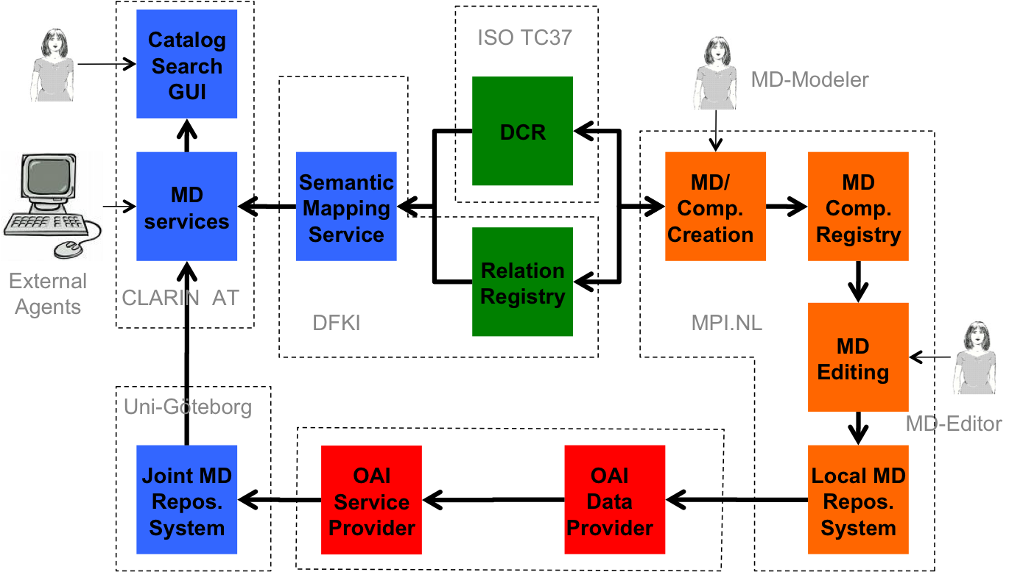
CMDI Software Components
Notes:
User specifies a query. This query is mapped or expanded to multiple queries that are equivalent and take into account the different terminology used in the metadata descriptions.

Slide 2
MD Service
Delivers services for the Catalog & Search GUI
  Query
  Populate UI
Acts as a WS and exposes the query and “queryModel()*” APIs
Uses expandQuery() from Semantic mapping
Uses Component Registry & MD Repository
Catalog
Search
GUI
Relation
Registry
MD
service
Semantic
Mapping
Service
DCR
DCMI
TEI
Joint
CLARINMD Repos.
Notes:
The sequence of looking first at the RR and only then at the Semantic Mapping Service assumes we know what the RR is for

Slide 3
MD Service
What APIs are currently defined?
What APIs are being build?

Slide 4
Relation Registry I
Store triples of concepts/data categories identifiers and relation types
Also support relation types already provided in the DCR
  IsValueOf, broaderConceptOf
Registration of recognized concept registries
Support for sets of relations “owned” by persons or projects. Fallback to “default” bundle
Set of APIs to support other SW components
Simple GUI for management and debugging
Catalog
Search
GUI
Relation
Registry
MD
service
Semantic
Mapping
Service
DCR
DCMI
TEI
Joint
CLARINMD Repos.
Notes:
The sequence of looking first at the RR and only then at the Semantic Mapping Service assumes we know what the RR is for

Slide 5
Relation Registry II
Catalog
Search
GUI
Relation
Registry
Store triples of two concepts /data
categories identifiers and a relation
type
Identifiers: PIDs
Relation types: isA, broaderConcept, isKindOf, isValueOf
May choose to delegate relation to the DCR???
MD
service
Semantic
Mapping
Service
DCR
DCMI
TEI
Joint
CLARINMD Repos.
Notes:
If there is still some time maybe we can look into a specially challenging part of the CMDI

Slide 6
Relation Registry III
Support for bundles of relations
“owned” by persons or projects.
Fallback to “default” bundle
Merge sets of relations?
Persistency of relation sets?
Persistency of relations?
Catalog
Search
GUI
Relation
Registry
MD
service
Semantic
Mapping
Service
DCR
DCMI
TEI
Joint
CLARINMD Repos.
Notes:
If there is still some time maybe we can look into a specially challenging part of the CMDI

Slide 7
Relation Registry VI
Set of APIs to support other SW
Components
API: set/get relations based on: “relation”, “set”, “Term”, …?
API: import/export sets of relations
API: register accepted concept registries.
Simple GUI for management and
debugging:
Browse through the relations by set.
Edit relations by hand
Catalog
Search
GUI
Relation
Registry
MD
service
Semantic
Mapping
Service
DCR
DCMI
TEI
Joint
CLARINMD Repos.

Slide 8
Semantic Mapping Service I
Catalog
Search
GUI
Relation
Registry
Allow metadata queries to be mapped on MD components using different terminology.
Depends on:
  the granularity of concepts in the DCR
  Required return precision
Use expansion:
  In: normalized query
  Out: list of “equivalent” queries
  Normalized query language concept seems to have faded since use of SRU
MD
service
Semantic
Mapping
Service
DCR
DCMI
TEI
Joint
CLARINMD Repos.
Notes:
If there is still some time maybe we can look into a specially challenging part of the CMDI

Slide 9
Expansion dimensions
Use of relations
  Not use DCR nor RR
  Use DCR
  Use DCR + RR
Use of context
  Use no context
    Actor.name == xyz -> name == xyz
  Use context
    Actor.name == xyz -> Participant.fullname == xyz
Actor
Name
Particip
Birth
Fullname
……
Birth
……

Slide 10
Expansion & Relations
No expansion. “Name” and “Fullname” are never mapped because they are different terms
Use only DCR and other concept registries
  “Name” and “Fullname” are mapped if both refer to same concept “Identifier”
Use also DCR and RR (equivalence only)
  “Name” and “Fullname” are mapped even when they refer to separated concepts but the RR knows: “Fullname” isA “Name”
Use DCR and RR (including all relation types)
  “Name” and “Fullname” are mapped even if the RR only contains “Fullname” isKindOfA “Name”

Slide 11
Expansion & Context
Relation
Registry
Query: Family.Actor.Name = xyz
Family isX Group
Family isX Household
Actor isX Participant
Name isX Fullname
Family.Actor.Name
DCR
Semantic
Mapping
Service
Family.Actor.Name
Group.Actor.Name
Household.Participant.Fullname
context
Name
Fullname
No context
Notes:
For the user of the semantic service it is not important where the relation info can be found: either the RR or the DCR
Implicitly we use relations

Slide 12
Semantic Mapping Service II
  API: registering concept registries & RRs
  only the DCR has a standardized API for the others we need bridges (DC, TEI) Now we think to put them in the DCR anyway
  API: expand query.
  API: return related concepts catalog GUI ( and debugging)
  API: ???
Catalog
Search
GUI
Relation
Registry
MD
service
Semantic
Mapping
Service
DCR
DCMI
TEI
Joint
CLARINMD Repos.

Slide 13
Semantic Mapping Service III
Catalog
Search
GUI
Relation
Registry
  Normalized query specs:
  Fullname = “Jan van Dongen”
  Actor.language = “French”
  Family.Actor.Name = “xyz”
  For speed:
  Semantic mapping service has to build up tables of all terms used in the descriptions and their related concepts
  Possibility renew cache
MD
service
Semantic
Mapping
Service
DCR
DCMI
TEI
Joint
CLARINMD Repos.

