Slide 1
Implementing SRU/CQL on Trova
Herman Stehouwer

Slide 2
Intoduction
SRU and CQL
Trova
Clarin Proposal
Implementation
Issues
Conclusion

Slide 3
SRU/CQL in Brief
SRU is the protocol
CQL is the query language
SRU defines three main operations
  Explain
  Scan
  SearchRetrieve

Slide 4
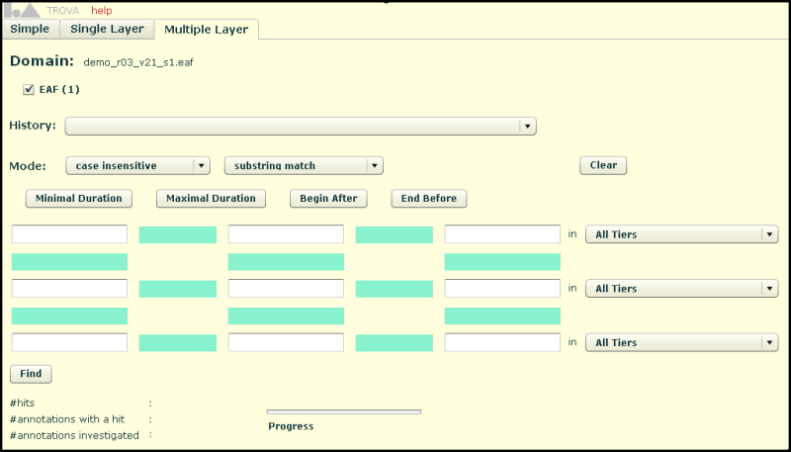
Trova in Brief
Content search over EAF files
Used as a back-end in our implementation
Open source, available to all
Includes our SRU/CQL implementation

Slide 5
Clarin Federated Search Proposal
Announcement of resources using scan
X-cmd-collections on searchRetrieve
In response per SRU record
  Resource are directly addressable
  ResourceFragment indirectly
  DataView provides a view on the hit
DataView is flexible

Slide 6
Implementation
explain, diag, and basic searchRetrieve
scan on cmd.collections
x-cmd-collections in searchRetrieve
full CQL parse
templates for xml output
Trova internally

Slide 7
Implementation Issues
All our implementations have issues
  Most issues simple to solve
Need to agree
  Need to agree on the exact response
  Need to agree on result encodings (DataView)
  Clarify Resource/ResourceFragment/DataView
  More information in the scan response

Slide 8
Moving Forward
conform to SRU/CQL and proposal
  We need to do this
Demo federation servlet
Not production code
Pazpar2 or writing our own federator?
Consensus

