Slide 1
Metadata Component Framework Possible Standardization Work within TC37/SC4

Slide 2
Status of ISOCat Metadata Thematic Domain
Based on extensive discussions with experts (Athens,…)
Analysing existing metadata sets & inventories: OLAC, IMDI, ENABLER, …
Input from CLARIN EU community that also provided translations
Dedicated CLARIN NL metadata project
Currently 220 metadata DCs

Slide 3
Further steps
Time to take stock of the situation
How to proceed with standardization?
Metadata TDG chair proposal is:
Today walk through the current set of metadata DCs and take note of all comments
Start round two, contact all previous contributors (incl. those that were active providing translations)
After Christmas, the TDG will take charge again
ISOCat supported standardization procedures are in place, but is this sufficient?
TDG members representative enough?
DCs ownership not completely transparent
Maybe just startup problems or …

Slide 4
Standardization process
Create “submission group”, collection of DC owners
Create (one or more coherent) DC selection(s)
After submission, the TDG chair forms a decision group {chair, at least one other member}
Decision group decides on all submitted DCs
This is further forwarded to the DCR board
DCR board has to validate and bring to publication

Slide 5
DCR Decision process

Slide 6
Standardization & Metadata Components
Assumption is that there is broad agreement about
limitations existing metadata schemas: DC/OLAC, IMDI, TEI header
Inflexible: too many (IMDI) or too few (OLAC) metadata elements
Limited interoperability (both semantic and syntactic)
Problematic (unfamiliar) terminology for some sub-communities.
Limited support for LT tool & services descriptions
Address this by:
Explicit defined schema & semantics
User/project/community defined components

Slide 7
Metadata Components
NOT a single new metadata schema
but rather allow coexistence of many (community/researcher) defined schemas
with explicit semantics for interoperability
How does this work?
Components are bundles of related metadata elements that describe an aspect of the resource
A complete description of a resource may require several components.
Components may contain other components
Components should be designed for reusability

Slide 8
Metadata Components
Lets describe a
speech recording
Sample frequency
Format
Size
Technical
Metadata
…

Slide 9
Metadata Components
Lets describe a
speech recording
Language
Name
Id
…
Technical
Metadata

Slide 10
Metadata Components
Lets describe a
speech recording
Actor
Name
Age
Language
Sex
Language
…
Technical
Metadata

Slide 11
Metadata Components
Lets describe a
speech recording
Location
Continent
Country
Address
Actor
…
Language
Technical
Metadata

Slide 12
Metadata Components
Project
Name
Lets describe a
speech recording
Contact
…
Location
Actor
Language
Technical
Metadata

Slide 13
Metadata Components
Project
Lets describe a
speech recording
Location
Profile definition
XML
Actor
Metadata schema
W3C XML Schema
Language
Technical
Metadata
Component definition
XML
Metadata description
Metadata profile
XML File

Slide 14
Recursive
Project
Recursive Component model
Components can contain other components
Enhances reusability
Location
Actor
ActorLanguage
Address

Slide 15
Reusability & Explicit Semantics
User selects appropriate components to create a new metadata profile or selects an existing profile
Component registry
Location
Country
Coordinates
Text
Language
user
Actor
Title
Semantic interoperability partly solved via references to ISO DCR or other registry
BirthDate
ISOCat or ISO DCR
implementation of ISO-12620 standard for data categories
under control of the linguistic community ISO TC37
Metadata is just one of the seven “thematic domains”
MotherTongue
Recording
CreationDate
Country dcr:1001
Dance
Type
ISOcat concept registry
Name
Language dcr:1002
Type
BirthDate dcr:1000
DCMI concept registry
Title: dc:title
Selecting metadata components & profiles from the registry
Notes:
Back to metadata components
(1) User selects appropriate components from a component registry (store) to form a profile
Different components are bound to have often semantic overlap.
The ISO DCR can store only very limited relation types, it is not an ontology.

Slide 16
How to proceed?
Decouple separate issues?
Standardization of metadata DCs in the ISO-DCR
------------------------------------------------------------------
Defining Requirements for a Metadata Component Model
Standardizing the Component Model itself
Standardizing a Component Specification Language
Design/Specify a number of recommended components for specific data types and usages.
Of course building on existing or continuing work like
ISOCat, PISA, … where possible

Slide 17
Requirements for the component model
For example:
Component has attributes: name, multiplicity, concept-link, …
Component model should support recursion
A component contains a number of metadata elements
A metadata element has a: name, value-scheme, multiplicity, concept link
A component can refer to a number of resources or to other metadata components
A component can contain information about resource relations
A component grammar has to be fully deterministic to avoid ambiguity

Slide 18
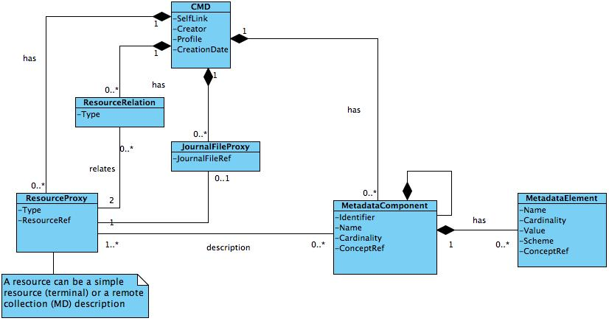
Metadata Component Model
Should embody the requirements without defining a component specification language
As an example the CLARIN CMDI component model

Slide 19
Component Specification Language
CLARIN Component example: ISO-635 component
<CMD_ComponentSpec isProfile="false">
<Header>
<ID>clarin.eu:cr1:c_1271859438108</ID>
<Name>iso-639-5</Name>
<Description>The list of ISO-639-5 language families. Based on: http://en.wikipedia.org/wiki/List_of_ISO_639-5_codes</Description>
</Header>
<CMD_Component name="ISO635">
<CMD_Element CardinalityMax="unbounded" CardinalityMin="1" name="iso-639-5-code">
<ValueScheme>
<enumeration>
<item AppInfo="Austro-Asiatic languages" ConceptLink="http://cdb.iso.org/lg/CDB-00138763-001">aav</item>
<item AppInfo="Afro-Asiatic languages" ConceptLink="http://cdb.iso.org/lg/CDB-00138759-001">afa</item>
<item AppInfo="Algonquian languages" ConceptLink="http://cdb.iso.org/lg/CDB-00138721-001">alg</item>
<item AppInfo="Atlantic-Congo languages" ConceptLink="http://cdb.iso.org/lg/CDB-00138719-001">alv</item>
[...]

Slide 20
ISO Recommended Components
Our CMDI experience is that we need to limit the proliferation of components
Offer a set of standardized ones for use with
specific data-types
for specific purposes

Slide 21
Reference implementation
CLARIN has been working on:
Metadata component registry and editor
Metadata editor
If a potential ISO standard for component model and specification is not too different from CLARIN requirements and practice these could serve as a reference implementation

Slide 22
Persistent Identifier Use
All is based on the recent FDIS-24619 PISA
Cool URIs for the concept links to ISOCat and ISOCDB
All references to resources and metadata can contain PIDs

Slide 23
Thank you for your attention

