Slide 1
CLARIN-NL Call 3 ISOcat follow-up

Slide 2
Topics
Data Category types
Bulk import
Beyond ISOcat
RELcat
SCHEMAcat

Slide 3
Data Category types
complex:
open
closed
constrained
writtenForm
grammaticalGender
email
string
string
string
Constraint: .+@.+
neuter
feminine
masculine
simple:

Slide 4
Data Category types
container:
lexicon
language
alphabet
entry
japanese
ipa
lemma
writtenForm

Slide 5
Which type?
Which type is appropriate depends on the place of the data category in the structure of your resource:
Can it have a value?
Complex Data Category with an data type
Any of the values of the data type?
Open Data Category
Can you enumerate the values?
Closed Data Category
Fill its value domain with simple Data Categories
Is there a rule to constrain the values?
Constrained Data Category
Express the rule/constraint in one of the rule languages
Is it a value?
Simple Data Category
Does it group other (container or complex) Data Categories?
Container Data Categories
If a Data Category both has a value and groups Data Categories
Complex Data Category

Slide 6
CMDI example
CMD component relates to a container DC
CMD element relates to a complex DC
CMD value relates to a simple DC
The ISOcat search in the CMD Component Editor enforces this
Also a DC should be public and member of the Metadata profile
However, if you link to a DC nothing of the specification is taken over into your profile ☹

Slide 7
Some examples
S
category
noun phrase
NP
VP
number
singular
agreement
Text=“John”
V
NP
person
third
Text=“hit”
Det
N
/category/ a closed DC
/noun phrase/ a simple DC
/agreement/ a container DC
/number/ a closed DC
/singular/ a simple DC
/person/ a closed DC
/third/ a simple DC
(Encoded as TEI P5 FSR the XML elements and attributes
are seen as syntactic sugar)
Text=“the”
Text=“ball”
/S/ a container DC
/NP/ an open DC
/VP/ a container DC
/V/ an open DC
/NP/ a container DC
/Det/ an open DC
/N/ an open DC
(Text is seen as syntactic sugar)

Slide 8
GrNe example
<morfI>aor. ἔπᾰθον; . πέπονθα, ep. . 2 plur. πέπασθε en πέποσθε; ptc. πεπονθώς, ep. . πεπᾰθυῖα; . ἐπεπόνθειν en Att. ἐπεπόνθη, Ion. plqperf. 3 . ἐπεπόνθεε; . . πείσομαι; </morfI>
Better structure: markup the symbols:
<morfl>…<s>plur.</s>…</morfl>
Under development: /morfl/ a constrained DC linked to an EBNF grammar in SCHEMAcat (see CGN EBNF) that accepts free text interleaved with a controlled vocabulary
Temporary: /morfl/ a closed DC linked to <morfl/> with the controlled vocabulary as its value domain

Slide 9
Bulk import: DCIF
http://www.isocat.org/forum/viewtopic.php?f=3&t=14
Create a valid DCIF XML document
In general by converting an existing digital resource
XSLT, Perl, …
DCIF Schema: http://www.isocat.org/12620/schemas/DCIF.rng
Human readable: http://www.isocat.org/12620/schemas/DCIF.html
DCIF Validation levels:
Structure: Relax NG validation
Referential integrity: Schematron validation
Example: http://www.isocat.org/12620/examples/dcif-example.dcif

Slide 10
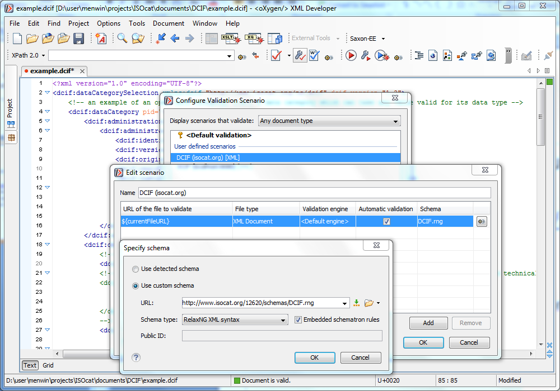
DCIF Validation Scenario in oXygen

Slide 11
What will be overwritten?
PIDs
Just invent your own URI, e.g., my:DC-1
Use them to relate DCs:
Closed DC conceptual domain to simple DC
Simple DC is-a relation to another simple DC
Will be overwritten by ISOcat PIDs
Unless you have ISOcat acceptale PIDs
Version -> 1:0
Registration status -> private
Creation date -> date of import

Slide 12
Contact ISOcat sysadmin
Email: isocat@mpi.nl
If you need:
Additional languages
Additional profiles
This will require ISO TC 37 involvement, start with an import in the private profile
Additional constraint rule languages
If you’re done:
Send DCIF file
Will be validated (again ☺)
Test import cycles on the ISOcat test server
Actual import on isocat.org
If you want to do bulk updates

Slide 13
Beyond ISOcat: RELcat
http://lux13.mpi.nl/relcat/
Collect typed relationships between your new DCs and existing DCs in an Excel spreadsheet or CSV file with at least three columns
Your ISOcat DC PID
typed relationship
sameAs: same semantics just different types or an uncooperative DC owner
almostSameAs: minor, but for you important, differences
subClassOf: yours is more specific
superClassOf: yours is more general
hasPart/partOf: partitive relationships
Related ISOcat DC PID (or an URL to an entry in another persistent concept/data category registry)
http://www.isocat.org/forum/viewtopic.php?f=12&t=16

Slide 14
Beyond ISOcat: SCHEMAcat
http://lux13.mpi.nl/schemacat/
Annotate your resource schema with ISOcat DC PIDs
Use what your schema language provides to link to an external semantic specification
ODD: <odd:equiv name=“morfl” uri=“…/DC-nnn”/>
Use @dcr:datcat or @dcr:valueDatcat in an XML-based schema language
RNG: <rng:element name=“morfl” dcr:datcat=“…/DC-nnn”/>
Embed an @dcr:datcat annotation in a comment in another (text-based) schema language
EBNF: (* @dcr:datcat MORFL …/DC-nnn *)
Embed an @dcr:datcat annotation in a description or note or …
MDF: \desc @dcr:datcat …/DC-nnn
Contact isocat@mpi.nl

Slide 15
ISOcat user interface
Problematic:
Simple DC selector for a closed value domain
Too slow especially when the closed DC is a member of the Private profile, if more specific, e.g., Metadata, the number of simple DCs loaded will be much smaller
Upcoming: replace full list by a search or selection from the basket or viewed DCS
Default Private profile
Users forget to select the proper profile, making the DC not appear in profile specific searches, e.g., CMDI search for metadata DCs
Upcoming: no default profile
Distinction between CLARIN-NL/VL candidate DCs and recommended DCs
Upcoming: CLARIN-NL/VL recommendations
Links between DCs
Upcoming: become clickable
Later: integration with RELcat for typed relationships

