Slide 1
Bulk loading
ISOcat data categories with the
Data Category Interchange Format

Slide 2
DCIF
Create a valid DCIF XML document
  In general by converting an existing digital resource
    XSLT, Perl, …
  DCIF Schema: http://www.isocat.org/12620/schemas/DCIF.rng
    Human readable: http://www.isocat.org/12620/schemas/DCIF.html
  DCIF Validation levels:
    Structure: Relax NG validation
    Referential integrity: Schematron validation
Example: http://www.isocat.org/12620/examples/dcif-example.dcif

Slide 3
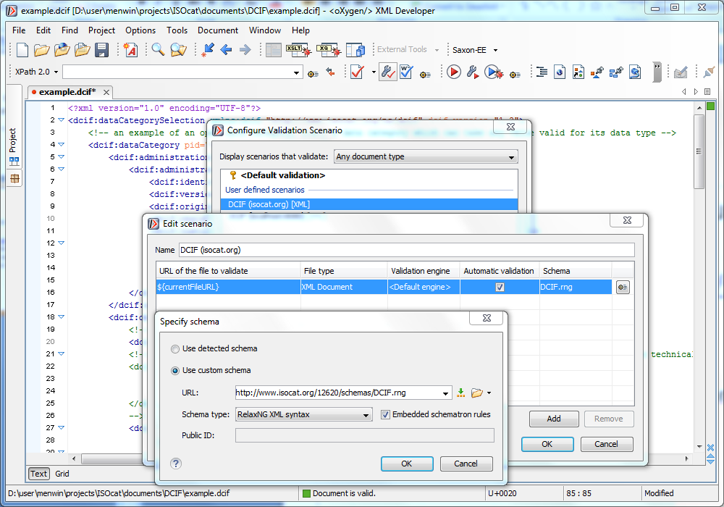
DCIF Validation Scenario in oXygen

Slide 4
What will be overwritten?
PIDs
  Just invent your own URI, e.g., my:DC-1
  Use them to relate DCs:
    Closed DC conceptual domain to simple DC
    Simple DC is-a relation to another simple DC
  Will be overwritten by ISOcat PIDs
    Unless you have ISOcat acceptale PIDs
Version -> 1:0
Registration status -> private
Creation date -> date of import

Slide 5
Contact ISOcat sysadmin
Email: isocat@mpi.nl
If you need:
  Additional languages
  Additional profiles
    This will require ISO TC 37 involvement, start with an import in the private profile
  Additional constraint rule languages
If you’re done:
  Send DCIF file
  Will be validated (again ☺)
  Test import cycles on the ISOcat test server
  Actual import on isocat.org
If you want to do bulk updates

