Slide 1
CLARIN Infrastructure Vision (and some real needs)
Daan Broeder
CLARIN EU/NL
Max-Planck Institute for Psycholinguistics

Slide 2
Contents
The CLARIN project
CLARIN vision
One or two concrete things we would really like to have.
Highly available (web) services
Workspaces
VO platform for CLARIN specific user attributes
Suitable Solution for WS security/delegation

Slide 3
What is CLARIN
The CLARIN project is a large-scale pan-European collaborative effort to create, coordinate and make language resources and technology available and readily useable for Language & SSH (Social Sciences & Humanities) researchers.
Resources: Lexica, text corpora, multi-media/multi-modal recordings, …
Technology: parsers, recognizers, editors, …

Slide 4
CLARIN Organization
CLARIN is an EU Infrastructure project with 4.2 ME funding for a 3 year preparatory phase started in 2008.
Additional funding from national governments, currently at least 16 ME
The CLARIN consortium has now 32 partners from 26 EU countries and 132 member organisations
CLARIN EU continuation after the preparatory phase likely as an ERIC
This is important if only to provide a legal entity that is able to make contracts with outside parties on behalf of the CLARIN community.

Slide 5
CLARIN “Holy Grail” Use Case
A researcher authenticates at his own organization and creates a “virtual” collection of resources from different repositories.
He does this on the basis of browsing a catalogue, searching through metadata, or searching in resource content.
He is then able to use a workflow specification tool and process this virtual collection using reliable distributed web services which he is authorized to use.
(Intermediate) results and provenance data are stored in a user specific workspace that can also keep a user profile
After evaluation resulting data (including metadata) can be added to a repository and the “virtual” collection specification can be stored for future reference

Slide 6
Infrastructure components & services
CLARIN centers with reliable repository systems
Stable pillars of the infrastructure, maintaining it and offering guidance & expertise for its use.
Main function is taking care of data preservation and access with depositor/owner specified restrictions
Persistent identification of resources
Metadata harvesting and catalog services for metadata browsing and searching
Registries for centers and services
E.g. which centers offer metadata, where can I store my virtual collection?
EU wide federated authentication
Specification tool for workflow chains of web services

Slide 7
CLARIN Vision
Integrated domain of data, services, users
Scalable: users, centers, costs
Non-monolithically but
Allow free choice of suitable components
interoperability between components through standardization
Partial opt-out
Not all centers need to support all services
Specialization is welcome
Users should be able to trust the solutions offered
Provide adequate documentation and ready to use recipes
Have good relations with the support people
Transparent costs, know what you pay for.

Slide 8
CLARIN & others
Ecosystem of infrastructures
CLARIN is not the only infrastructure or support service project out there
They may be community based ones offering many services: CLARIN,DARIAH,CESDA
There are existing EU wide general ones like: GEANT, EGI, …
there are national ones: BiG Grid
And those offering a single function only:, EPIC for PIDs
Need to look carefully what can be shared: Bitstream preservation, PID services, Federated authentication and what services might be used from each other
CESDA
CLARIN
DARIAH
eduGAIN
Federated
authent.
Persistent
storage
EPIC PID
services

Slide 9
Highly Available Services
Popular web services in workflow chains
Registries: center & services registries.
Expensive to guarantee 100% uptime
Sometimes better to run a large number of instances
It is doubtful if CLARIN centers are the best suited to host these.

Slide 10
Workspaces
Temporary storage for results from WS workflow chains
User specific
Not tied to any specific repository
Flexible capacity
Repository/Archive
WS1
WS2
WS3
Workspace API
WF
engine
WorkSpace
Provenance data
resource

Slide 11
CLARIN AAI
It looks that EU wide federated authentication will be solved either by:
A future GEANT eduGain solution (confederation of national Identity Federations)
Creating CLARIN SP federation and making contracts with the individual IDFs
Current state of affairs, CLARIN test federation was successfully demonstrated.
However three problems remain unsolved
Homeless users. CLARIN members with no national IDF
For true SSO functionality requires the CLARIN users to have CLARIN specific user attributes that no IdP will support.
Authentication for web services

Slide 12
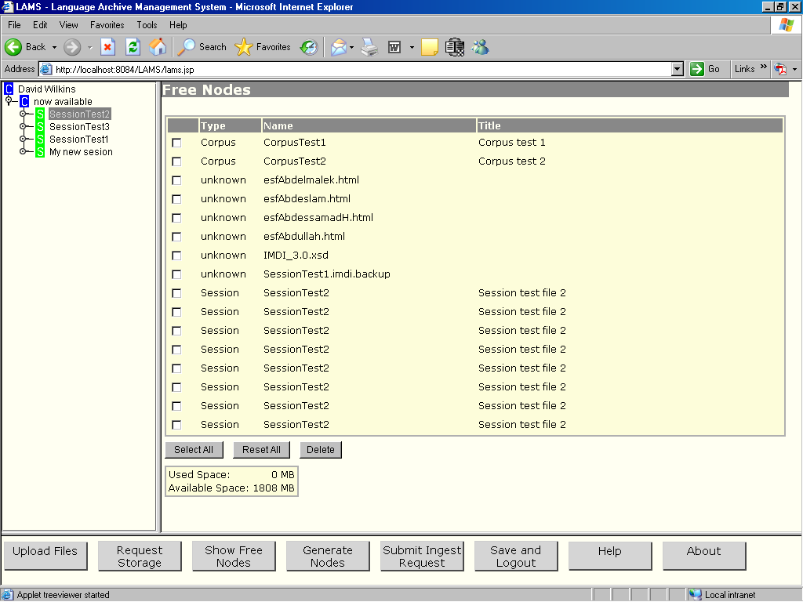
CLARIN AAI & EULAs 1
SP requires EULA signed and takes care of this but only for its own domain
This can break the SSO if the user is required to sign the same EULA several times
EULA DB
SPa
EULA DB
SPb
browser
user
IdP
CLARIN will harmonize the
EULAs and licenses to a limited number (WP7)
Notes:
EULA End User License Agreement
SP is service provider – (a center running) software that offers resources for use (a suitably configured Apache web server)
IdP Identity provider: is software that which can authenticate a user and can provide information on a user e.g. if he is a student etc.
Current situation every repository manages its own EULA administration

Slide 13
CLARIN AAI & EULAs 2
SPa
SPb
browser
user
IdP
Store the EULA info in the user attributes at the IdP
But how does it get there?
Special app?
Not every IdP will/can run this
EULA DB

Slide 14
VO Platform
SPa
SPb
External
User
Attribute
Authority
browser
VO
Platform
user
EULA DB
IdP
Create special EULA service. This is part of the CLARIN SPF CLARIN independent of the IDFs
Notes:
A Virtual Organization (VO) is a group of individuals that have something in common, in example working on a project. Virtual Organization may span multiple real organizations, from multiple federations and multiple countries.
The VO Platform is the technology that enables a Service Provider to collect information about a VO from a single source.
The VO Platform has a web frontend that enables management of the virtual organizations Information Model, and also supports one or more data access protocol for VO Services to be able to extract group information from the VO Platform.

Slide 15
WS Security/delegation
delegation
tokenizer
dataflow
authentication
}
parserA
WF engine
parser
Composite
Web service
parserB
semantic
tagger
Notes:
This scenario was added to the GN3 portfolio

Slide 16
Thank you for your attention
CLARIN has received funding from the European Community's Seventh Framework Programme under grant agreement n° 212230

