Slide 1
NP 24622 CMDI-1
Metadata Component Framework
New Standardization Work within TC37/SC4

Slide 2
Background
Metadata for Language Resources has already been discussed for more then a decade. Many initiatives have tried to create the definitive metadata set. However the landscape is still fragmented in DC/OLAC, IMDI, TEI and many metadata sets limited to individual projects and corpora

Slide 3
How to address the fragmentation?
Assumption is that there is broad agreement about
  Limitations existing metadata schemas: DC/OLAC, IMDI, TEI header
    Inflexible: too many (IMDI) or too few (OLAC) metadata elements
    Limited interoperability (both semantic and syntactic)
    Problematic (unfamiliar) terminology for some sub-communities.
    Limited support for LT tool & services descriptions
  The way to address this by:
    Explicit defined schema & semantics
    User/project/community defined components

Slide 4
Current “new” European Initiatives
European projects and initiatives have been funded that offer the possibility to create a flexible metadata framework that can overcome this fragmentation.
CLARIN
  Aimed at the research world
  Work done for 3 years on CMDI
  Uses ISO-DCR for semantic interoperability
NaLiDa
  Uses CMDI to describe LRs in Germany
META-SHARE
  Also oriented towards industry
  Plans to use component strategy for metadata
These are interested in ISO standardization of the metadata component “model”

Slide 5
Metadata Components
NOT a single new metadata schema
but rather allow coexistence of many (community/researcher) defined schemas
with explicit semantics for interoperability
How does this work?
Components are bundles of related metadata elements that describe an aspect of the resource
A complete description of a resource may require several components.
Components may contain other components
Components should be designed for reusability

Slide 6
Metadata Components
Lets describe a
speech recording
Sample frequency
Format
Size
Technical
Metadata
…

Slide 7
Metadata Components
Lets describe a
speech recording
Language
Name
Id
…
Technical
Metadata

Slide 8
Metadata Components
Lets describe a
speech recording
Actor
Name
Age
Language
Sex
Language
…
Technical
Metadata

Slide 9
Metadata Components
Lets describe a
speech recording
Location
Continent
Country
Address
Actor
…
Language
Technical
Metadata

Slide 10
Metadata Components
Project
Name
Lets describe a
speech recording
Contact
…
Location
Actor
Language
Technical
Metadata

Slide 11
Metadata Components
Project
Lets describe a
speech recording
Location
Profile definition
XML
Actor
Metadata schema
W3C XML Schema
Language
Technical
Metadata
Component definition
XML
Metadata description
Metadata profile
XML File

Slide 12
Recursive
Project
Recursive Component model
Components can contain other components
Enhances reusability
Location
Actor
ActorLanguage
Address

Slide 13

Reusability & Explicit Semantics
User selects appropriate components to create a new metadata profile or selects an existing profile
Component registry
Location
Country
Coordinates
Text
Language
user
Actor
Title
Semantic interoperability partly solved via references to ISO DCR or other registry
BirthDate
ISOCat or ISO DCR
implementation of ISO-12620 standard for data categories
under control of the linguistic community ISO TC37
Metadata is just one of the seven “thematic domains”
MotherTongue
Recording
CreationDate
Country dcr:1001
Dance
Type
ISOcat concept registry
Name
Language dcr:1002
Type
BirthDate dcr:1000
DCMI concept registry
Title: dc:title
Selecting metadata components & profiles from the registry
Notes:
Back to metadata components
(1) User selects appropriate components from a component registry (store) to form a profile
Different components are bound to have often semantic overlap.
The ISO DCR can store only very limited relation types, it is not an ontology.

Slide 14
Standardization roadmap
It is worthwhile to separate the standardization work in a number of separate tasks so that the work can divided over multiple people and that different stakeholder projects can have a share in the responsibility

Slide 15
Standardization Roadmap
Standardization of metadata DCs in the ISO-DCR
  Metadata TDG, chair Peter Wittenburg
Defining Requirements for a Metadata Component Model and standardizing the Model itself
  Project leader: Daan Broeder, CLARIN, NEN
Standardizing a Component Specification Language
  Project leader: Thorsten Trippel, NaLiDa, DIN
Design/Specify a number of recommended components for specific data types and usages.
  Project leader Maria Gavrilidou, META-SHARE, ELOT

Slide 16
ISO/NP 24622-1 CMDI-1 Ballot Results
Results known since 6-8-2011
20 votes cast, 3 not cast
Main question: “agree to the addition of the proposed new work item to the program of work of the committee"
16 in favor, 2 against, 2 abstentions
Experts added:
  Germany (DIN), Italy (UNI), Japan (JISC), Netherlands (2) (NEN), Slovenia (SIST)

Slide 17
Objections to NW 24622-1
CA (SCC)
This standard is a great idea, but it's going to send a shockwave through every standard that has been proposed by ISO TC 37/SC 4. This simply has not been addressed in this proposal. We believe this warrants further consideration before proceeding with a draft standard on this subject. In particular, we expect to see (1) an enumeration of what changes this standard will entail for the other language resource management standards, and (2) a schedule for synchronizing the adoption of a CLARIN-style meta-model across the subcommittee's standards and current work items.

Slide 18
Objections to NW 24622-1
UK (BSI)
The UK are extremely concerned that the content will be duplicating several standards. Standards duplicated include the following:
ISO 12620:2009 Terminology and other language content resources - Specification of data catagories and management of a Data Category Register for language resources
and from a metadata point of view:
  ISO/IEC 11179 series: Information technology - Metadata registries (MDR)
  ISO/IEC 19763 series: Information technology - Metamodel framework for interoperability (MFI)

Slide 19
Possible Reference implementation
CLARIN project has been working on:
  Metadata component registry and editor
  Metadata editor
If a potential ISO standard for component model and specification is not too different from CLARIN requirements and practice these could serve as a reference implementation

Slide 20
Component Specification Language
CLARIN Component example: ISO-635 component
<CMD_ComponentSpec isProfile="false">
<Header>
<ID>clarin.eu:cr1:c_1271859438108</ID>
<Name>iso-639-5</Name>
<Description>The list of ISO-639-5 language families. Based on: http://en.wikipedia.org/wiki/List_of_ISO_639-5_codes</Description>
</Header>
<CMD_Component name="ISO635">
<CMD_Element CardinalityMax="unbounded" CardinalityMin="1" name="iso-639-5-code">
<ValueScheme>
<enumeration>
<item AppInfo="Austro-Asiatic languages" ConceptLink="http://cdb.iso.org/lg/CDB-00138763-001">aav</item>
<item AppInfo="Afro-Asiatic languages" ConceptLink="http://cdb.iso.org/lg/CDB-00138759-001">afa</item>
<item AppInfo="Algonquian languages" ConceptLink="http://cdb.iso.org/lg/CDB-00138721-001">alg</item>
<item AppInfo="Atlantic-Congo languages" ConceptLink="http://cdb.iso.org/lg/CDB-00138719-001">alv</item>
[...]

Slide 21
ISO Recommended Components
Our CMDI experience is that we may well need to limit the proliferation of components
Offer a set of standardized ones for use with
  specific data-types
  for specific purposes
We hope that input from more “industry” oriented initiatives as META-SHARE will motivate the design of stable well thought-out components and profiles that can be standardized.

Slide 22
METADATA COMPONENT MODEL
The Metadata Component Model is an abstract model. It should be independent of the component specification language and any specific components. However it may be necessary to define a “required” component.
Although it is inspired by the CMDI work, it is not be dependent on any of CMDIs implementations. However for the moment there is no alternative to CMDI for the terminology describing the model nor for the requirements analysis.

Slide 23
Requirements for the component model
Component has attributes:
  name, multiplicity, concept-reference, …
Component model should support recursion
A component contains a number of metadata elements
A component can refer to a number of resources or to other metadata components
A component grammar has to be fully deterministic to avoid ambiguity
A component can contain information about resource relations

Slide 24
Terminology
Need first to define some terminology and link this to established (metadata) practices:
Metadata schema
Metadata profile – (application profile)
Metadata component (LMF)
Metadata element
Metadata element concept link – (DCR)

Slide 25
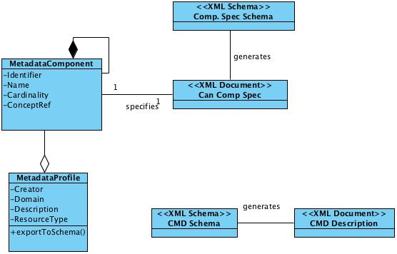
Metadata Components, Profiles and Schemas
the dependencies between metadata components, profiles and schemas

Slide 26
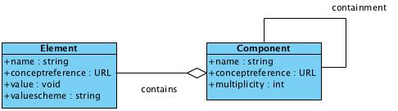
Metadata Element Context
The metadata element component relation

Slide 27
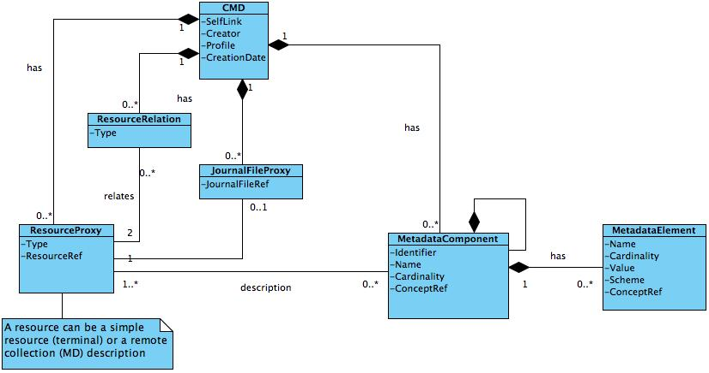
Metadata Component Model
A complete component model as used by the CLARIN CMDI implementation

Slide 28
Persistent Existing (ISO) standards use
All is based on the recent ISO-24619 PISA, ISO 12620:2009 DCR
Cool URIs for the concept links to ISOCat and ISOCDB
All references to resources and metadata can contain PIDs

Slide 29
Thank you for your attention

