Slide 1

Advanced Metadata Usage
Daan Broeder
TLA - MPI for Psycholinguistics / CLARIN
Metadata in Context, APA/CLARIN Workshop, September 2010 Nijmegen

Slide 2
Content
Metadata for aggregations / collections
Metadata and Vocabularies
Matching Services and Data / Profile matching

Slide 3
COLLECTIONS

Slide 4
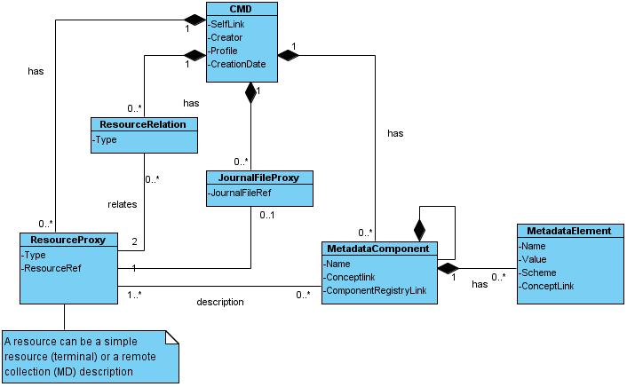
CMDI record data model
Recursive structure of metadata components: An Actor component can contain a Language component, Contact component etc.
All Metadata elements consist from Name, Value, Scheme AND a concept reference
Possible relations & pointers to Journal files (special feature for workflow systems)
A CMDI record can describe/point to resources but also to other metadata descriptions.
Notes:
Salient points
1. Recursive structure of metadata
An Actor component can contain a Language component, Contact component etc.
2.All Metadata elements consist from Name, Value, Scheme AND concept link
3. A CMD component can describe/point to resources but also to other metadata descriptions.
4.Possible relations & pointers to Journal files (special feature for workflow systems)

Slide 5

Metadata & Collections I
MD
MD
R
R
R
R
R
Single resource: one metadata
record describes one resource
Simple collection: one metadata
record describes multiple resources.
The metadata represents the collection
MD
MD
MD
MD
MD
R
R
R
R
R
R
R
R
R
Flexible hierarchy of sub-collections
using separate MD records
easy extension with new (sub) collections
Notes:
Collections are represented by metadata. Collection metadata can refer directly to resources or to other metadata for collections. Thus making it possible to create a hierarchy of collections and sub collections. This is enabled by having the CMD model by recursive.

Slide 6
Issues with metadata record hierarchies
MD
the metadata pertains to all
referenced resources
R
R
R
R
Simple collection: one metadata
record describes multiple resources
Dutch
Dutch/French
MD
the metadata pertains to all
implied resources
French
Dutch
MD
MD
We do not want to duplicate metadata
So:
make use of percolation both downwards and upward
But percolation has rules
R
R
R
R
hierarchy of sub-collections
Notes:
Collections are represented by metadata. Collection metadata can refer directly to resources or to other metadata for collections. Thus making it possible to create a hierarchy of collections and sub collections. This is enabled by having the CMD model by recursive.

Slide 7
Virtual Collections
What makes a collection virtual.
Not published by the resource creator/owner
Created by a researcher for a particular research purpose
Often distributed resources
It has no “natural” home so needs a VC registry
In research papers a reference to the VC is preferable to referring to perhaps thousands of metadata records or resources
Virtual Collection
Registry
MD
MD
R
R
R
Repository A
MD
R
R
Repository B

Slide 8
Issues for Virtual Collections
Registry of Virtual Collections
  Maintained by a suitable authority that guarantees its persistence
  Accessibility to users, who can create one?
Unique & persistent identification of collections
  Link from the VC metadata to the (sub) collection metadata must be equally persistent as that to the resources
Searching & browsing collections
  Should the the VC be equally visible as are the collections that are maintained and published by bona-fide archives?
Notes:
There are many issues involved in setting up a VC infrastructure.

Slide 9
Metadata & Vocabularies

Slide 10
Metadata Quality
If we learnt anything from the CLARIN VLO prototype, it is that the general metadata content quality is not that good.
  Formatting variants
  Spelling variants and errors
  Translations
  Misinterpretations of the metadata schema
If that basis is not good anything we build on it is flawed
Therefore CLARIN wants to provide services
that help improve the metadata content quality

Slide 11
MD Quality improvement
At the metadata creation stage
  Provide metadata creation tools that constrict user input e.g. pick lists in ARBIL (the CLARIN metadata editor)
  However there is no guarantee these tools are used. Often the metadata is created from other metadata created by other tools
  Expert knowledge about the resources is probably available
After the metadata harvesting stage
  Curation can be a central effort
  No expert knowledge about the resources available
But both possibilities need well maintained vocabularies to help create or curate the metadata

Slide 12
Vocabularies for CLARIN MD
General vocabularies:
Country, Organization name, …
Technical vocabularies:
media type, mime-type, …
Linguistic type vocabularies:
Genre, linguistic subject, language names, language identifiers, …

Slide 13
Vocabularies for CLARIN MD
Where can we fetch them?
The metadata schema itself
  Good choice for a very stable vocabulary
  No updates of vocabularies possible when schema are distributed
  No support for a “recommendation” vocabulary
ISO DCR, excellent for linguistic type vocabularies
  Maintained and updated by the linguistic community
  No support for a “recommendation” vocabulary
ISO CDB, ISO 639-3 language codes, country codes,..
  Limited accessibility
A “new” special vocabulary (web) service
  Technology is not difficult, several similar services exist.
  Providing updates is the real problem e.g. when does a new country or organization get added?

Slide 14
Vocabulary one stop shop
The management & maintenance is done by several organizations for good reasons.
On the other hand we would like a central registry that can act as a one stop shop rather than maintain N different interfaces.
ISO CDB
ISO 639-3
Language codes
MD Editor.
General
Vocabulary
Service
MD
Creator
ISO DCR
Linguistic vocabularies
MD repair
EC
Org. DB
MD
Curator
Vocabulary
curation
Vocabulary
curation

Slide 15
Matching services and data

Slide 16
Language Technology
Think of parsers, taggers,
translators, aligners, speech
recognizers and synthesizers,…
For efficiency need to use a Service Oriented Architecture (SOA), where only remote processing takes place
Add to that a way of combining distributed services in a workflow
with interaction with resource repositories
Tools like this exist in a more or less usable form: TAVERNA, GATE, Weblicht, ...
R
Workflow
Editor
WS1
tokenizer
Workflow
Engine
WS2
POS
tagger
S
WF
specification
WS3
Named Entity
recognition
R
Notes:
Language Technology was also mentioned
Another name for this Service Orchestration
SOA not at all simple to achieve, but is the only architecture scalable and flexible enough
standardization and harmonization is required to realize workflow mechanisms
TAVERNA, BPEL, GATE, UIMA, Weblicht

Slide 17
Profile matching
The workflow editor should not show all available tools
It must make a selection based on the metadata of the resource and that of the service
Simple via type system or complicated via in and ouput schema matching
R
R
Workflow
Editor
WS1
WS1
tokenizer
Resource
metadata
Service
metadata
Service
metadata
Service
metadata
Service
metadata
Service
metadata
Metadata registry for
Services and data

Slide 18
CLARIN WF workspace
Repository/Archive
WS1
WS2
WS3
WF
engine
Workspace
metadata
provenance data
resource

Slide 19
Thank you for your attention
CLARIN has received funding from
the European Community's Seventh Framework Programme
under grant agreement n° 212230

Slide 20
Collections II (Bundles)
MD
Bundle:
A few tightly related resources
also used for collections generated by workflow systems
MD
media file
=
MD1
R1
MD2
R2
R
R
R
R
annotation
Proces
1
Proces
2
MD
MD
MD
MD
MD
MD
MD
MD1
MD1
MD1
MD1
MD1
MD1
MD1
MD2
R1
MD2
R1
MD2
R1
MD2
R1
R1
MD2
Metadata records
are copied and extended
and so are complete
MD3
R2
R2
R2
R3

