Slide 1
CMDI use in the NaLiDa project
Thorsten Trippel
thorsten.trippel@uni-tuebingen.de
Notes:
This presentation is based on the manuscript which is contained in the notes for each slide.
The slides as such are supposed to visualize the content as contained in the manuscript, not replace it.

Slide 2
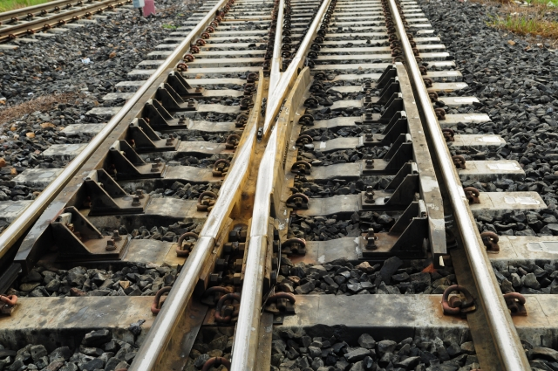
Notes:
The project I represent here is called NaLiDa, which stands for sustainability of linguistic resources. When we talk about language resources we talk about all kinds of resources created and used by linguists for their research, such as corpora, lexical resources, experimental data sets, but also software tools and webservices. The project NaLiDa aims at the sustainability of language resources, that is the long term archiving and access to this data. Sustainability of these resources is part of the research infrastructure of the research community, just as libraries are.

Slide 3
Notes:
When we talk about long term archiving, we talk not necessarily about the same timespan which we see for libraries, but initially we talk about time spans that cover more than three to five years, which is sort of the standard project funding period. In fact, at least in Germany funding agencies require the availability of primary research data for at least 10 years.
However, floating researchers with short time contracts and short project durations do not foster a climate for archiving. This archiving is supposed to cater for the reuse of resources, which are often expensive, a way of citing and referring to these resources from within publications and bona fide proof of work for fraud prevention in the research community.

Slide 4
Archiving? Someday, but we are only at the beginning
Nobody could use my data, it is too specialized.
I‘ll save it to 3.5‘‘ floppy discs/CD-ROM/Exabyte ...
Notes:
The situation however is difficult When talking about archiving you can hear statements such as "Archiving? Someday, but at present we are only at the beginning." or "Someone will always be here, they can worry about that if somebody asks for it." Or "Nobody could use my data, it is too specialized." or "I'll save it to 3.5'' floppy discs/CD-Roms/Exabytes, that's persistent".

Slide 5
How should I do it?
We hardly have the means for our core project?
Help!
Notes:
Some worry about it saying "How should I do it" or "I don't have any means for it, the resources are hardly sufficient for the project as such."

Slide 6
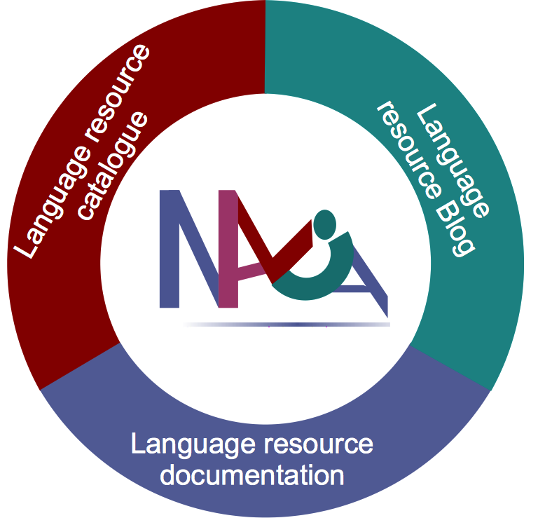
Worked
examples
Consulting
for projects
Workshops
Coordination
Hands on
Training
Evaluation
Notes:
The NaLiDa project in this case takes a slightly different approach, as we are a project funded for infrastructure. Hence we want to support individual researchers and groups, while we are actively participating in the development of standards and technologies for resource sustainability. A major issue, and I am going to talk about this later, is the creation of state of the art examples as reference for others, a kind of a prototype for various types of resources serving as points of reference for those who are new to archiving their data.

Slide 7
Notes:
This involves a very detailed documentation, containing tutorial like How-Tos, blog entries, workshops and simple one on one hands-on training with colleagues.

Slide 8
Notes:
A major requirement in this case is to show potential users the added value. Let's face it: archiving and the creation of metadata take additional time and costs, if they do not see the usefulness, they ain't gonna do it. The added value for the individual reseacher, from our perspective and which have been tested against living researchers is findability, collaboration, fame and a good overview over their own data.

Slide 9
Notes:
Findability here means that first of all it is easier for them to find their data within a couple of months. But it also refers to the process of finding other person's related resources and being found by others as well. This of course also means that collaboration is increased and can be extended with those who create similar resources. Fame, that is the personal relation to a resource did not trigger too much interest, though the referencing in papers seems to be relevant.
Right this sounds extremely programmatic so far, so what did we do? First of all we tried to identify prototypical resources from various fields, of course selecting resources of colleagues we knew and were in contact with, that makes life much easier.
The prototypical resources we looked at are: lexical resources, corpora, experimental data and software tools.

Slide 10
Lexical
Resources
SL
Corpora
Experimental
Data
WL
Corpora
Grammar
Multimodal
Corpora
Treebanks
Notes:
For lexical resources we selected two different kinds, namely a wordnet type resource which was available inhouse and an etymological dictionary of German. These cover both semasiological and onomasiological dictionaries and pose additional challenges: the wordnet type resource can hardly be described adequately by the traditional lexicographers microstructure, or as a table, and we tested if this has an effect on the metadata.

Slide 11
Notes:
The baseline for our metadata is: if somebody from the community sees the metadata only does this person get a clear idea of the resource if the resource is relevant for them or recognizes that the resource is not relevant for them.

Slide 12
Notes:
For lexical resources that means that lexicographers need to know something about the data types they are going to find in the resource and a hint on certain structures.

Slide 13
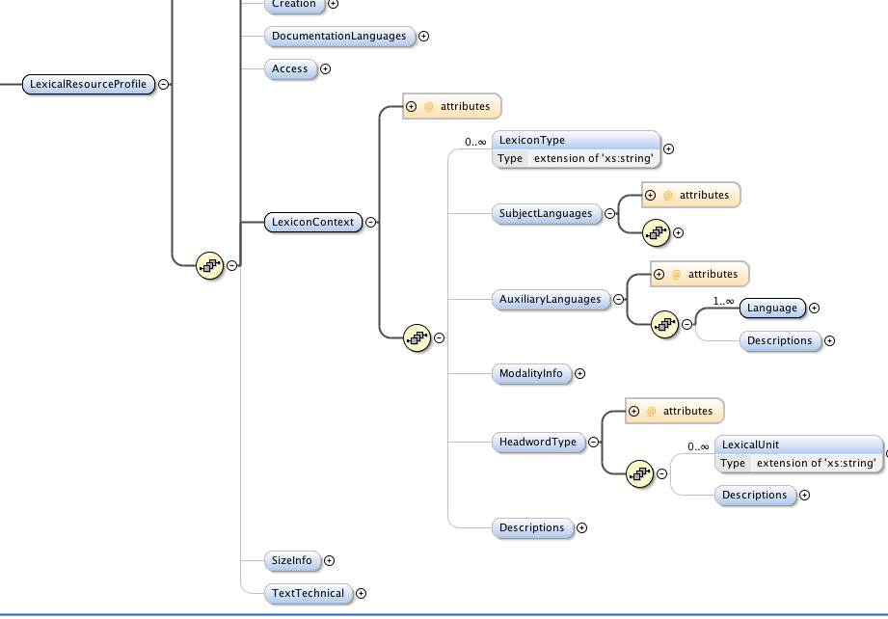
Notes:
Etymological dictionaries on the other hand are special as they contain many reference languages, pointing to the source language and origin, though these languages are not the primary language of the resource, there was the requirement by project partners to represent these languages in the metadata.

Slide 14
Notes:
It is easy to find a suitable scenario for the use of this information: an old language such as middle high German or old Norse may not have too many attested sources, hence all sources could be relevant, even if it is only a couple of words in a dictionary of another language.

Slide 15
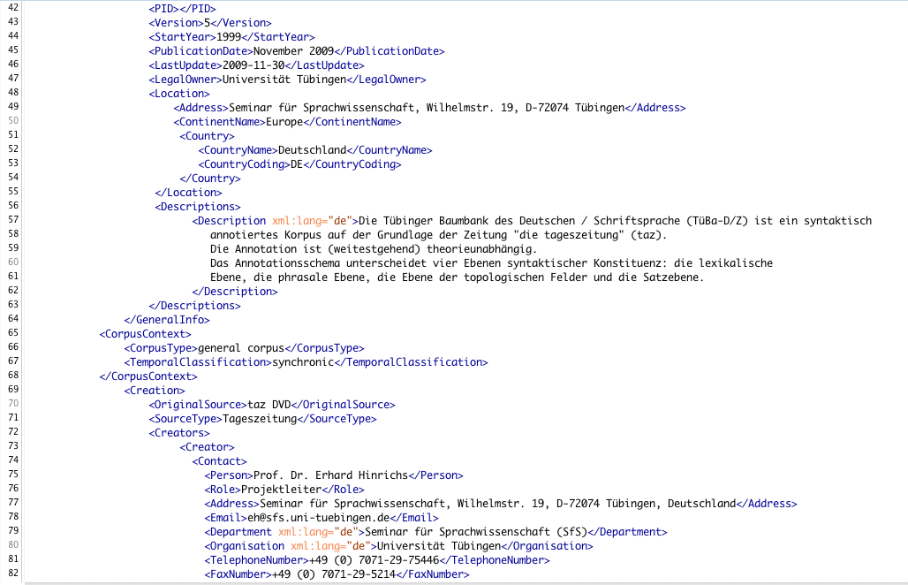
Notes:
For corpora we analyzed the requirements for a syntactically annotate corpus, a treebank and spoken language corpora. The treebank poses the challenge of having various annotation levels, produced in different processes, while the spoken language data is a multi-tier annotation with separated signal file.

Slide 16
Notes:
Both are rather typical, but not the easy cases for corpora that are available only as one block and where the annotation follows one type only, or where there is only one institution and principal researcher involved. This corpus also allows to serve as an example for handling subcorpora and collections of corpora.

Slide 17
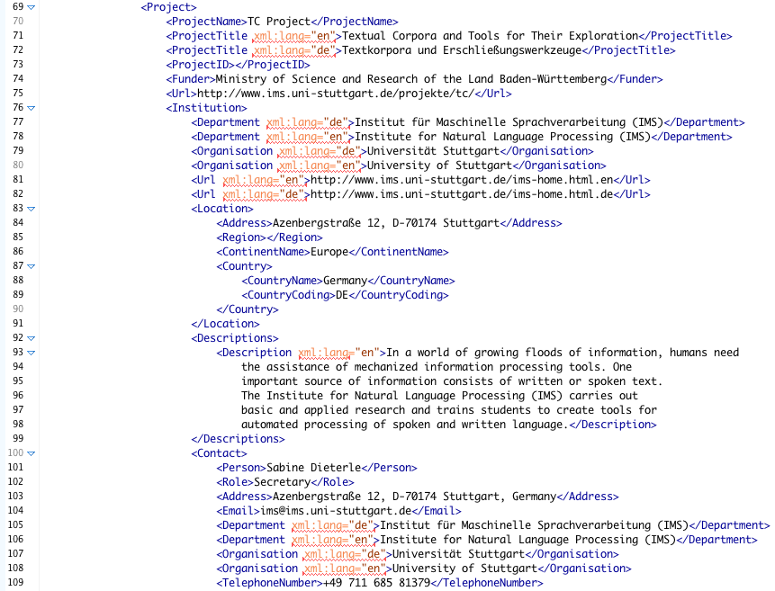
Notes:
Software tools seem to be special cases as they frequently occur in the discussion but only few have been described in a meta fashion. The reason seems to be obvious: there are various releases, there is a life-cycle, they are specialized and those who need them, know what they are looking for. Of course this is not necessarily true, but that's the way it is interpreted. We took the TreeTagger, a morphological analyser and a couple of webservices as our test case. The TreeTagger's challenge is the support of various platforms with different restrictions, multiple languages. The morphological analyser had various annotation levels. Different from these standalone programs are webservices that are actually integrated in toolchains of services.

Slide 18
Notes:
To be usable in these toolchains there are requirements for input and output plus the address and paramaters of the service need to be known. Up to here, this is independent of SOAP or REST architectures and their metadata. However, when we talk about metadata in the CMDI context, we think of course of descriptive metadata similar to those bits of information you would find in a library catalogue. Neither the REST nor SOAP technical metadata, sometimes referred to as orchestration metadata, is sufficient to provide descriptions, copyrights, etc. Nevertheless these bits of information are essential for those creating a toolchain of webservices, not technically, but actually creating them, without knowing all the individual services. At the same time webservices are floating, you don't have strict versioning as for other tools. At the same time, many webservices also correspond to standalone programms, maybe with an API addon. However, starting with existing metadata, we created CMDI metadata for more than 120 webservices from the linguistic field.

Slide 19
Notes:
Rather special is also the kind of resources created in psycholinguistics, dialect research, etc. Data sets from these areas are basically numeric sets of questionnaire answers. Without a detailed description of the experiment it is almost impossible to guess what the primary data is all about. We found that at the same time the researchers do not want too detailed experiment descriptions before a paper on the experiment appears. Nevertheless they have very detailed ideas on a theoretical background and classification system for this kind of resources that are a must for them.

Slide 20
Interview
CMDI Draft
Draft Review
Repository
Notes:
For each of these procedures we use a simple creation bootstrapping technique: we contact the producers of the resource and ask them for a detailed description of their resource. Very often they answered with websites or parts of published articles plus some additional verbal explanation. This we used to create a draft CMDI file, trying to reuse as many components as possible, but feeling free to modify them as needed and to introduce new data categories and components as needed. We returned these CMDI files to the authors of the resources, who proofread the instances, currated their data and sometimes asked for additions and changes. After incorporating the changes, we returned the CMDI files to the resource providers for their approval. If they approved we integrated them into our metadata repository.
The result for us is a large set of modified and improved components. We currently have 71 components and three profiles in the component registry, the speech corpus profile currently using a non-improved recycled profile, the experimental data still in a pre-component registry phase. Additionally we use a couple of other components that are publicly available in the component registry. As a rule of thumb we create a standalone component if we see a scenario in which the component can be reused in other contexts. Many of the 71 components are actually derivations from existing components from other authors but where we saw the need to include additional data categories or where in our context we saw the need for other cardinalities. Many components were adjusted when a low level component needed to be changed, so the top-level-components needed to included them.

Slide 21
CMDI Data in NaLiDa
Type | Manual | Transformed | Harvested
Lexical resources | 2 | 6 | 0**
Corpora | 2 | 55 | ~2800*
Tools | 2 | 0* | 145*
Webservices | 2 | 119 | 0*
Experimental Data | 0* | 0 | 0
 |  |  | >10000
*: not originally in CMDI
**: classification in harvested data not available, often counted among corpora
Notes:
In addition to this data for best practice we also worked on the transformation of additional metadata from previous projects if possible. As the previously used metadata schemas were not as adapted to the type of resource, they were much more restricted and not as detailed in their descriptions. This resulted in our change of the metadata components into more optional data categories than we would have liked. Using this procedure we created additional 61 metadata records for corpora and 121 records for webservices. Additional transformations for lexical resources are still in an earlier development phase.

Slide 22
Tagset
Tool context
Corpus
context
Text-Technical
Creation
Access
Size
Info
General Info
Subject
language
Project
Modality Info
Documentation
Languages
Lexical resource
Experimental context
Notes:
We found that we can work with a set of core components, called general info, creation, documentation, access and technical information. For the individual types of resources there are extensions, some extensions such as size information, reoccurring in various resources. For searching and we are going to hear about searching later, we found that most search scenarios can easily operate on closed classes of data categories, the resource class extension leading to additional facets in the search after the selection of the document type.
The consequence of profiles here is that we implicitly use a classification system for language resources. And the different classes of resources have a number of consequences for the metadata, not only in the creation process but also in the use and interpretation of the metadata. This is one of the factors that is not covered by other metadata schemas.

Slide 23
Lexical Resource
WL corpus
SL corpus
Experimental
data
Tools
eng
Type
deu
nld
Resources
Language
ega
Modality
non
Various
tlh
Written
Multimodal
Spoken
Signed
Notes:
Another addition which we found is necessary is the indication of the life-cycle status of resources. If, what we hope, the resource creators actually create their own metadata, we recommend them to start to create the metadata in the planning process of the resource or whenever it is possible. This could lead to the creation of metadata where the data is at different stages, be it in planning state, under development, released, evaluated or reviewed, but of course also superseded, retired, or withdrawn. For legacy data, it could be even necessary to classify them as "archived" not saying anything about a life-cycle process because it may be unknown.
Another typical classification of linguistic project, resources and procedures is related to spoken vs. written language. The modality is also something not covered by many metadata schemas as they operate on written resources alone. We see the necessity of distinguishing at least spoken and written language, but also signs, and non-verbal communications seem to be be relevant. As some resources, especially tools, do not correspond to a specific modality, this is optional.
Hence we included into our core categories a life-cycle status, a resource class and the involved modalities.

Slide 24
The NaLiDa contribution
Added value
Findability
Structured description
Long term archiving
Prototypical examples
Notes:
When we talked to our project partners we found out that for the establishment of CMDI for metadata there are a couple of points that are crucial.
Added value: the individual researcher needs to see a personal value in creating metadata. This is strongly connected to
Findability: you need to have a good way of finding the resources as a full text search is just not sufficient if you are looking for material with specific linguistic attributes.
Structured description of resources: you see the description and you get a good idea about what it is good for. The overview, a kind of technical fact sheet, is essential for Quality Assurance of the metadata and a means for further overviews and statistics.
Long term archiving in a central infrastructure: this requires trust in the repositories especially when restrictions to the access to the data is applied.
Prototypical examples: It is essential not only to describe how to create the metadata but to show examples.
In Germany we in the project NaLiDa work exactly in these areas, assisting individual researchers to archive their material and to create findable metadata.

Slide 25
Credits/Photos
Petroleum Pipes Image: Suat Eman / FreeDigitalPhotos.net
Railway Image: samurai / FreeDigitalPhotos.net
Lake Vyrnwy Dam Image: Matt Banks / FreeDigitalPhotos.net
Man reading Image: Arvind Balaraman / FreeDigitalPhotos.net
Business Woman Taking Notes Image: Michal Marcol / FreeDigitalPhotos.net
Euro In Pila Image: Idea go / FreeDigitalPhotos.net
Notes:
Thank you.

