Slide 1
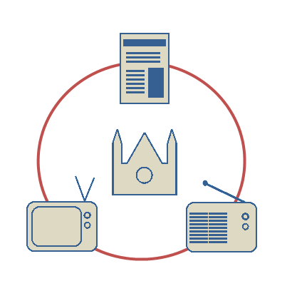
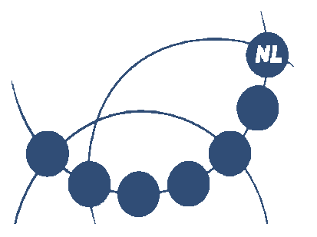
PoliMedia
Interlinking multimedia for the analysis of media coverage of political debates
www.polimedia.nl

Slide 2
The Team
Henri Beunders
Martijn Kleppe
Max Kemman
Geert-Jan Houben
Laura Hollink (VU)
...
Johan Oomen
Jaap Blom
PoliMedia

Slide 3
Main research question
What choices do different media make in the coverage of people and topics while reporting on debates in the Dutch parliament since the first televised evening news in 1956 until 1995?
PoliMedia

Slide 4
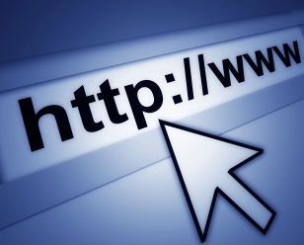
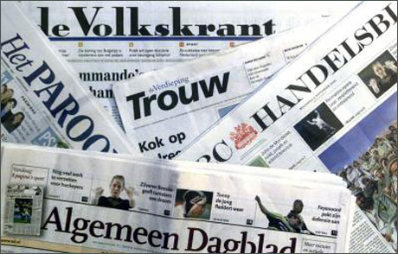
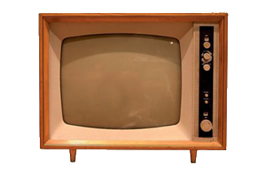
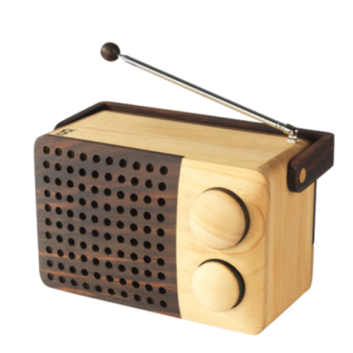
Current approach of research
Potential research questions
How is a person, subject or process covered by the media?
How do debates and arguments develop over a longer period of time?
Analysing the changing ideas, arguments and presentation in different media
PoliMedia

Slide 5
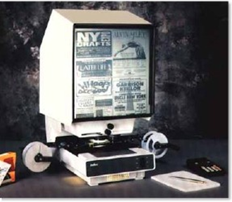
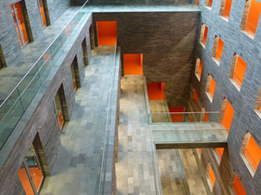
Issues with current approach
+
=
Too much work
Limited material and different systems
+
=
PoliMedia
Notes:
Limited: not everything is in it, but more importantly no mark-up or pages

Slide 6
PoliMedia approach
PoliMedia Portal
Browse: debate and date
Search: debate and person
Newspapers
KB
Staten Generaal Digitaal
KB
Television
Sound and Vision
Radio
KB
PoliMedia

Slide 7
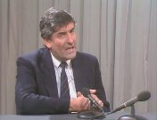
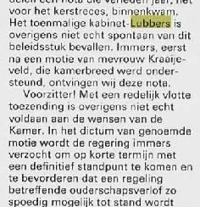
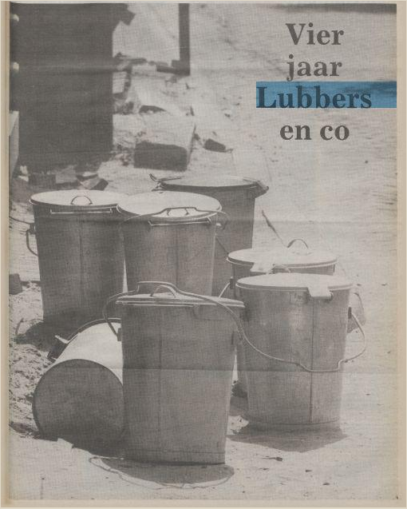
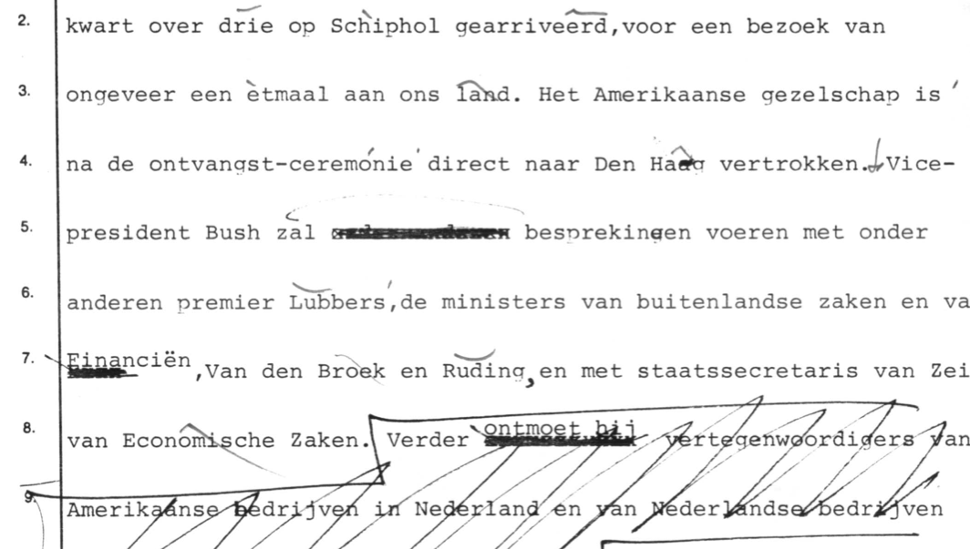
Advantage of PoliMedia
Better insight in the relations between media items
PoliMedia
Notes:
Searching and browsing multimedial databases in a single interface
Offering a better insight in the relations between media items
Allowing researchers to create their own interface on top of the infrastructure

Slide 8
Roles
User requirements
Usability evaluation
Linking media and debates
Structured information about people and debates
Published in Web standards
Academia dataset
Virtual workspace/Portal
PoliMedia
Notes:
EUR:
Requirements
What do researchers want?
Searching/Browsing/Analysing
Method: Interviews
Usability
Technique
Interface of portal
Method: Experiments
Delft:
Semantic model
Representing links between the four datasets
Linking
Transforming XML into RDF
Annotate entities
People
Timestamps
Locations
Detect links
NISV:
Dataset
Academia
Dublin Core, CDMI
OAI-PMH end-point
IPR: Usable for educative purposes
Virtual workspace
Browse system on linked datasets
Installation on CLARIN server
Documentation (API, code and datasets)

Slide 9
PoliMedia+?
PoliMedia

Slide 10
Contact
www.polimedia.nl
kemman@eshcc.eur.nl
PoliMedia

