Slide 1
CLARIN (NL PART): What’s in it for Linguists?
Jan Odijk
Uilendag
Utrecht, 2014-03-27

Slide 2
Overview
CLARIN-NL & CLARIN
CLARIN Infrastructure (NL part)
Find data and tools
Apply tools to data
Store data and tools
Conclusions and Invitation

Slide 3
Overview
CLARIN-NL & CLARIN
CLARIN Infrastructure (NL part)
Find data and tools
Apply tools to data
Store data and tools
Conclusions and Invitation

Slide 4
CLARIN-NL
CLARIN-NL
National project in the Netherlands
2009-2015
Budget: 9.01 m euro
Funding by NWO (National Roadmap Large Scale Infrastructures)
Coordinated by Utrecht University
>33 partners (universities, royal academy institutes, independent institutes, libraries, etc.)

Slide 5
CLARIN-NL
Dutch National contribution to the Europe-wide CLARIN infrastructure
Prepared by CLARIN preparatory project (2008-2011)
Also coordinated by Utrecht University
From Feb 2012 coordinated by the CLARIN-ERIC, hosted by the Netherlands
ERIC: a legal entity at the European level specifically for research infrastructures
Other ERIC members: AT BG CZ DK DLU EE DE NO PL (SV) and growing

Slide 6
CLARIN Infrastructure
A research infrastructure for humanities researchers who work with digital language-related resources

Slide 7
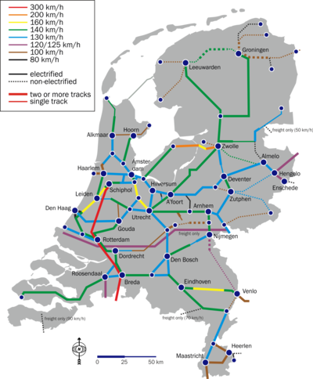
CLARIN Infrastructure
Infrastructure:
(Usually large-scale) basic physical and organizational resources, structures and services needed for the operation of a society or enterprise
Railway network, road network, electricity network, …
eduroam

Slide 8
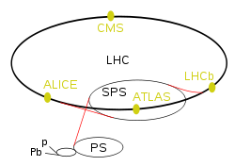
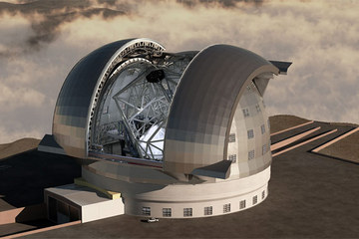
CLARIN Infrastructure
Research infrastructure
Infrastructure intended for carrying out research: facilities, resources and related services used by the scientific community to conduct top-level research
Famous ones: Chile large telescope, CERN Large Hadron Collider

Slide 9
CLARIN Infrastructure
humanities researcher
Linguists, historians, literary scholars, philosophers, religion scholars, ….
And a little bit in the social sciences: e.g. political sciences researchers
Focus here on linguists

Slide 10
CLARIN Infrastructure
Digital language-related resources
Data in natural language (texts, lexicons, grammars)
Databases about natural language (typological databases, dialect databases, lexical databases, …)
Audio-visual data containing (written, spoken, signed) language (e.g. pictures of manuscripts, av-data for language description, description of sign language, interviews, radio and tv programmes, …)

Slide 11
CLARIN Infrastructure
Language in various functions
As object of inquiry
As carrier of cultural content
As means of communication
As component of identity

Slide 12
CLARIN Infrastructure
CLARIN
Has not created any new data
Has mainly adapted existing data and tools
Has created new easy and user-friendly tools for searching, analysing and visualising data

Slide 13
CLARIN Infrastructure
The CLARIN infrastructure
Is distributed: implemented in a network of CLARIN centres
Is virtual: it provides services electronically (via the internet)
The CLARIN infrastructure
Is still under construction
Highly incomplete
Fragile in some respects
But you can use many parts already

Slide 14
Overview
CLARIN-NL & CLARIN
CLARIN Infrastructure (NL part)
Find data and tools
Apply tools to data
Store data and tools
Conclusions and Invitation

Slide 15
CLARIN Infrastructure
The CLARIN infrastructure offers services so that a researcher
Can find all data and tools relevant for the research
Can apply the tools and services to the data without any technical background or ad-hoc adaptations
Can store data and tools resulting from the research
via one portal

Slide 16
Overview
CLARIN-NL & CLARIN
CLARIN Infrastructure (NL part)
Find data and tools
Apply tools to data
Store data and tools
Conclusions and Invitation

Slide 17
CLARIN Infrastructure
Finding data and tools via the portal?
Portal is under development
Will be available first half of 2014
In the meantime:
Use http://www.clarin.nl/node/404
for an overview of CLARIN-NL
Data
Applications
Services
Links to the CLARIN Europe data and services

Slide 18
CLARIN Infrastructure ‘Can find all data and Tools’
Virtual Language Observatory
Faceted browsing and geographical navigation
CLARIN-PP
Demo
CLARIN Metadata Search

Slide 19
Overview
CLARIN-NL & CLARIN
CLARIN Infrastructure (NL part)
Find data and tools
Apply tools to data
Store data and tools
Conclusions and Invitation

Slide 20
CLARIN Infrastructure Tools: Illustration
Example Problem (based on Odijk 2011)
Glimpse of
Searching in PoS-tagged Corpus
Searching for grammatical relations
Searching for Constructions
Searching for synonyms/ hyponyms
Analyzing/Visualising Word occurrence patterns in CHILDES

Slide 21
CLARIN Infrastructure Tools: Illustration
MORE
 | A | P | V
 | Zij is daar __ blij mee | Zij is daar __ mee in haar nopjes | Zij verheugde zich daar __ over
Zeer | OK | OK | OK
Erg | OK | OK | OK
Heel | OK | * | *

Slide 22
CLARIN Infrastructure Tools: Illustration
Differences
not due to semantics
purely syntactic
does not follow from a general principle,
so it must be ‘learned’ by a child acquiring Dutch as a first language

Slide 23
CLARIN Infrastructure Tools: Illustration
Research Questions
How can such facts be acquired (L1 acquisition)?
How can child learn that zeer and heel can modify A, V, and P?
Is there enough evidence for this to the child?
How can a child `learn’ that heel cannot modify Ps or Vs-> there is no evidence for this (no negative evidence)
Is there a relation between time of acquisition and modification potential?
Role of indirect negative evidence?
(and much more can be said about this)

Slide 24
CLARIN Infrastructure Tools: Illustration
How to approach this problem
Study literature, study grammars, form and test hypotheses, look for relevant data sets, create new datasets, enrich data with annotations, search in and through datasets, analyze data and visualize analysis results, design and carry out experiments, design and do simulations, ….
Focus here: searching relevant data easily in large resources using (components of ) the CLARIN infrastructure

Slide 25
CLARIN Infrastructure Tools: Illustration
Google is no good for this!
Because you need (inter alia) grammatical information
Because (as any decent word) the relevant words are highly ambiguous (syntax and semantics):
Erg (4x)= noun(de) ‘erg’; noun(het)’evil’, adj+adv ‘unpleasant’, adv ’very’
Zeer (3x)= noun ‘pain’; adj ‘painful’; adv ‘very’
Heel (4x) = adj ‘whole’; adj `big’; verbform ‘heal’; adv ‘very

Slide 26
CLARIN Infrastructure Tools: Illustration
Are the basic facts correct?
Search with OpenSONAR
Search in PoS-tagged corpus SONAR-500
reduces problem with ambiguities
Sneak preview
Demo

Slide 27
CLARIN Infrastructure Tools: Illustration
Conclusions after analysis
Heel does occur with certain adverbially used PPs
Heel in het begin, heel af en toe, heel in het bijzonder, heel in het kort, heel op het laatst, heel in de verte, heel uit de verte, heel in het algemeen,
Dat ligt hem heel na aan het hart
Heel does occur with predicative PPs (but I find them ill-formed)
buiten zijn verwachting, in de mode, in de vakantiestemming, in het zwart, in orde
Maybe heel is used as geheel by some people

Slide 28
CLARIN Infrastructure Tools: Illustration
PoS code annotation
is (just) OK for adjacent words (but quite some noise)
Is useless for more distant grammatically related words
Desired: Search for words that have a grammatical relation (dependency relations)
LASSY Woordrelaties Interface
LASSY Small: 65 k sentences (1 m words)
LASSY-LARGE/wiki: 8.6 m sentences (125 m words)
Demo

Slide 29
CLARIN Infrastructure Tools: Illustration
Conclusions
Heel
There are examples where heel modifies a `verb’
But `verb’ is actually a deverbal (participle) adjective
in ‘heel open staan voor’ heel is incorrectly analyzed as modifying the verb
Zeer:
most examples of deverbal adjectives
But also some real verbs
➔confirms initial assumptions about the facts

Slide 30
CLARIN Infrastructure Tools: Illustration
Searching for Constructions
GrETEL
Example-based treebank query system
LASSY-Small, Corpus Gesproken Nederlands (CGN)
Currently extended to LASSY-LARGE (700 m tokens)
Small Demo on CGN
Want to know more?
Mar 31, 2014, 15:30 Syntax Interface Meeting

Slide 31
CLARIN Infrastructure Tools: Illustration
Cornetto data and Interface to Cornetto
Lexico-semantic database based on Dutch WordNet and ReferentieBestand Nederlands
Created in STEVIN programme
User-friendly interface made in CLARIN-NL
Example to search for (near-)synonyms of zeer, erg, heel.

Slide 32
CLARIN Infrastructure Tools: Illustration
What is the modification potential of near-synonyms of zeer, heel, erg?
allemachtig-adv-2 beestachtig-adv-2 bijzonder-a-4 bliksems-adv-2 bloedig-adv-2 bovenmate-adv-1 buitengewoon-adv-2 buitenmate-adv-1 buitensporig-adv-2 crimineel-a-4 deerlijk-adv-2 deksels-adv-2 donders-adv-2 drommels-adv-2 eindeloos-a-3 enorm-adv-2 erbarmelijk-adv-2 fantastisch-adv-6 formidabel-adv-2 geweldig-adv-4 goddeloos-adv-2 godsjammerlijk-adv-2 grenzeloos-adv-2 grotelijks-adv-1 heel-adv-5 ijselijk-adv-2 ijzig-a-4 intens-adv-2 krankzinnig-adv-3 machtig-adv-4 mirakels-adv-1 monsterachtig-adv-2 moorddadig-adv-4 oneindig-adv-2 onnoemelijk-adv-2 ontiegelijk-adv-2 ontstellend-adv-2 ontzaglijk-adv-2 ontzettend-adv-3 onuitsprekelijk-adv-2 onvoorstelbaar-adv-2 onwezenlijk-adv-2 onwijs-adv-4 overweldigend-adv-2 peilloos-adv-2 reusachtig-adv-3 reuze-adv-2 schrikkelijk-adv-2 sterk-adv-7 uiterst-adv-4 verdomd-adv-2 verdraaid-a-4 verduiveld-adv-2 verduveld-adv-2 verrekt-adv-3 verrot-adv-3 verschrikkelijk-adv-3 vervloekt-adv-2 vreselijk-adv-5 waanzinnig-adv-2 zeer-adv-3 zeldzaam-adv-2 zwaar-adv-10
Many of these appear atypical for young children and are probably learned late
Is there a correlation between this and their modification potential?

Slide 33
CLARIN Infrastructure Tools: Illustration
COAVA application CHILDES browser
Application built for research into the relation between language acquisition and lexical dialectical variation
Cognition, Acquisition and Variation tool
Demo of the COAVA CHILDES browser analyzing and visualising children’s speech
(for child-directed speech see here)

Slide 34
CLARIN Infrastructure Tools: Illustration
 | found | mod A | mod V | mod N | mod P | other | Un-clear
zeer | 52 | 1 | 0 | 0 | 0 | 51
heel | 800 | 744 | 4 | 7 | 0 | 2 | 43
erg | 54 | 25 | 1 | 1 | 0 | 26 | 1
First relevant occurrence | heel | erg | zeer
Day(Yr;Mo) | 705 (1;11) | 1048 (2;10) | 1711 (4;8)

Slide 35
CLARIN Infrastructure Tools: Illustration
Summary: CLARIN-NL tools
Enable search for grammatical and semantic properties
In small (1M) to large (700M) annotated corpora
And in rich lexical databases
With easy to use interfaces
Provide new data gathering opportunies
that mostly did not exist for Dutch until recently
were available for specialists only until one year ago

Slide 36
Overview
CLARIN-NL & CLARIN
CLARIN Infrastructure (NL part)
Find data and tools
Apply tools to data
Store data and tools
Conclusions and Invitation

Slide 37
CLARIN Infrastructure ‘Can store the data & tools’
What about your research data /software?
Make them CLARIN-compatible
➔CLARIN tools and services apply to them
For analysis, improvement, creation
Others can use them more easily
Store them at a CLARIN Centre
For long term preservation
For easy access by you and others (e.g. via the VLO)
For verifiability and replicability of your research

Slide 38
CLARIN Infrastructure ‘Can store the data & tools’
CLARIN Centres in the Netherlands:
DANS
Huygens ING
INL
Meertens Institute
MPI
CLARIN offers many tools to make your data / software CLARIN compatible

Slide 39
CLARIN Infrastructure `UiL-OTS Inside’
Many UiL-OTS people have done / are doing this:
DuELME project data (multi-word expressions) and interface with metadata (Jan Odijk)
Database of the Longitudinal Utrecht Collection of English Accents (D-LUCEA) curated data … expected in 2014 (Hugo Quené)
2013 DISCAN text corpus enriched with discourse Annotation and its metadata (Ted Sanders)

Slide 40
CLARIN Infrastructure ‘UiL-OTS Inside’
More UiL-OTS resources…
TDS-Curator project Access to the Typological Database System (TDS) (Alexis Dimitriadis)
MIMORE project metadata for DiDDD, Dynasand, and GTRP and the Mimore search engine (Sjef Barbiers)

Slide 41
CLARIN Infrastructure ‘UiL-OTS Inside’
More UiL-OTS resources….
MIGMAP project Dutch Interface or English Interface for migration analysis and web service plus documentation (Gerrit Bloothooft)
Semantic Role Assignment in the TTNWW workflow (Paola Monachesi, Thomas Markus)

Slide 42
Overview
CLARIN-NL & CLARIN
CLARIN Infrastructure (NL part)
Find data and tools
Apply tools to data
Store data and tools
Conclusions and Invitation

Slide 43
Conclusions (1)
CLARIN is starting to provide the data, facilities and services to carry out humanities research supported by large amounts of data and tools
With easy interfaces and easy search options (no technical background needed)
Still some training is required, to exploit the full possibilities but also to understand the limitations, of the data and the tools
Educational modules are being developed for selected functionality
coordinated by Gerrit Bloothooft & David Onland (UU)
Course at LOT 2014 Summerschool, Nijmegen

Slide 44
Invitation
Use (elements from) the CLARIN infrastructure
(Questions? Problems? CLARIN-NL Helpdesk!)
Join user groups of specific services
Provide feedback so that we can further improve CLARIN
So that you can improve your research

Slide 45
Conclusions (2)
But there is still a lot to do
Not all data (even some crucial data) are visible via the VLO or via Metadata Search
Very few tools and web services are currently visible via the VLO
Many tools are still prototypes or first versions
There are good search facilities for some individual resources but not for all
The search facilities so far are aimed at a single resource, or a small group of closely related resources.
Federated content search, which enables one to search with one query in multiple, quite diverse, resources, is still being worked on but difficult
Many other desiderata

Slide 46
Thanks for your attention!

Slide 47
DO NOT ENTER HERE

Slide 48
Still desired
TTNWW enables automatic enrichment of text corpora
But that is just a first step. No researcher is interested in that in itself
It must be followed by e.g.
Search in the enriched data, or
Analysis of the enriched data (statistics, etc)
But using the TTNWW output in Search services is currently not possible yet
Analysis is possible but only in limited ways
➔ facilities for this are desired

Slide 49
Still desired
Search queries applied to large data often yields large results
Cannot be analyzed by hand
➔flexible Workflows for search – analysis services – visualisation services
Each search tool should yield output formats suitable for existing analysis software (e.g. CSV format for input to Excel, Calc, R, SPSS, …)
(and/or) Search can apply to its own output
Incremental refinement

Slide 50
Still desired
Full-fledged federated content search is not possible yet
But much simpler cases are not possible either
Search with one query in multiple Dutch lexical resources:
CGN-lexicon, CELEX, GTB, Cornetto, DuELME-LMF, …
Search with one query in multiple Dutch pos-tagged text corpora
CGN, D-COI, SONAR-500, VU-DNC, Childes corpora, …
Search with one query in multiple Dutch treebanks
CGN treebank, LASSY-Small, LASSY-Large
This might be an incremental way to get to full-fledged federated content search
[MPI’s TROVA offers some of the functionality described here]

Slide 51
Still desired
Chaining Search, e.g.
GrETEL followed by semantic filtering (Cornetto)
Bare noun phrases where the head noun is count
N N constructions where first N indicates a quantity
GrETEL followed by morphological potential filtering (CGN/SONAR/CELEX lexicon)
Het adj-ø N where adj has no e-form potential
GrETEL followed by phonological filtering
Het adj-ø N where adj ends in /C+$C+$C+/

Slide 52
Still desired
Parameterized queries (batch queries)
give me all example sentences containing any word from a given set of `synonyms’ of the adverb zeer (itself derived from Cornetto) and, for each word, statistics on the categories it modifies
allemachtig-adv-2 beestachtig-adv-2 bijzonder-a-4 bliksems-adv-2 bloedig-adv-2 bovenmate-adv-1 buitengewoon-adv-2 buitenmate-adv-1 buitensporig-adv-2 crimineel-a-4 deerlijk-adv-2 deksels-adv-2 donders-adv-2 drommels-adv-2 eindeloos-a-3 enorm-adv-2 erbarmelijk-adv-2 fantastisch-adv-6 formidabel-adv-2 geweldig-adv-4 goddeloos-adv-2 godsjammerlijk-adv-2 grenzeloos-adv-2 grotelijks-adv-1 heel-adv-5 ijselijk-adv-2 ijzig-a-4 intens-adv-2 krankzinnig-adv-3 machtig-adv-4 mirakels-adv-1 monsterachtig-adv-2 moorddadig-adv-4 oneindig-adv-2 onnoemelijk-adv-2 ontiegelijk-adv-2 ontstellend-adv-2 ontzaglijk-adv-2 ontzettend-adv-3 onuitsprekelijk-adv-2 onvoorstelbaar-adv-2 onwezenlijk-adv-2 onwijs-adv-4 overweldigend-adv-2 peilloos-adv-2 reusachtig-adv-3 reuze-adv-2 schrikkelijk-adv-2 sterk-adv-7 uiterst-adv-4 verdomd-adv-2 verdraaid-a-4 verduiveld-adv-2 verduveld-adv-2 verrekt-adv-3 verrot-adv-3 verschrikkelijk-adv-3 vervloekt-adv-2 vreselijk-adv-5 waanzinnig-adv-2 zeer-adv-3 zeldzaam-adv-2 zwaar-adv-10

Slide 53
Still desired
Replicability
Student tried to replicate similarity measure calculations on Wordnet of Patwardhan and Pedersen (2006) and Pedersen (2010)
in an excellent team: Piek Vossen and his research group
With help of one the original authors: Ted Pedersen
Using the exact same software and data
They failed to reproduce the original results!
Reason: ‘properties which are not addressed in the literature may influence the output of similarity measures’
Many experiments and Pedersen’s unpublished intermediate results to find out
the original settings of all parameters (e.g. treatment of ties in Spearman ρ )
Which aspects of the data had been used and how

Slide 54
Still desired
One step towards a solution for this
All tools must allow input of metadata associated with data
All tools must provide provenance data
All tools must provide a list with settings of all parameters (also usable as an input parameter, ‘configuration file’) as part of the provenance data
All tools must generate new metadata for its results based on the input metadata, the generated provenance data, and possibly some manual input of a user
Fokkens, A., M. van Erp, M. Postma, T. Pedersen, P. Vossen & N. Freire ‘Offspring from Reproduction problems: What Replication Failure Teaches Us’, Proceedings of the 51st Annual Meeting of the Association for Computational Linguistics, pages 1691–1701, Sofia, Bulgaria, 2013.

Slide 55
Google v. Desired
Property | Google | What you want
String search | yes | yes
Relation between strings | nearness | Grammatical relations, PoS codes
Search for function words | No / unreliable | Yes
Search for morpho-syntactic and syntactic properties | no | Yes
Construction search | no | Yes
Dutch only | unreliable | Yes
Size | huge | Huge (but so far there is only small (1m) or large (700m)

Slide 56
Improvement Suggestions
Actual use of the search facilities leads to suggestions for improvements, e.g.
Selection of inflection (extended PoS) in GreTel was originally not possible (and is still not possible) for LASSY-Small but has been added for search in CGN
In the Dutch CGN/SONAR (de facto standard ) PoS tagging system one cannot easily express ‘definite determiner’ (only as a complex regular expression over PoS tags): a special facility for this is required
The Dutch CGN/SONAR (de facto standard ) Pos tagging system uses, for adjectives, the ø-form tag for cases where the distinction between e-form and ø-form is neutralized. This is not incorrect but a facility to distinguish the two would be very desirable (and this is possible by making use of the CGN lexicon and/or the CELEX lexicon
Idem for adjectives that have an e-form identical to a ø-form because of phonological reasons (adjectives ending in two syllables headed by schwa)
Zero-inflection in MIMORE is represented by absence of an inflection tag. That makes search for such examples very difficult and requires either a NOT-operator (which is not there) or explicit tagging of absence of inflection

Slide 57
Actual Use Case
Actual use case for TTNWW (May 2013)
Art history student investigates opinion mining in art reviews and needs relative frequency of adjectives and adverbs in art reviews
TTNWW can be used to do PoS-tagging. Excel or statistical package can then be used to calculate the relative frequencies.
However ,TTNWW is, so far, a prototype
TTNWW allows only uploading one file at a time. But the student came with 150!
TTNWW allows only plain text as input. But the student came with a mix of Word, html , plain text and pdf documents.
‘Which character encoding was used for the plain text files?’ Blank stare!
Determining the relation between input and output and logging files in TTNWW is quite a challenge!
Output of TTNWW PoS-tagging is CSV so can be easily imported into statistical packages
but not if you have to do it 150 times (e.g. Excel)!
So some support for batching such processes is desirable
or output one file with original file name as extra column

Slide 58
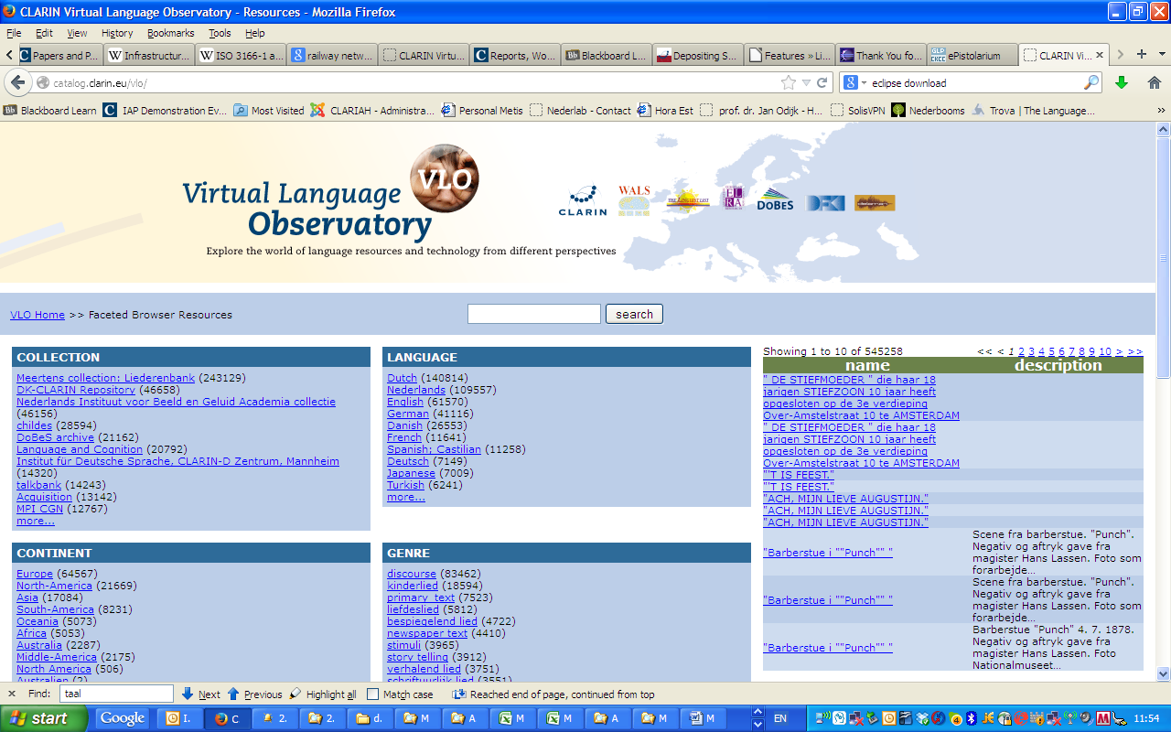
Improvement Suggestions

Slide 59
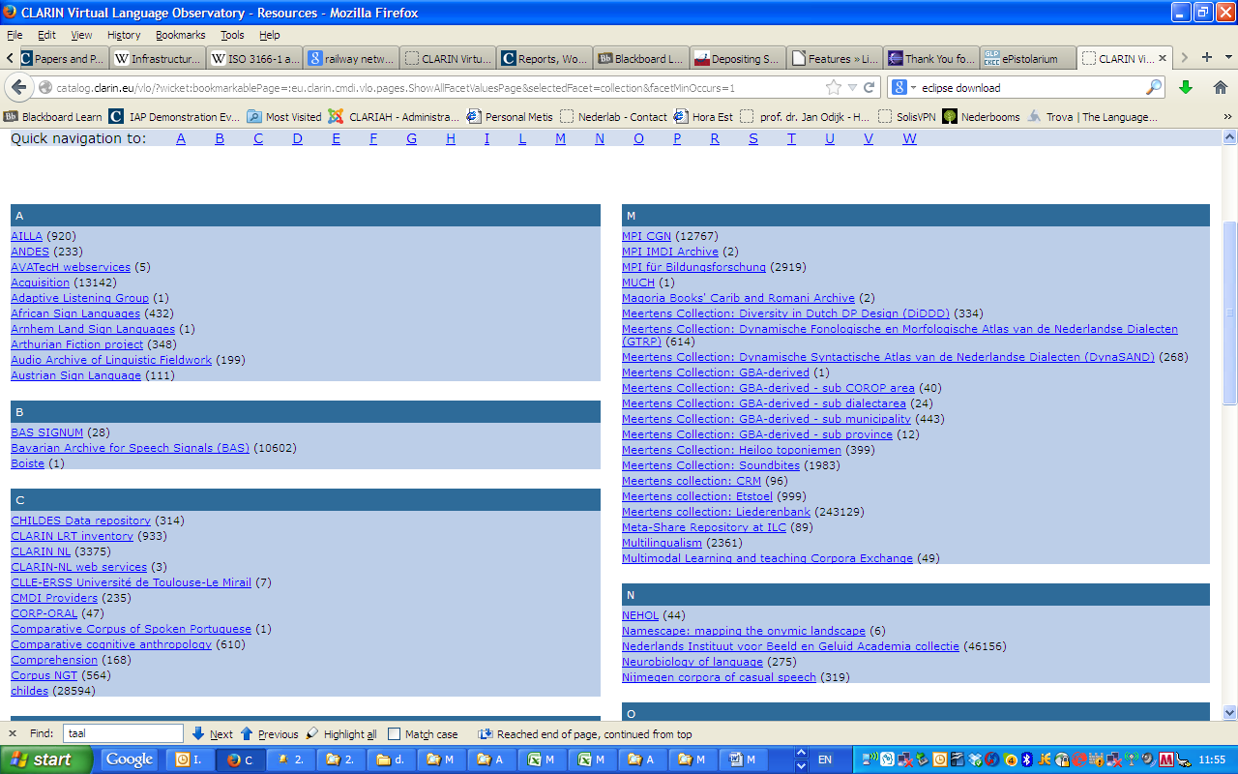
Improvement Suggestions

Slide 60
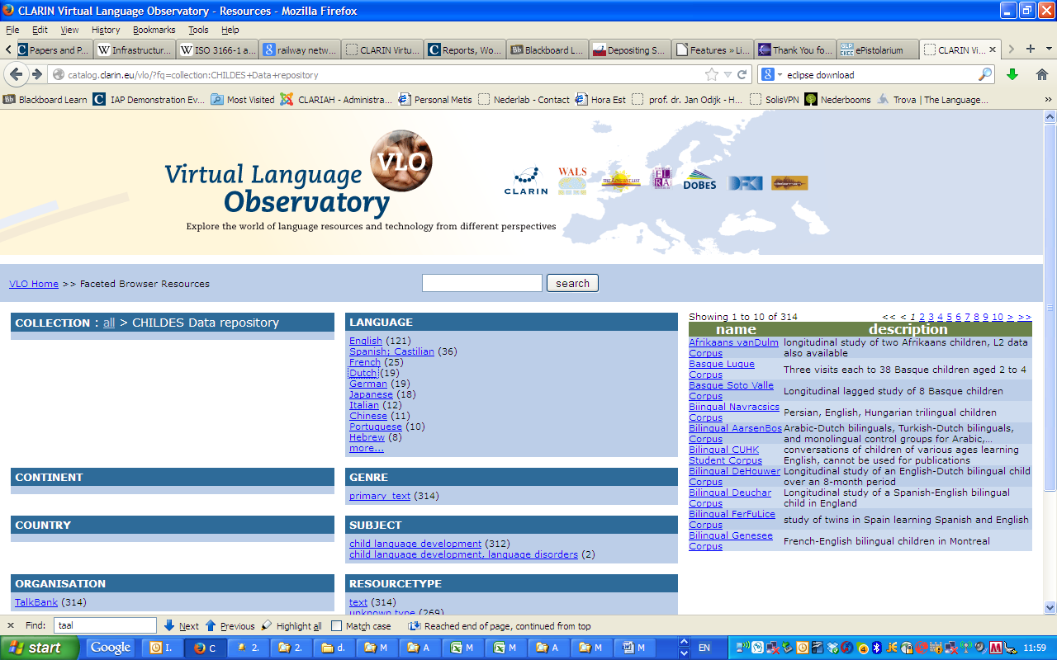
Improvement Suggestions

Slide 61
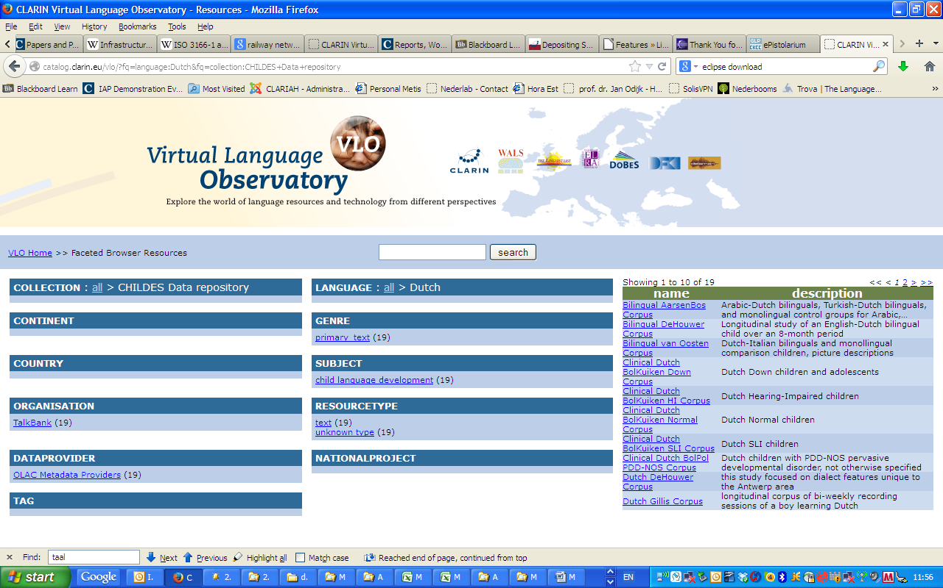
Improvement Suggestions

Slide 62
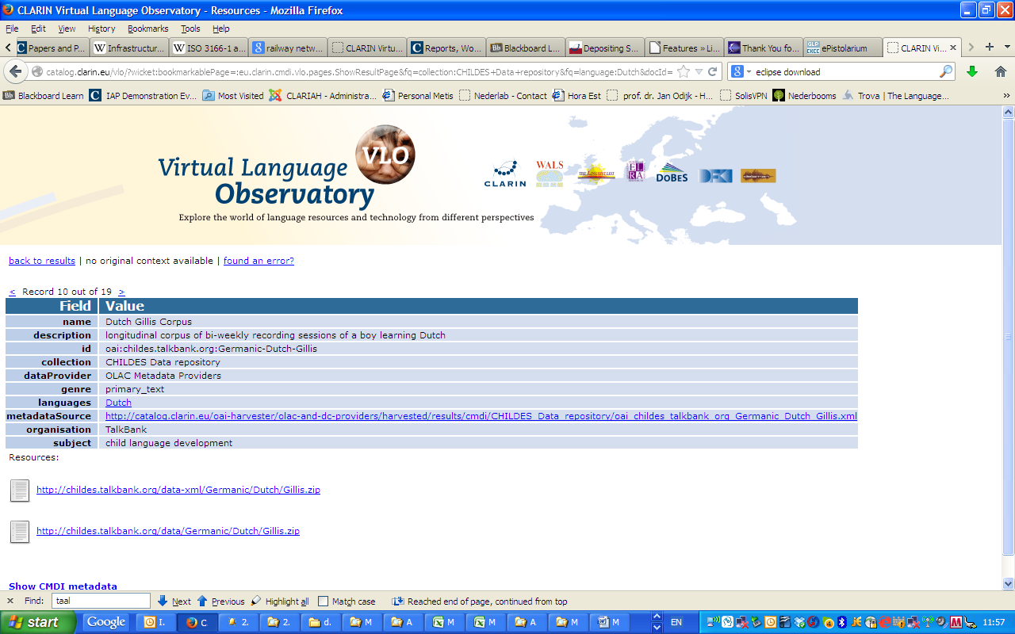
Improvement Suggestions

Slide 63
VLO
RETURN Page

Slide 64
OpenSonar
Start Page

Slide 65
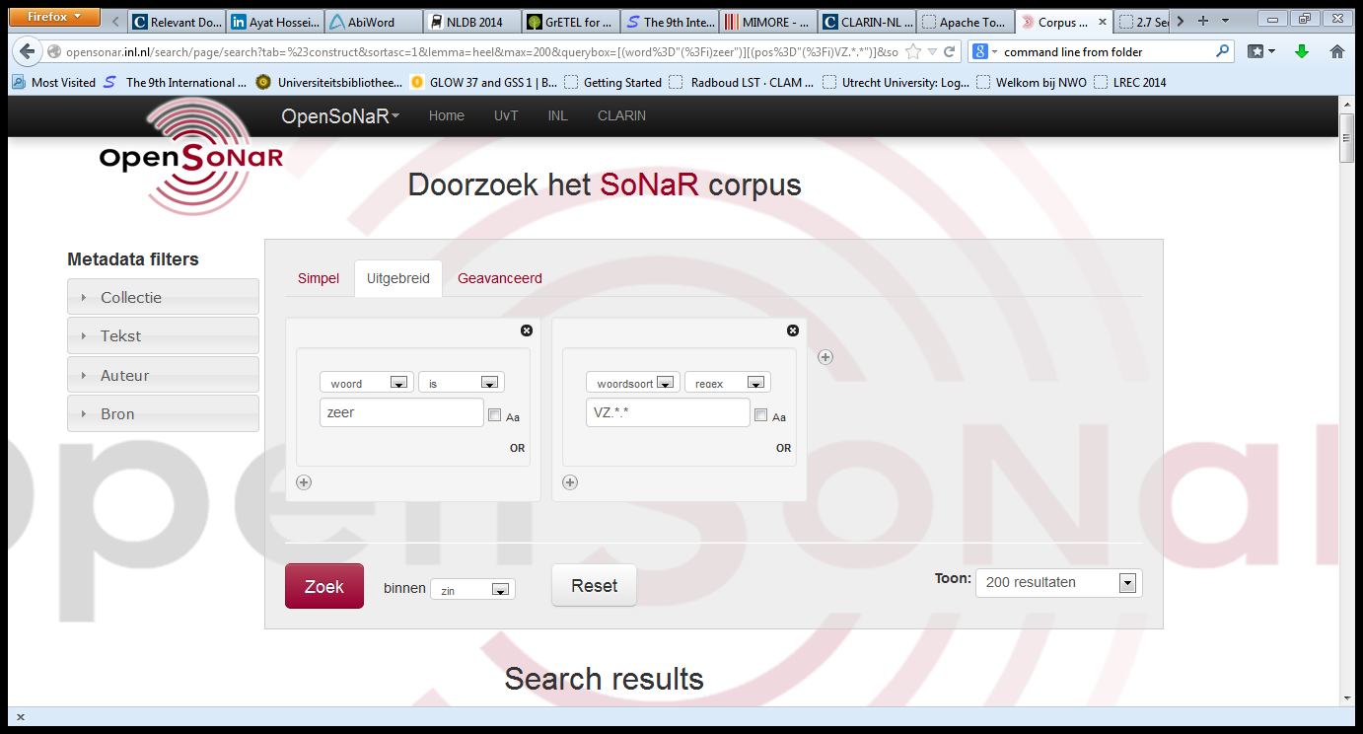
OpenSonar
Start Page

Slide 66
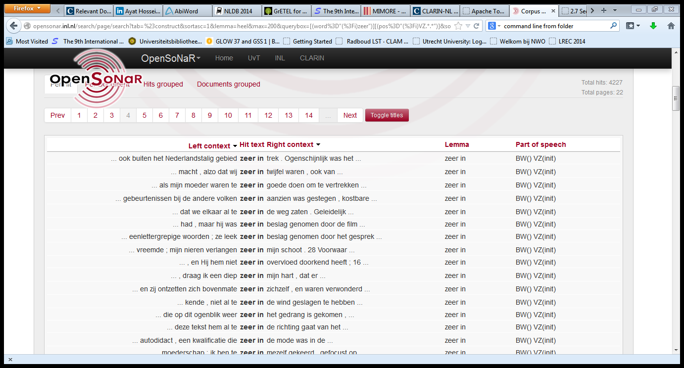
OpenSonar
Start Page

Slide 67
OpenSonar
Start Page

Slide 68
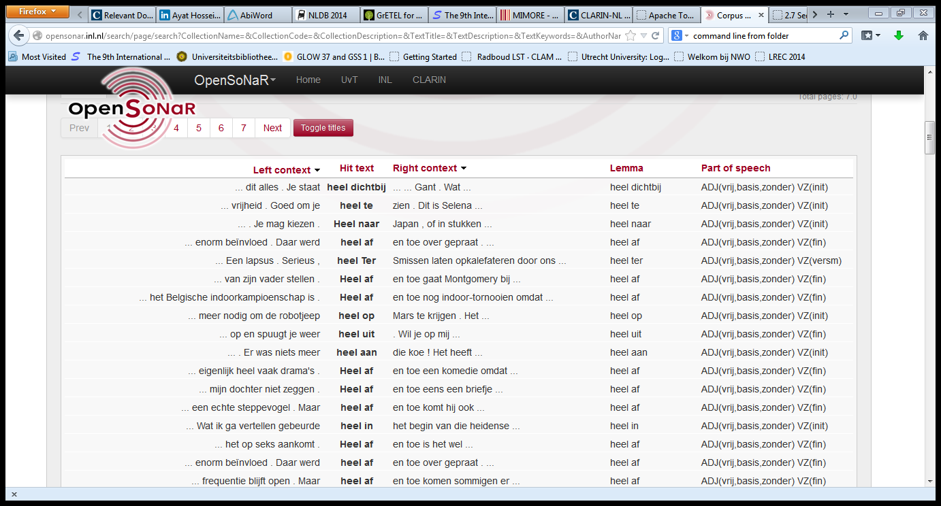
OpenSonar
Start Page

Slide 69
OpenSonar
Start Page

Slide 70
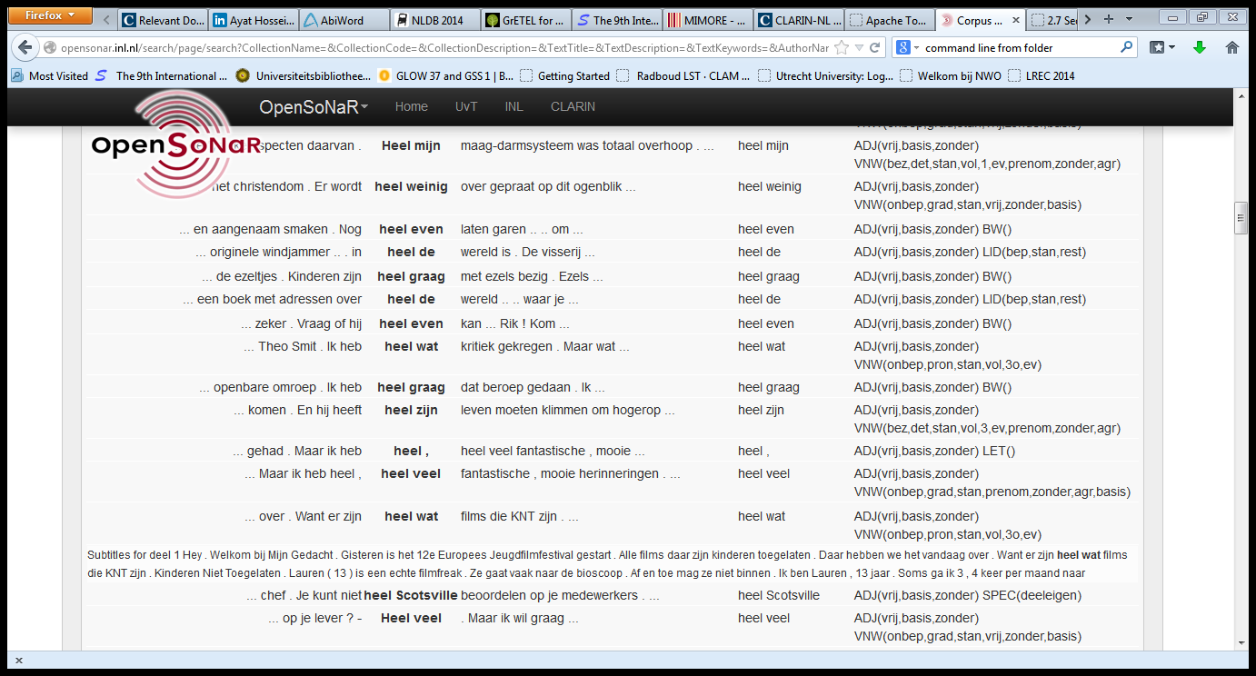
OpenSonar
Start Page

Slide 71
OpenSonar
Return Page

Slide 72
LASSY Simple Interface
Start Page

Slide 73
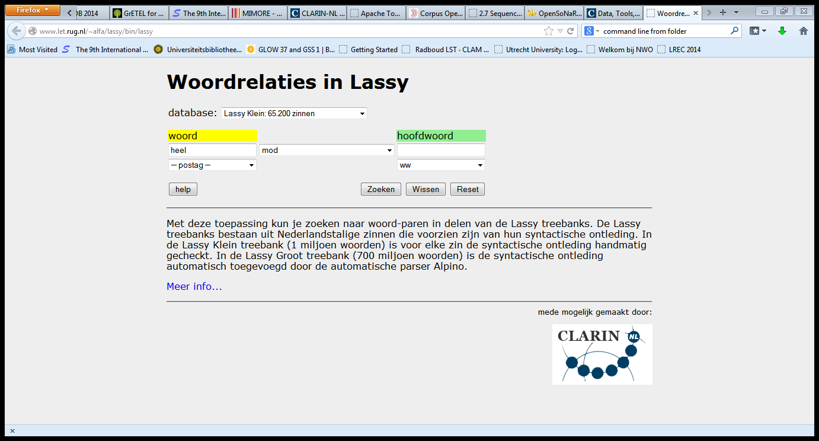
LASSY Simple Interface
Start Page

Slide 74
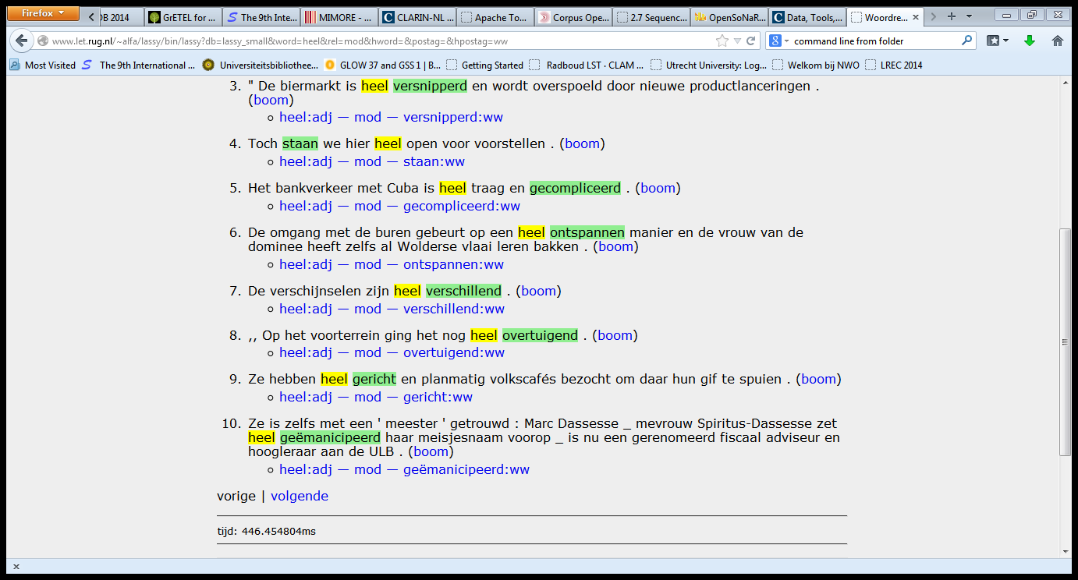
LASSY Simple Interface
Start Page

Slide 75
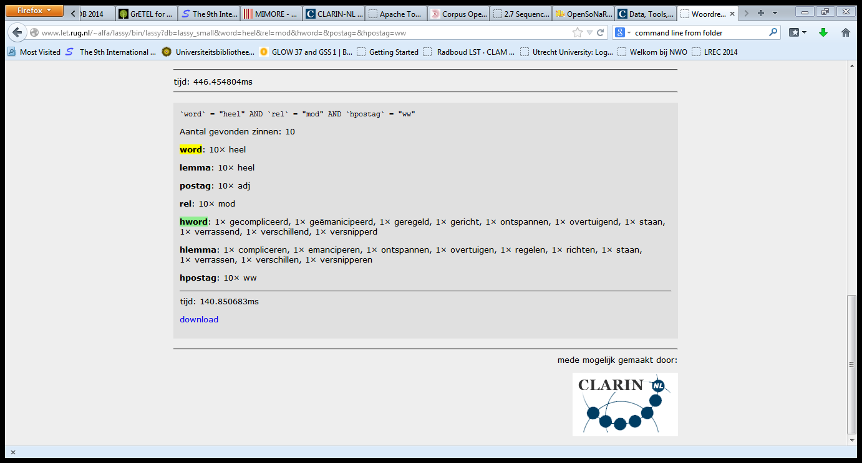
LASSY Simple Interface
Start Page

Slide 76
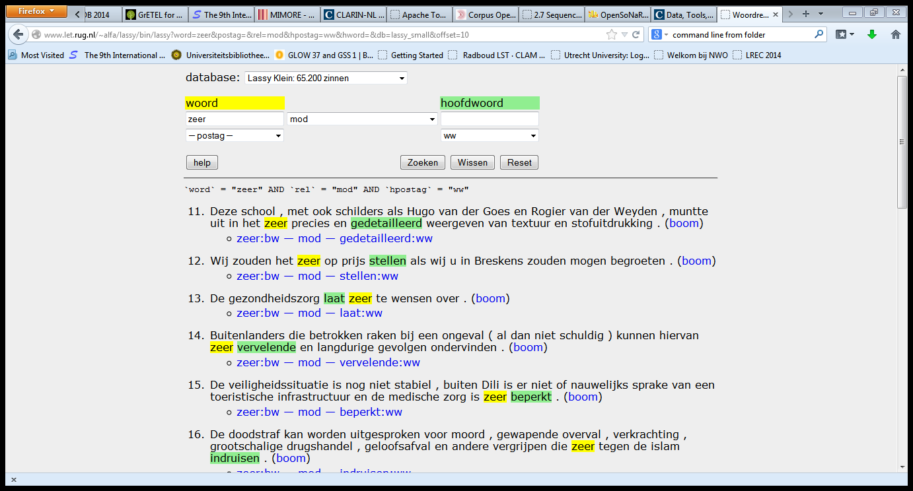
LASSY Simple Interface
Start Page

Slide 77
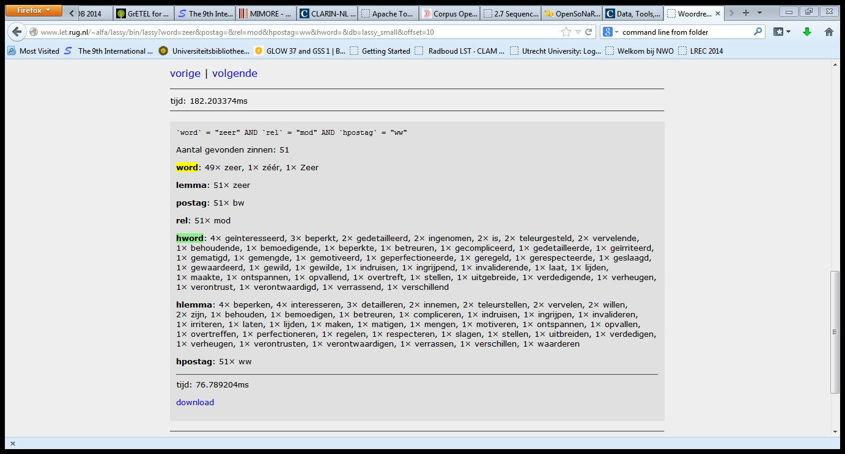
LASSY Simple Interface
Start Page

Slide 78
LASSY Simple Interface
Return Page

Slide 79
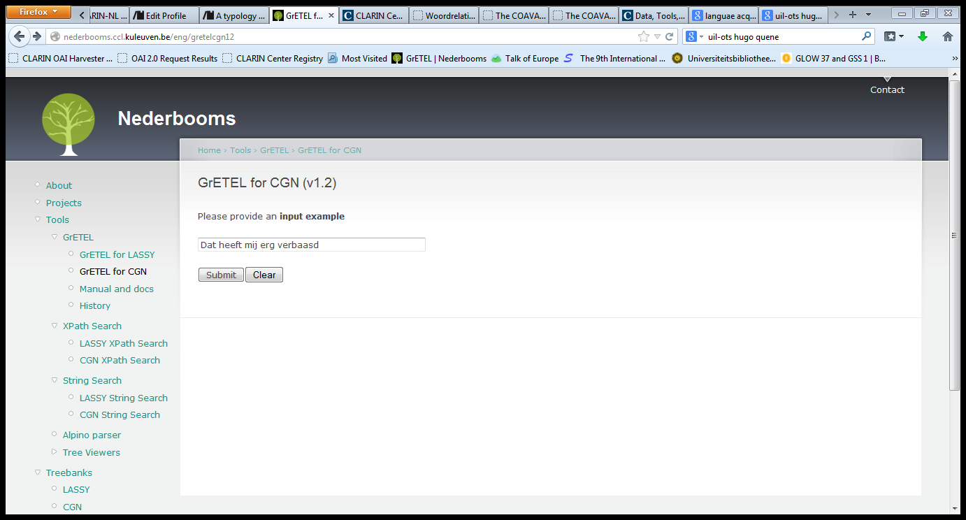
GrETEL CGN
Return Page

Slide 80
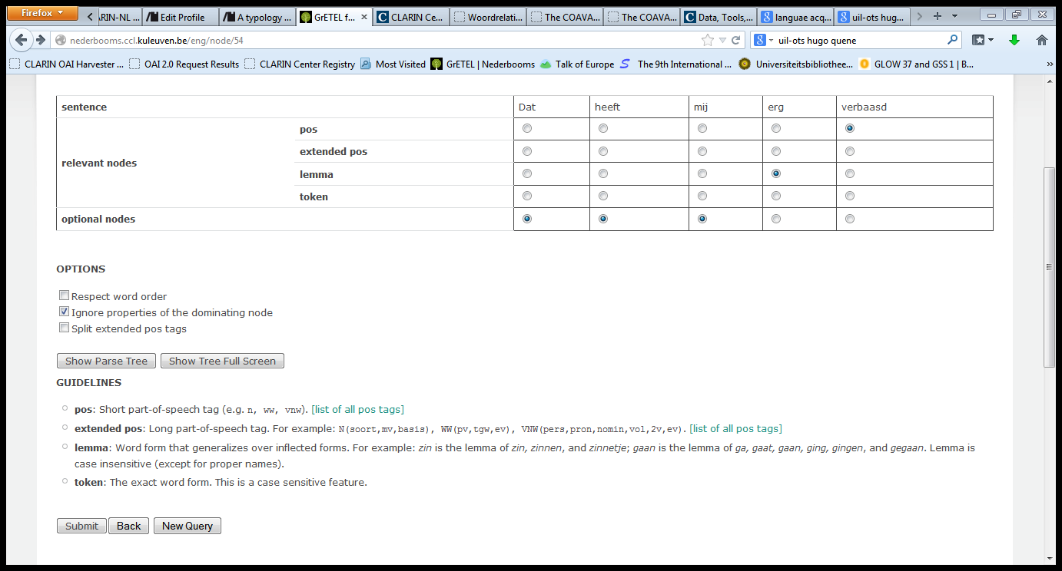
GrETEL CGN
Return Page

Slide 81
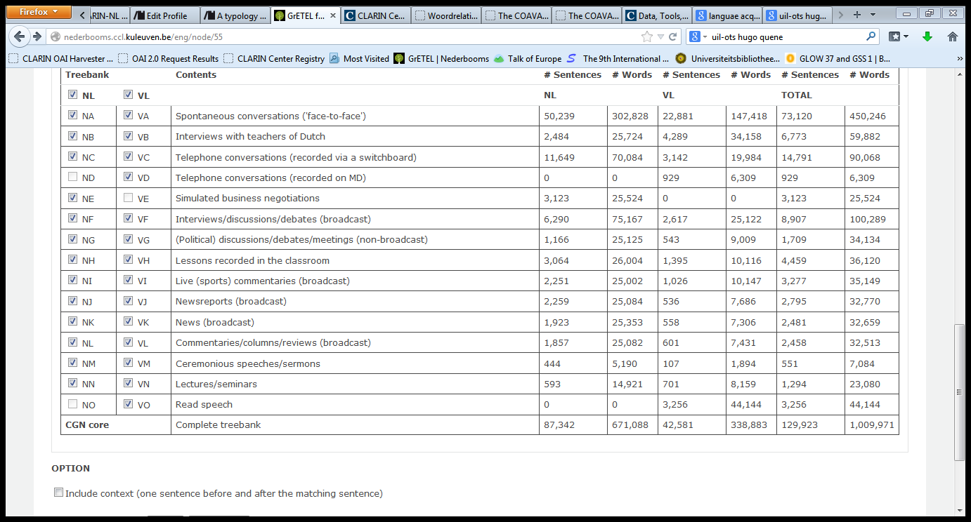
GrETEL CGN
Return Page

Slide 82
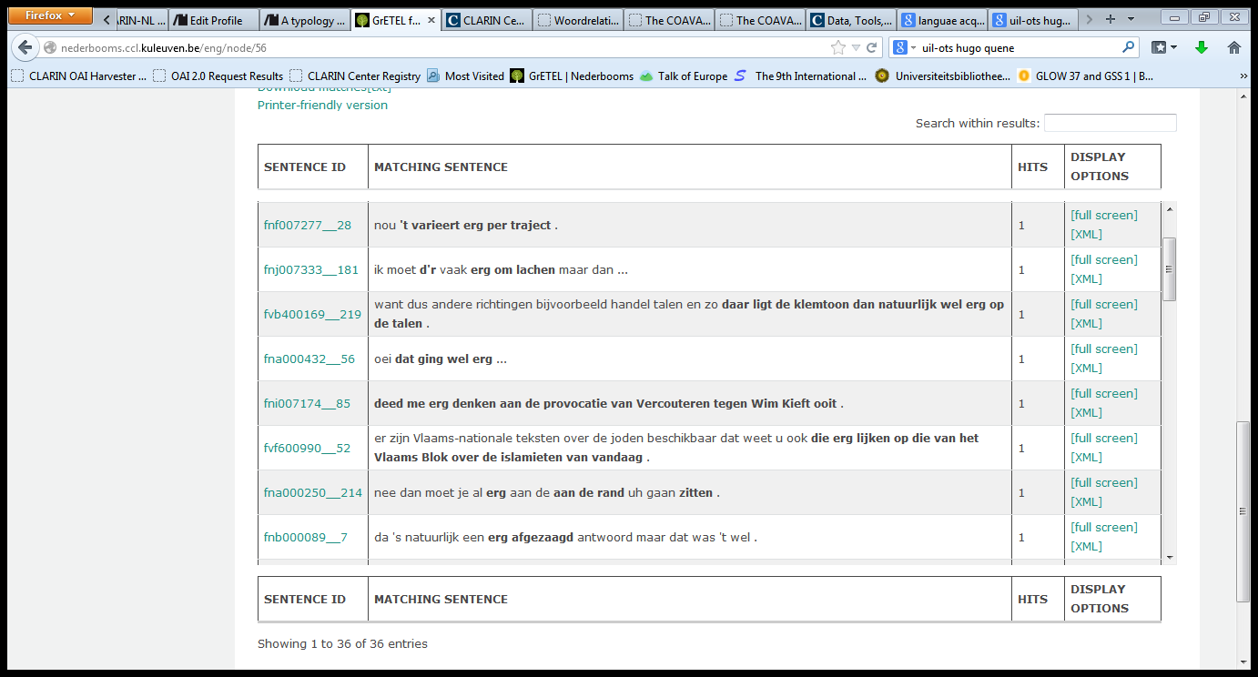
GrETEL CGN
Return Page

Slide 83
GrETEL CGN
Return Page

Slide 84
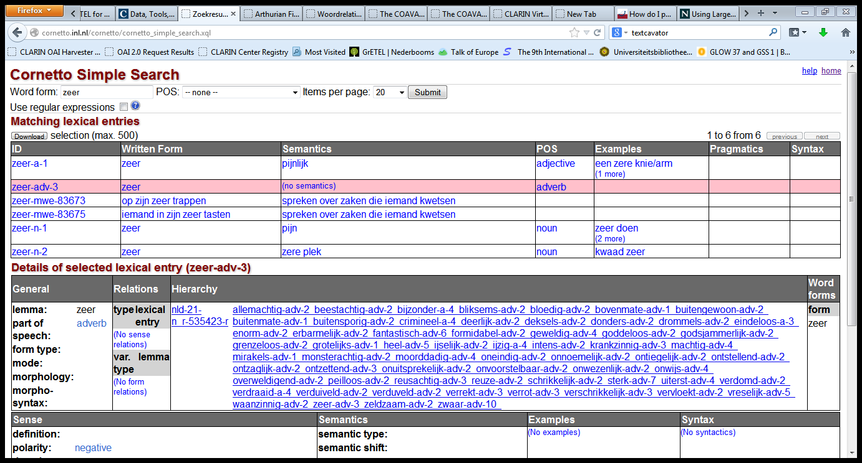
Cornetto
Return Page

Slide 85
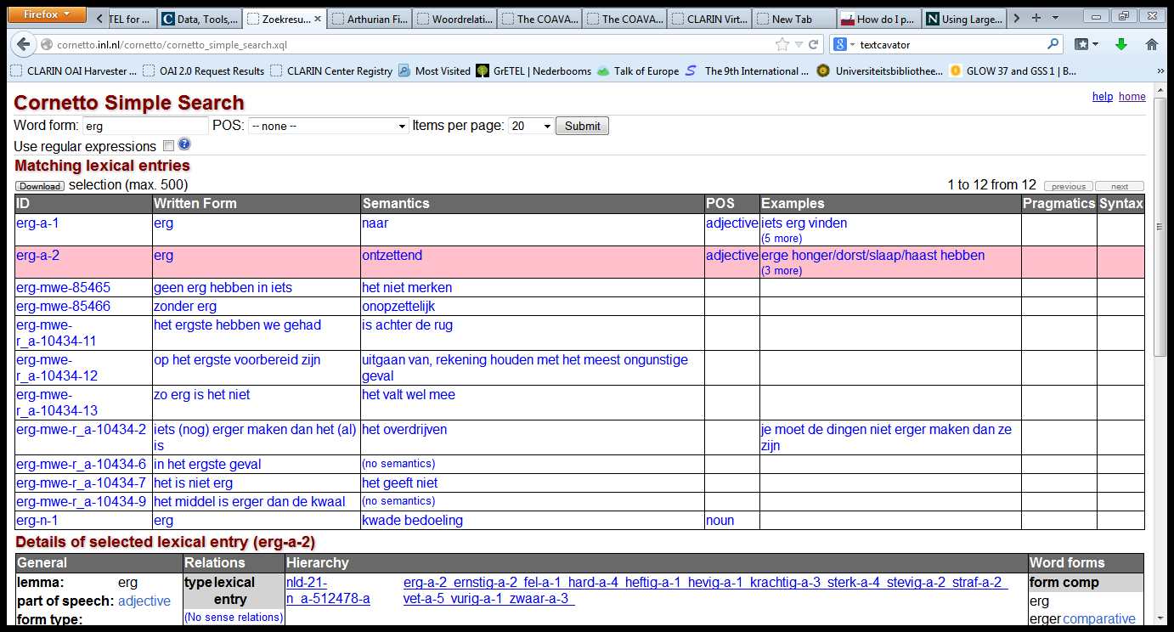
Cornetto
Return Page

Slide 86
Cornetto
Return Page

Slide 87
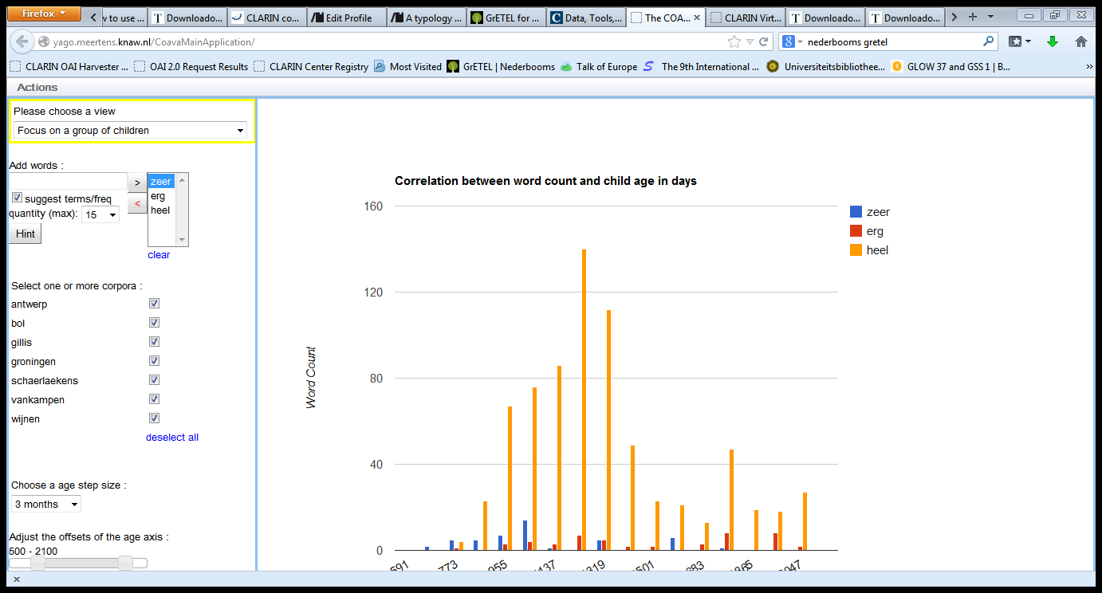
COAVA

Slide 88
COAVA
Return Page

Slide 89
GrETEL CGN
Return Page

Slide 90
Other Examples
PP/A
In zijn sas, in verwachting, tegen, voor, onder de indruk, uit de tijd
Tevreden met v. in zijn sas met
Zwanger v. in verwachting
Verward v. in de war
Modieus v. in de mode / in zwang
English: very v. very much
V:
Worden (AP, NP, *PP) v. raken (AP, *NP, PP)

Slide 91
Child-directed Speech
Heel, zeer, erg in children-addressed speech (Van Kampen only):
 | Mod A | Mod N | Mod V | Mod P | Pred | Other | Unclear
heel | 421 | 10 | 2 | 0 | 7 | 1 | 4
erg | 2 | 0 | 2 | 0 | 37 | 0 | 0
zeer | 33 | 2 | 0 | 0 | 54 | 0 | 2

