Slide 1
Comparative Linguistic research in CLARIN
Jan Odijk
Language Diversity Congress
Groningen, 2013-07-18

Slide 2
Overview
Linguistic Problem
21 years ago
11 years ago
1 year ago
CLARIN-NL & CLARIN
CLARIN Infrastructure
CLARIN & Comparative Linguistics
Conclusions
Recommendation
Invitation

Slide 3
Linguistic Problem
Inflection of attributively used adjectives
Influence of number, gender, case, definiteness (strong/weak inflection), animacy, other factors?
Exceptional agreement
Many languages have overt inflection on attributively used adjectives
In some definiteness plays a role: German, Scandinavian languages
many have special/unexpected agreement, e.g. Brasilian Portuguese [Menuzzi 1994], Russian (animacy), [Mel’chuk 1980]), …

Slide 4
Linguistic Problem
Dutch Adjectives: e-form and ø-form
Main Rule
Indef, neuter, sg: ø-form
In all other cases: e-form
Neuter:
Een klein(*e) meisje v. het klein*(e) meisje v. (de) klein*(e) meisjes
A little girl v. the little girl v. (the) little girls
Sg indef v. sg def v. pl (def/indef)
Uter
Een klein*(e) jongen v. de kleine*(e) jongen v. (de) kleine*(e) jongens
A little boy v. the little boy v. (the) little boys
Sg indef v. sg def v. pl (def/indef)

Slide 5
Linguistic Problem
Exceptions to the main rule such as
het bijvoeglijk(?e) naamwoord, (v. bijvoeglijk*(e) naamwoorden)
Lit. the adjectival nominal, ‘the adjective’
het medisch(*e) onderzoek (v. medisch*(e) onderzoeken)
`the medical research’
de medisch(*e) onderzoeker and de medisch(*e) onderzoekers
`the medical researcher’
Een goed(e) linguïst v. de goed*(e) linguïst(en)
‘a good linguist’ v. ‘the good linguist(s)’
The exceptions are not (all) arbitrary, there are further subregularities: I want to find out what these are.

Slide 6
Linguistic Problem
For example, for one type of exception, apparently involving `phrasal names’ [Booij 2010] [Odijk 2012]
Some phrases do not allow the e-form (in sg):
Het bijvoeglijk naamwoord ‘the adjectival nominal’, het centraal station ‘the central station’, het schriftelijk examen ‘the written exam’, het medisch dossier ‘the medical file’, het openbaar ministerie ‘the Prosecuting Counsel’, het Burgerlijk Wetboek ‘the civil code’, het academisch ziekenhuis ‘the academic hospital’, etc. etc.

Slide 7
Linguistic Problem
Others require the e-form
het Rode Leger ‘the Red Army’, het Gele Kruis ‘the Yellow Cross’, het aardse slijk ‘the eartly filth (filthy lucre)’, het rechte pad ‘the straight path’, het laatste avondmaal ‘the Last Supper’, het bittere einde ‘the bitter end’, (met) het blote oog ‘(with) the naked eye’, het boze oog ‘the evil eye’, het Heilige Land ‘the Holy Land’, het alternatieve circuit ‘the alternative circuit’, het zwarte schaap ‘the black sheep’, het laatste woord ‘the last word’, het hoogste woord ‘the highest word’, het zilte nat ‘the salty liquid’ (the briny), etc. etc.
Is there some systematicity behind this?

Slide 8
Linguistic Problem
What is needed?
Good theories /exciting hypotheses (has to come from you)
Large amounts of empirical data
to test the hypothesis
and may suggest new hypotheses
even useful for theoretical linguists working on their native language

Slide 9
21 years ago
A (theoretical)/comparative linguist could study these phenomena only by using
grammar books,
linguistic articles
more or less accidental encounters of occurrences in texts
(corpus linguistics did exist but was a different discipline and invisible to theoretical linguists)
[Odijk 1992]

Slide 10
11 years ago
Spoken Dutch Corpus (CGN)
corpus exploration tool COREX
it became possible to systematically search for relevant occurrences in a reasonably sized corpus (10M tokens).
[Oostdijk et al. 2002]
http://lands.let.ru.nl/cgn/home.htm

Slide 11
11 years ago
Search in CGN-corpus
Give me subsequences of utterances of the form:
A wordtoken with PoS='definite_determiner', immediately followed by
A wordtoken with PoS=adjective with vorm=zonder-e, immediately followed by
A wordtoken with Pos=noun
examples are 'het bijvoeglijk naamwoord', 'de gulden snede', 'het ingewikkelder probleem')

Slide 12
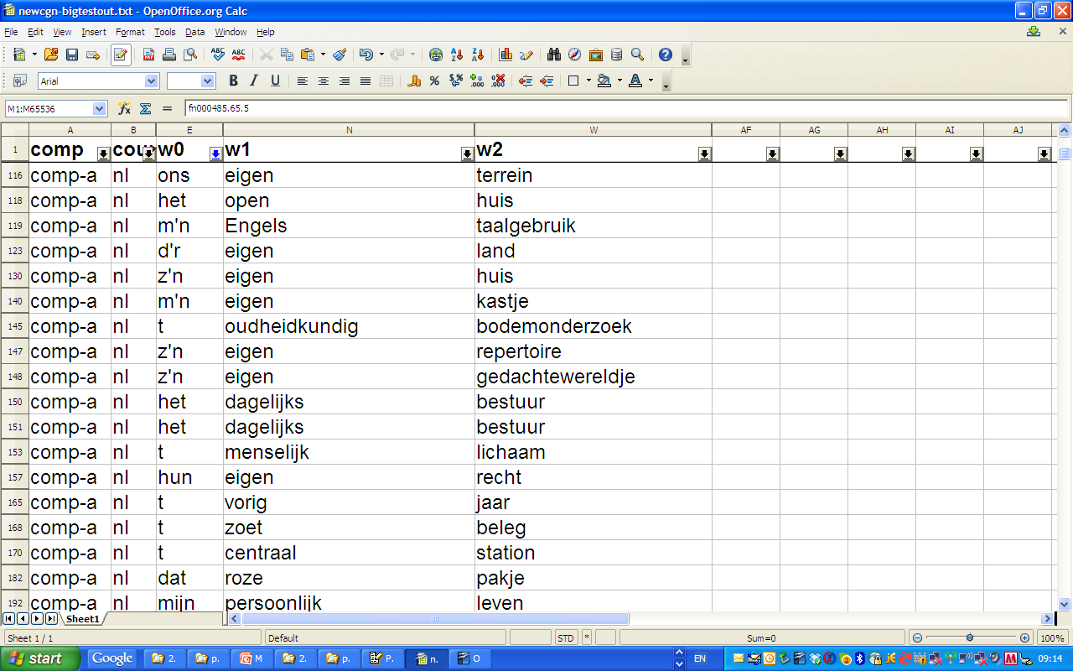
Search in Corpora

Slide 13
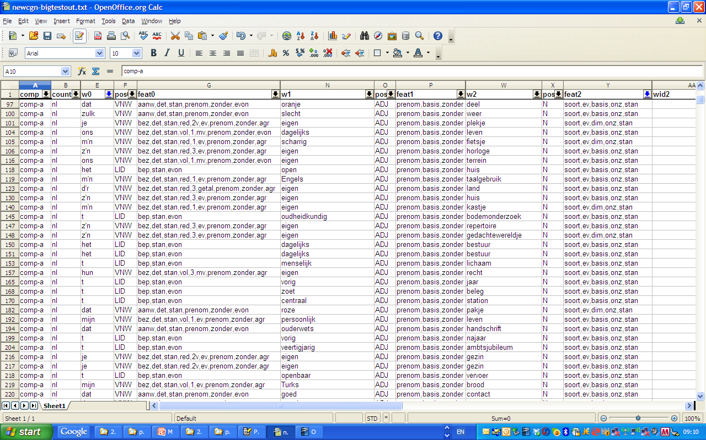
Search in Corpora

Slide 14
1 year ago
LASSY-Small treebank
1 M tokens
Manually verified syntactic structures
LASSY-Large treebank
700 M tokens
Automatically generated syntactic structures
DACT
Tool for viewing and analyzing Alpino corpora (incl. LASSY)
SONAR written corpus
>500M tokens
➔ very large and richly annotated corpora are available

Slide 15
1 YEAR AGO
These data do require some care
They are performance data
The annotations presuppose specific linguistic assumptions and assumptions on the grammar of Dutch
Are assigned by tools (e.g. a parser) that in some cases have to filter calculations because of limited computational resources (‘computers are slow’)
But with this care, they can be very useful!

Slide 16
1 year ago
However,
DACT
may have an ‘easy to use interface’
Writing queries is (too) difficult
No exploration tool for SONAR

Slide 17
CLARIN-NL
CLARIN-NL
National project in the Netherlands
2009-2015
Budget: 9.01 m euro
Funding by NWO (National Roadmap Large Scale Infrastructures)
Coordinated by Utrecht University
>33 partners (universities, royal academy institutes, independent institutes, libraries, etc.)

Slide 18
CLARIN-NL
Dutch National contribution to the Europe-wide CLARIN infrastructure
Prepared by CLARIN preparatory project (2008-2011)
Also coordinated by Utrecht University
From Feb 2012 coordinated by the CLARIN-ERIC, hosted by the Netherlands
ERIC: a legal entity at the European level specifically for research infrastructures

Slide 19
CLARIN Infrastructure
A technical research infrastructure in which a humanities researcher who works with language-related resources
Can find all data relevant for the research
Can find all tools and services relevant for the research
Can apply the tools and services to the data without any technical background or ad-hoc adaptations
Can store data resulting from the research
Can store tools resulting from the research
via one portal

Slide 20
CLARIN Infrastructure
Can find all data and tools relevant for the research
Via the Virtual Language Observatory
Faceted browsing and geographical navigation
SnapShot
Or via CLARIN Metadata Search Demo
Can apply the tools and services to the data without any technical background or ad-hoc adaptations
http://yago.meertens.knaw.nl/apache/TTNWW/
Parsing Example
Pos-Tagging Example

Slide 21
CLARIN Infrastructure
Can apply the tools and services …(cont.)
Erik Tjong Kim Sang’s very simple interface to LASSY-Small
Query for heads and their dependents
Indeed simple, and useful but limited. Demo
CLARIN-NL project OpenSONAR
Online Personal Exploration and Navigation of SoNaR
Sep 1, 2013 – Sep 1, 2014

Slide 22
CLARIN Infrastructure
Can apply the tools and services …(cont.)
CLARIN-VL GreTel Interface
LASSY-Small
Spoken Dutch Corpus (CGN)
Example-based querying
Demo
GreTel is being extended/improved
Join the User Group! gretel@ccl.kuleuven.be

Slide 23
CLARIN INFRASTRUCTURE
Can store data resulting from the research
Will come in another presentation
Can store tools resulting from the research
Will come in another presentation
via one portal
Is being constructed

Slide 24
CLARIN and Comparative Linguistics
Czech: Prague Dependency Treebank, Czech Academic Corpus
German: Tübingen Diachronic Treebank, Tiger Treebank
Bulgarian: BulTreeBank
Parallel treebanks: Sophie’s World for Danish, Dutch, English, Estonian, Finnish, German, Icelandic, Norwegian, Swedish.
Croatian: Croatian Dependency Treebank
French: Corpus arborée du français
Spanish (Castilian): CESS-ECE-CAST
Catalan: CESS-ECE-CAT
Basque: CESS-ECE-EUS
Hungarian: Szeged Treebank 2.0

Slide 25
CLARIN and Comparative Linguistics
Typological databases are integrated into CLARIN
Typological Database System (TDS) and its (old) interface and its new interface (soon to come)
World Atlas of Language Structures database (see next slide)

Slide 26
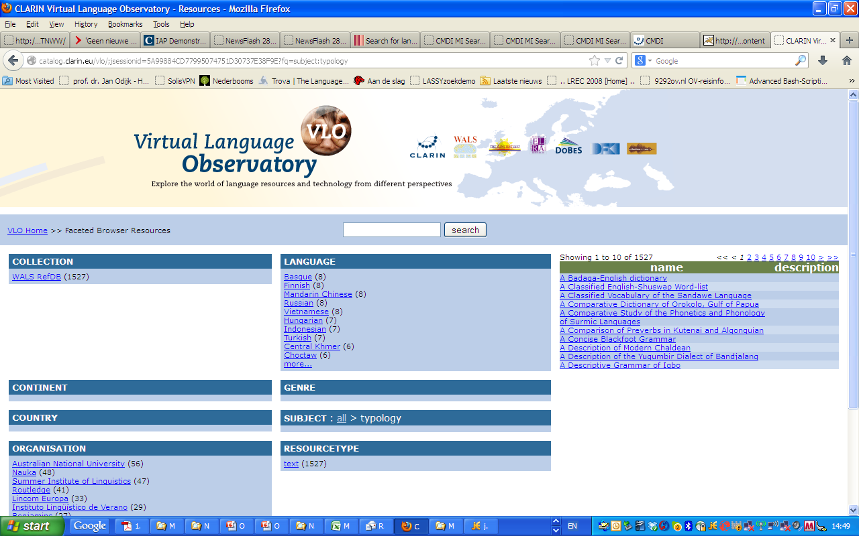
CLARIN and Comparative Linguistics
Typological databases are integrated into CLARIN
Typological Database System (TDS)
WALS database

Slide 27
CLARIN and Comparative Linguistics
Microcomparative search
MIMORE
Search in three different but related microcomparative databases for Dutch dialects
Edisyn Search Interface
Search in microcomparative databases for multiple languages
See presentation Sjef Barbiers tomorrow.

Slide 28
Conclusions
CLARIN is starting to provide facilities and services to carry out linguistics, including comparative linguistics, with a more solid empirical basis than was possible before
With easy interfaces and easy search options (no technical background needed)
Still some training is required, to understand both the possibilities and the limitations of these methods
But there is still a lot to do
Not all data (even some crucial data) are visible via the VLO or via Metadata Search
Very few tools and web services are currently visible via the VLO
Single Sign On is growing but not implemented everywhere yet

Slide 29
Conclusions
There are good search facilities for some individual resources but not for all
The search facilities so far are aimed at a single resource, or a small group of closely related resources. But we have to go further to federated content search, which enables one to search with one query in multiple, quite diverse, resources
E.g. GreTel currently works separately for CGN and for LASSY-Small (so, two queries and two search actions needed)
I want to search with one action through CGN, SONAR and VU-DNC
Work on federated content search in CLARIN is on-going but it has turned out to be a very difficult problem requiring optimal formal and semantic interoperability and development of a new query language. We probably have to step back and do it more incrementally, per resource type

Slide 30
Conclusions
Actual use of the search facilities leads to suggestions for improvements, e.g.
Selection of inflection (extended PoS) in GreTel was originally not possible (and is still not possible) for LASSY-Small but has been added for search in CGN
In the Dutch CGN/SONAR (de facto standard ) PoS tagging system one cannot easily express ‘definite determiner’ (only as a complex regular expression over PoS tags): a special facility for this is required
The Dutch CGN/SONAR (de facto standard ) Pos tagging system uses, for adjectives, the ø-form tag for cases where the distinction between e-form and ø-form is neutralized. This is not incorrect but a facility to distinguish the two would be very desirable (and this is possible by making use of the CGN lexicon and/or the CELEX lexicon
Idem for adjectives that have an e-form identical to a ø-form because of phonological reasons (adjectives ending in two syllables headed by schwa)
Zero-inflection in MIMORE is represented by absence of an inflection tag. That makes search for such examples very difficult and requires either a NOT-operator (which is not there) or explicit tagging of absence of inflection
And to suggestions for new functionality

Slide 31
recommendation
Use (elements from) the CLARIN infrastructure
(questions? Problems? CLARIN-NL Helpdesk!)
Join user groups of specific services
Provide feedback so that we can further improve CLARIN
So that you can improve your research

Slide 32
Invitation
Send me your grammar problem (morphology, syntax)
Specify the type of data you would need
We will help with making queries
We will organize a workshop to discuss these cases (autumn 2013), learn from each other, and improve CLARIN

Slide 33
Thanks for your attention!

Slide 34
References
[Booij 2010] G. Booij. Construction Morphology, Oxford: Oxford University Press.
[Mel’chuk 1980] I. Mel’chuk. Animacy in Russian cardinal numerals and adjectives as an inflectional category. Language 56.4, pp. 797-811.
[Menuzzi 1994] S. Menuzzi. Adjectival Positions inside DP, in R. Bok-Bennema & C. Cremers, Linguistics in the Netherlands 1994, pp 127-138
[Odijk 1992] J. Odijk. Uninflected Adjectives in Dutch. In R. Bok-Bennema & R. van Hout, Linguistics in the Netherlands 1992, pp.197-208. Amsterdam: Benjamins
[Odijk 2012] J. Odijk. De structuur van Phrasal Names. Nederlandse Taalkunde, 17(2), 292-298.
[Oostdijk et al 2002] N. Oostdijk et al. (2002). Experiences from the Spoken Dutch Corpus Project. In Proceedings of LREC 2002 pp 340-347, Paris:ELRA. [pdf]

Slide 35
DO NOT ENTER HERE

Slide 36
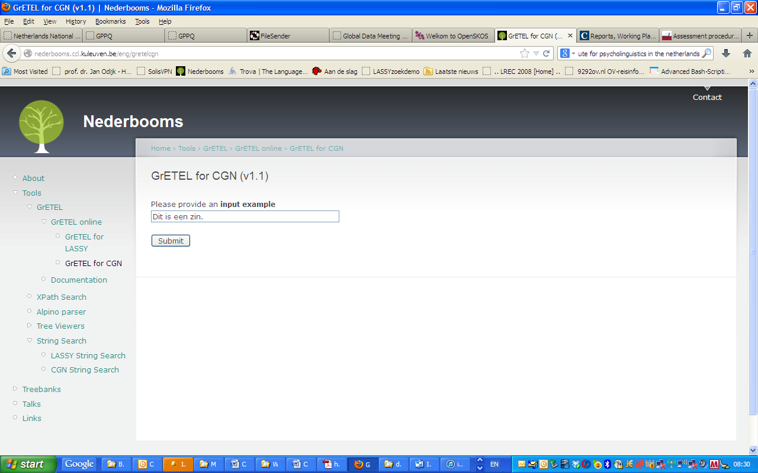
DO NOT ENTER HERE

Slide 37
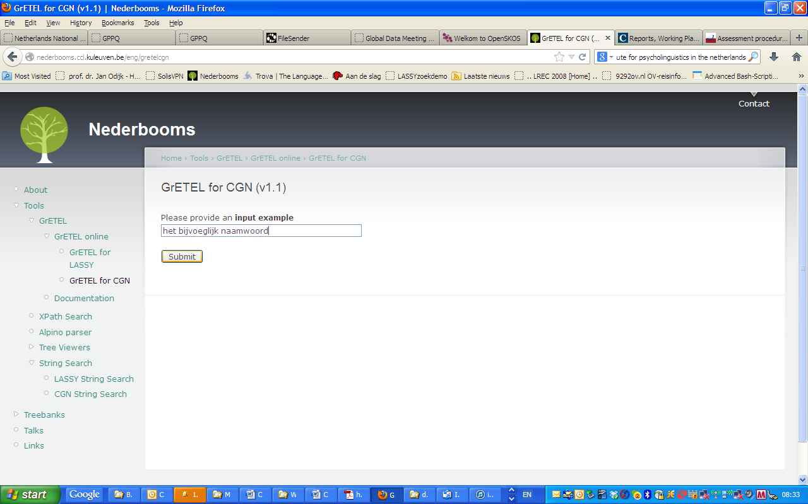

Slide 38
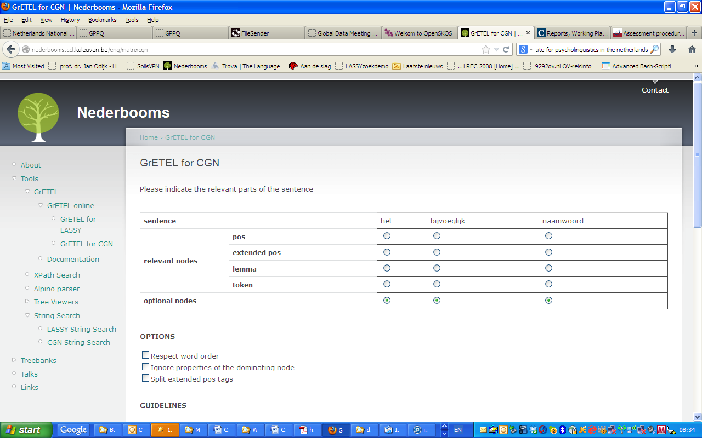

Slide 40
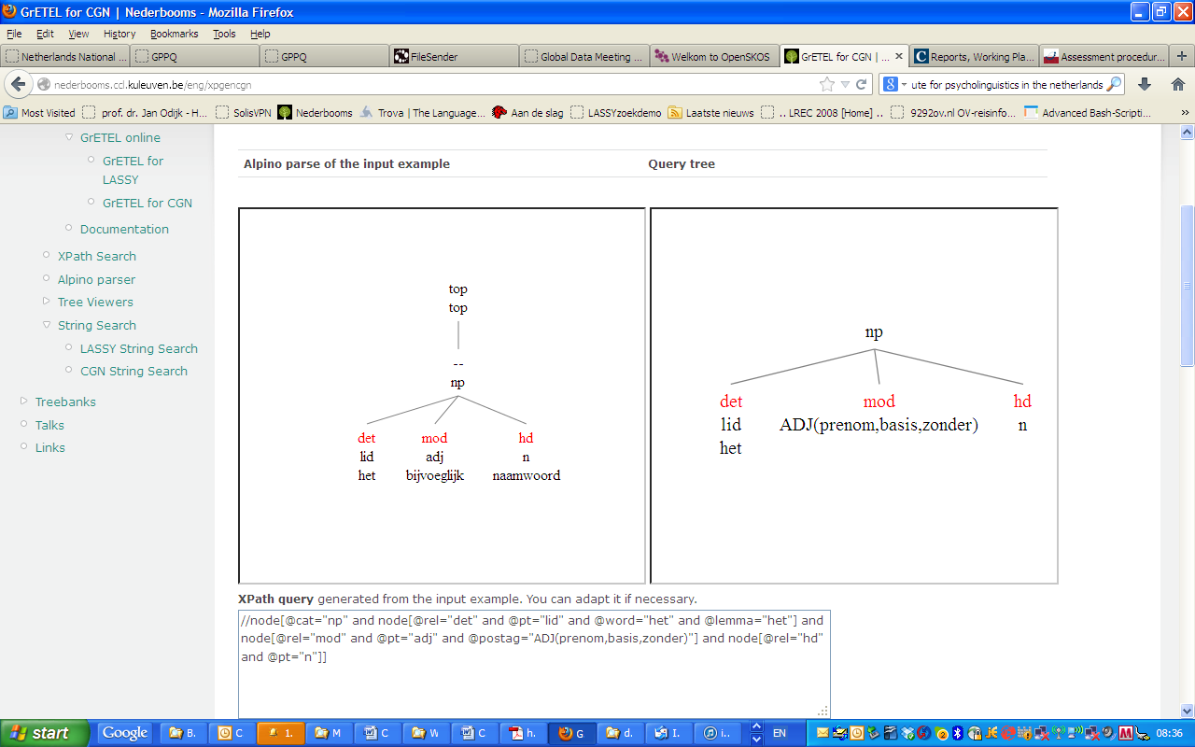

Slide 41
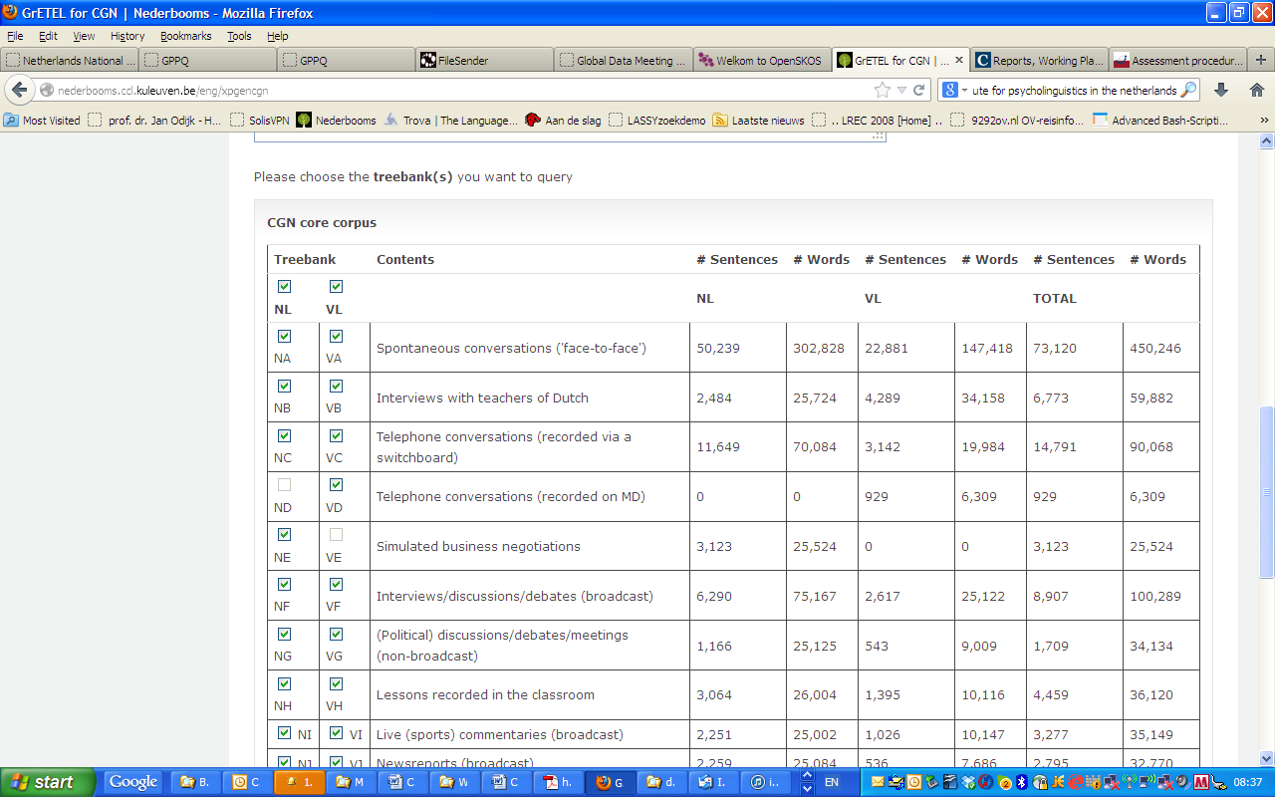

Slide 42
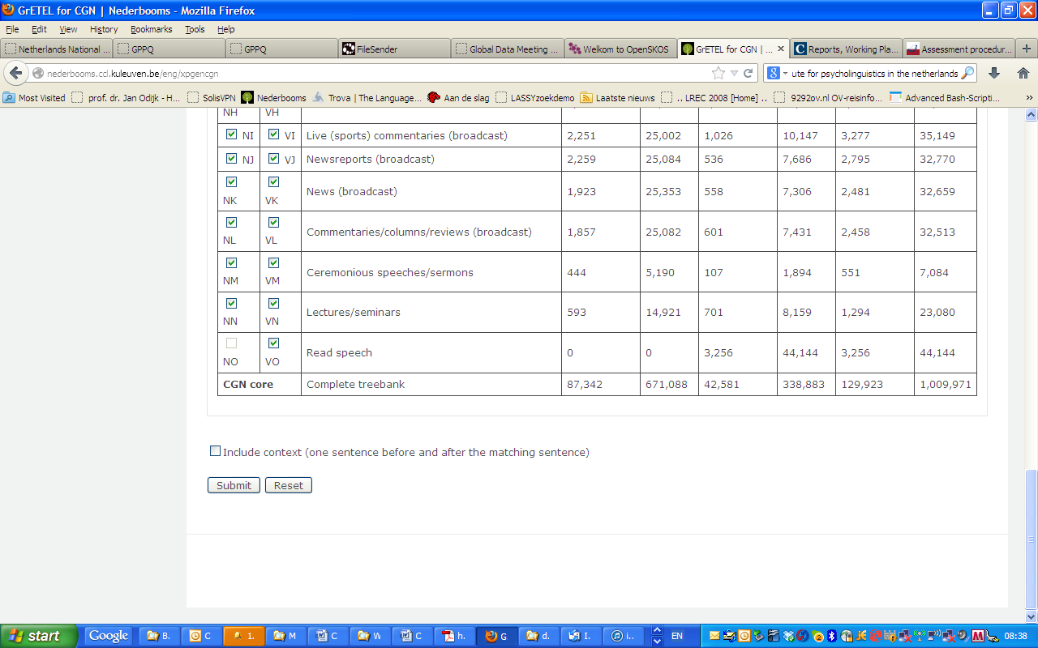

Slide 43
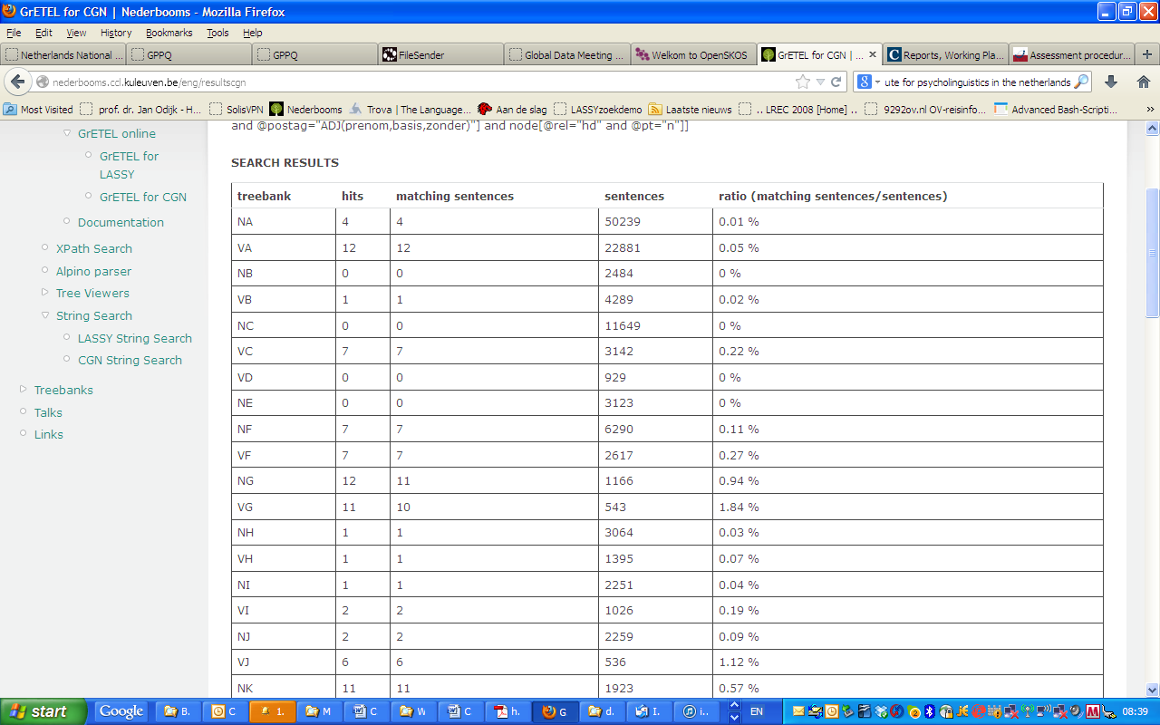

Slide 44
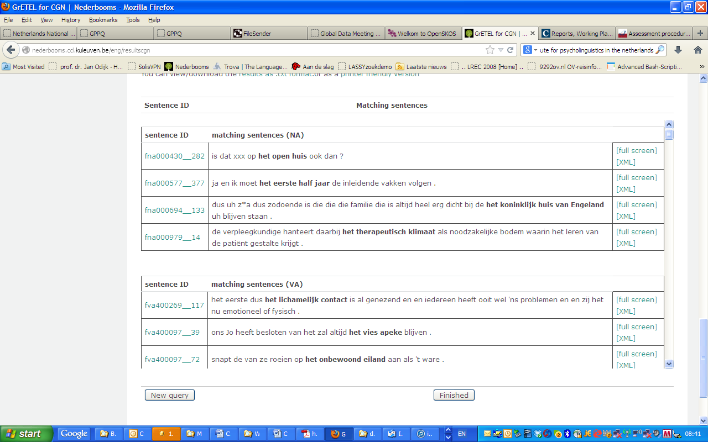

Slide 45
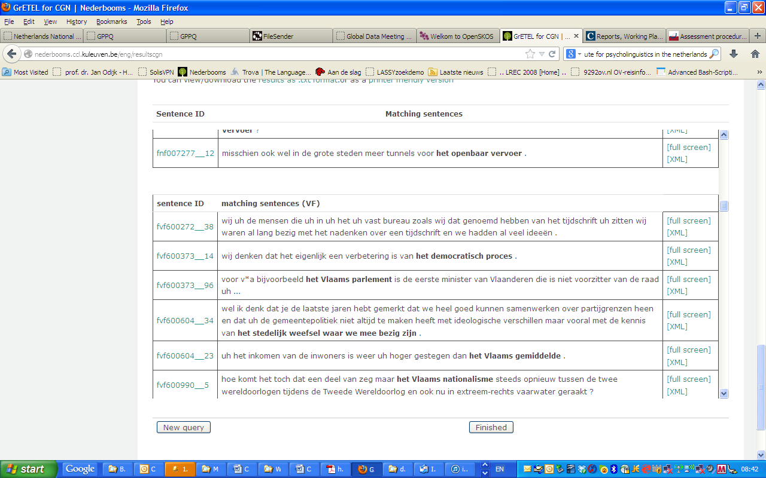

Slide 47
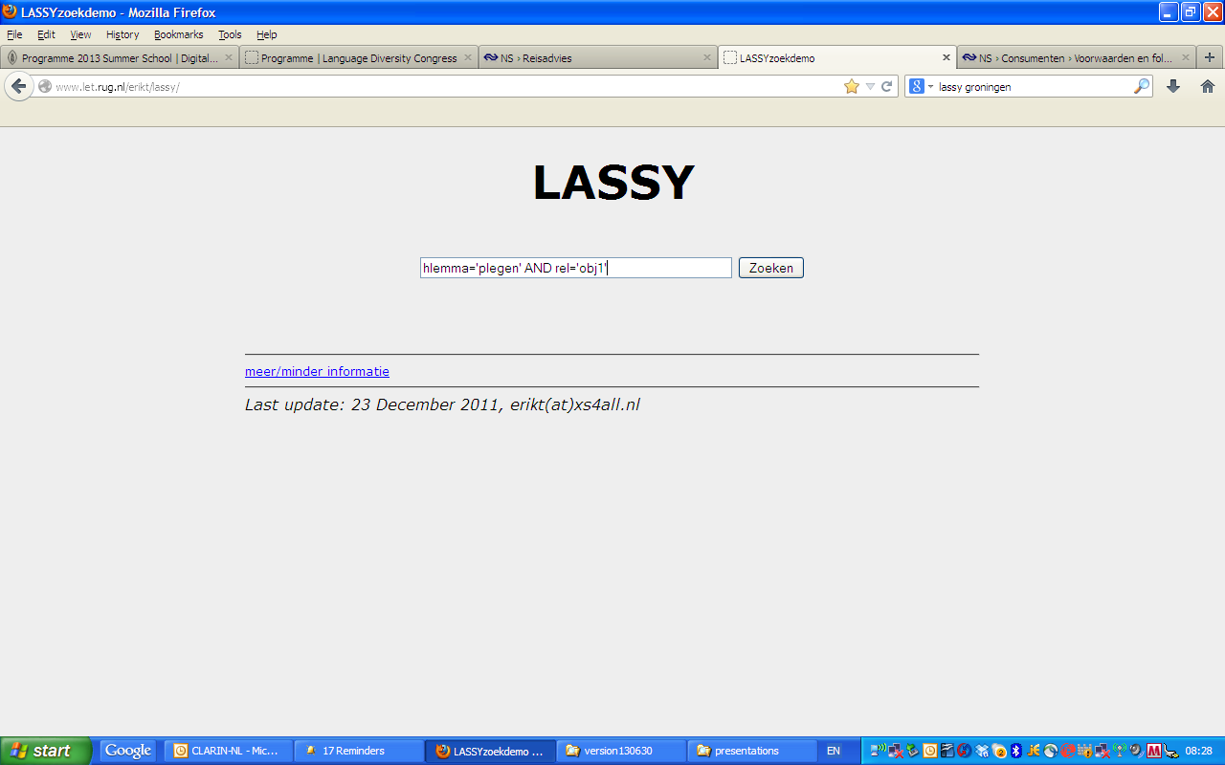

Slide 48
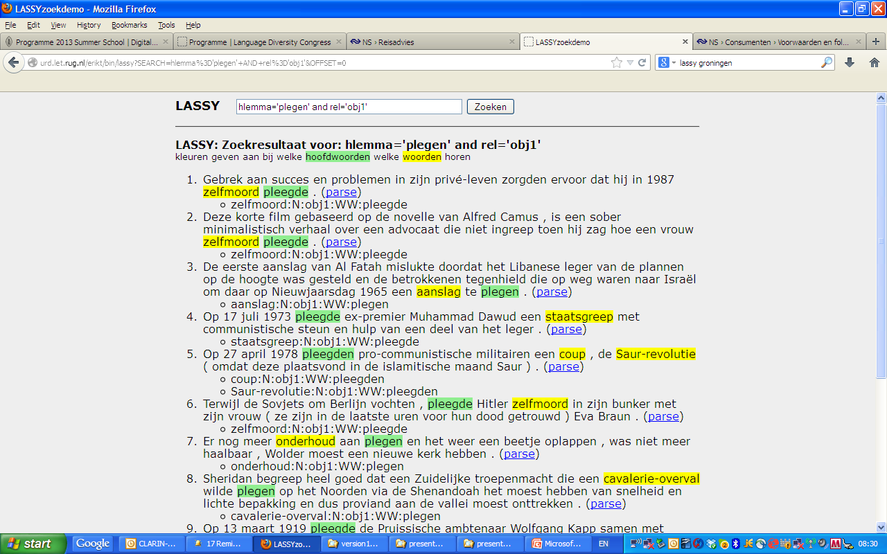

Slide 49
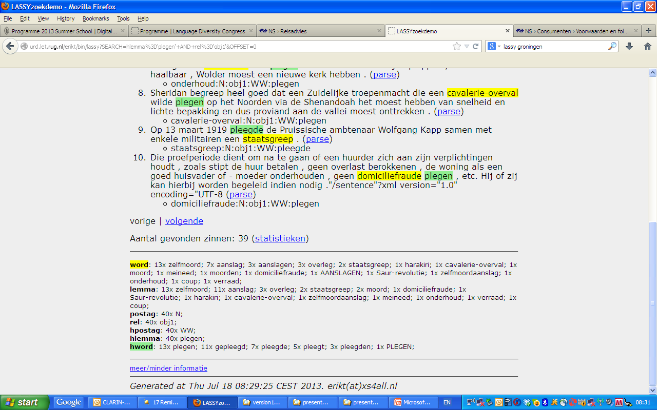

Slide 50
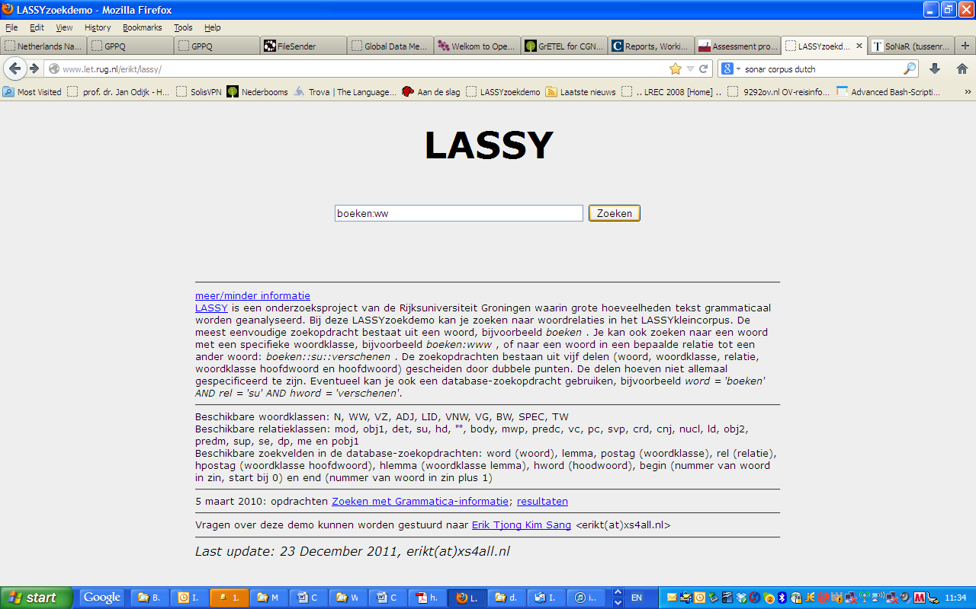

Slide 51
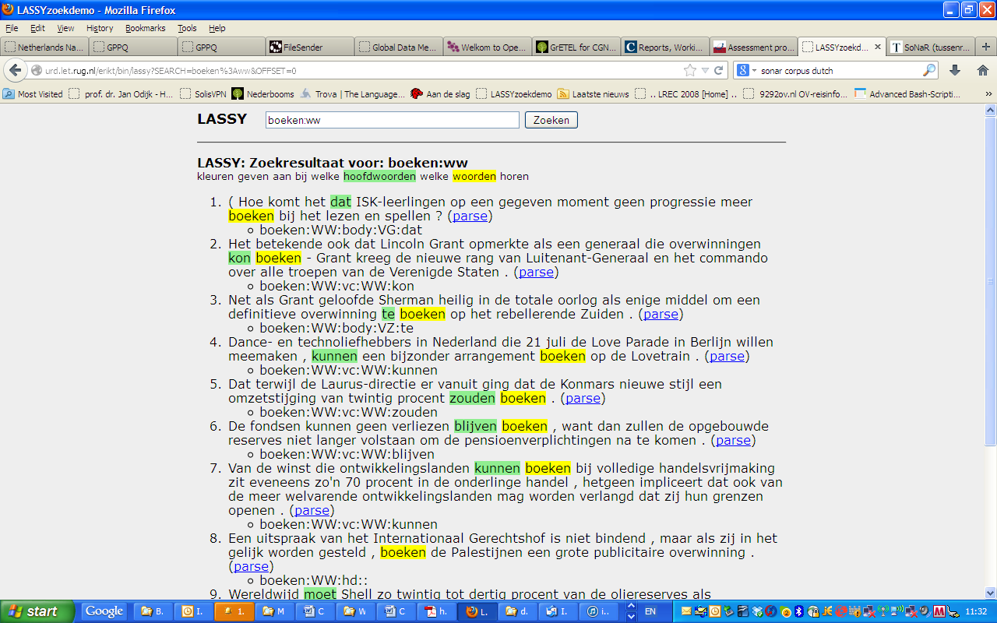

Slide 52
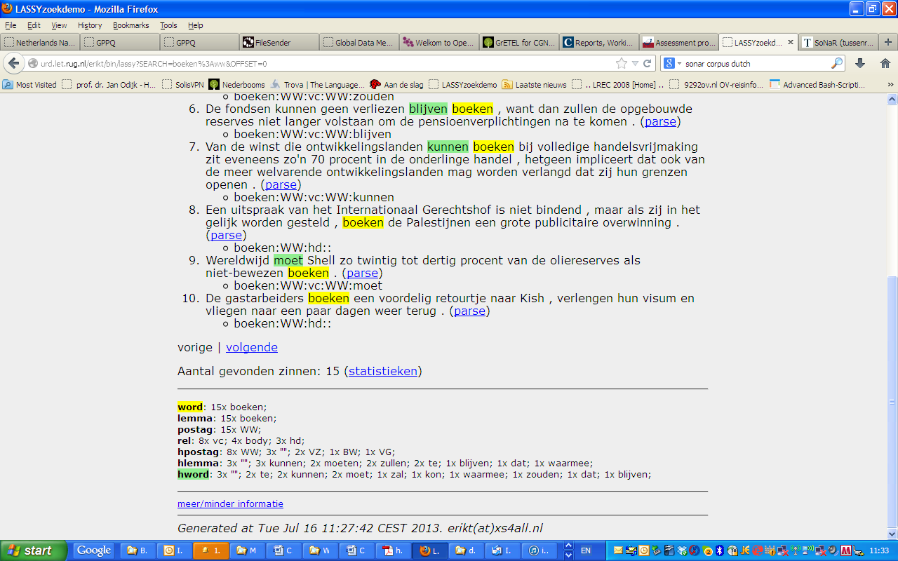

Slide 54
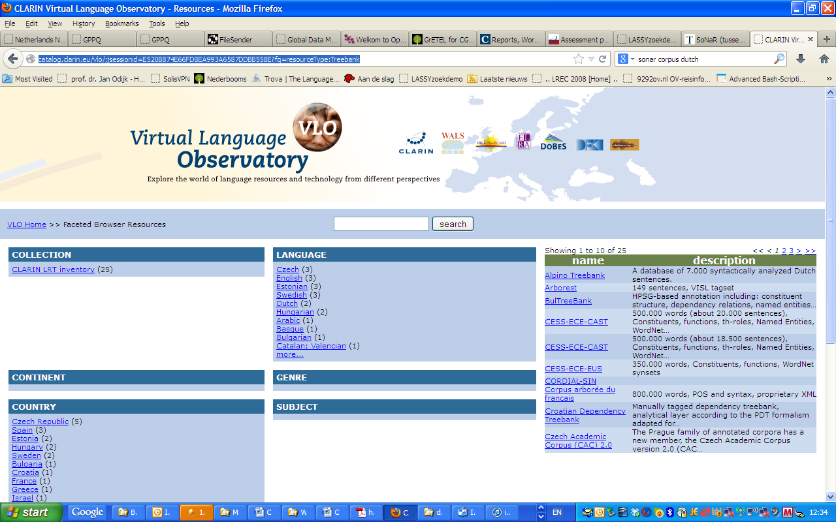
VLO Snapshot

Slide 56
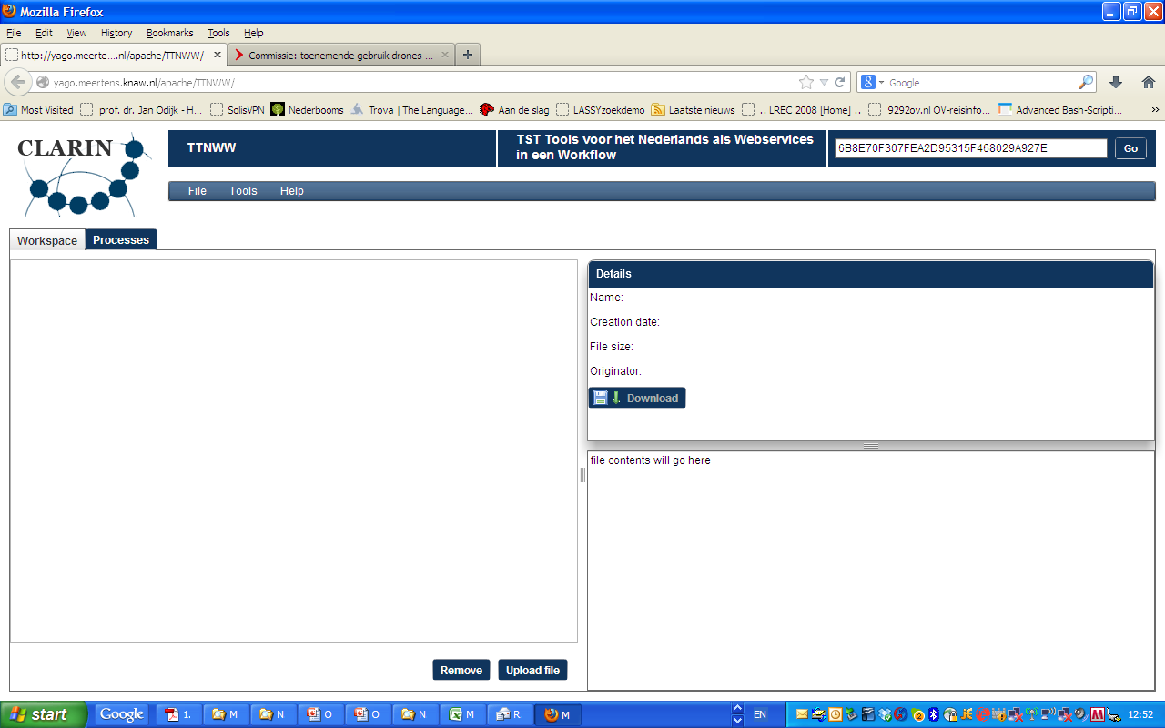
TTNWW - Parsing

Slide 57
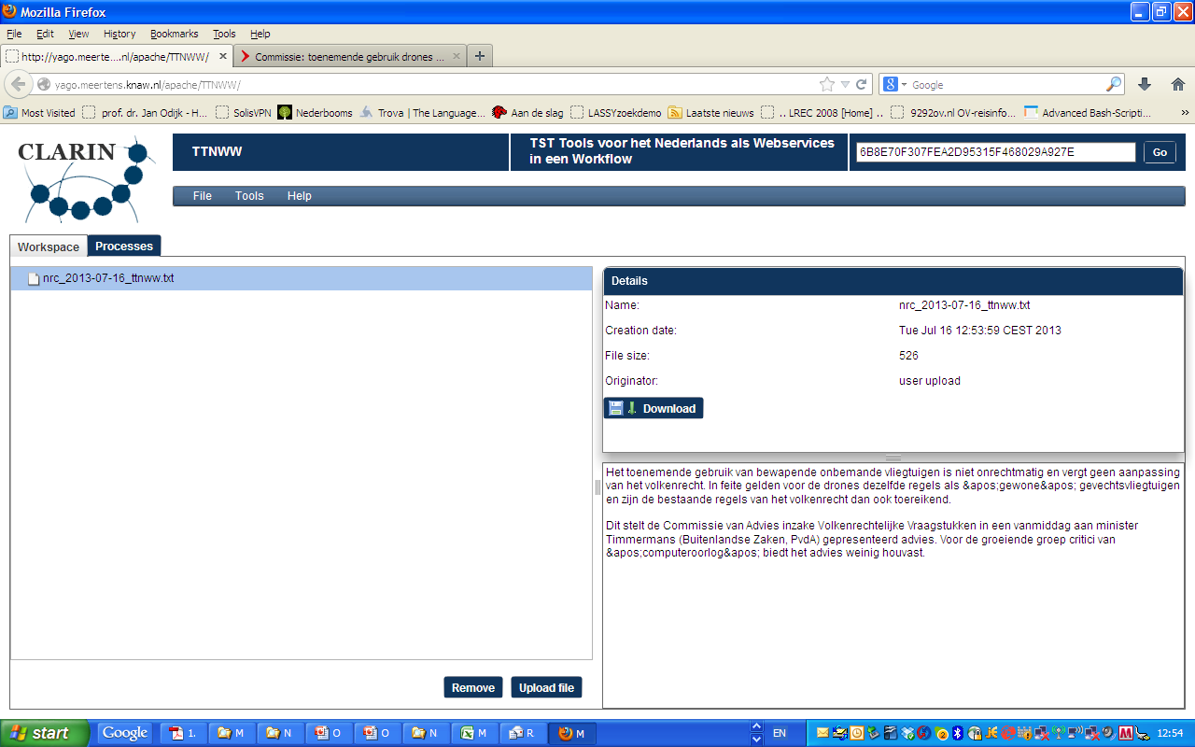

Slide 58
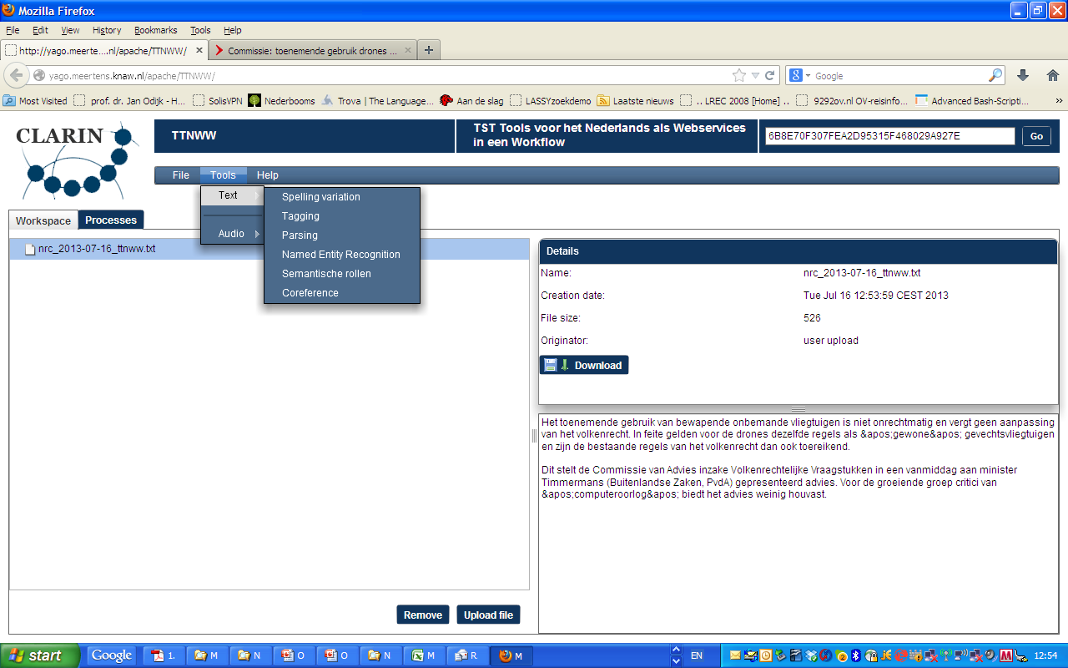

Slide 59
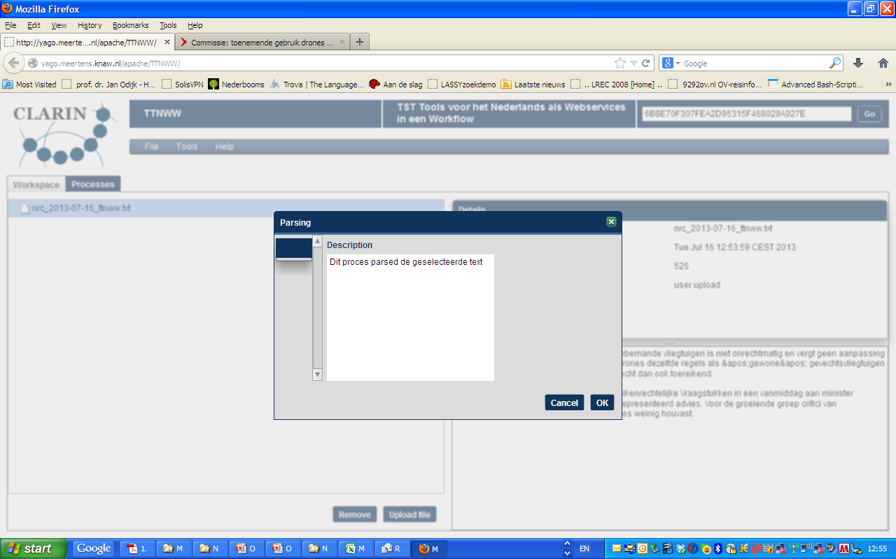

Slide 60
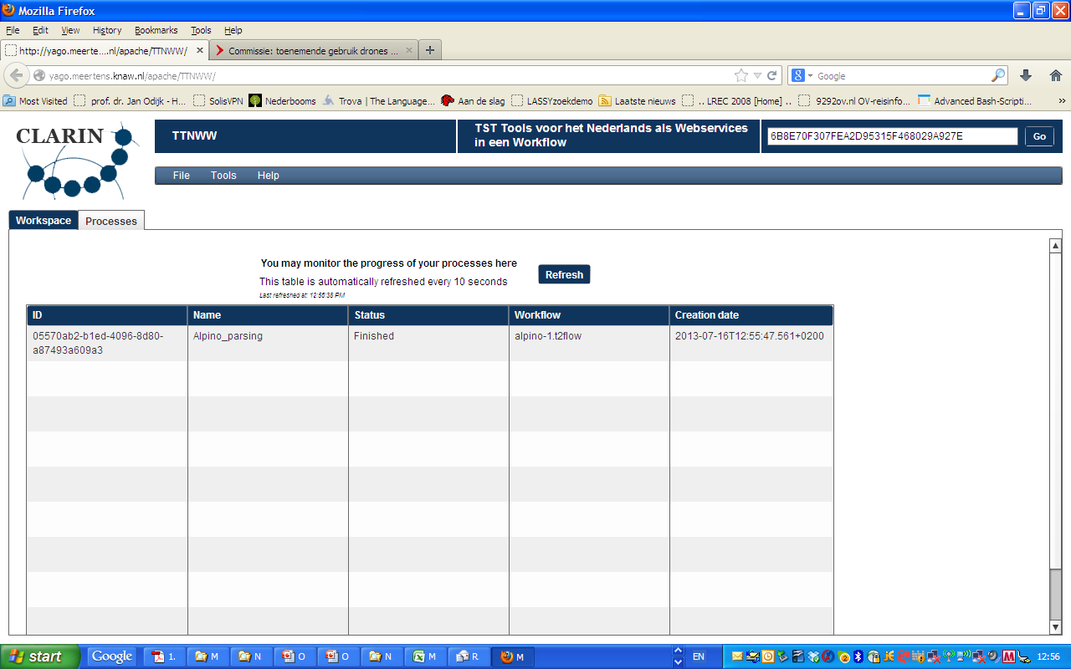

Slide 61
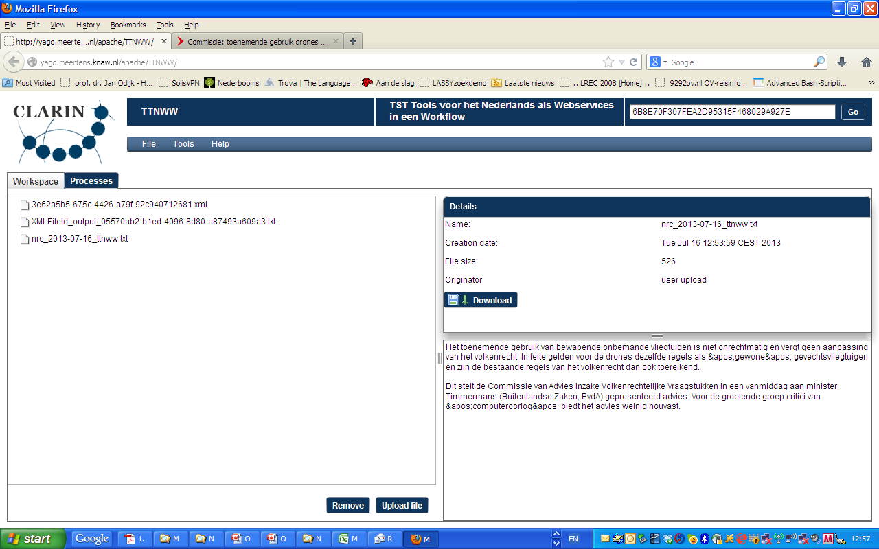

Slide 62
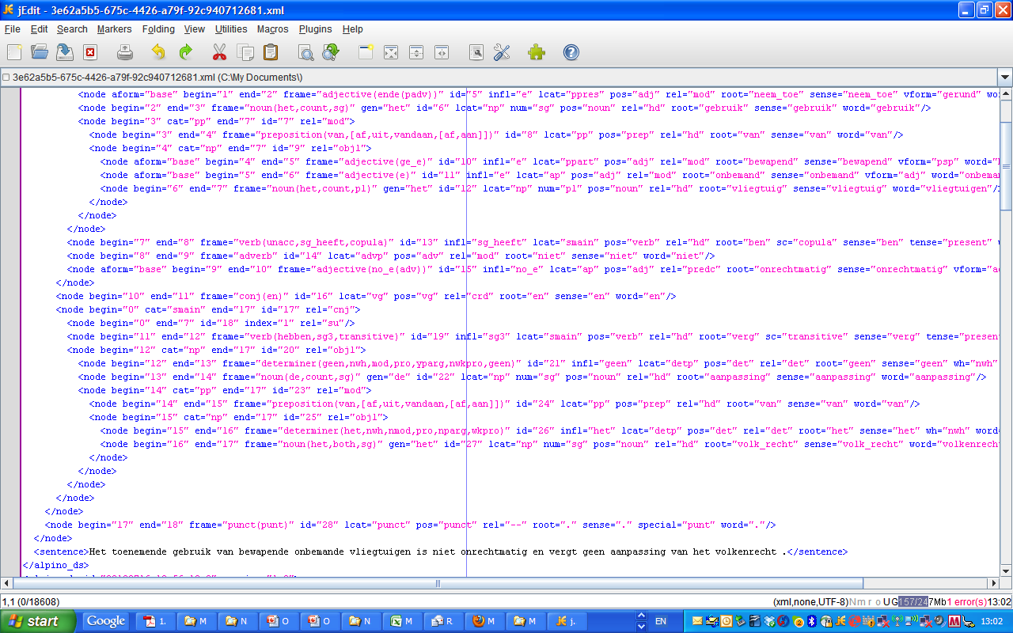

Slide 64
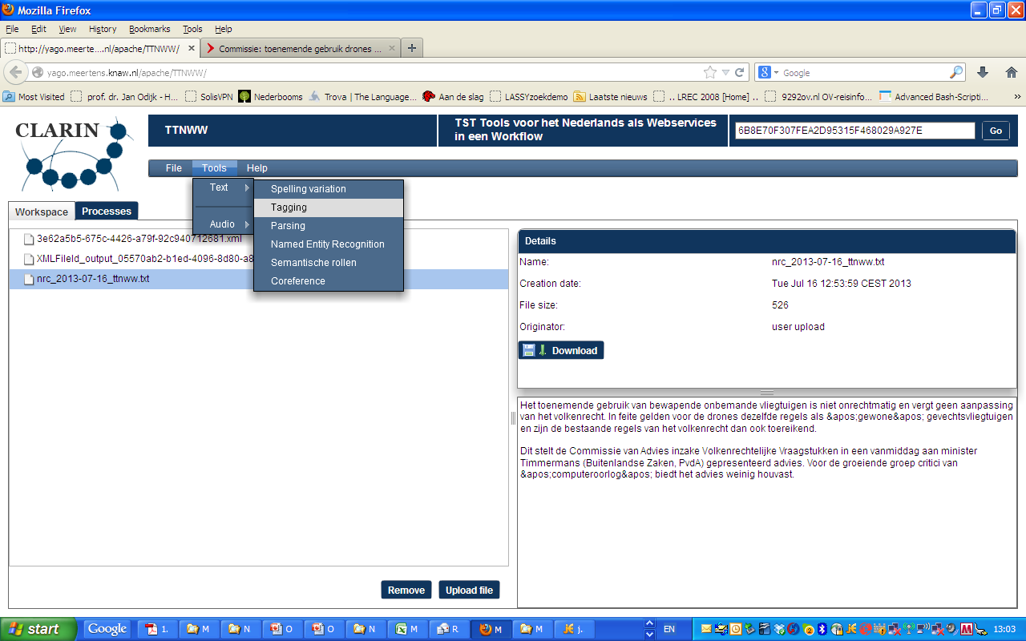
TTNWW Tagging

Slide 65
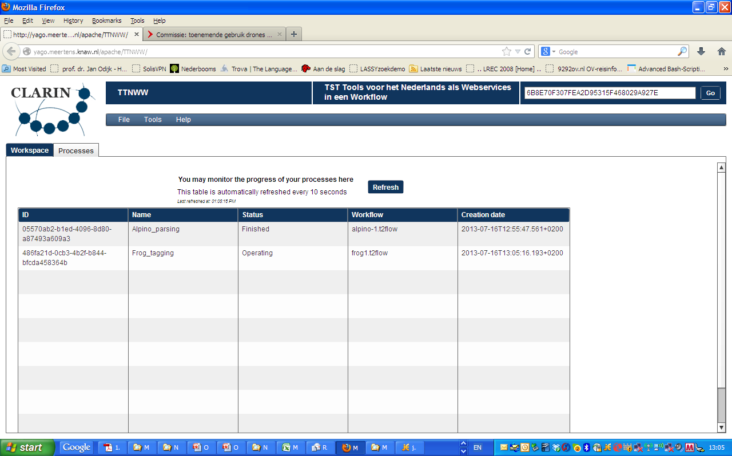

Slide 66
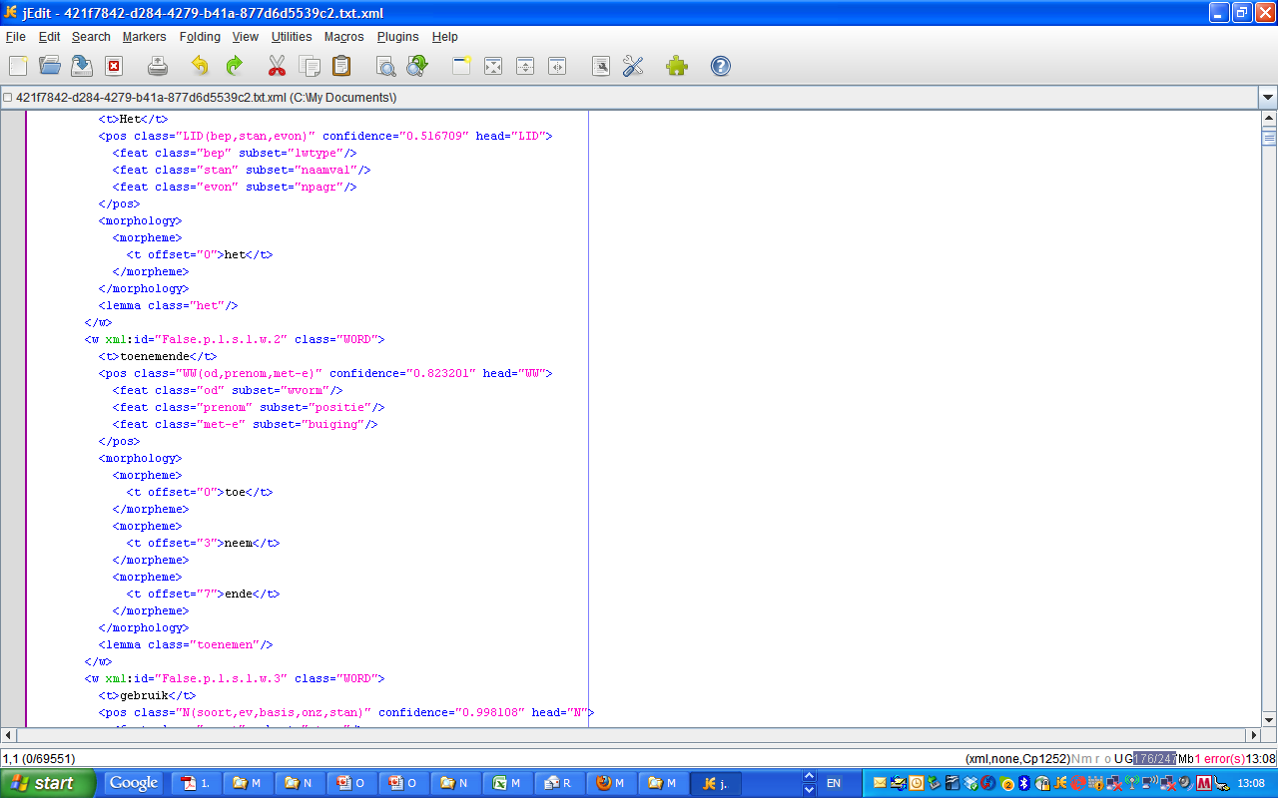

Slide 68
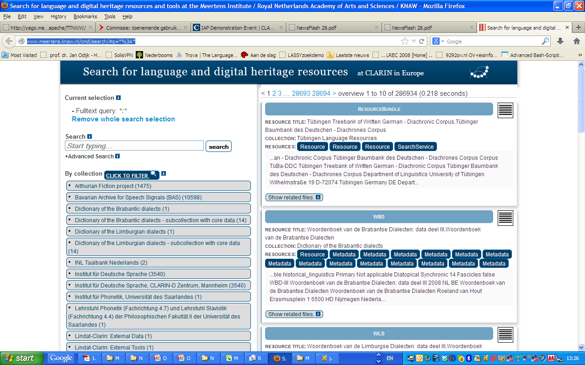
Metadata Search

Slide 69
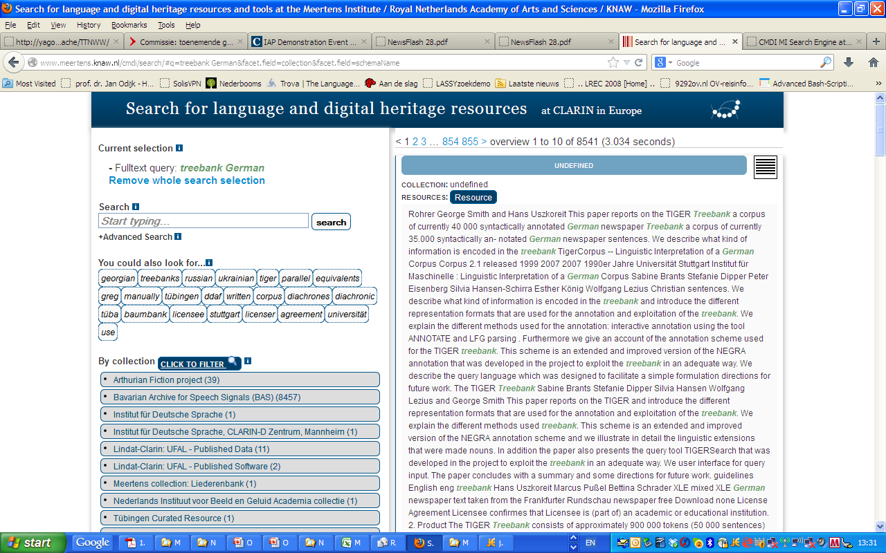

Slide 70
