Slide 1
Linguistic Research with CLARIN
Jan Odijk
MA Rotation
Utrecht, 2015-11-10

Slide 2
Overview
Introduction
Search in Corpora and Lexicons
Search in PoS-tagged Corpus
Search for grammatical relations
Search for Constructions
Search for synonyms/ hyponyms
Analyzing/Visualising Word occurrence patterns in CHILDES
Search in your own enriched corpus
Conclusions

Slide 3
Introduction
Cat | init | modifier | predicate | rest
A | Hij is daar | Heel / erg /zeer | blij | mee
gloss | He is there | very | happy | with
P | Hij is daar | *heel / erg / zeer | in zijn sas | mee
gloss | He is there | very | happy | with
V | …omdat dat mij | *heel / erg / zeer | verbaast
gloss | …because that me | very | surprises
(See [Odijk 2011, 2014] for more data and qualifications

Slide 4
Introduction
Summary
Heel, erg, zeer are (near-)synonyms ‘very’
Heel can modify only A predicates
Zeer, erg can modify A, V, P predicates
Assessment
Distinction is purely syntactic
Cannot be derived from semantic differences
Correlation with other known facts unlikely
Cannot be derived from general (universal) principles
➔ must be acquired by L1 learners of Dutch

Slide 5
Introduction
Minimal pair in acquisition
Requires acquisition of negative property
No evidence in the input
No ‘correction’ or correction ignored
May provide evidence for/against relevant hypotheses
E.g. Indirect Negative Evidence hypothesis
Absence of evidence ➔ evidence for absence
Notes:
Heel erg zeer are (near-)synonyms meaning `very’
Heel can modify adjectival (A) predicates only
Erg en zeer can modify A, verbal (V) and prepositional (P) predicates
very in English is like Dutch heel (v. very much)

Slide 6
Introduction
How to approach this problem
Study literature, study grammars, form and test hypotheses, look for relevant data sets, create new datasets, enrich data with annotations, search in and through datasets, analyze data and visualize analysis results, design and carry out experiments, design and do simulations, ….
Focus here: searching relevant data easily in large resources using (components of ) the CLARIN infrastructure

Slide 7
Search in Corpora
Why search in corpora?
Complements self-constructed examples and your own intuitions
Broadens your view of the data
May point out variation you are not aware of
Constructed examples often not possible
Can provide natural examples as basis for experiments / self-constructed examples

Slide 8
Search in Corpora
Are the basic facts correct?
Search with OpenSONAR
Search in PoS-tagged corpus SONAR-500
Demo

Slide 9
Search in Corpora
Conclusions after analysis
Heel does occur with certain adverbially used PPs
Heel in het begin, heel af en toe, heel in het bijzonder, heel in het kort, heel op het laatst, heel in de verte, heel uit de verte, heel in het algemeen,
Dat ligt hem heel na aan het hart
Heel does occur with predicative PPs (but I find them ill-formed)
buiten zijn verwachting, in de mode, in de vakantiestemming, in het zwart, in orde
Maybe heel is used as geheel by some people

Slide 10
Search in Corpora
PoS code annotation
is (just) OK for adjacent words (but quite some noise)
Is useless for more distant grammatically related words
Desired: Search for words that have a grammatical relation (dependency relations)
LASSY Woordrelaties Interface
LASSY Small: 65 k sentences (1 m words)
LASSY-LARGE/wiki: 8.6 m sentences (125 m words)
Demo

Slide 11
Search in Corpora
Conclusions
Heel
There are examples where heel modifies a `verb’
But `verb’ is actually a deverbal (participle) adjective
in ‘heel open staan voor’ heel is incorrectly analyzed as modifying the verb
Zeer:
most examples of deverbal adjectives
But also some real verbs
➔confirms initial assumptions about the facts

Slide 12
Search in Corpora
Searching for Constructions
GrETEL
Example-based treebank query system
LASSY-Small, Corpus Gesproken Nederlands (CGN)
SONAR (500 m tokens, automatically parsed)
Small Demo on CGN

Slide 13
Search in Corpora
Analysis
Heel mod V: 61
=mod A (participles): 53
=mod N (Substantivized infinitives): 3
Heel = geheel ‘completely’ (Flemish only): 2
Wrong analysis: 3
Heel mod P: 6
=mod P (adverbial) heel op het laatst: 4
Heel = geheel ‘completely’ (Flemish only): 1
Counterexample(?): ?Heel voor de hand liggen: 1

Slide 14
Search in Corpora
Analysis
Heel mod MWU 9:
=mod A: 3 (heel ver weg ‘very far away’)
=mod P (af en toe lit. off and to ‘now and then’): 2
=mod N: 4 (heel Den Haag ‘whole The Hague’)
Wrong analysis: 3
Conclusion
Consistent with OpenSONAR findings
consistent with initial assumptions

Slide 15
Search in Lexica
Cornetto data and Interface to Cornetto
Lexico-semantic database based on Dutch WordNet and ReferentieBestand Nederlands
Created in STEVIN programme
User-friendly interface made in CLARIN-NL
Example to search for (near-)synonyms of zeer, erg, heel.

Slide 16
CLARIN Infrastructure Tools: Illustration
What is the modification potential of near-synonyms of zeer, heel, erg?
allemachtig-adv-2 beestachtig-adv-2 bijzonder-a-4 bliksems-adv-2 bloedig-adv-2 bovenmate-adv-1 buitengewoon-adv-2 buitenmate-adv-1 buitensporig-adv-2 crimineel-a-4 deerlijk-adv-2 deksels-adv-2 donders-adv-2 drommels-adv-2 eindeloos-a-3 enorm-adv-2 erbarmelijk-adv-2 fantastisch-adv-6 formidabel-adv-2 geweldig-adv-4 goddeloos-adv-2 godsjammerlijk-adv-2 grenzeloos-adv-2 grotelijks-adv-1 heel-adv-5 ijselijk-adv-2 ijzig-a-4 intens-adv-2 krankzinnig-adv-3 machtig-adv-4 mirakels-adv-1 monsterachtig-adv-2 moorddadig-adv-4 oneindig-adv-2 onnoemelijk-adv-2 ontiegelijk-adv-2 ontstellend-adv-2 ontzaglijk-adv-2 ontzettend-adv-3 onuitsprekelijk-adv-2 onvoorstelbaar-adv-2 onwezenlijk-adv-2 onwijs-adv-4 overweldigend-adv-2 peilloos-adv-2 reusachtig-adv-3 reuze-adv-2 schrikkelijk-adv-2 sterk-adv-7 uiterst-adv-4 verdomd-adv-2 verdraaid-a-4 verduiveld-adv-2 verduveld-adv-2 verrekt-adv-3 verrot-adv-3 verschrikkelijk-adv-3 vervloekt-adv-2 vreselijk-adv-5 waanzinnig-adv-2 zeer-adv-3 zeldzaam-adv-2 zwaar-adv-10
Many of these appear atypical for young children and are probably learned late
Is there a correlation between this and their modification potential?

Slide 17
Search in Corpora
CHILDES
recordings of adult-child interaction
with transcriptions and metadata
COAVA application CHILDES browser
Application built for research into the relation between language acquisition and lexical dialectical variation
Cognition, Acquisition and Variation tool
Demo of the COAVA CHILDES browser analyzing and visualising children’s speech

Slide 18
CLARIN Infrastructure Tools: Illustration
First relevant occurrence | heel | erg | zeer
Day(Yr;Mo) | 705 (1;11) | 1048 (2;10) | 1711 (4;8)

Slide 19
Corpus Analysis
Problem: Ambiguity
Heel 7-fold ambiguous
Erg 4-fold ambiguous
Zeer 3-fold ambiguous
(as any decent natural language word)
For our purposes:
Morpho-syntactic and syntactic properties resolve the ambuigities
But: CHILDES does not contain that!
Notes:
Heel erg zeer are (near-)synonyms meaning `very’
Heel can modify adjectival (A) predicates only
Erg en zeer can modify A, verbal (V) and prepositional (P) predicates
very in English is like Dutch heel (v. very much)

Slide 20
PaQu
PaQu= Parse and Query: https://dev.clarin.nl/node/4182
Web application made by Groningen University
Upload corpus
Plain text or in Alpino format
Plain Text is automatically parsed by Alpino
Resulting treebank can be searched and analyzed
Search
Word relations interface and XPATH Queries
Analysis
User-definable statistics on search results (and metadata)
Notes:
Heel erg zeer are (near-)synonyms meaning `very’
Heel can modify adjectival (A) predicates only
Erg en zeer can modify A, verbal (V) and prepositional (P) predicates
very in English is like Dutch heel (v. very much)

Slide 21
Experiments
Take the Dutch CHILDES corpora
Select all utterances containing heel, erg or zeer
Clean the utterances, e.g.
ja , maar <we be> [//] we bewaren (he)t ook
ja , maar we bewaren het ook
Upload it into PaQu
Gather statistics and draw conclusions
Notes:
Heel erg zeer are (near-)synonyms meaning `very’
Heel can modify adjectival (A) predicates only
Erg en zeer can modify A, verbal (V) and prepositional (P) predicates
very in English is like Dutch heel (v. very much)

Slide 22
Experiment 1
Adult utterances of Van Kampen Corpus
Manual annotation used as gold standard
Alpino makes finer distinctions: I mapped these
Notes:
Heel erg zeer are (near-)synonyms meaning `very’
Heel can modify adjectival (A) predicates only
Erg en zeer can modify A, verbal (V) and prepositional (P) predicates
very in English is like Dutch heel (v. very much)

Slide 23
Experiment 1: Results
Accuracy
word | Accuracy
heel | 0.95
erg | 0.91
zeer | 0.21
Notes:
Heel erg zeer are (near-)synonyms meaning `very’
Heel can modify adjectival (A) predicates only
Erg en zeer can modify A, verbal (V) and prepositional (P) predicates
very in English is like Dutch heel (v. very much)

Slide 24
Experiment 1: Interpretation
Good for heel, erg
Bad for zeer, but:
Completely due to zeer doen (lit. pain(ful) do, ‘to hurt’)
Can be identified very easily in PaQu
Generalisability: Limited
It concerns (cleaned) adult speech
It concerns relatively short sentences, explicitly separated
It mostly concerns a very local grammatical relation
Notes:
Heel erg zeer are (near-)synonyms meaning `very’
Heel can modify adjectival (A) predicates only
Erg en zeer can modify A, verbal (V) and prepositional (P) predicates
very in English is like Dutch heel (v. very much)

Slide 25
Experiment 2:
All adults’ utterances:
Results | mod A | mod N | Mod V | mod P | predc | other | unclear | Total
heel | 886 | 46 | 2 | 2 | 14 | 0 | 2 | 952
erg | 347 | 27 | 109 | 0 | 187 | 5 | 0 | 675
zeer | 7 | 1 | 83 | 0 | 19 | 21 | 7 | 138
Notes:
Heel erg zeer are (near-)synonyms meaning `very’
Heel can modify adjectival (A) predicates only
Erg en zeer can modify A, verbal (V) and prepositional (P) predicates
very in English is like Dutch heel (v. very much)

Slide 26
Experiment 2: Interpretation
Heel most frequent (almost 54%)
Heel as mod A overwhelming: > 93%
Heel as mod V, mod P wrong analysis
Mod A and mod V more balanced for erg
Evidence for zeer mostly lacking
Cases of Mod V are mostly wrong analyses
Evidence for Mod P mostly lacking
Some evidence for erg, zeer (4 occurrences)
Notes:
Heel erg zeer are (near-)synonyms meaning `very’
Heel can modify adjectival (A) predicates only
Erg en zeer can modify A, verbal (V) and prepositional (P) predicates
very in English is like Dutch heel (v. very much)

Slide 27
Experiment 3:
Van Kampen Children’s speech: Accuracy
Similar to the Adults’ speech but slightly lower
Word | Acc
heel | 0.90
erg | 0.73
zeer | 0.17
Notes:
Heel erg zeer are (near-)synonyms meaning `very’
Heel can modify adjectival (A) predicates only
Erg en zeer can modify A, verbal (V) and prepositional (P) predicates
very in English is like Dutch heel (v. very much)

Slide 28
Conclusions
CLARIN tools
Enable search for grammatical and semantic properties
In Dutch annotated corpora (1M to 500M tokens)
in unannotated corpora that are automatically enriched with grammatical properties
And in rich lexical databases
With easy to use interfaces
Provide new data gathering and analysis opportunies
that mostly did not exist for Dutch until recently
were available for specialists only until one year ago

Slide 29
Conclusions
Where do I find these tools?
CLARIN-NL portal: http://portal.clarin.nl , Services
How do I find the right tool there?
Use the faceted search (research discipline, tool task, language, …)
How do I learn to use a tool?
Help files, demonstration scenarios
Educational material
Request for a course: clarinnl@uu.nl

Slide 30
Conclusions (2)
Can I get help when there is a problem?
Helpdesk: helpdesk@clarin.nl
But I do not work on Dutch!
CLARIN is international
PML-TQ treebanks for > 27 languages
Tündra: German, English, Bulgarian, Japanese, Latin
INESS, Corpuscle: many languages
British National Corpus: English
And many more and even more coming!

Slide 31
Thanks for your attention!

Slide 32
DO NOT ENTER HERE

Slide 33
OpenSonar
Start Page

Slide 34
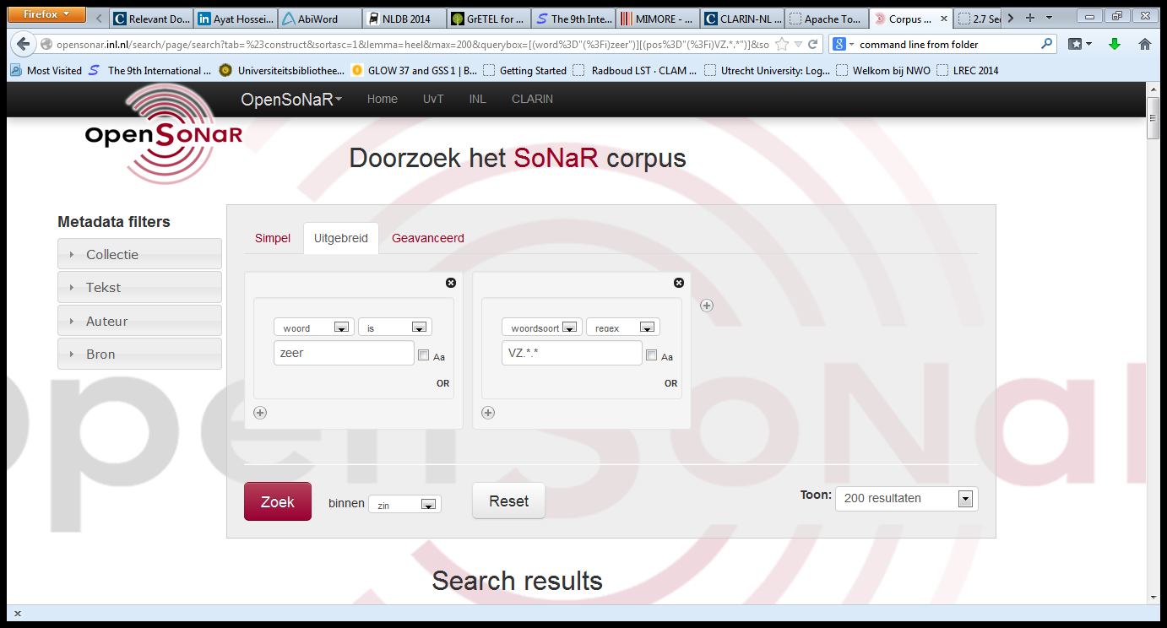
OpenSonar
Start Page

Slide 35
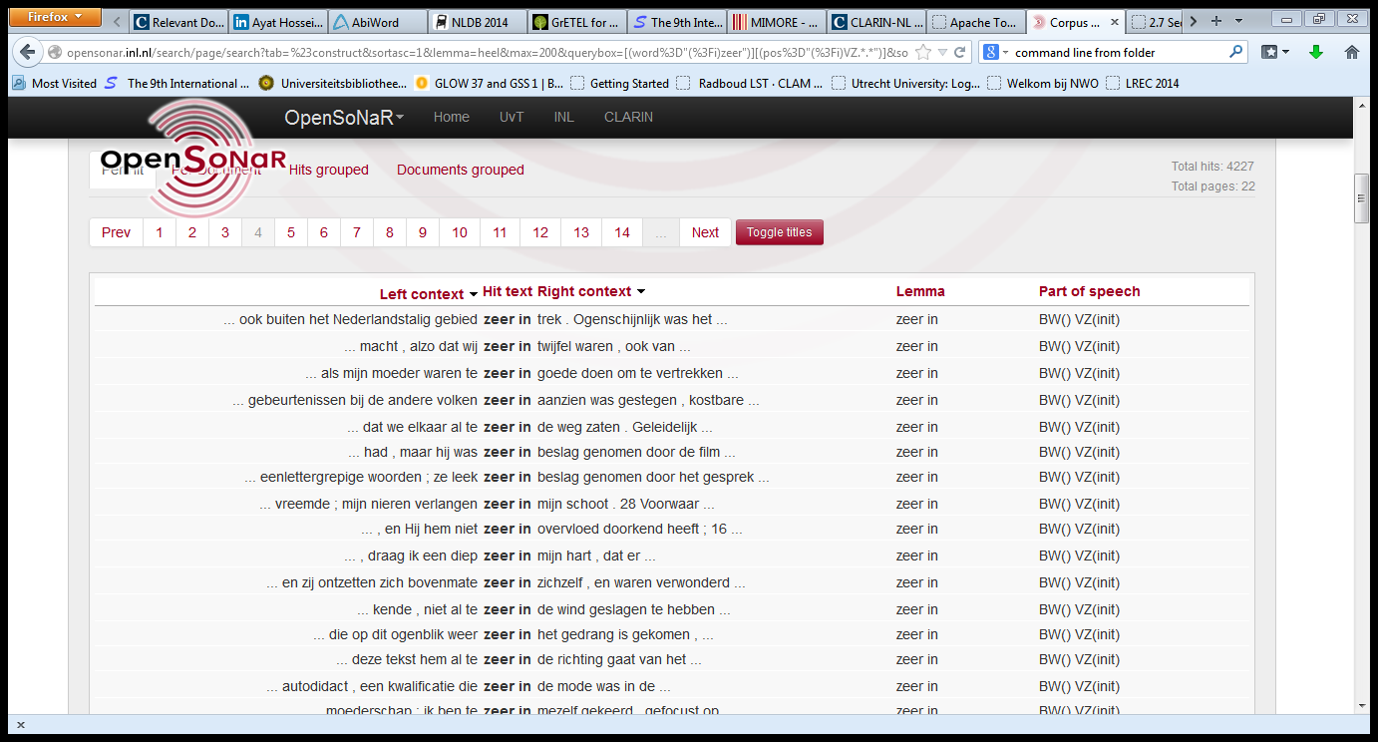
OpenSonar
Start Page

Slide 36
OpenSonar
Start Page

Slide 37
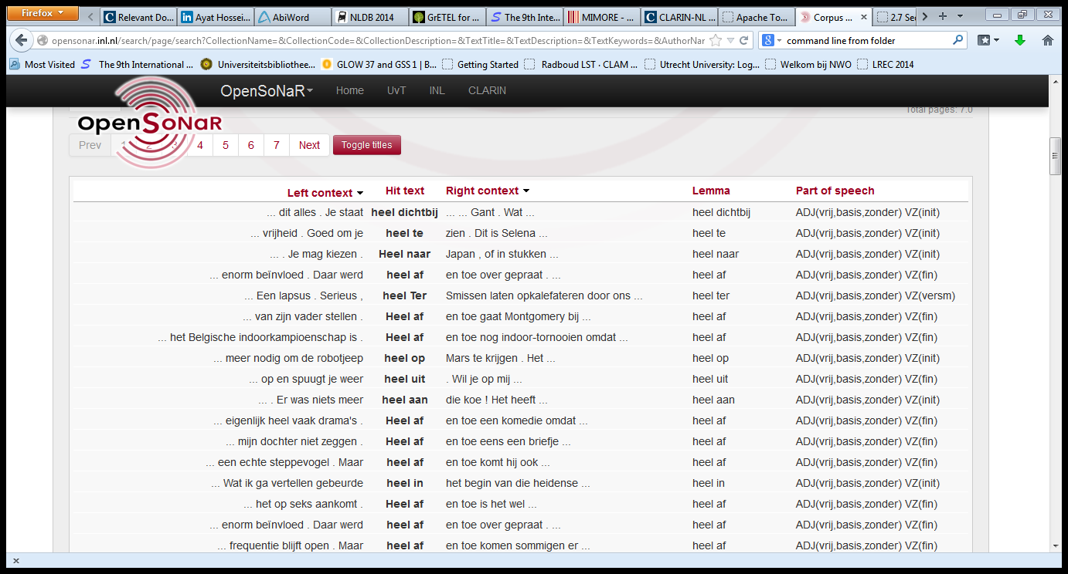
OpenSonar
Start Page

Slide 38
OpenSonar
Start Page

Slide 39
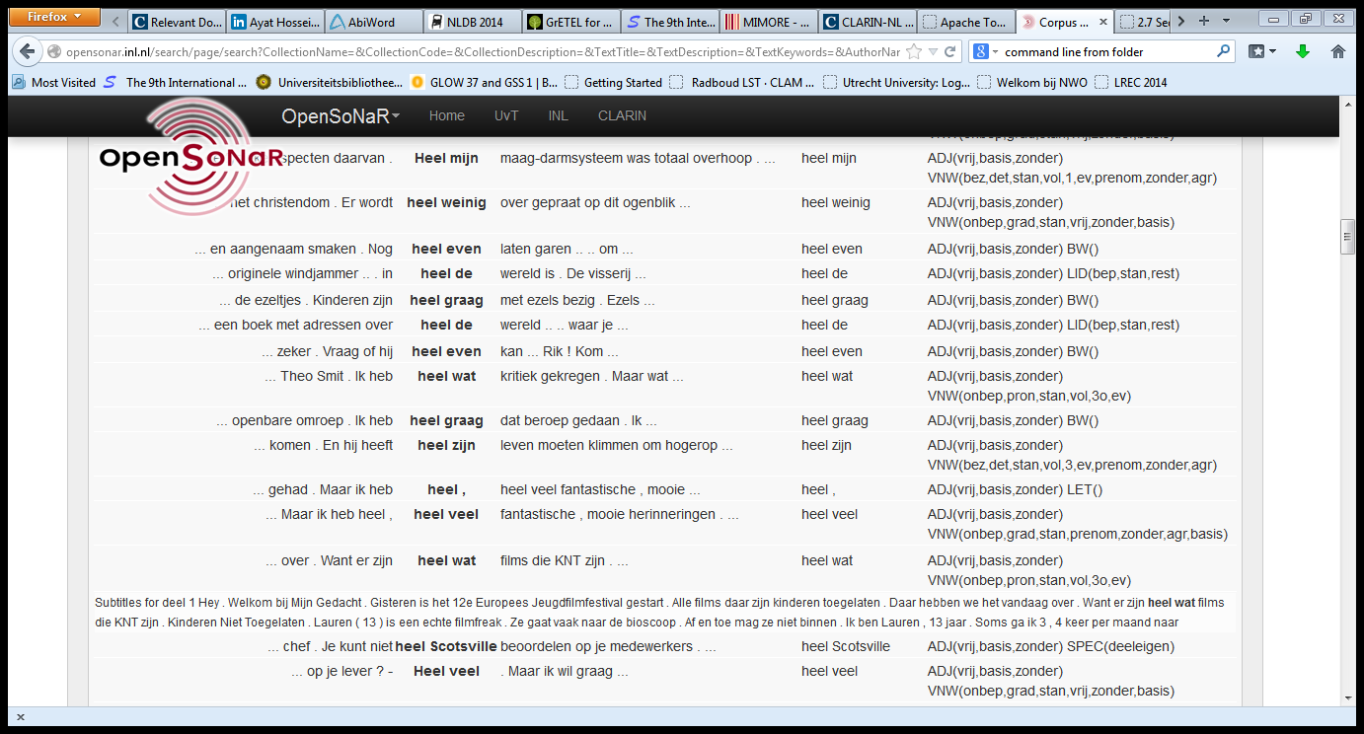
OpenSonar
Start Page

Slide 40
OpenSonar
Return Page

Slide 41
LASSY Simple Interface
Start Page

Slide 42
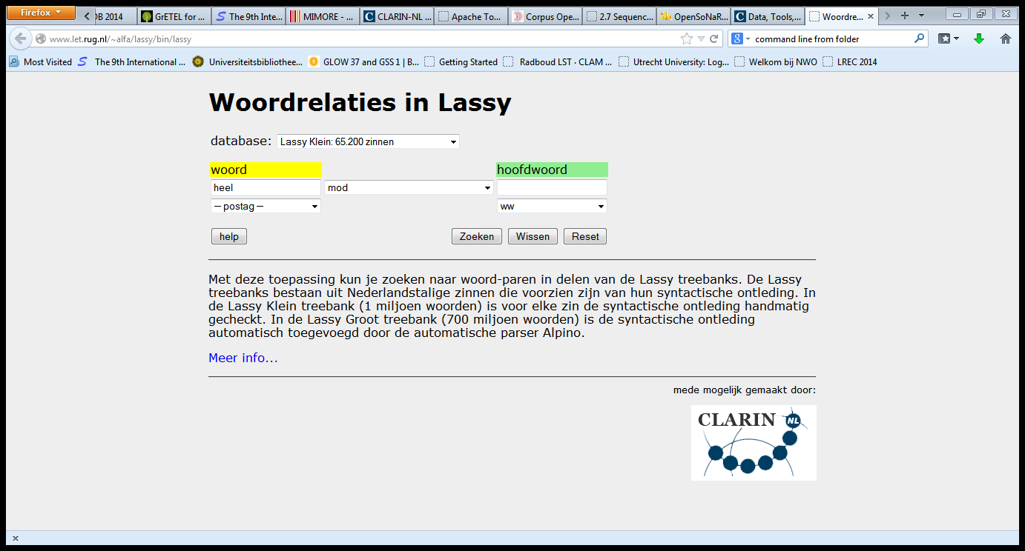
LASSY Simple Interface
Start Page

Slide 43
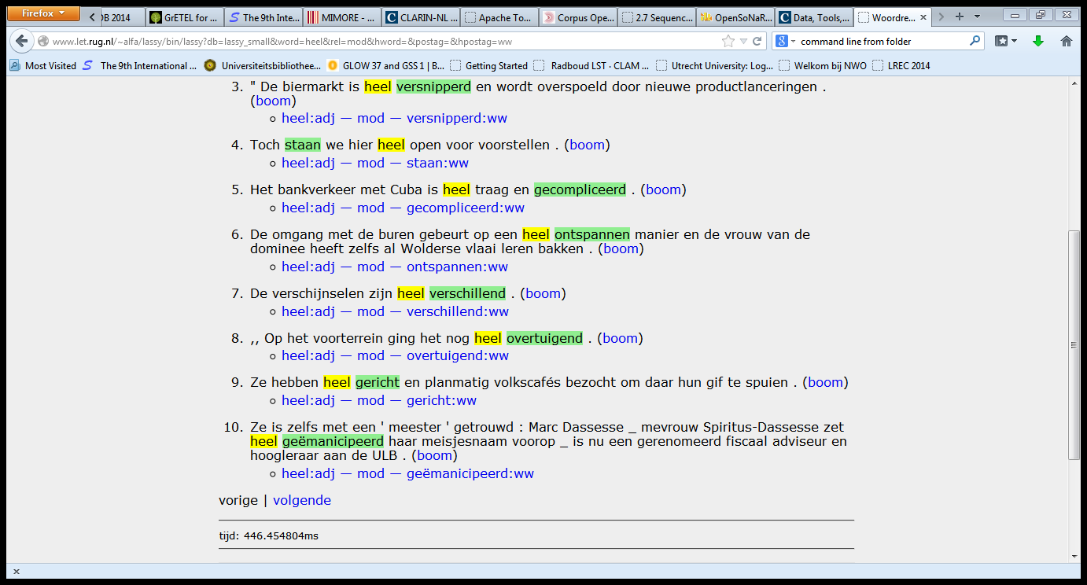
LASSY Simple Interface
Start Page

Slide 44
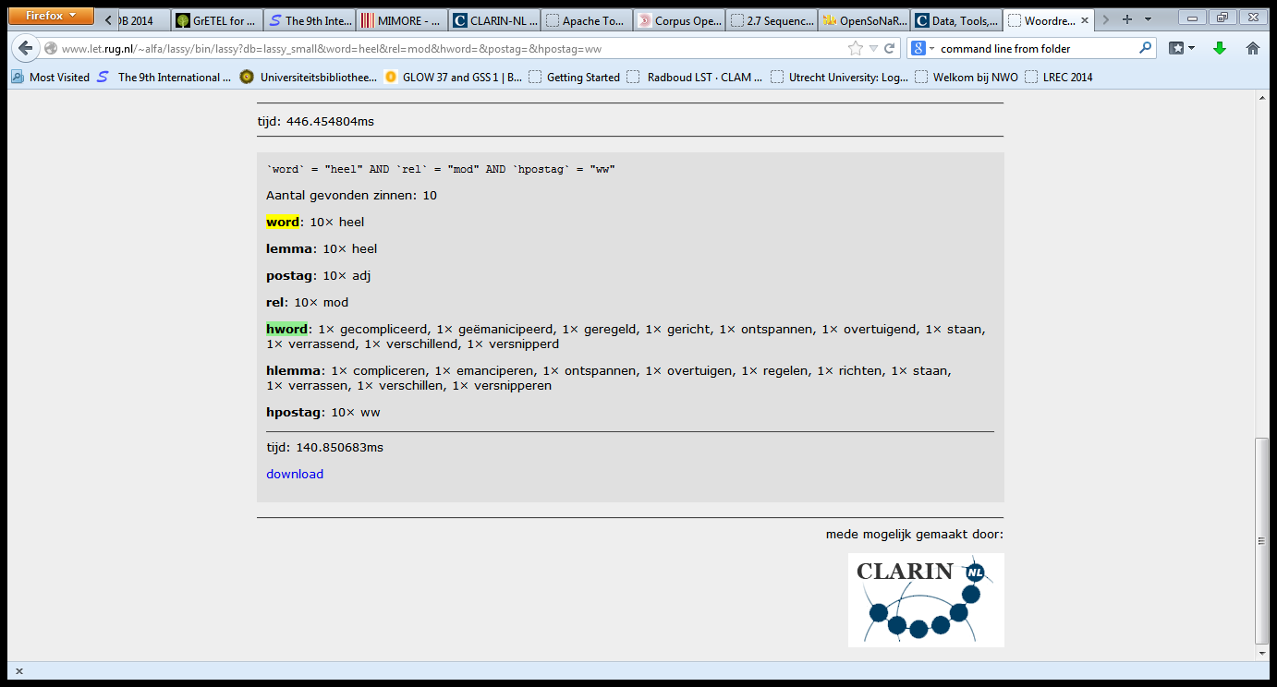
LASSY Simple Interface
Start Page

Slide 45
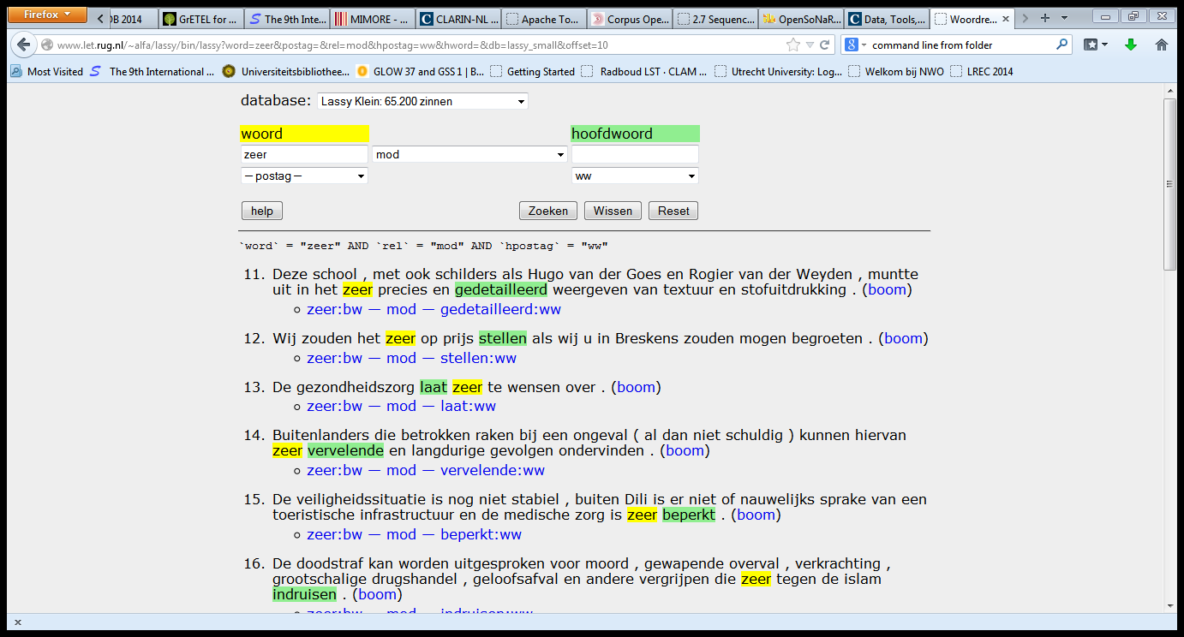
LASSY Simple Interface
Start Page

Slide 46
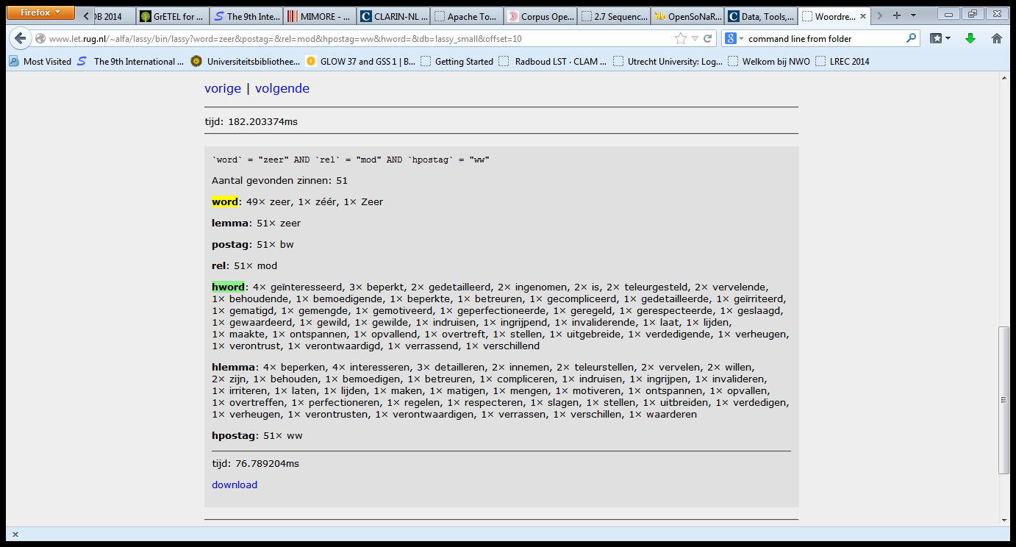
LASSY Simple Interface
Start Page

Slide 47
LASSY Simple Interface
Return Page

Slide 48
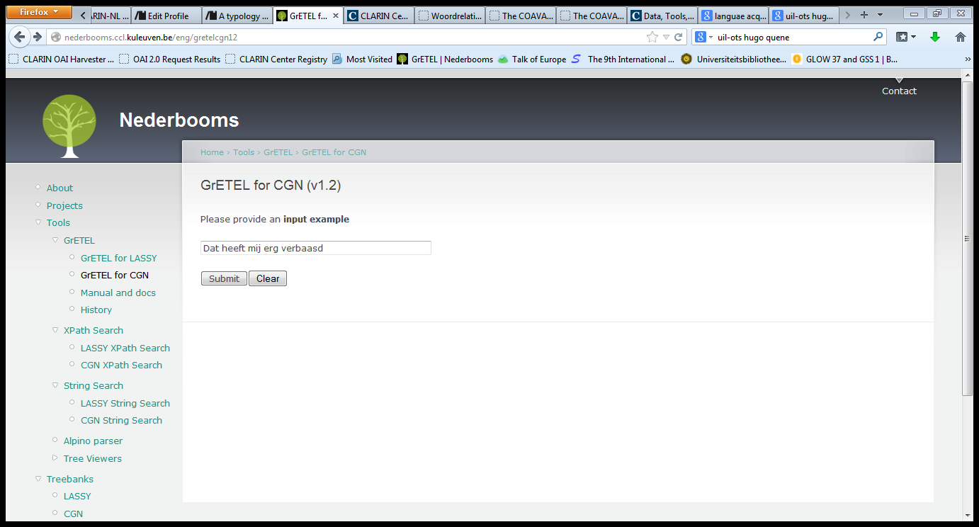
GrETEL CGN
Return Page

Slide 49
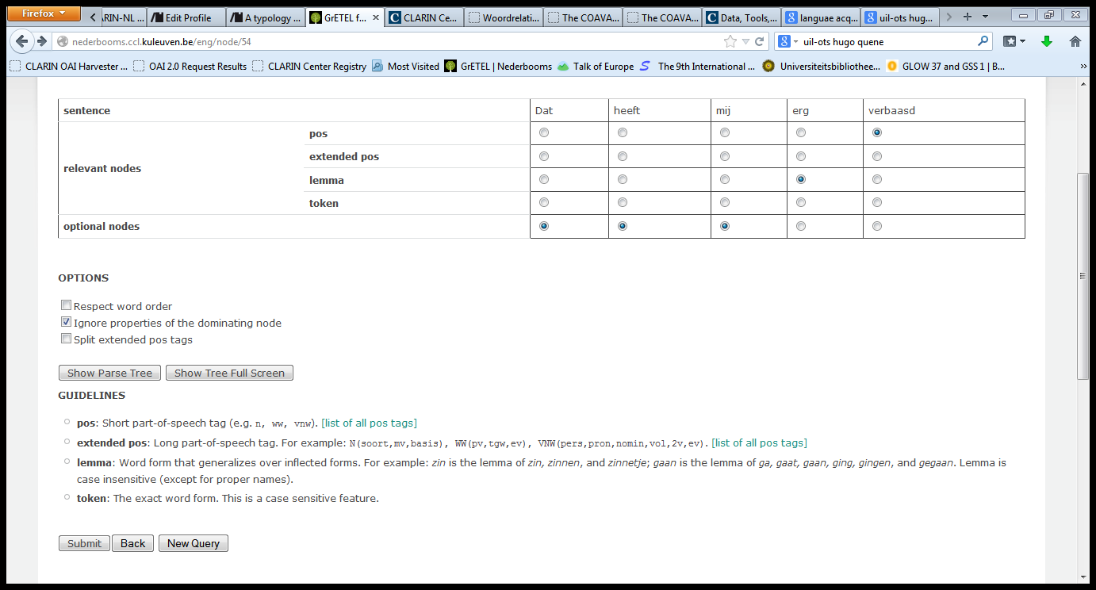
GrETEL CGN
Return Page

Slide 50
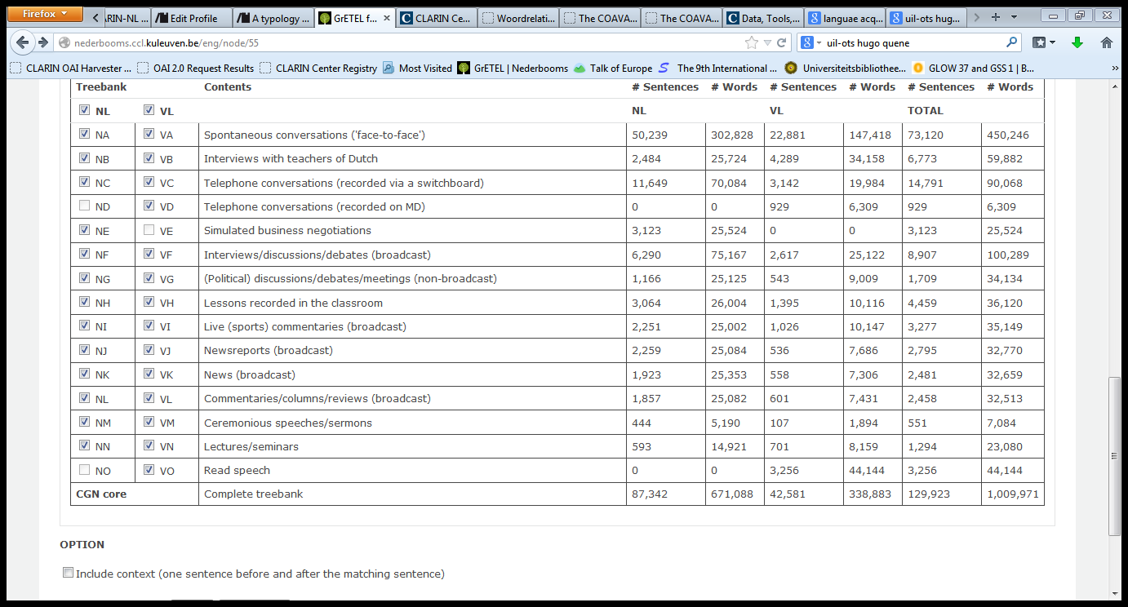
GrETEL CGN
Return Page

Slide 51
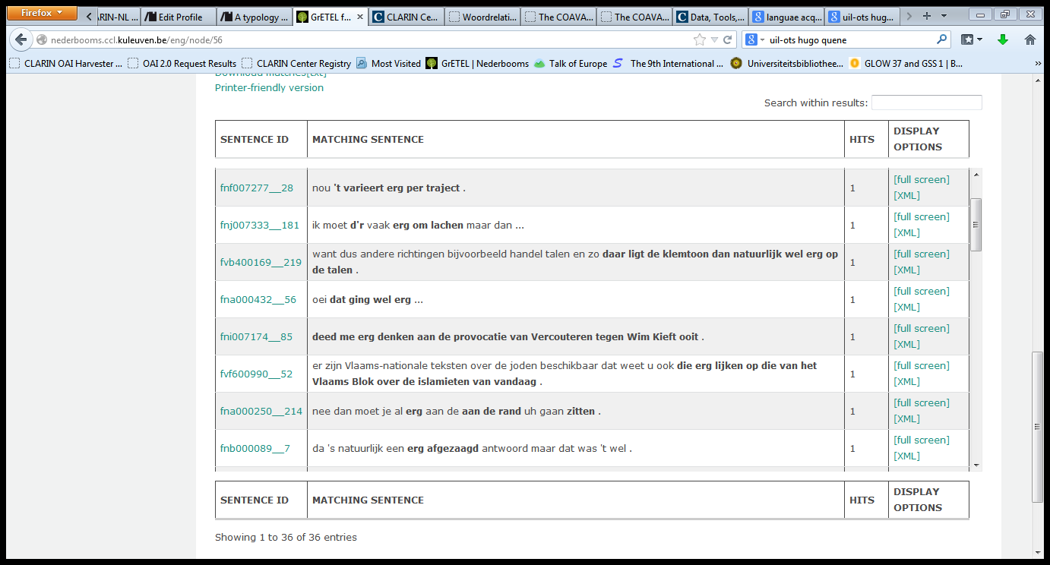
GrETEL CGN
Return Page

Slide 52
GrETEL CGN
Return Page

Slide 53
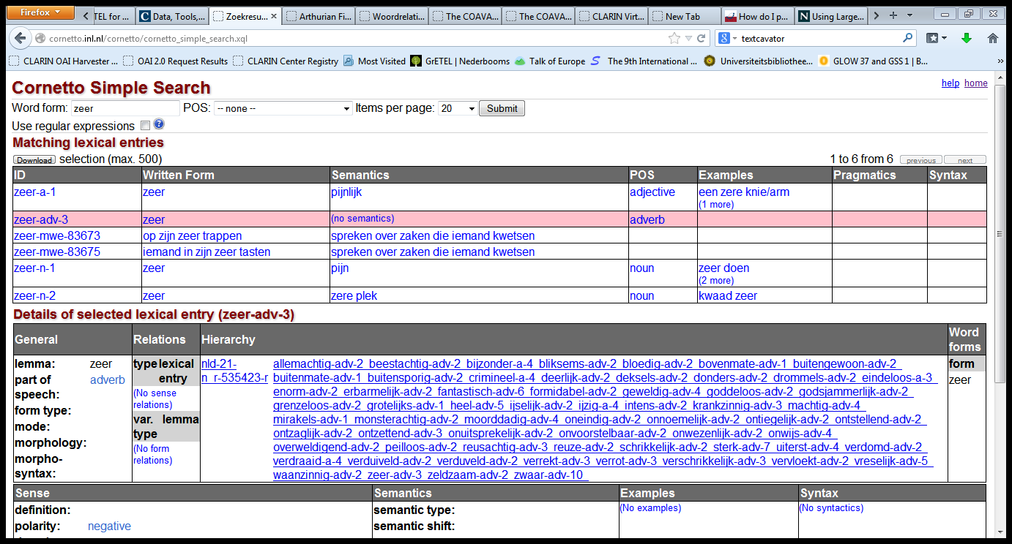
Cornetto
Return Page

Slide 54
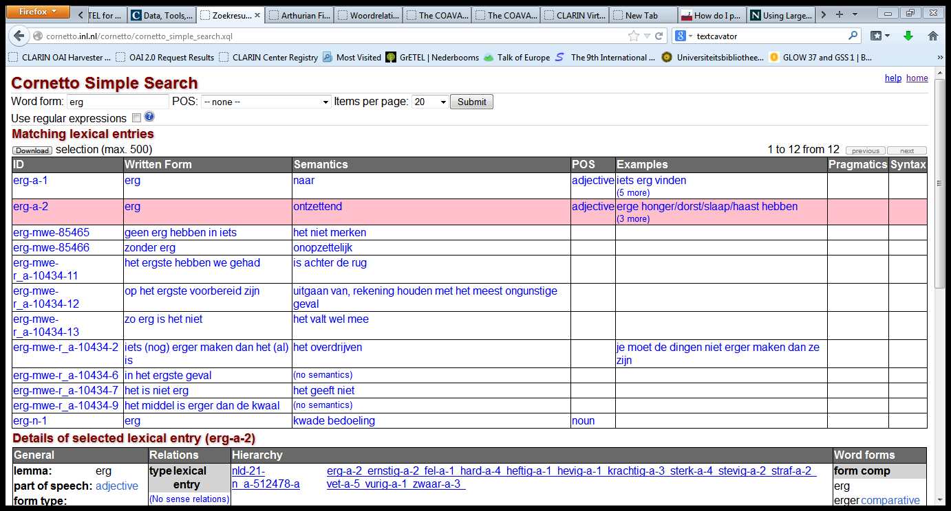
Cornetto
Return Page

Slide 55
Cornetto
Return Page

Slide 56
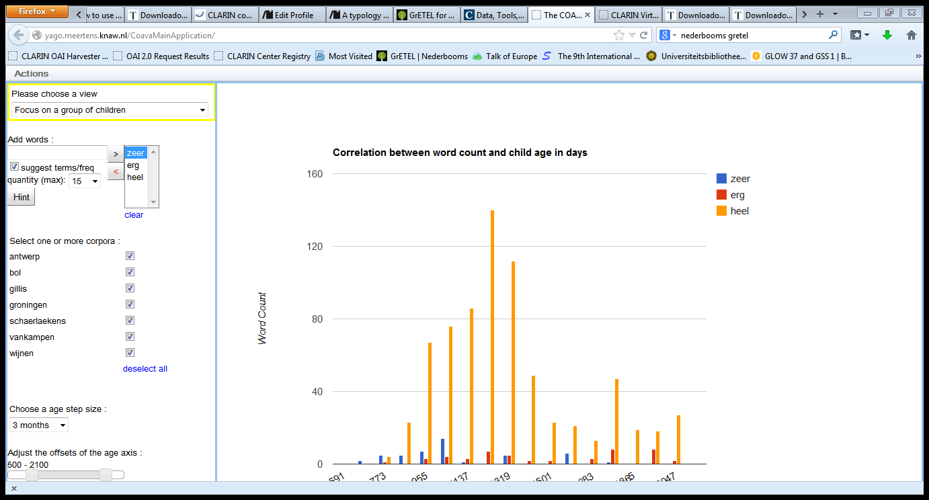
COAVA

Slide 57
COAVA
Return Page

Slide 58
GrETEL CGN
Return Page

Slide 59
Other Examples
PP/A
In zijn sas, in verwachting, tegen, voor, onder de indruk, uit de tijd
Tevreden met v. in zijn sas met
Zwanger v. in verwachting
Verward v. in de war
Modieus v. in de mode / in zwang
English: very v. very much
V:
Worden (AP, NP, *PP) v. raken (AP, *NP, PP)

Slide 60
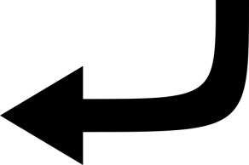
Correlation with other Differences?
Phenomenon | Opposes | Versus
Mod V,P | heel | erg, zeer
Meaning | erg | heel, zeer
Inflection | heel, erg | zeer
Comparative, Superlative | erg | heel, zeer
Modifiee | erg | heel, zeer
Pragmatics | zeer | heel, erg
➔ NO!

Slide 61
Ambiguity: HEEL
word | Morpho- syntax | Syntax | Meaning
heel | A | Mod N | `whole’ ‘in one piece’ `large’
 |  | Predc | ‘in one piece’
 |  | Mod A | `very’
 | Vf |  | `heal’ `receive’

Slide 62
Ambiguity: ERG
word | Morpho- syntax | Syntax | Meaning
erg | N utrum |  | `erg’
 | N neutrum |  | `evil’
 | A | Mod N, predc | ‘bad’, ‘awful’
 |  | Mod A V P | very

Slide 63
Ambiguity: ZEER
word | Morpho- Syntax | Syntax | Meaning
zeer | N |  | `pain’
 | A | Mod N, predc | ‘painful’
 |  | Mod A V P | ‘very’

Slide 64
Experiment 2: Interpretation
Heel most frequent (almost 54%)
Results | mod A | mod N | Mod V | mod P | predc | other | unclear | Total
heel | 886 | 46 | 2 | 2 | 14 | 0 | 2 | 952
erg | 347 | 27 | 109 | 0 | 187 | 5 | 0 | 675
zeer | 7 | 1 | 83 | 0 | 19 | 21 | 7 | 138
Notes:
Heel erg zeer are (near-)synonyms meaning `very’
Heel can modify adjectival (A) predicates only
Erg en zeer can modify A, verbal (V) and prepositional (P) predicates
very in English is like Dutch heel (v. very much)

Slide 65
Experiment 2: Interpretation
Heel as mod A overwhelming: > 93%
Results | mod A | mod N | Mod V | mod P | predc | other | unclear | Total
heel | 886 | 46 | 2 | 2 | 14 | 0 | 2 | 952
erg | 347 | 27 | 109 | 0 | 187 | 5 | 0 | 675
zeer | 7 | 1 | 83 | 0 | 19 | 21 | 7 | 138
Notes:
Heel erg zeer are (near-)synonyms meaning `very’
Heel can modify adjectival (A) predicates only
Erg en zeer can modify A, verbal (V) and prepositional (P) predicates
very in English is like Dutch heel (v. very much)

Slide 66
Experiment 2: Interpretation
Heel as mod V, mod P wrong analysis
Results | mod A | mod N | Mod V | mod P | predc | other | unclear | Total
heel | 886 | 46 | 2 | 2 | 14 | 0 | 2 | 952
erg | 347 | 27 | 109 | 0 | 187 | 5 | 0 | 675
zeer | 7 | 1 | 83 | 0 | 19 | 21 | 7 | 138
Notes:
Heel erg zeer are (near-)synonyms meaning `very’
Heel can modify adjectival (A) predicates only
Erg en zeer can modify A, verbal (V) and prepositional (P) predicates
very in English is like Dutch heel (v. very much)

Slide 67
Experiment 2: Interpretation
Mod A and mod V more balanced for erg
Results | mod A | mod N | Mod V | mod P | predc | other | unclear | Total
heel | 886 | 46 | 2 | 2 | 14 | 0 | 2 | 952
erg | 347 | 27 | 109 | 0 | 187 | 5 | 0 | 675
zeer | 7 | 1 | 83 | 0 | 19 | 21 | 7 | 138
Notes:
Heel erg zeer are (near-)synonyms meaning `very’
Heel can modify adjectival (A) predicates only
Erg en zeer can modify A, verbal (V) and prepositional (P) predicates
very in English is like Dutch heel (v. very much)

Slide 68
Experiment 2: Interpretation
Evidence for zeer mostly lacking
Cases of Mod V are mostly wrong analyses
Results | mod A | mod N | Mod V | mod P | predc | other | unclear | Total
heel | 886 | 46 | 2 | 2 | 14 | 0 | 2 | 952
erg | 347 | 27 | 109 | 0 | 187 | 5 | 0 | 675
zeer | 7 | 1 | 83 | 0 | 19 | 21 | 7 | 138
Notes:
Heel erg zeer are (near-)synonyms meaning `very’
Heel can modify adjectival (A) predicates only
Erg en zeer can modify A, verbal (V) and prepositional (P) predicates
very in English is like Dutch heel (v. very much)

Slide 69
Experiment 2: Interpretation
Evidence for Mod P mostly lacking
Some evidence for erg, zeer (4 occurrences)
Results | mod A | mod N | Mod V | mod P | predc | other | unclear | Total
heel | 886 | 46 | 2 | 2 | 14 | 0 | 2 | 952
erg | 347 | 27 | 109 | 0 | 187 | 5 | 0 | 675
zeer | 7 | 1 | 83 | 0 | 19 | 21 | 7 | 138
Notes:
Heel erg zeer are (near-)synonyms meaning `very’
Heel can modify adjectival (A) predicates only
Erg en zeer can modify A, verbal (V) and prepositional (P) predicates
very in English is like Dutch heel (v. very much)

