Slide 1
The CLARIN INFRASTRUCTURE
Jan Odijk
MA Rotation
Utrecht, 2014-02-13

Slide 2
Contents
Brief overview of CLARIN
Illustration of one tool: GrETEL
Conclusions

Slide 3
Contents
Brief overview of CLARIN
Illustration of one tool: GrETEL
Conclusions

Slide 4
CLARIN Infrastructure
A research infrastructure for humanities researchers who work with digital language-related resources

Slide 5
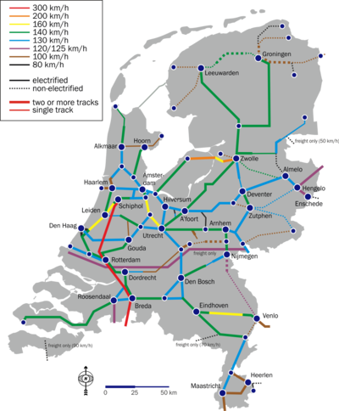
CLARIN Infrastructure
Infrastructure:
(Usually large-scale) basic physical and organizational structures and services needed for the operation of a society or enterprise
Railway network, road network, electricity network, …
eduroam

Slide 6
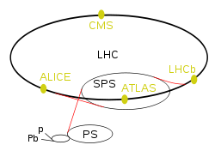
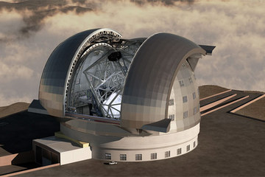
CLARIN Infrastructure
Research infrastructure
Infrastructure intended for carrying out research: facilities, resources and related services used by the scientific community to conduct top-level research
Famous ones: Chile large telescope, CERN Large Hadron Collider

Slide 7
CLARIN Infrastructure
humanities researcher
Linguists, historians, literary scholars, philosophers, religion scholars, ….
And a little bit in the social sciences: e.g. political sciences researchers
Focus here on linguists

Slide 8
CLARIN Infrastructure
Digital language-related resources
Data in natural language (texts, lexicons, grammars)
Databases about natural language (typological databases, dialect databases, lexical databases, …)
Audio-visual data containing (written, spoken, signed) language (e.g. pictures of manuscripts, av-data for language description, description of sign language, interviews, radio and tv programmes, …)

Slide 9
CLARIN Infrastructure
In various functions
As object of inquiry
As carrier of cultural content
As means of communication
As component of identity

Slide 10
CLARIN Infrastructure
The CLARIN infrastructure
Is distributed: implemented in a network of CLARIN centres
Is virtual: it provides services electronically (via the internet)
The CLARIN infrastructure
Is still under construction
Highly incomplete
Fragile in some respects
But you can use many parts already

Slide 11
CLARIN Infrastructure
The CLARIN infrastructure offers services so that a researcher
Can find all data relevant for the research
Can find all tools and services relevant for the research
Can apply the tools and services to the data without any technical background or ad-hoc adaptations
Can store data and tools resulting from the research
via one portal

Slide 12
CLARIN Infrastructure
CLARIN-NL Portal
under construction
This page brief overview CLARIN-NL results:
http://www.clarin.nl/node/404
CLARIN Data and tools (from all over Europe):
Virtual Language Observatory
Browsing and faceted search for data
Geographical navigation over data
Demo

Slide 13
CLARIN Infrastructure
Cornetto-LMF-RFD project Interface to Cornetto lexico-semantic database
Find semantically related words (synonyms, antonyms, hyponyms, etc etc)
And many lexical properties of words and expressions
Mimore search engine through 3 Dutch dialect databases and a presentation of a demonstration scenario

Slide 14
CLARIN Infrastructure
Gabmap web application for analysis of dialect variation and introduction video (by the ADEPT subproject)
Adelheid project website, web service, tokenizer, lexicon and editor/visualiser : tokenization, lemmatization, and PoS-tagging of Historical Dutch (14th century)

Slide 15
CLARIN Infrastructure
INL Corpus Hedendaags Nederlands (Contemporary Dutch Corpus) Search Interface
FESLI Search application for search in language selective impairment acquisition data

Slide 16
CLARIN Infrastructure
TTNWW workflow system (result of CLARIN-NL / CLARIN Flanders Cooperation)
Spelling normalisation
Part of Speech-tagging
Parsing
Named Entity Recognition
Semantic Role Assignment
Assignment of co-referential relations
Transcription of speech files

Slide 17
Contents
Brief overview of CLARIN
Illustration of one tool: GrETEL
Conclusions

Slide 18
Overview
What is GrETEL
Treebanks
Example Parse
Searching in treebanks
Searching with GreTel
Searching with GreTel: Limitations
Comparison with Google
Conclusions

Slide 19
GrETEL
Greedy Extraction of Trees for Empirical Linguistics
Web application for intelligent searching in treebanks
Web: on the world wide web, accessible via internet
Application: software with a user interface targeted at a specific user group: for GrETEL: linguists
Intelligent searching: searching in a more sophisticated way than just searching for strings (sequences of characters), as Google does
Treebank: a text corpus with for each sentence a syntactic parse (Dutch: ontleding)
Syntactic parse is usually in the form of a tree (hence treebank)
GrETEL applies to the LASSY-Small and CGN treebanks
http://nederbooms.ccl.kuleuven.be/eng/aboutgretel

Slide 20
Treebanks
LASSY-Small: treebank for written Dutch
CGN treebank: for spoken Dutch
CGN= Corpus Gesproken Nederlands
Both are encoded in XML
XML= eXtensible Mark-up Language
W3C standard for the exchange of data

Slide 21
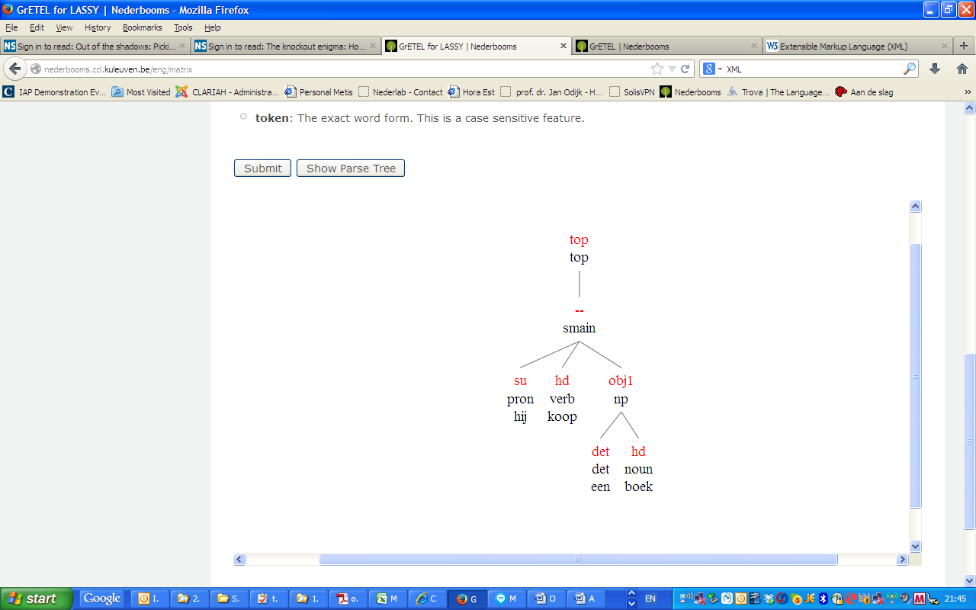
Example Parse
LASSY-Small: treebank for written Dutch
CGN treebank: for spoken Dutch
CGN= Corpus Gesproken Nederlands
Both are encoded in XML
XML= eXtensible Mark-up Language
W3C standard for the exchange of data

Slide 22
Example Parse (XML)
In XML (simplified):
<node rel = "top" cat="top">
<node rel = "--" cat="smain">
<node rel="su" pos="pron" root="hij"/>
<node rel="hd" pos="verb" root="koop"/>
<node rel="obj1" cat="np">
<node rel="det" pos="det" root="een"/>
<node rel="hd" pos="noun" root="boek"/>
</node>
</node>
</node>

Slide 23
PARSING
‘taalkundige ontleding’ (‘dependency analysis’)
Grammatical relation (rel) of constituents: subject (su), direct object (obj1), head (hd), determiner (det), ….
‘redekundige ontleding’ (‘categorial analysis’)
Part of Speech (pos): pronoun (pron), verb (verb), determiner (det), noun (noun), …
Syntactic category (cat) : utterance (top), main clause (smain), noun phrase (np), …
Order in the Lassy and CGN trees is NOT significant. Order is encoded by attributes
(not represented in the simplified example)

Slide 24
Searching in Treebanks
Usually formulated in a programming language for queries (query language)
Query languages to search in XML documents:
Xpath, Xquery
Simple Example query in Xpath:
//node[@cat="ap" and node[@rel="mod" and @pos="adj"] and node[@rel="hd" and @pos="adj"]]

Slide 25
Searching in Treebanks
XPath | Meaning
// | Find Anywhere in the tree
Node[ | A node
@cat="ap" | In which feature ‘cat’ has value ‘ap’
and node[ | And that contains a node
@rel="mod" and @pos="adj“ ] | In which feature ‘rel’ has value ‘mod’ and feature ‘pos’ has value ‘adj’
and node[ | And a node
@rel="hd" and @pos="adj"]] | In which feature ‘rel’ has value ‘hd’ and feature ‘pos’ has value ‘adj’

Slide 26
Searching in Treebanks
Or even:
//node[@cat="ppart" and node[@rel="obj2" and @cat="pp" and node[@rel="hd" and @pos="prep" and @root="aan" and @word="aan" and @begin < ../../node[@rel="obj1" and @cat="np"]/node[@rel="hd" and @pos="noun"]/@begin]] and node[@rel="obj1" and @cat="np" and node[@rel="hd" and @pos="noun" and @begin < ../../node[@rel="hd" and @pos="verb"]/@begin]] and node[@rel="hd" and @pos="verb"]]
This is too difficult!

Slide 27
Searching with GrETEL
Problems
One must learn the Xpath language
One must know exactly what the structure of the document is
Even simple queries get quite complex rather fast

Slide 28
Searching with GrETEL
GreTel Approach
Desired query: Give me (sentences that contain) adverbs that modify adjectives
Provide an example of this construction in natural language: dat is erg groot
Parsed automatically by Alpino parser
Mark which aspects of the example are important.
In this case Pos (part of speech) of erg and groot
Automatically includes the dependency relation between these two words

Slide 29
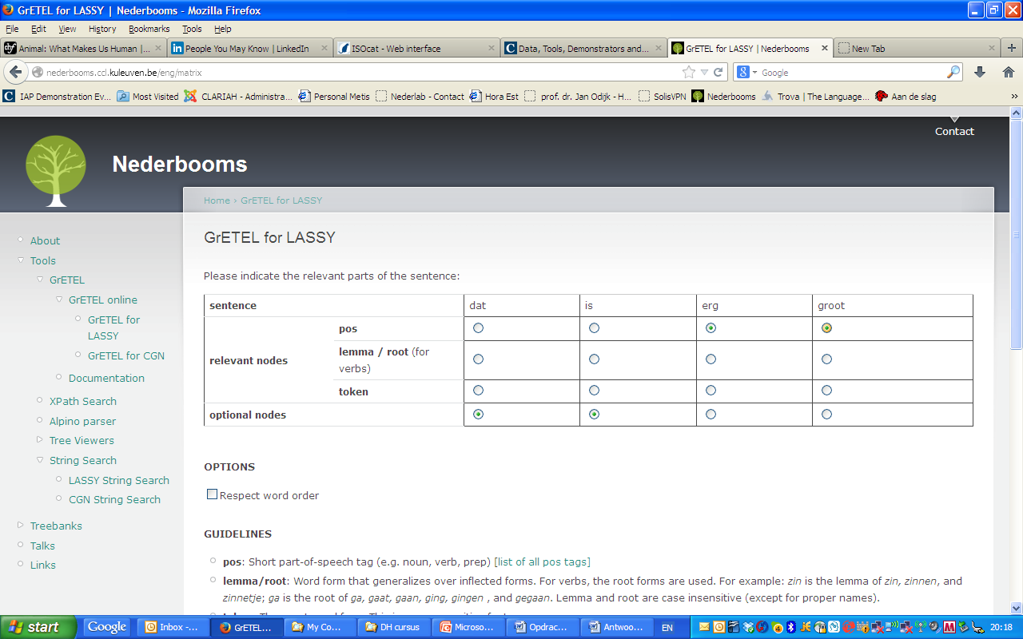
Searching with GrETEL

Slide 30
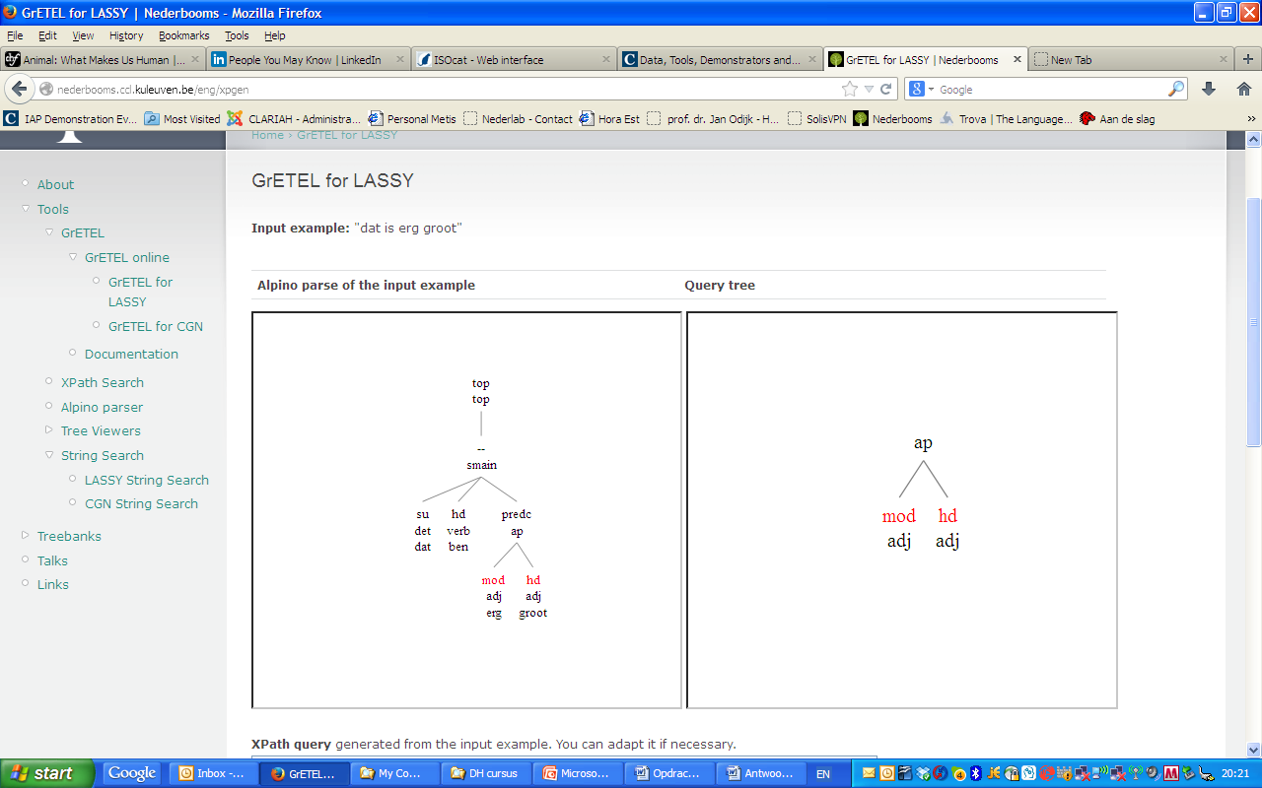
Searching with GrETEL

Slide 31
Searching with GrETEL
Query is now automatically generated:
//node[@cat="ap" and node[@rel="mod" and @pos="adj"] and node[@rel="hd" and @pos="adj"]] (= the query of slide 24)
Applied to LASSY-Small yields 2474 hits

Slide 32
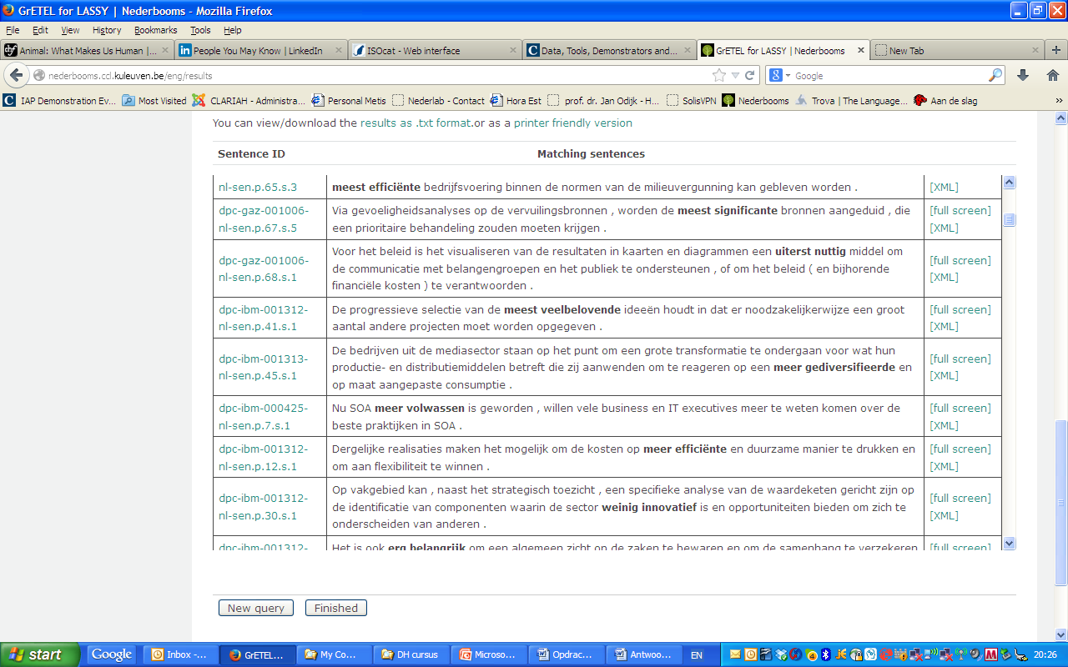
Searching with GrETEL

Slide 33
Searching with GrETEL
Causative ‘doen’
Het bijvoeglijk naamwoord
Circumpositions (op de man af)
Krijgen passive
*Bare nouns (attempt)
**Object topicalisation

Slide 34
Searching with GrETEL
Try these at home:
Two or more attributive adjectives (mooie blauwe ogen)
De medisch specialist
*‘hun’ as subject in (1) CGN, and (2) LASSY
Indirect object with aan (1) before the direct object; (2) after the direct object but before the verb; (3) after the direct object and after the verb
Binominal NPs: een kudde olifanten
Substantivised infinitives: het doden van dieren

Slide 35
Searching with GrETEL Limitations
‘Performance’ (actually used) data
Including errors, hesitations, fillers, etc
Good for certain research questions
Less good for other research questions
No `negative’ data
Linguists sometimes want to know what is NOT possible in language

Slide 36
Searching with GrETEL Limitations
Danger of circularity
‘Which verbs occur with a predicative adjective?’
➔the verbs that have been specified as such in the Alpino grammar
Can be avoided by globally knowing how the Alpino grammar works
No controlled experiments
Minimal pairs seldom occur naturally
BUT: GreTel can be used to construct minimal pairs on the basis of really occurring examples

Slide 37
Searching with GrETEL Limitations
User friendly interface implies limitations:
NOT: ‘give me nouns that occur with any determiner’ (de, het, deze, die, een, enkele…)
NOT: ‘give me nouns that occur with a definite determiner (de, het, deze, die, ... but not een, geen enkele, …)
NOT: ‘give me verbs that occur with a predicative complement’

Slide 38
Searching with GrETEL Limitations
Simple cases can be solved by small adaptations in the Xpath query,e.g.
Verbs that take a predicative complement of pos adjective:
//node[@cat="ssub" and node[@rel="predc" and @pos="adj"] and node[@rel="hd" and @pos="verb"]]
1044 hits
Verbs that take a predicative complement:
//node[@cat="ssub" and node[@rel="predc" and @pos="adj"] and node[@rel="hd" and @pos="verb"]]
3429 hits
Try this at home!

Slide 39
Searching with GrETEL v. Google
Property | Google | GrETEL
String search | yes | yes
Relation between strings | nearness | Grammatical relation
Search for morpho-syntactic and syntactic properties | no | yes
Construction search | no | yes
Dutch only | unreliable | yes
Size | huge | Currently: Small (1M) Soon: Large (700M)

Slide 40
Contents
Brief overview of CLARIN
Illustration of one tool: GrETEL
Conclusions

Slide 41
Conclusions
GrETEL makes formulation of queries significantly simpler than Xpath
You do not have to know Xpath or the exact structure of the treebank
The simple user interface however implies limitations
Some queries cannot be formulated

Slide 42
Conclusions
Some limitations can be overcome
by making small modifications in a generated Xpath query
This also makes the researchers more familiar with query languages (educational effect)
It is complementary to other methods of obtaining empirical evidence
And can be used to support these other methods
Is it really useful despite its limitations?
Try it and provide feedback!

Slide 43
Conclusions
CLARIN is starting to provide the data, facilities and services to carry out humanities research supported by large amounts of data and tools
With easy interfaces and easy search options (no technical background needed)
Still some training is required, to understand both the possibilities and the limitations of the data and the tools
Educational modules are being developed for selected functionality

Slide 44
Invitation
Use (elements from) the CLARIN infrastructure
(Questions? Problems? CLARIN-NL Helpdesk!)
Join user groups of specific services:
gretel@ccl.kuleuven.be
Provide feedback so that we can further improve CLARIN
So that you can improve your research

Slide 45
Further Exploration
LASSY website
DACT Manual
LASSY Annotation manual (in Dutch)

Slide 46
References
GrETEL:
Liesbeth Augustinus, Vincent Vandeghinste, Ineke Schuurman, and Frank Van Eynde. (2013). "Example-Based Treebank Querying with GrETEL – now also for Spoken Dutch" In: Proceedings of the 19th Nordic Conference of Computational Linguistics (NODALIDA 2013). NEALT Proceedings Series 16. Oslo, Norway. pp. 423-428. Liesbeth Augustinus and Frank Van Eynde (2012). "A Treebank-based Investigation of IPP-triggers in Dutch" Digital Humanities Workshop, Leuven. [poster]
Liesbeth Augustinus, Vincent Vandeghinste, and Frank Van Eynde (2012). "Example-Based Treebank Querying" In: Proceedings of the 8th International Conference on Language Resources and Evaluation (LREC-2012). Istanbul, Turkey.
LASSY:
Gertjan van Noord, Gosse Bouma, Frank Van Eynde, Daniël de Kok, Jelmer van der Linde, Ineke Schuurman, Erik Tjong Kim Sang, and Vincent Vandeghinste. (2013). "Large Scale Syntactic Annotation of Written Dutch: Lassy." In: Peter Spyns and Jan Odijk (eds.) Essential Speech and Language Technology for Dutch, Theory and Applications of Natural Language Processing. Springer, pp. 147-164.
CGN
Oostdijk, N., Goedertier, W., Van Eynde, F., Boves, L., Martens, J.-P Moortgat, M., and Baayen, H. (2002). "Experiences from the Spoken Dutch Corpus Project." In: Proceedings of the 3rd International Conference on Language Resources and Evaluation (LREC-2002) Las Palmas, Spain, pp. 340–347.
Alpino
Gertjan van Noord (2006). "At Last Parsing Is Now Operational" In: TALN 2006, pp. 20-42.
LASSY Annotatie
Gertjan van Noord, Ineke Schuurman, and Gosse Bouma. (2011). "Lassy Syntactische Annotatie"

Slide 47
Thanks for your attention!

Slide 48
DO NOT ENTER HERE

Slide 49
Improvement Suggestions
Actual use of the search facilities leads to suggestions for improvements, e.g.
Selection of inflection (extended PoS) in GreTel was originally not possible (and is still not possible) for LASSY-Small but has been added for search in CGN
In the Dutch CGN/SONAR (de facto standard ) PoS tagging system one cannot easily express ‘definite determiner’ (only as a complex regular expression over PoS tags): a special facility for this is required
The Dutch CGN/SONAR (de facto standard ) Pos tagging system uses, for adjectives, the ø-form tag for cases where the distinction between e-form and ø-form is neutralized. This is not incorrect but a facility to distinguish the two would be very desirable (and this is possible by making use of the CGN lexicon and/or the CELEX lexicon
Idem for adjectives that have an e-form identical to a ø-form because of phonological reasons (adjectives ending in two syllables headed by schwa)
Zero-inflection in MIMORE is represented by absence of an inflection tag. That makes search for such examples very difficult and requires either a NOT-operator (which is not there) or explicit tagging of absence of inflection

Slide 50
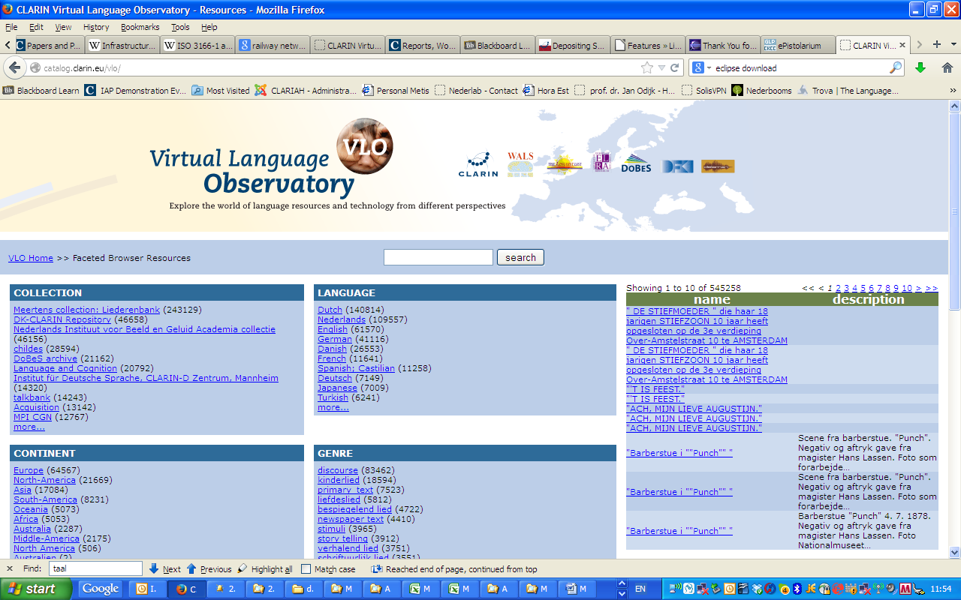
Improvement Suggestions

Slide 51
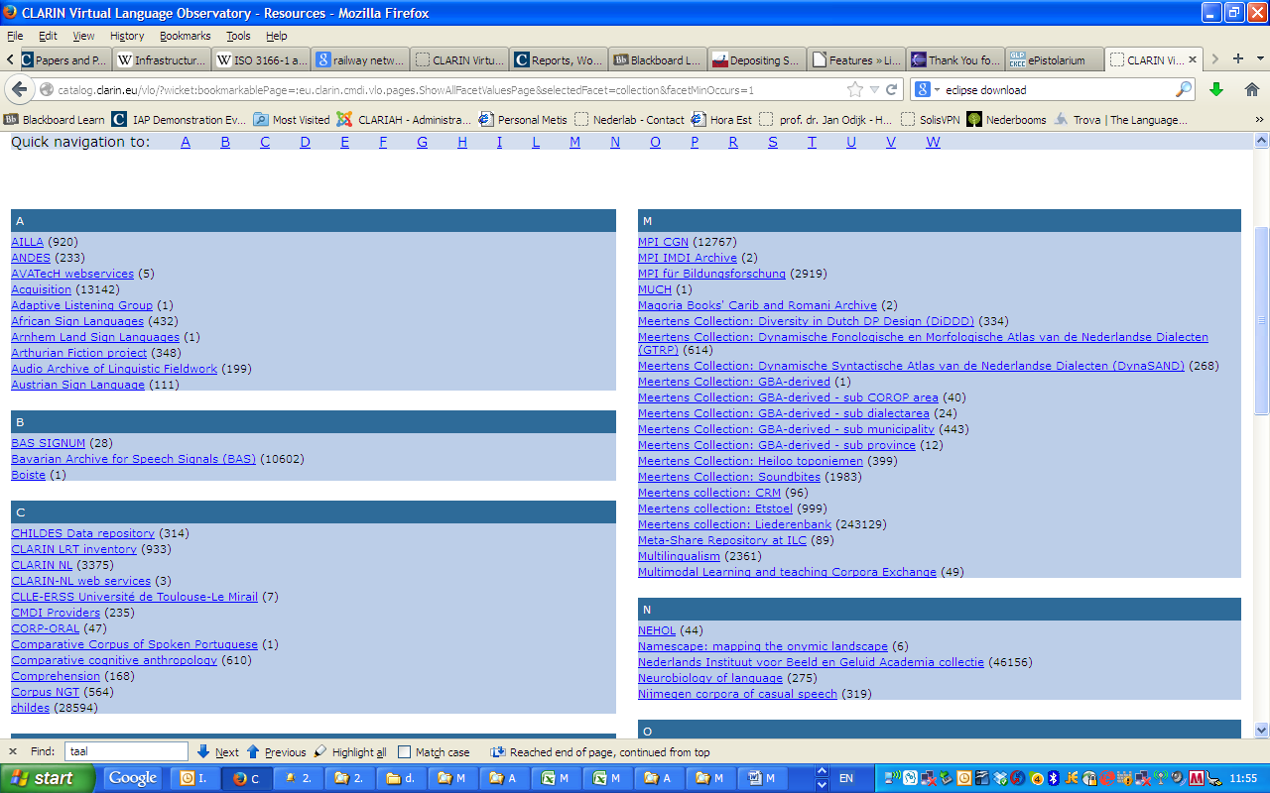
Improvement Suggestions

Slide 52
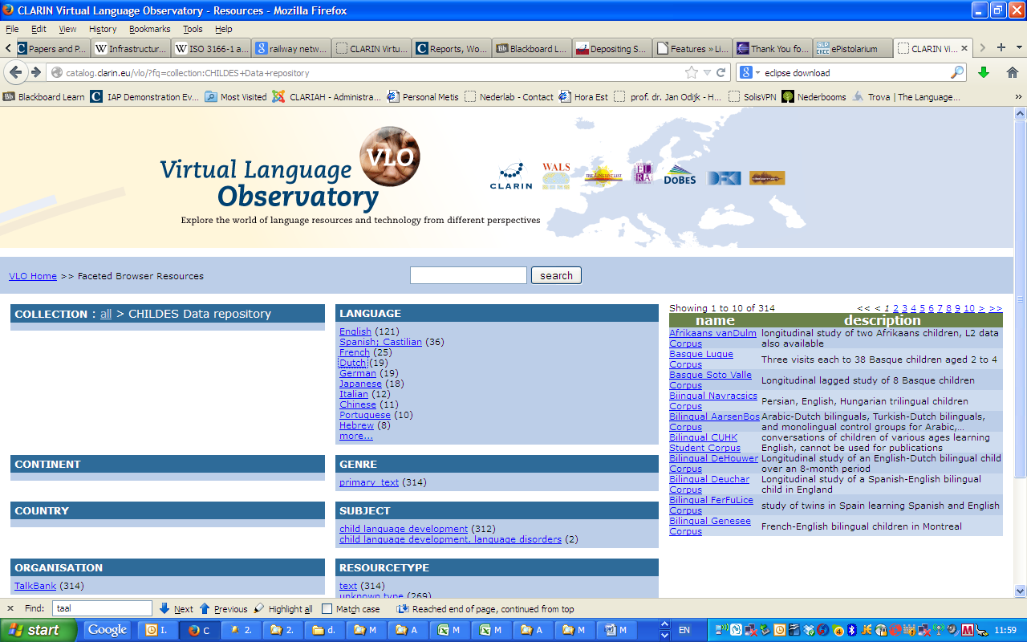
Improvement Suggestions

Slide 53
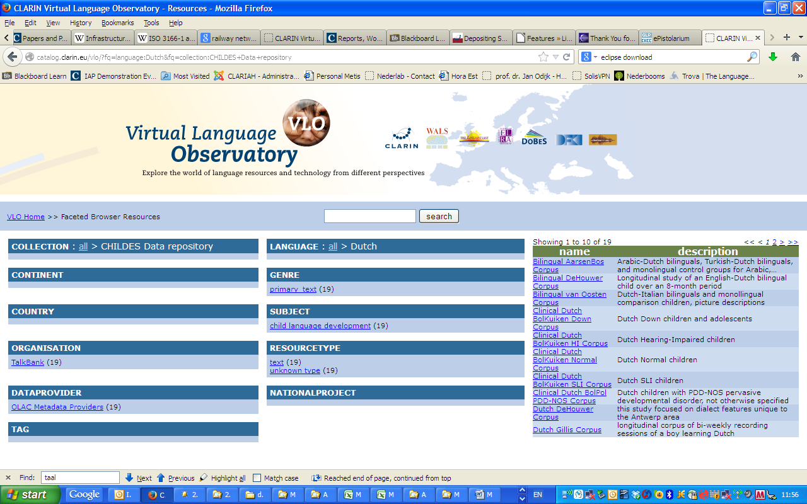
Improvement Suggestions

Slide 54
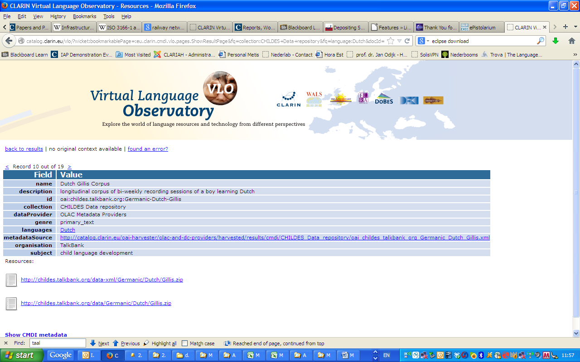
Improvement Suggestions

Slide 55
VLO
RETURN Page

Slide 56
Doen Causative

Slide 57
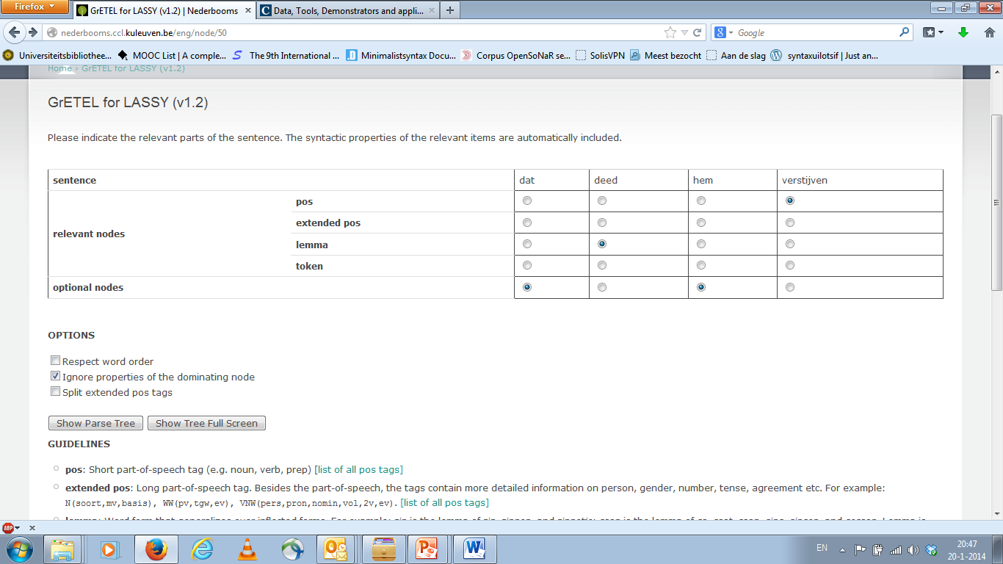
Doen Causative
RETURN Page

Slide 58
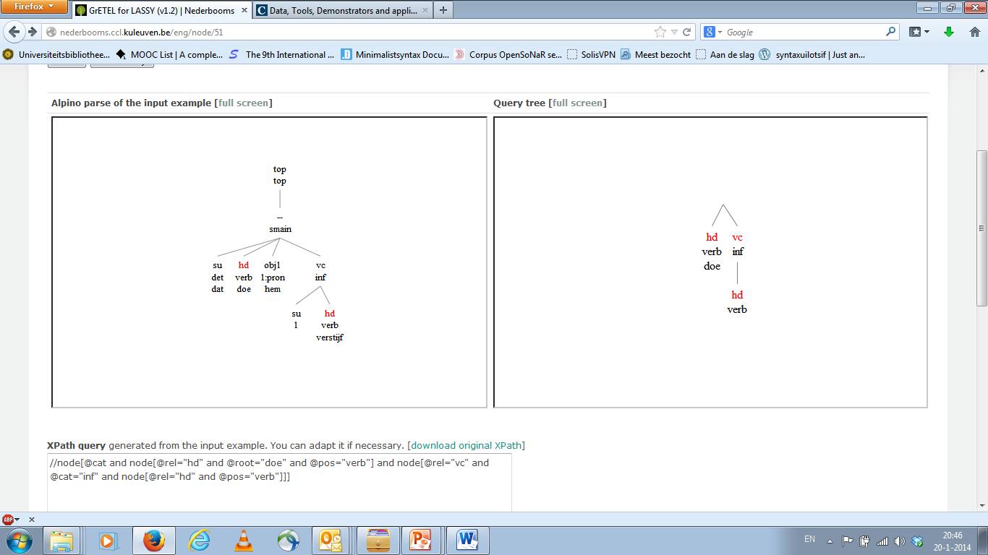
Doen Causative
RETURN Page

Slide 59
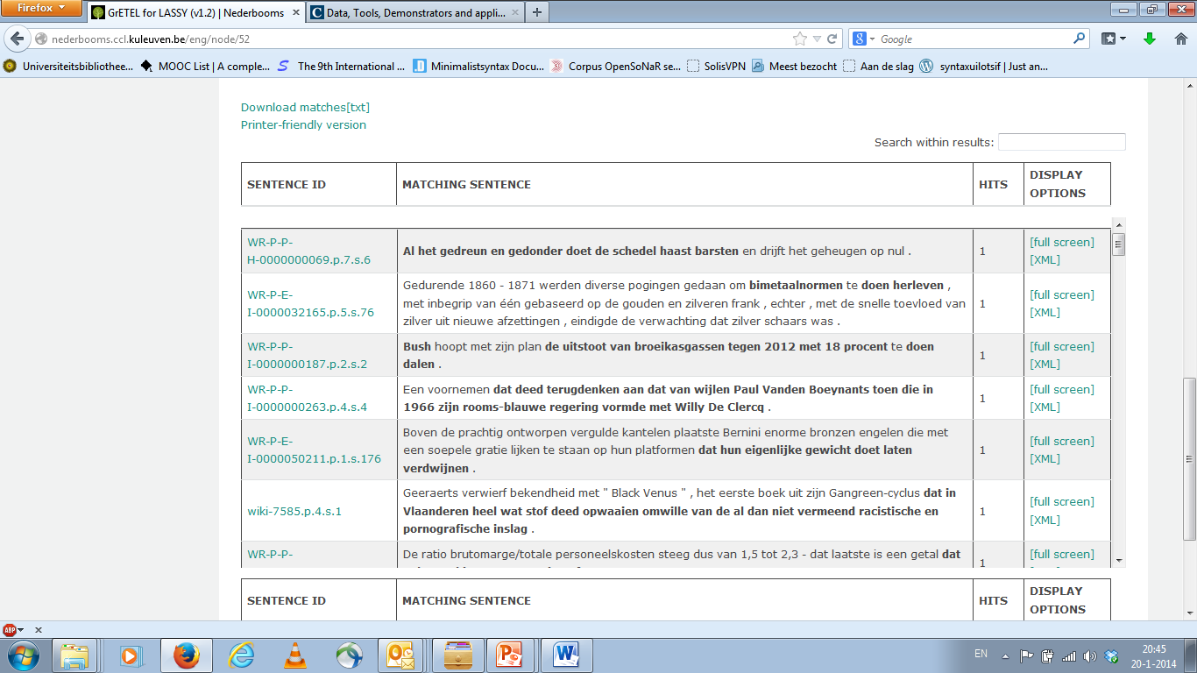
Doen Causative
RETURN Page

Slide 60
Doen Causative
RETURN Page

Slide 61
Het bijvoeglijk naamwoord

Slide 62
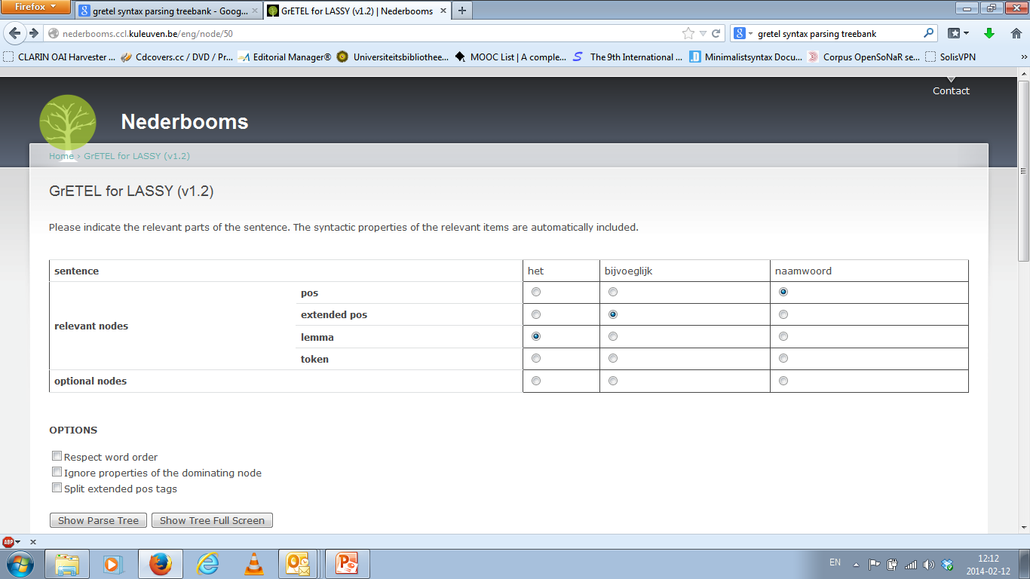
Het Bijvoeglijk naamwoord
RETURN Page

Slide 63
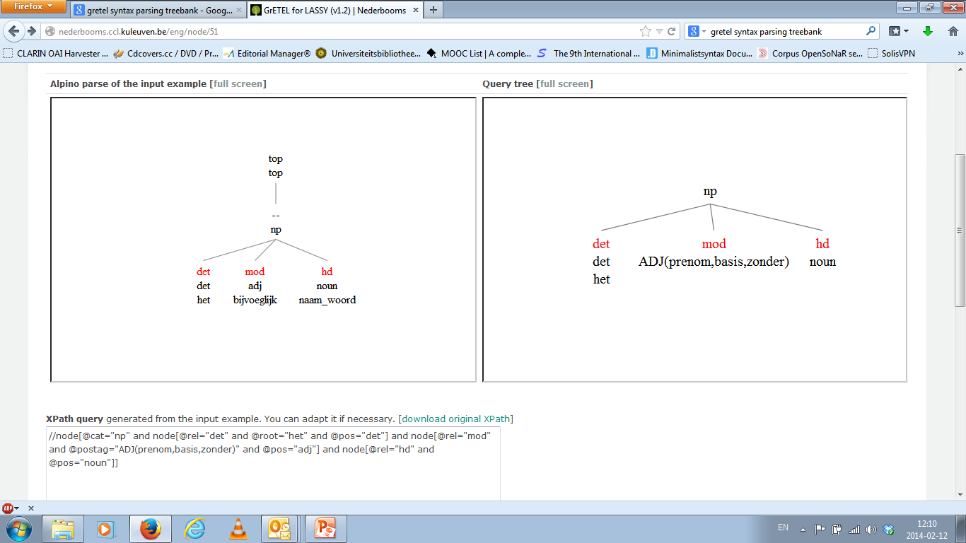
Het Bijvoeglijk naamwoord
RETURN Page

Slide 64
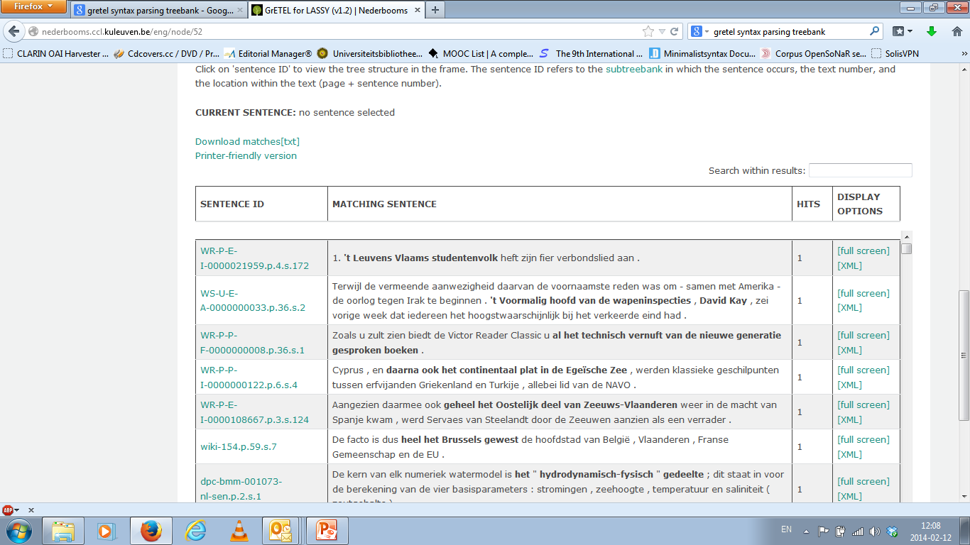
Het bijvoeglijk naamwoord
RETURN Page

Slide 65
Het Bijvoeglijk naamwoord
RETURN Page

Slide 66
Circumpositions
Start

Slide 67
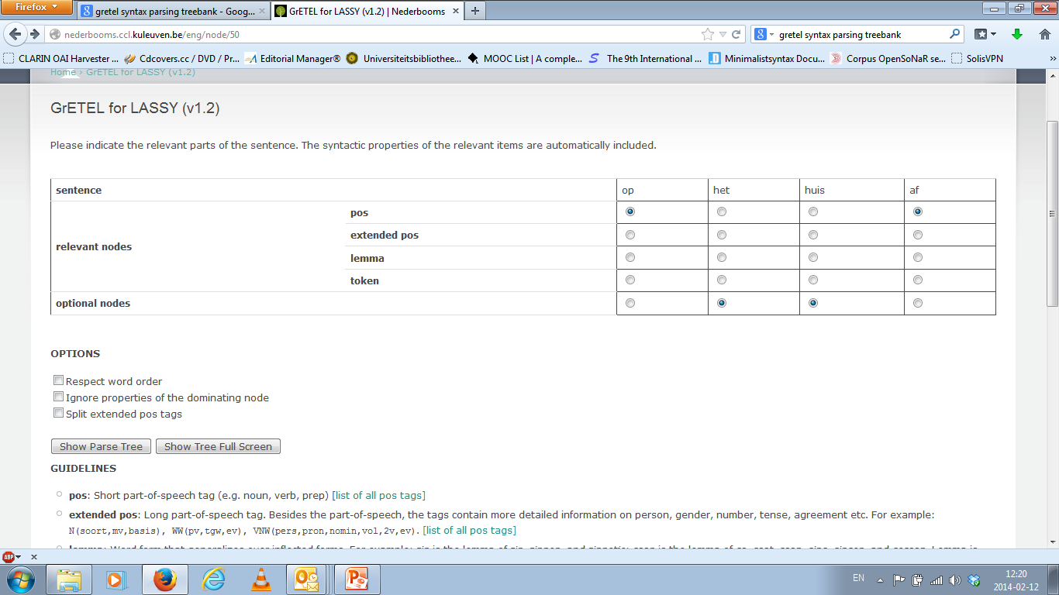
Circumpositions
RETURN Page

Slide 68
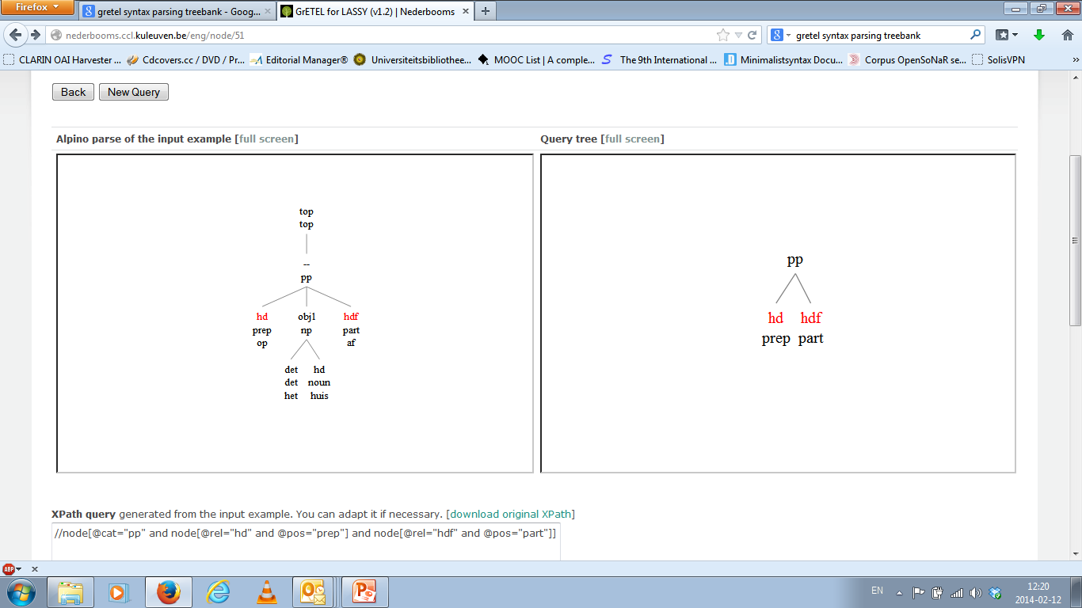
Circumpositions
RETURN Page

Slide 69
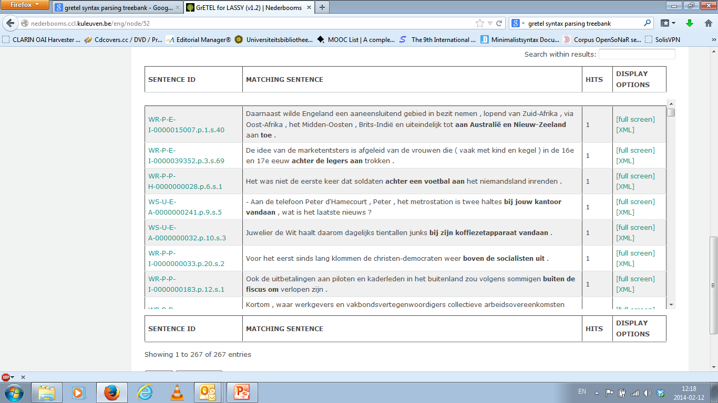
Circumpositions
RETURN Page

Slide 70
Circumpositions
RETURN Page

Slide 71
Krijgen-passive
Start Page

Slide 72
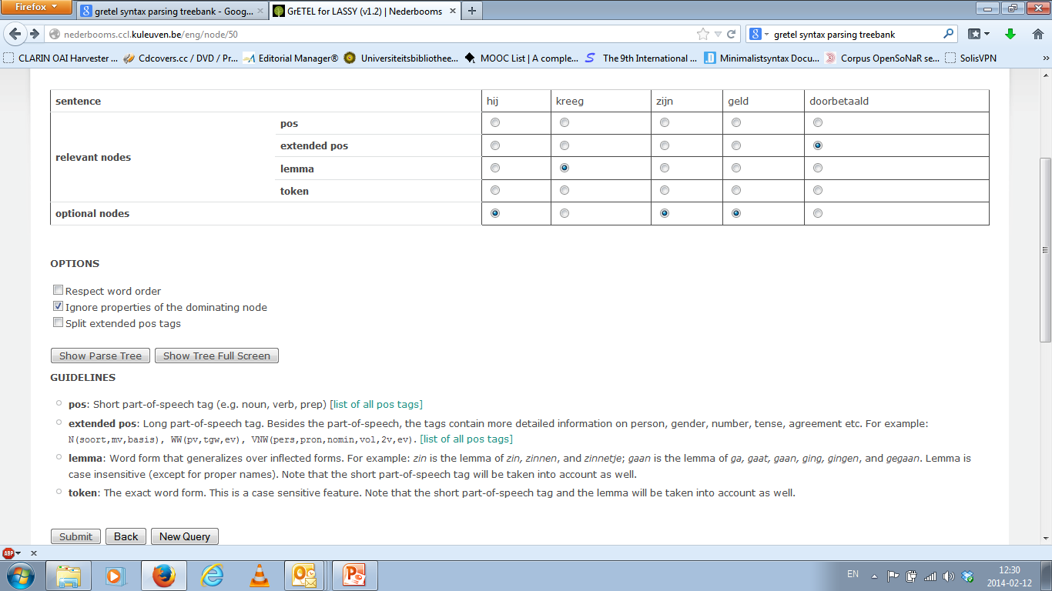
Krijgen-passive
RETURN Page

Slide 73
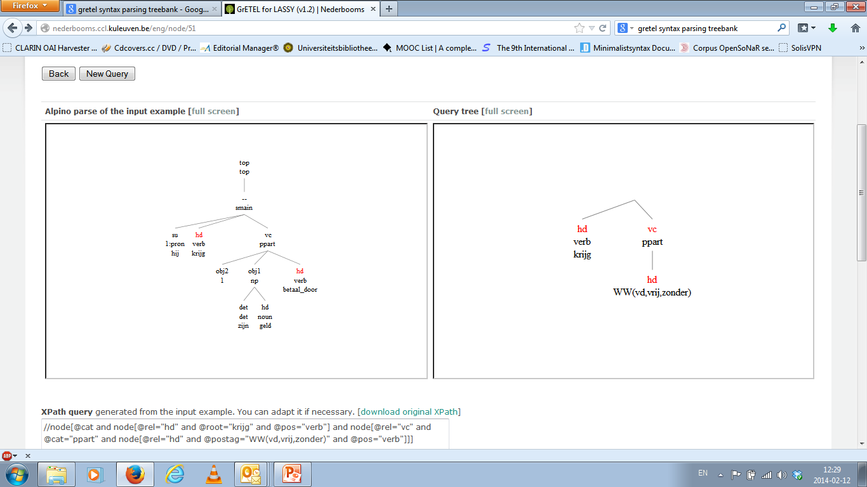
Krijgen-passive
RETURN Page

Slide 74
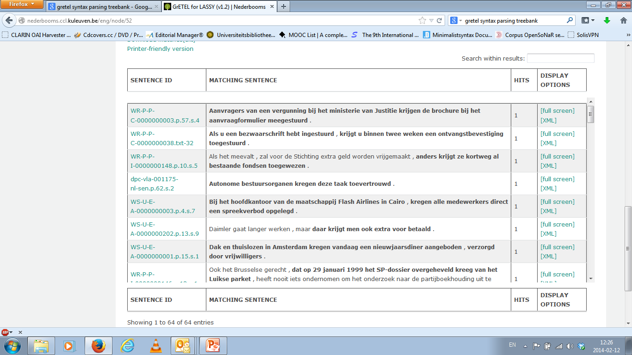
Krijgen-passive
RETURN Page

Slide 75
Krijgen-passive
RETURN Page

Slide 76
Bare Nouns
Start Page

Slide 77
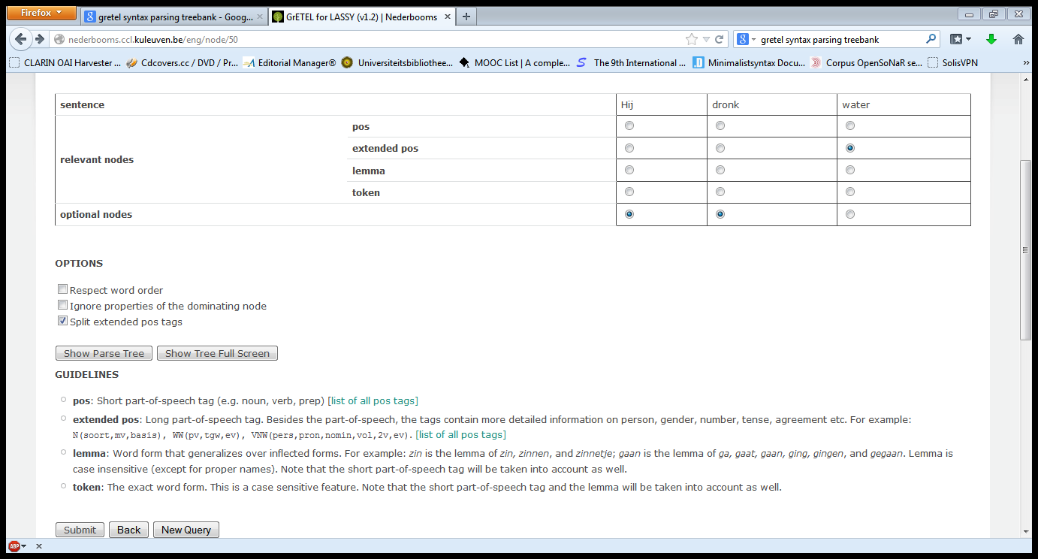
Bare Nouns
RETURN Page

Slide 78
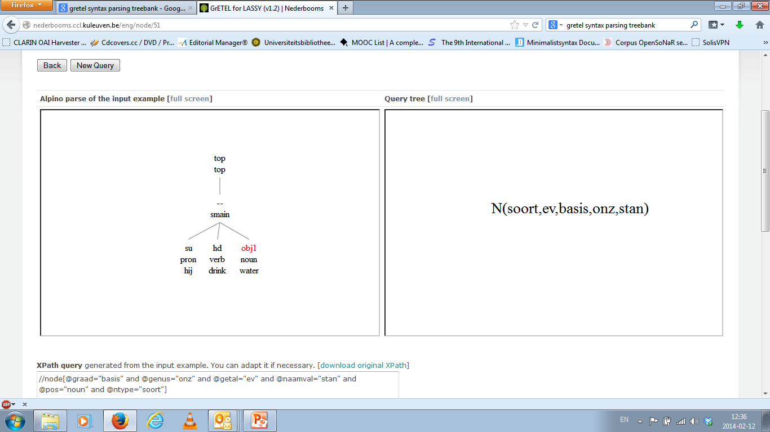
Bare Nouns
RETURN Page

Slide 79
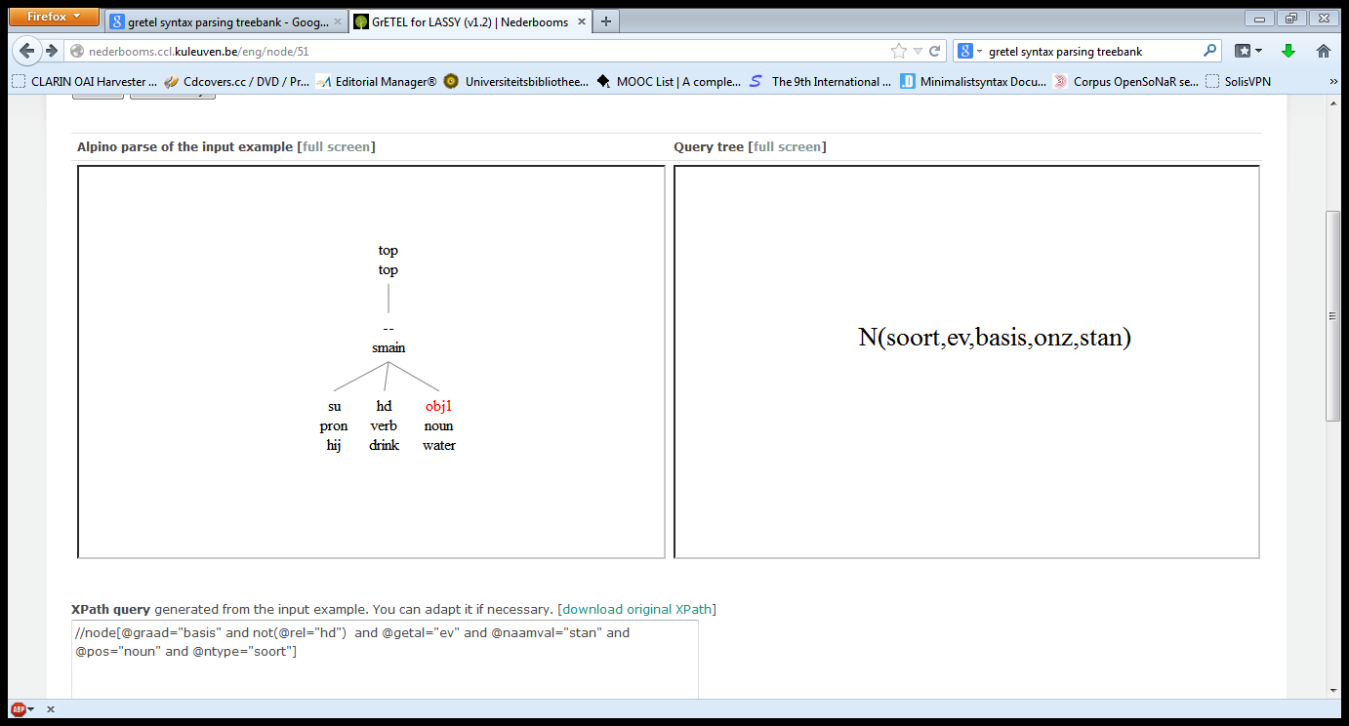
Bare Nouns
RETURN Page

Slide 80
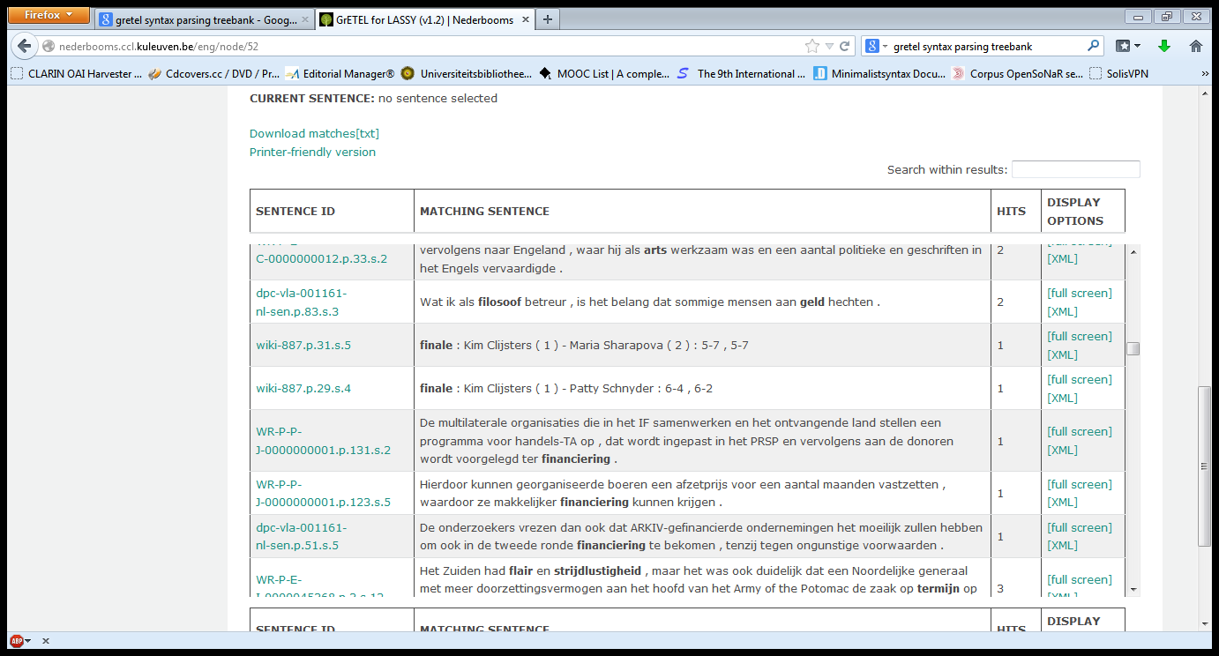
Bare Nouns
RETURN Page

Slide 81
Bare Nouns
RETURN Page

Slide 82
Object Topicalisation
Start Page

Slide 83
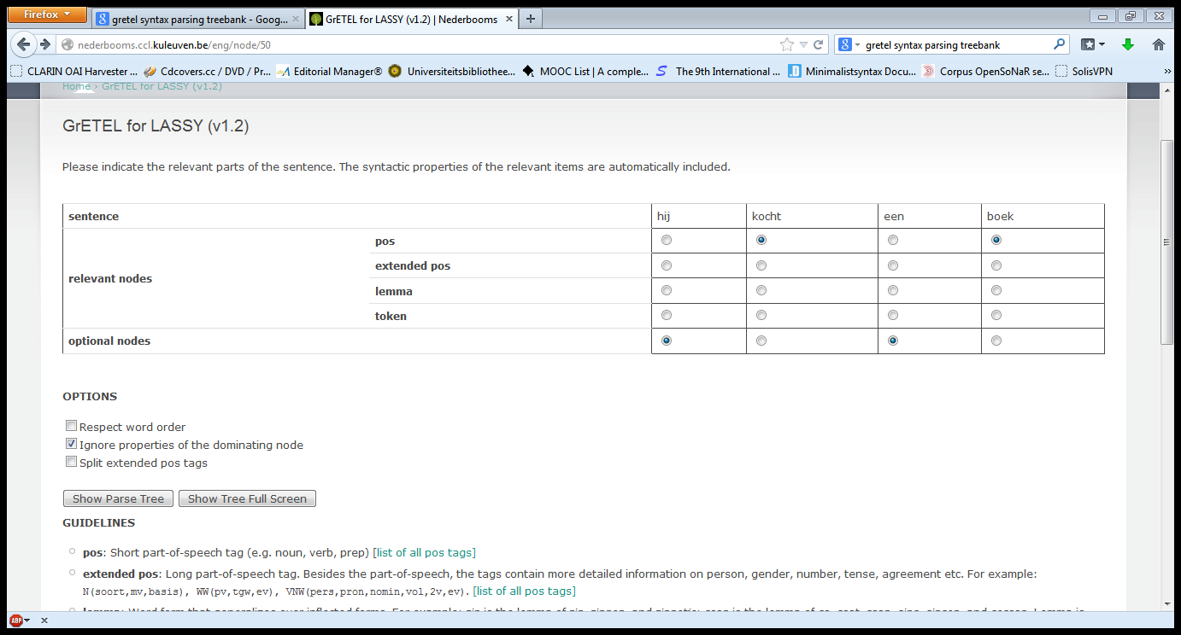
Object Topicalisation
RETURN Page

Slide 84
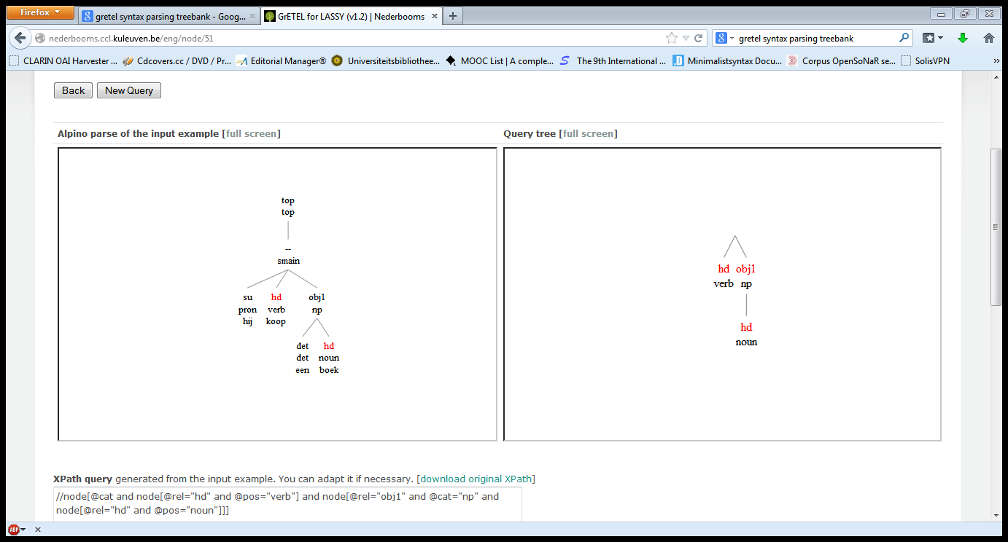
Object Topicalisation
RETURN Page

Slide 85
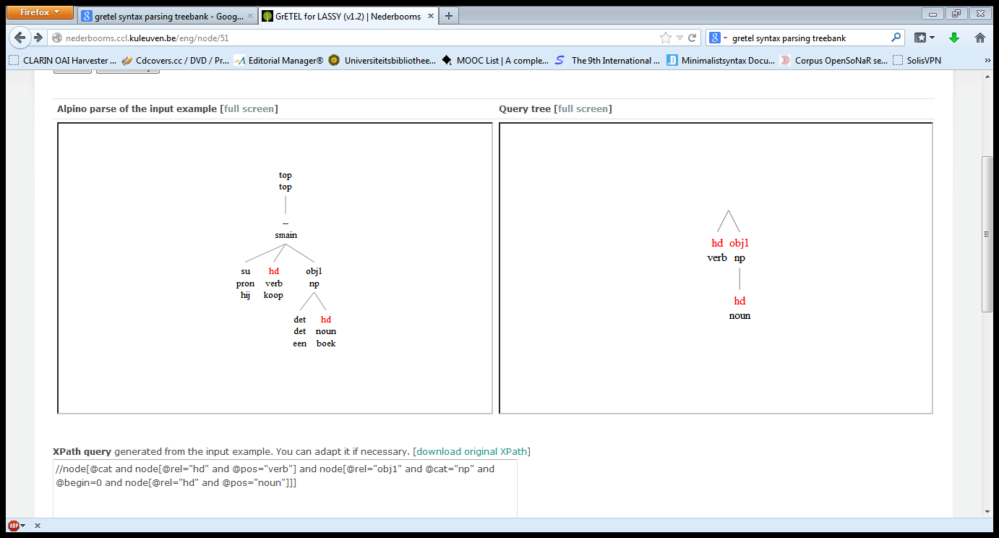
Object Topicalisation
RETURN Page

Slide 86
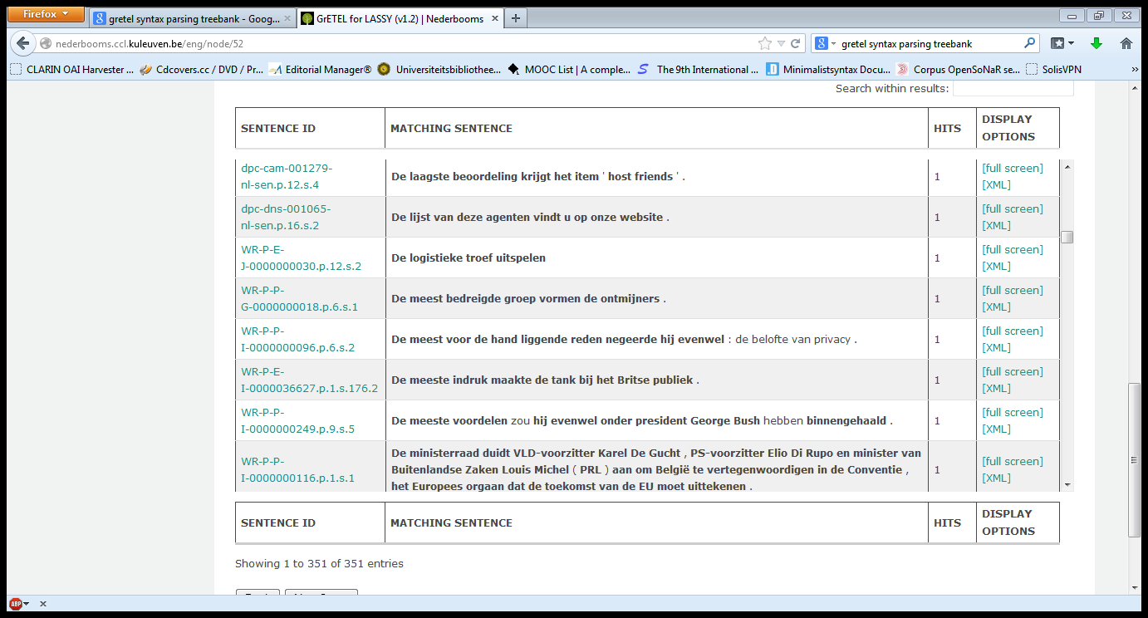
Object Topicalisation
RETURN Page

Slide 87
Object Topicalisation
RETURN Page

