Slide 1
Linguistics with CLARIN Storing resources in CLARIN
Jan Odijk
LOT Winterschool
Amsterdam, 2015-01-16

Slide 2
Overview
Why store resource in CLARIN?
How to store resources in CLARIN
What you must do
What the CLARIN Centre must do

Slide 3
Overview
Why store resource in CLARIN?
How to store resources in CLARIN
What you must do
What the CLARIN Centre must do

Slide 4
Why?
You may benefit from it
Existing tools in CLARIN
faster production, better quality, more features
Search engines, analysis tools, visualisation tools
Can be easily combined with other data in CLARIN
Others may benefit from it
Many unexpected uses of your data
Now or in the future

Slide 5
Why?
Openness in Science
Usually produced with public money
Integrity
Recently many scandals with faked data
Verifiability and Replicability of research results
Essential for the proper conduct of science
More and more journals are requiring it
Funding Agency requires it (data management plan)
DANS CLIP on data sharing (in Dutch)

Slide 6
Overview
Why store resource in CLARIN?
How to store resources in CLARIN
What you must do
What the CLARIN Centre must do

Slide 7
How?
Start early
Preferably before you start creating data
Contact a CLARIN Type B centre
They can help you
Your resource must be stored at a CLARIN centre
Which CLARIN centre?
Check CLARIN-NL portal (http://dev.clarin.nl )
CLARIN-NL website Centres page
Brief summary

Slide 8
Overview
Why store resource in CLARIN?
How to store resources in CLARIN
What you must do
What the CLARIN Centre must do

Slide 9
What you must do
Define what your data are / are going to be
Ensure legal / ethical compliance
Permission from subjects to use the data for research
Provisions for respecting privacy matters
Determine Metadata Contents
Determine what information should be included in the metadata (resource description) of your resource
Collect this information

Slide 10
What you must do
Determine centre
Contact them and make arrangements
Determine CLARIN-recommended standard format(s) for your data
Consult with the CLARIN Centre
Ask help from the helpdesk helpdesk@clarin.nl
E.g. LMF (Lexical Markup Framework for lexicons, cf. Cornetto, DuELME, …)

Slide 11
What you must do
Metadata must be in CMDI format
CMDI provides
A model for metadata
A format for metadata
Tools to make metadata
CMDI Metadata are written in XML
It does NOT proscribe the contents of the metadata
Introduction to CMDI cmdi@clarin.eu

Slide 12
What you must do
CMDI Metadata use a metadata profile
Metadata profile: a combination of
Metadata components
Metadata elements
Metadata Component: a combination of
Metadata components (optional)
Metadata elements (optional)
Metadata Element
XML element: name, value (of an explicit type), attribute-value pairs

Slide 13
What you must do
This provides high flexibility
YOU can determine the metadata for your resource
By defining your own profiles, components, elements
CMDI helps you with
A profile and component editor [login required]
A list of commonly used profiles and components
A metadata editor: ARBIL

Slide 14
What you must do
Flexibility requires explicit semantics!
The CLARIN infrastructure must `know’ what you mean with your metadata elements
Otherwise it cannot use faceted browsing in the VLO or the Meertens Metadata Search Engine

Slide 15
What you must do
Explicit semantics:
Each element in the data and metadata must have a link to a CLARIN-recognized concept or data category registry
Most prominent data category registry in CLARIN was ISOCAT
Example Data Category in ISOCAT
Example Link to ISOCAT in element definition

Slide 16
What you must do
Explicit semantics (2):
RELCAT alpha version
For relations between data categories
SCHEMACAT alpha version
For describing schemas of resources
Recently changed to CLARIN Concept Registry
CCR Browser
an OpenSKOS instance hosted by Meertens Institute
CLAVAS Vocabulary Service
Interface to other data category registries and vocabularies
ISO 639-3 Language codes

Slide 17
What you must do
Attend dedicated tutorials on CMDI and ISOCAT/CCR
Regularly organized in NL (each 2+ times/year)
Usually the CLARIN Centre helps you creating the CMDI metadata
Maximally reuse existing profiles /components
It will help you get better metadata
You do not have to reinvent the wheel

Slide 18
What you must do
CLARIN
strongly recommends using certain components (e.g. GeneralInfo component) and
may require inclusion of certain properties
Do not forget properties that are ‘obvious to you’, e.g.
Language
Period of the language
Standard language or dialects
Title
Version

Slide 19
What you must do
Add properties that are important from a linguistic perspective:
Which linguistic annotations does it contain
For which subdisciplines of linguistics is it mostly relevant
Does it involve text, audio, video, or databases?
For tools
What are the linguistic properties of its input and output (which annotations, which annotation schemata, pos-tags, formats, etc)

Slide 20
What you must do
Live Version v. exchange/archive version
E.g. lexicon
in Lexical Markup Framework compatible XML text v.
database with indexes for fast search
Live version is ideally derived fully automatically from the exchange/archive version
In close cooperation with the CLARIN Centre

Slide 21
What you must do
Software
Desktop tool
Desktop application
Web service
SOAP / REST , use CLAM if possible
Web application
There must be `metadata’ for software as well!
Generic profile exists and is being refined
Consult with the CLARIN Centre

Slide 22
Overview
Why store resource in CLARIN?
How to store resources in CLARIN
What you must do
What the CLARIN Centre must do

Slide 23
What the CLARIN Centre must do
Assist you with your tasks
Assign Persistent Identifiers (PIDs) to all data and metadata
Handle system for assignment and resolution of PIDs
example
Make Metadata harvestable
OAI-PMH protocol
Open Archives Initiative Protocol for Metadata Harvesting

Slide 24
What the CLARIN Centre must do
Store the data in the centre’s repository
LAMUS (the Language Archive) and its documentation online or as PDF
EASY (DANS) and its Help and Support Page
Make data themselves available and accessible in the CLARIN infrastructure

Slide 25
What the CLARIN Centre must do
Provisions for legal / ethical restrictions
Long term preservation
Data Seal of Approval
(Minimal) Maintenance

Slide 26
What about existing data?
Adapt them to meet the CLARIN requirements
Data Curation
CLARIN-NL
has financed many data curation projects
Has set up Data Curation Service
CLARIAH (successor project)
Will continue these curation activities

Slide 27
Thanks for your attention!

Slide 28
DO NOT ENTER HERE

Slide 29
CLARIN-NL B Centres
Meertens Institute: resources relevant for the study of
cultural expressions and Language variation within the Dutch language
Max Planck Institute for Psycholinguistics (The Language Archive): resources related to the study of
psychological, social and biological foundations of language
Huygens Institute: resources related to the study of
history and literature of the Netherlands.
Institute for Dutch Lexicology (INL)
relevant to the lexicological study of the Dutch language
Data Archiving and Networked Centres (DANS)
digital research data generally

Slide 30
CLARIN-NL D Centres
Koninklijke Bibliotheek (National Library):
Digital books, articles, newspapers
Includes DBNL (Digital Library for Dutch Literature)
(will be available in the VLO soon)
Nederlands Instituut voor Beeld & Geluid (NIBG, Netherlands Institute for Sound and Vision )
Audio-visual data (esp. TV and radio programmes)
NIBG data via the VLO
Utrecht University Library (UBU)
Digital books, articles
UBU data via the VLO

Slide 31
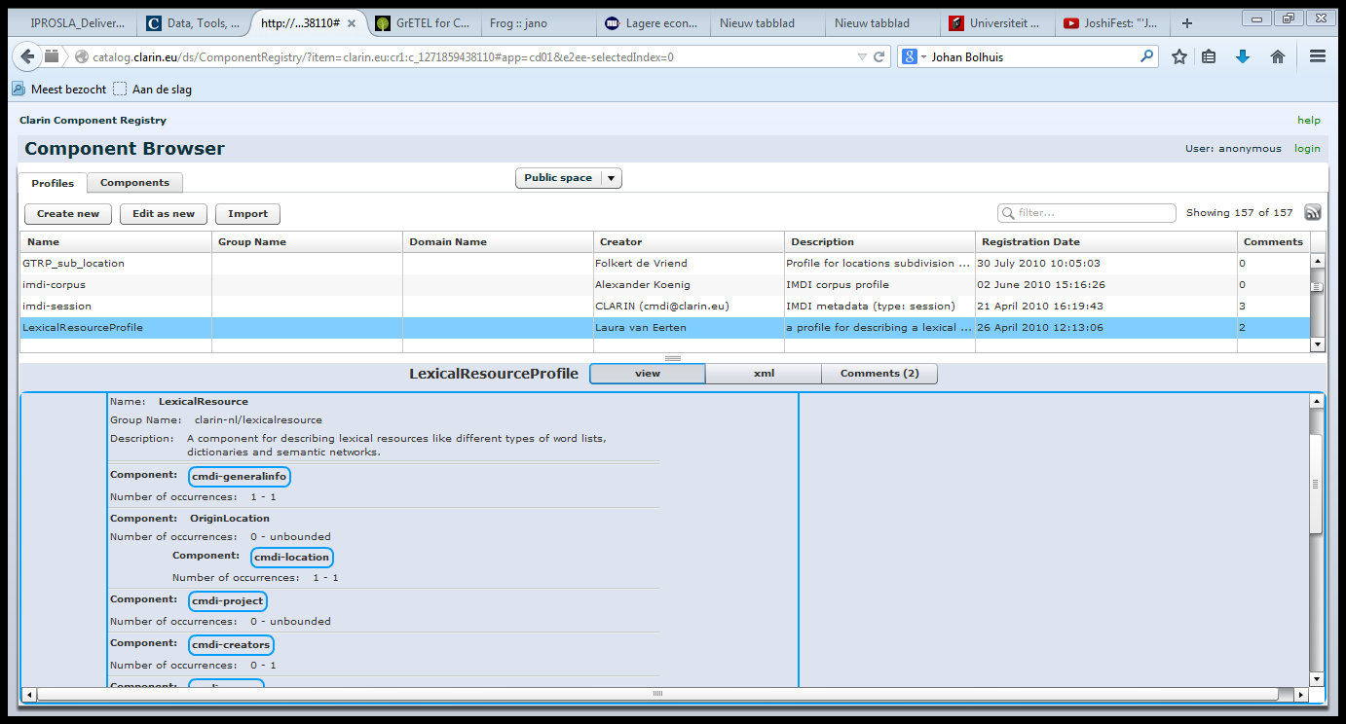
CMDI Profile: Example
Return Page

Slide 32
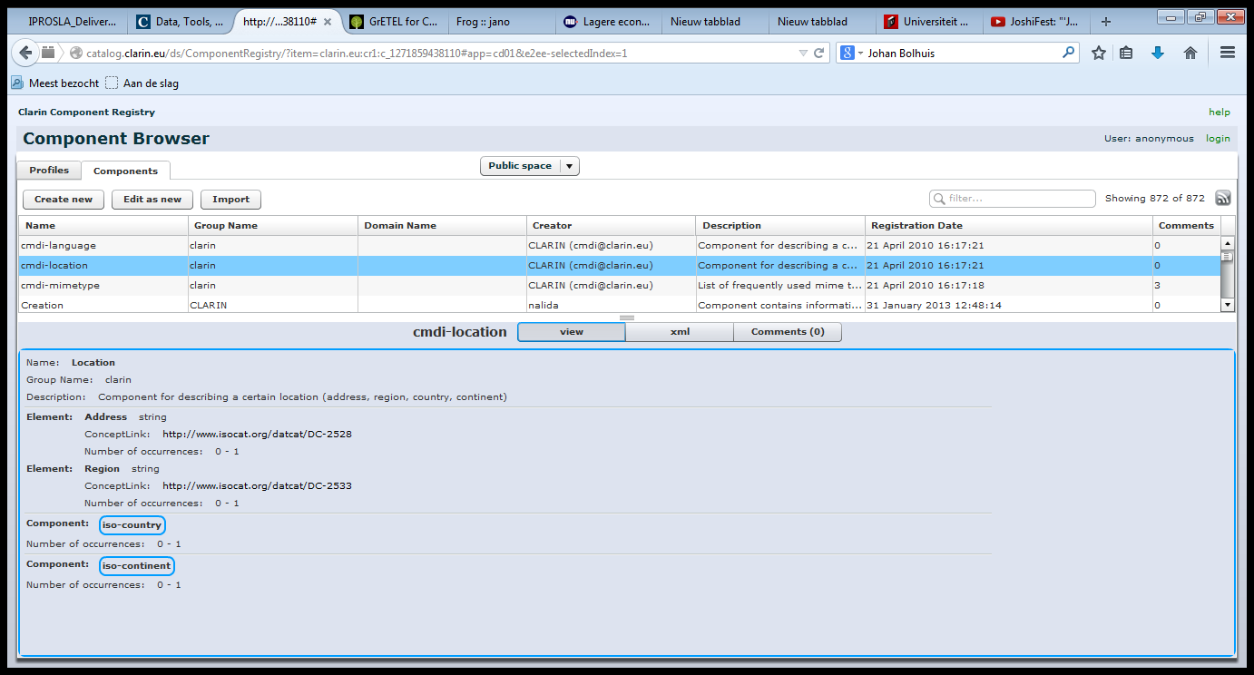
CMDI Component: Example
Return Page

Slide 33
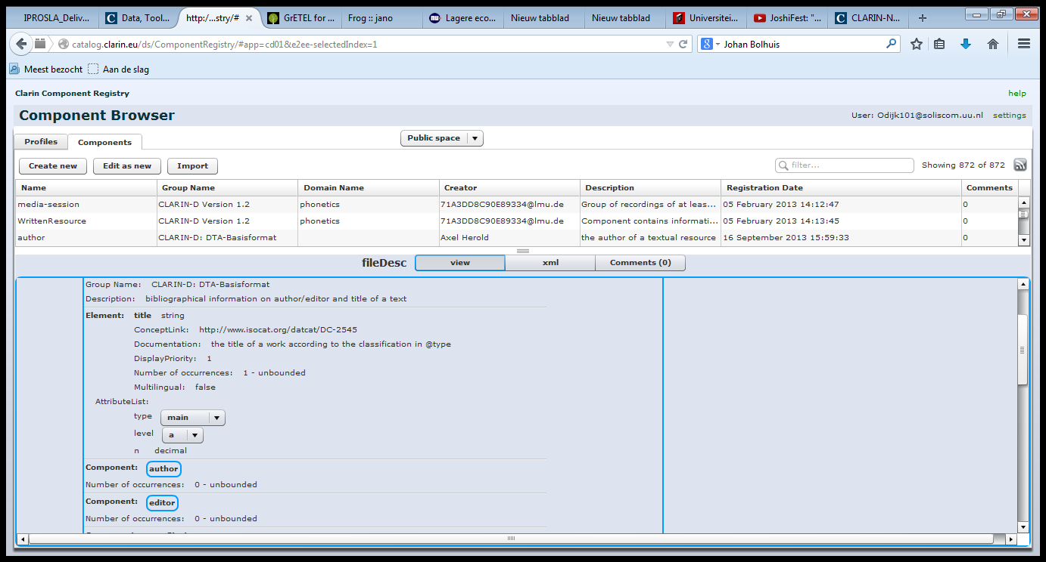
CMDI Element: Example
Return Page

Slide 34
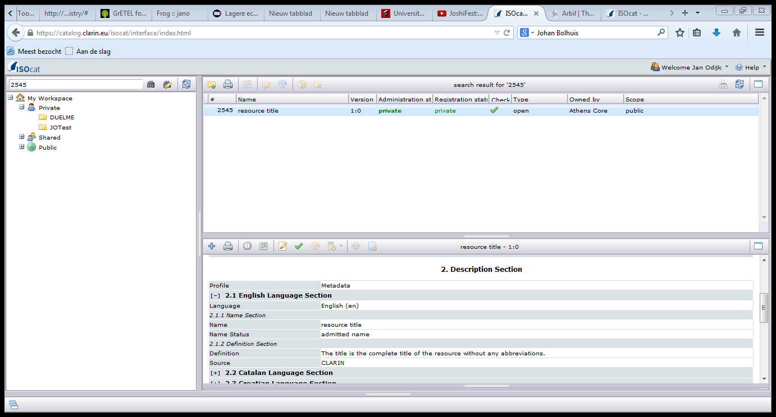
ISOCAT DC
Return Page

Slide 35
LINK to ISOCAT DC
Return Page

Slide 36
LOGIN
CLARIN attempts to maximize open and free access to resources
with as little restrictions as possible
no login unless it cannot be avoided
Sometimes, a login (Authentication and Authorisation, AAI) is required, e.g.
Because there are legal and/or ethical restrictions on the data
To identify you and assign you your own workspace / data
To enter with your own personal settings

Slide 37
LOGIN
CLARIN is a distributed infrastructure
How can we avoid that you have to login again and again?
How can we avoid that you have to remember many user names and passwords?
How can we avoid that CLARIN has to securely store user names, passwords and possibly other privacy-sensitive information?

Slide 38
LOGIN
The answer: Shibboleth
When you log in, you are directed to a login with your own institute
You then log in with you institute’s user name and password
The institute server then confirms that you are a trusted person, and you can enter this part of the CLARIN infrastructure
it does not pass on any sensitive information such as your user name or password
If you now go to another part of the CLARIN infrastructure that requires login, it `knows’ that you are already logged in, so you do not have to do this again (Single Sign On, SSO)

Slide 39
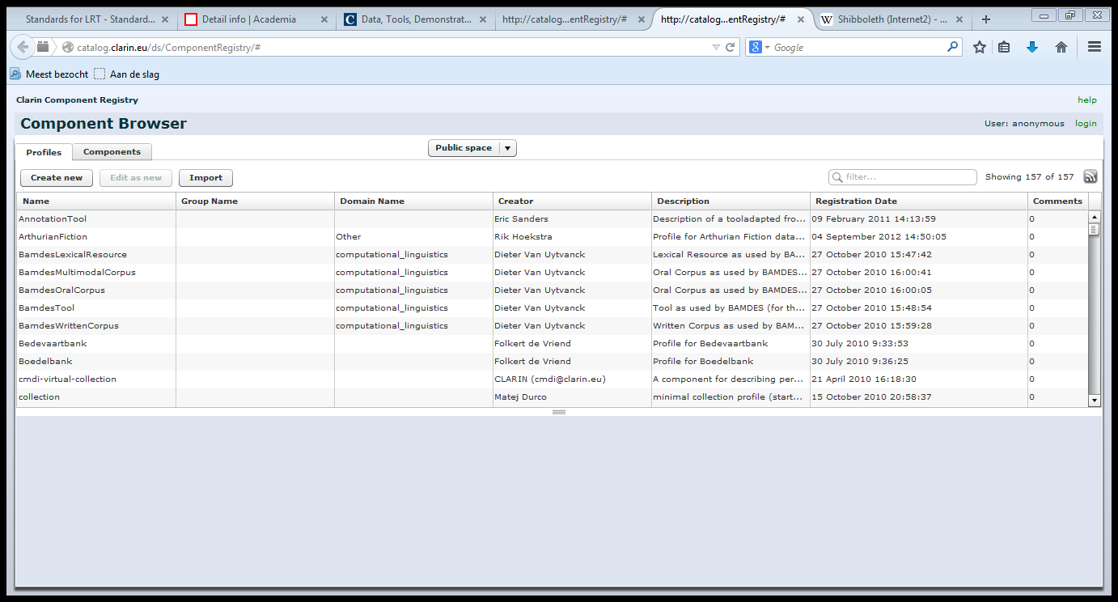
LOGIN
Return Page

Slide 40
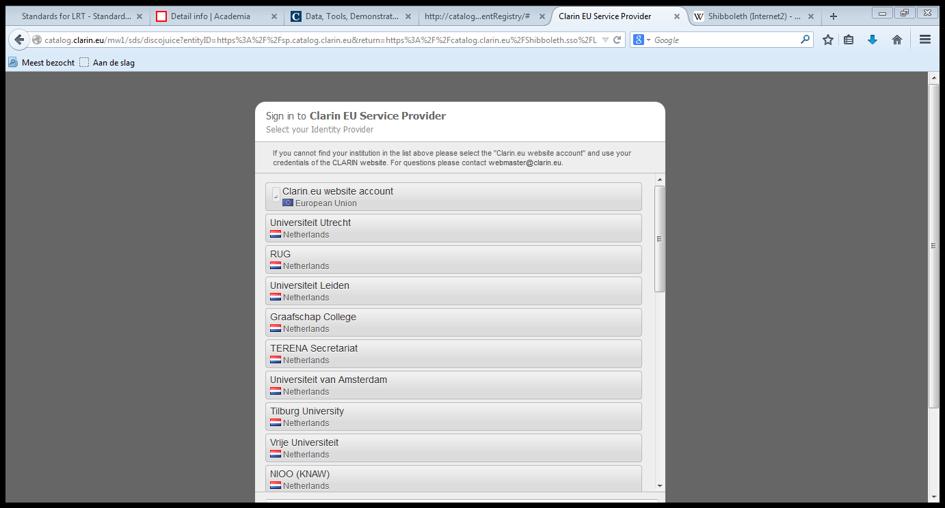
LOGIN
Return Page

Slide 41
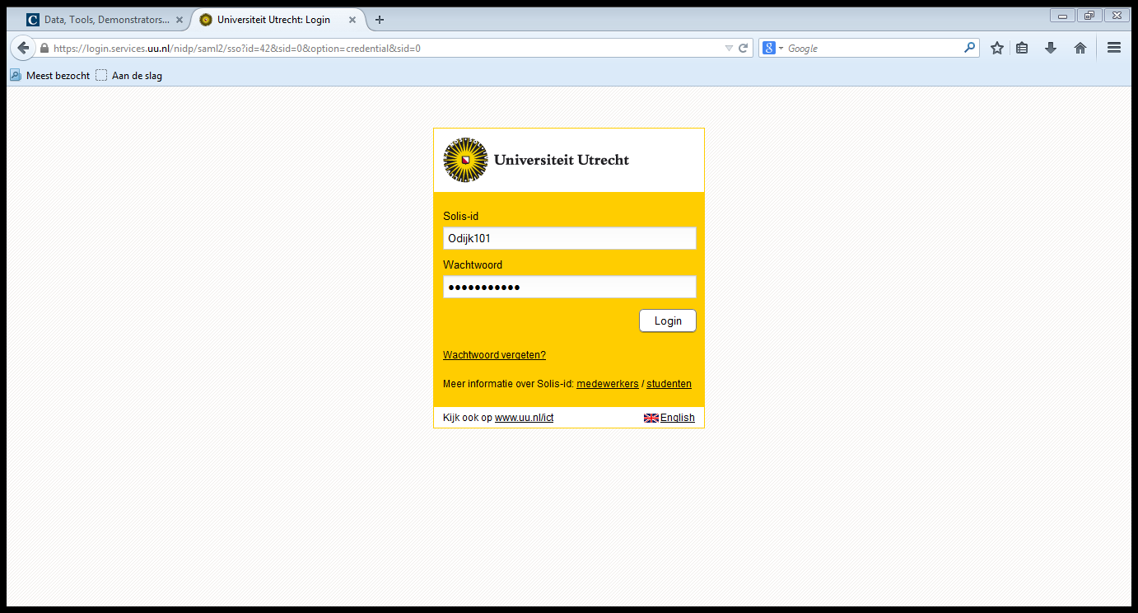
LOGIN
Return Page

Slide 42
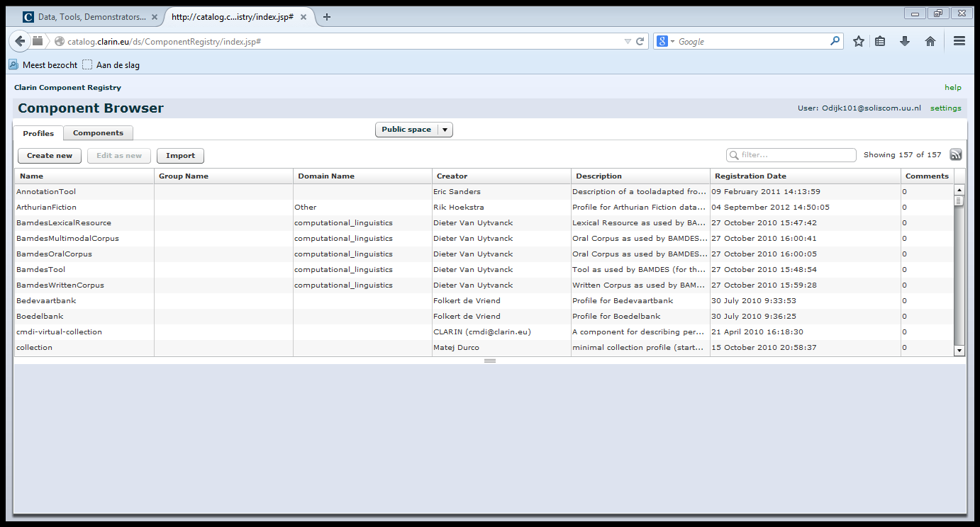
LOGIN
Return Page

Slide 43
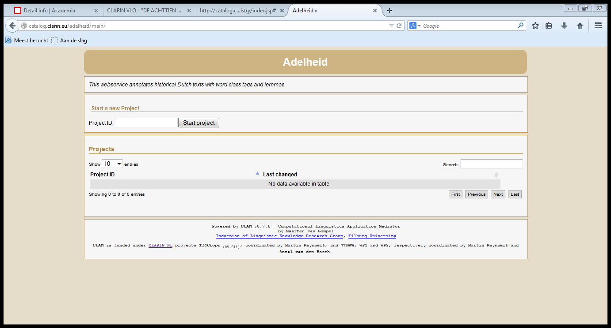
LOGIN
Return Page

Slide 44
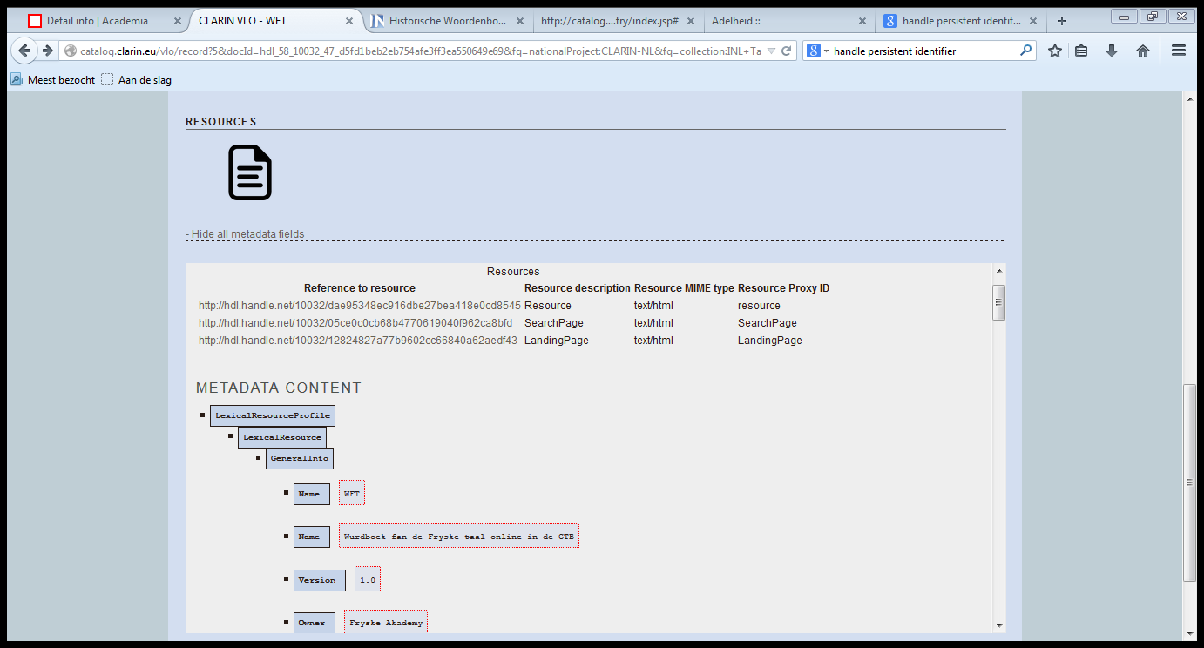
PIDs
Return Page

Slide 45
LOGIN
Return Page

