Slide 1
Linguistics with CLARIN Search Illustration 1
Jan Odijk
LOT Winterschool
Amsterdam, 2015-01-12

Slide 2
CLARIN Infrastructure Tools: Illustration
Example Problem (based on Odijk 2011)
Glimpse of
Searching in PoS-tagged Corpus
Searching for grammatical relations
Searching for Constructions
Searching for synonyms/ hyponyms
Analyzing/Visualising Word occurrence patterns in CHILDES

Slide 3
CLARIN Infrastructure Tools: Illustration
MORE
 | A | P | V
 | Zij is daar __ blij mee | Zij is daar __ mee in haar nopjes | Zij verheugde zich daar __ over
Zeer | OK | OK | OK
Erg | OK | OK | OK
Heel | OK | * | *

Slide 4
CLARIN Infrastructure Tools: Illustration
Differences
not due to semantics
purely syntactic
does not follow from a general principle,
so it must be ‘learned’ by a child acquiring Dutch as a first language

Slide 5
CLARIN Infrastructure Tools: Illustration
Research Questions
How can such facts be acquired (L1 acquisition)?
How can child learn that zeer and heel can modify A, V, and P?
Is there enough evidence for this to the child?
How can a child `learn’ that heel cannot modify Ps or Vs-> there is no evidence for this (no negative evidence)
Is there a relation between time of acquisition and modification potential?
Role of indirect negative evidence?
(and much more can be said about this)

Slide 6
CLARIN Infrastructure Tools: Illustration
How to approach this problem
Study literature, study grammars, form and test hypotheses, look for relevant data sets, create new datasets, enrich data with annotations, search in and through datasets, analyze data and visualize analysis results, design and carry out experiments, design and do simulations, ….
Focus here: searching relevant data easily in large resources using (components of ) the CLARIN infrastructure

Slide 7
CLARIN Infrastructure Tools: Illustration
Google is no good for this!
Because you need (inter alia) grammatical information
Because (as any decent word) the relevant words are highly ambiguous (syntax and semantics):
Erg (4x)= noun(de) ‘erg’; noun(het)’evil’, adj+adv ‘unpleasant’, adv ’very’
Zeer (3x)= noun ‘pain’; adj ‘painful’; adv ‘very’
Heel (4x) = adj ‘whole’; adj `big’; verbform ‘heal’; adv ‘very

Slide 8
CLARIN Infrastructure Tools: Illustration
Are the basic facts correct?
Search with OpenSONAR
Search in PoS-tagged corpus SONAR-500
reduces problem with ambiguities
Sneak preview
Demo

Slide 9
CLARIN Infrastructure Tools: Illustration
Conclusions after analysis
Heel does occur with certain adverbially used PPs
Heel in het begin, heel af en toe, heel in het bijzonder, heel in het kort, heel op het laatst, heel in de verte, heel uit de verte, heel in het algemeen,
Dat ligt hem heel na aan het hart
Heel does occur with predicative PPs (but I find them ill-formed)
buiten zijn verwachting, in de mode, in de vakantiestemming, in het zwart, in orde
Maybe heel is used as geheel by some people

Slide 10
CLARIN Infrastructure Tools: Illustration
PoS code annotation
is (just) OK for adjacent words (but quite some noise)
Is useless for more distant grammatically related words
Desired: Search for words that have a grammatical relation (dependency relations)
LASSY Woordrelaties Interface
LASSY Small: 65 k sentences (1 m words)
LASSY-LARGE/wiki: 8.6 m sentences (125 m words)
Demo

Slide 11
CLARIN Infrastructure Tools: Illustration
Conclusions
Heel
There are examples where heel modifies a `verb’
But `verb’ is actually a deverbal (participle) adjective
in ‘heel open staan voor’ heel is incorrectly analyzed as modifying the verb
Zeer:
most examples of deverbal adjectives
But also some real verbs
➔confirms initial assumptions about the facts

Slide 12
CLARIN Infrastructure Tools: Illustration
Searching for Constructions
GrETEL
Example-based treebank query system
LASSY-Small, Corpus Gesproken Nederlands (CGN)
Recently extended to SONAR (500 m tokens)

Slide 13
CLARIN Infrastructure Tools: Illustration
Cornetto data and Interface to Cornetto
Lexico-semantic database based on Dutch WordNet and ReferentieBestand Nederlands
Created in STEVIN programme
User-friendly interface made in CLARIN-NL
Example to search for (near-)synonyms of zeer, erg, heel.

Slide 14
CLARIN Infrastructure Tools: Illustration
What is the modification potential of near-synonyms of zeer, heel, erg?
allemachtig-adv-2 beestachtig-adv-2 bijzonder-a-4 bliksems-adv-2 bloedig-adv-2 bovenmate-adv-1 buitengewoon-adv-2 buitenmate-adv-1 buitensporig-adv-2 crimineel-a-4 deerlijk-adv-2 deksels-adv-2 donders-adv-2 drommels-adv-2 eindeloos-a-3 enorm-adv-2 erbarmelijk-adv-2 fantastisch-adv-6 formidabel-adv-2 geweldig-adv-4 goddeloos-adv-2 godsjammerlijk-adv-2 grenzeloos-adv-2 grotelijks-adv-1 heel-adv-5 ijselijk-adv-2 ijzig-a-4 intens-adv-2 krankzinnig-adv-3 machtig-adv-4 mirakels-adv-1 monsterachtig-adv-2 moorddadig-adv-4 oneindig-adv-2 onnoemelijk-adv-2 ontiegelijk-adv-2 ontstellend-adv-2 ontzaglijk-adv-2 ontzettend-adv-3 onuitsprekelijk-adv-2 onvoorstelbaar-adv-2 onwezenlijk-adv-2 onwijs-adv-4 overweldigend-adv-2 peilloos-adv-2 reusachtig-adv-3 reuze-adv-2 schrikkelijk-adv-2 sterk-adv-7 uiterst-adv-4 verdomd-adv-2 verdraaid-a-4 verduiveld-adv-2 verduveld-adv-2 verrekt-adv-3 verrot-adv-3 verschrikkelijk-adv-3 vervloekt-adv-2 vreselijk-adv-5 waanzinnig-adv-2 zeer-adv-3 zeldzaam-adv-2 zwaar-adv-10
Many of these appear atypical for young children and are probably learned late
Is there a correlation between this and their modification potential?

Slide 15
CLARIN Infrastructure Tools: Illustration
COAVA application CHILDES browser
Application built for research into the relation between language acquisition and lexical dialectical variation
Cognition, Acquisition and Variation tool
Demo of the COAVA CHILDES browser analyzing and visualising children’s speech
(for child-directed speech see here)

Slide 16
CLARIN Infrastructure Tools: Illustration
 | found | mod A | mod V | mod N | mod P | other | Un-clear
zeer | 52 | 1 | 0 | 0 | 0 | 51
heel | 800 | 744 | 4 | 7 | 0 | 2 | 43
erg | 54 | 25 | 1 | 1 | 0 | 26 | 1
First relevant occurrence | heel | erg | zeer
Day(Yr;Mo) | 705 (1;11) | 1048 (2;10) | 1711 (4;8)

Slide 17
CLARIN Infrastructure Tools: Illustration
Summary: CLARIN-NL tools
Enable search for grammatical and semantic properties
In small (1M) to large (500M) annotated corpora
And in rich lexical databases
With easy to use interfaces
Provide new data gathering opportunies
that mostly did not exist for Dutch until recently
were available for specialists only until one year ago

Slide 18
Thanks for your attention!

Slide 19
DO NOT ENTER HERE

Slide 20
Google v. Desired
Property | Google | What you want
String search | yes | yes
Relation between strings | nearness | Grammatical relations, PoS codes
Search for function words | No / unreliable | Yes
Search for morpho-syntactic and syntactic properties | no | Yes
Construction search | no | Yes
Dutch only | unreliable | Yes
Size | huge | Huge (but so far there is only small (1m) or large (700m)

Slide 21
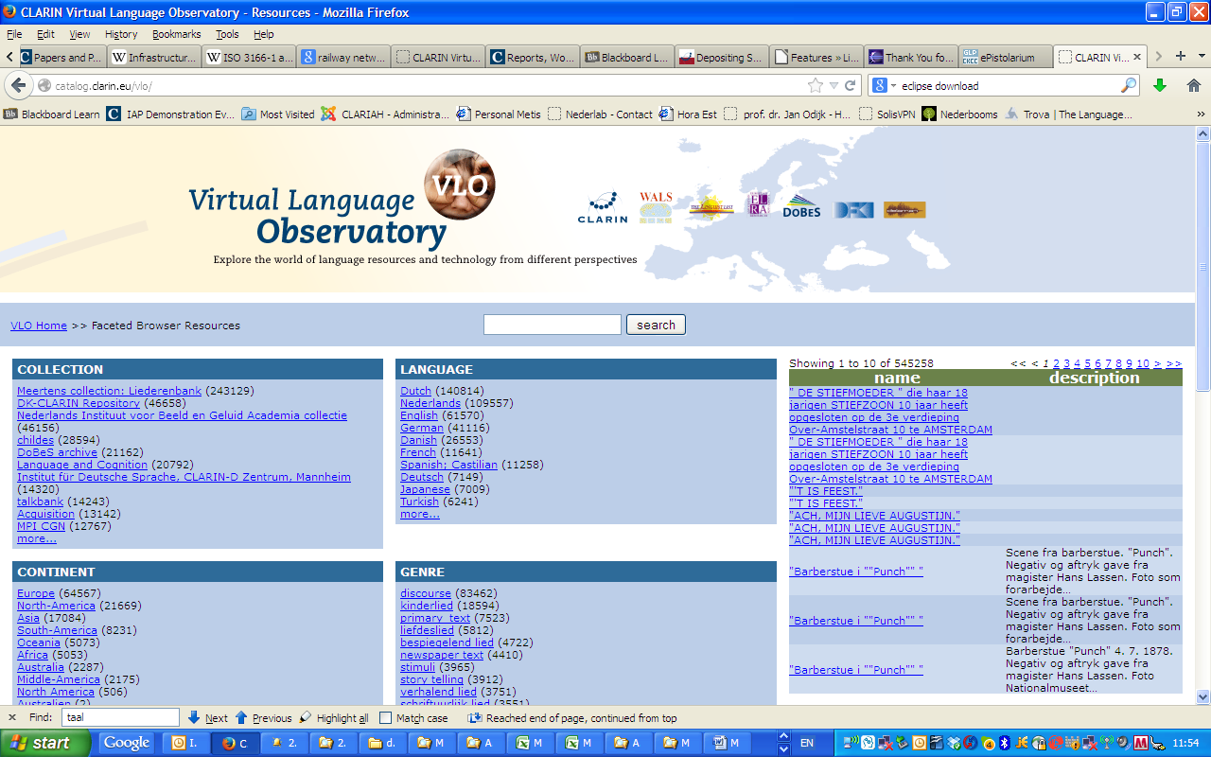
Improvement Suggestions

Slide 22
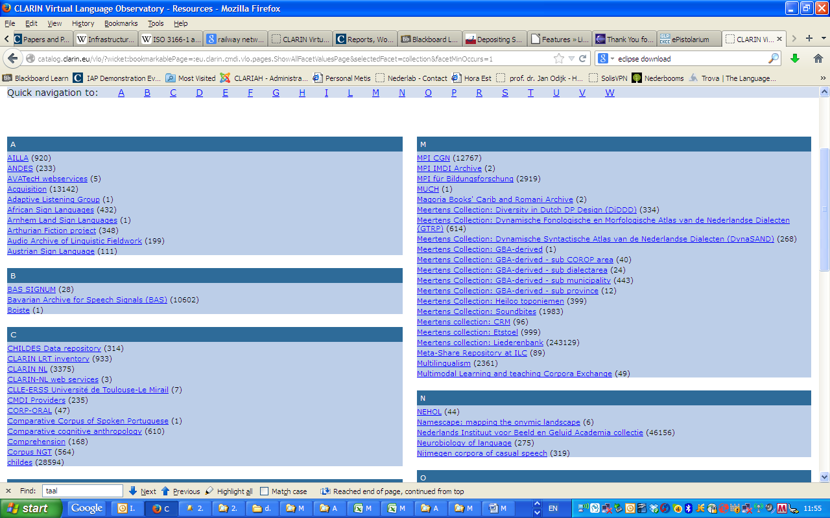
Improvement Suggestions

Slide 23
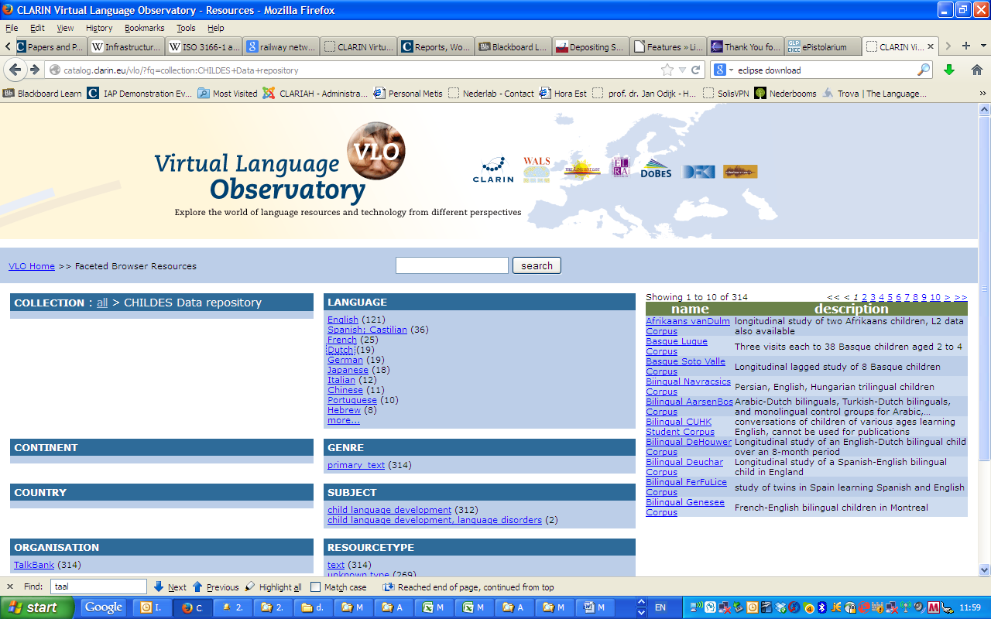
Improvement Suggestions

Slide 24
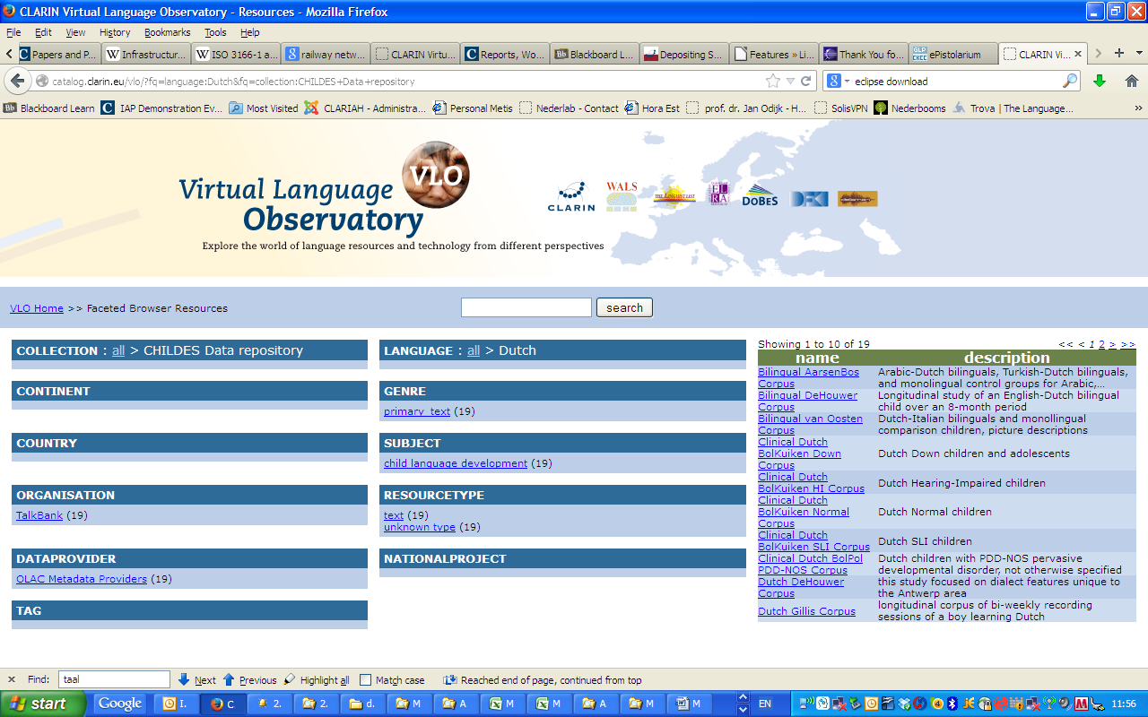
Improvement Suggestions

Slide 25
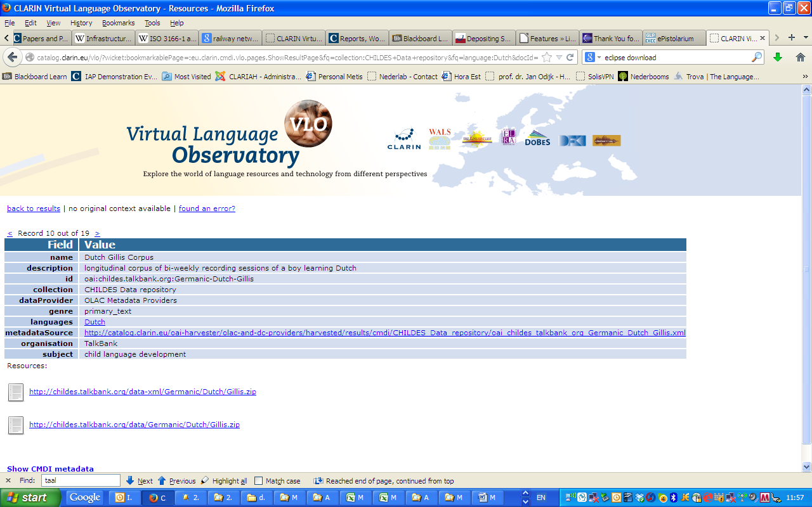
Improvement Suggestions

Slide 26
VLO
RETURN Page

Slide 27
OpenSonar
Start Page

Slide 28
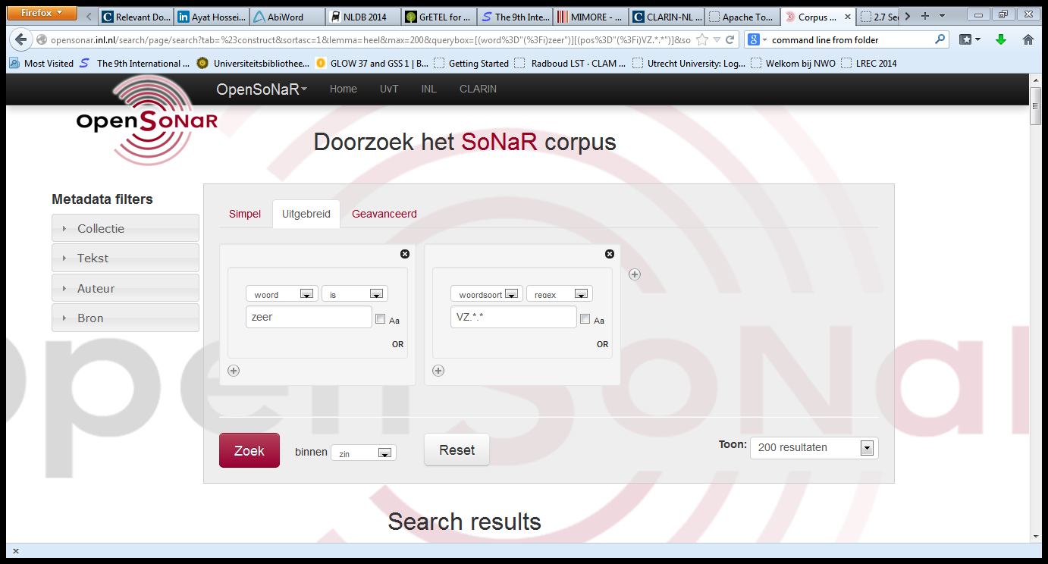
OpenSonar
Start Page

Slide 29
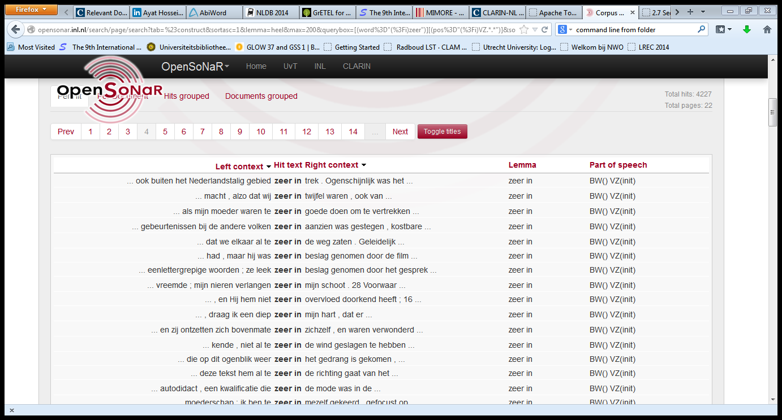
OpenSonar
Start Page

Slide 30
OpenSonar
Start Page

Slide 31
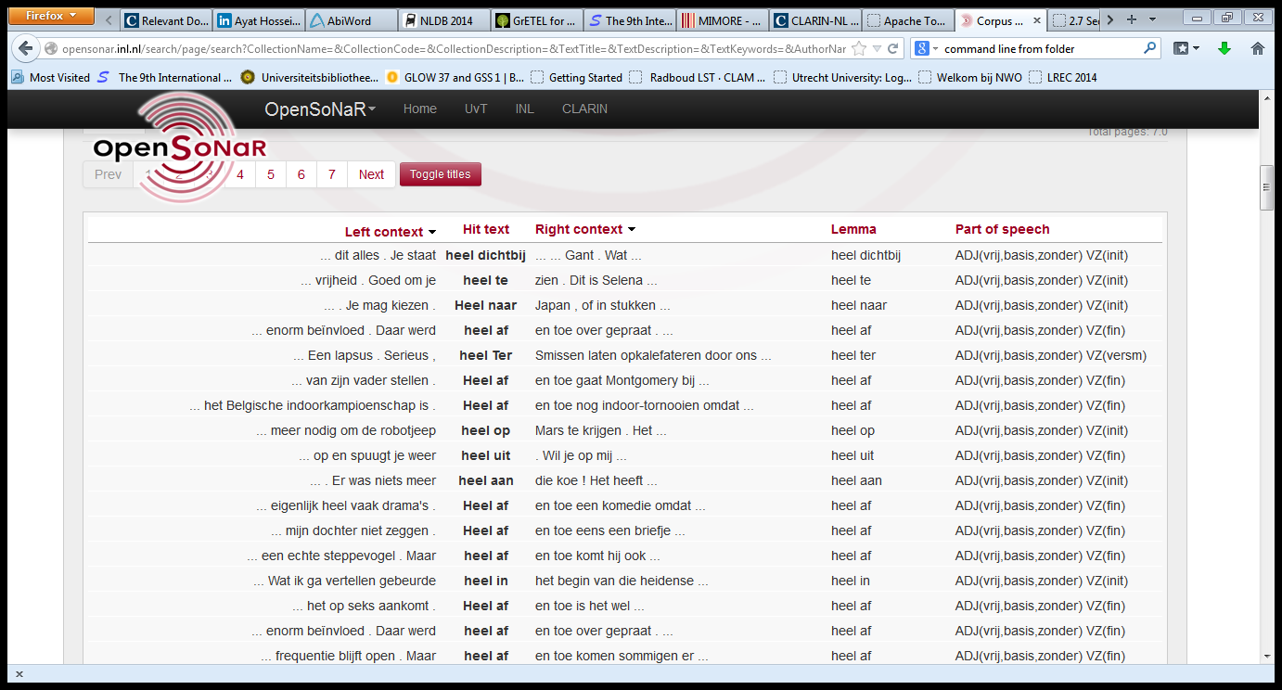
OpenSonar
Start Page

Slide 32
OpenSonar
Start Page

Slide 33
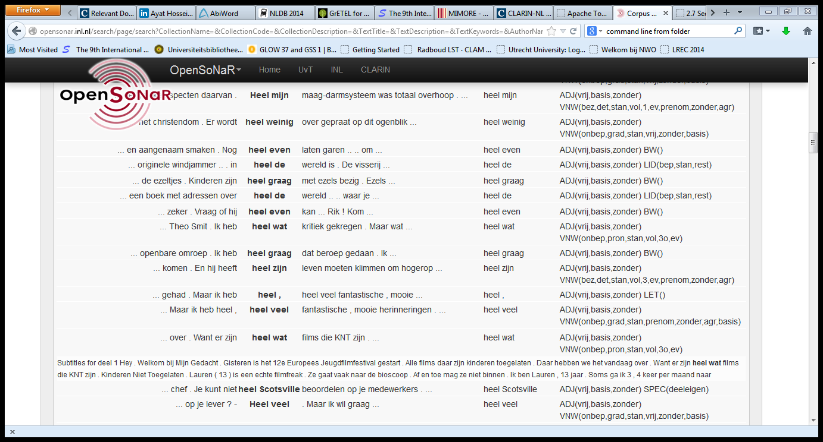
OpenSonar
Start Page

Slide 34
OpenSonar
Return Page

Slide 35
LASSY Simple Interface
Start Page

Slide 36
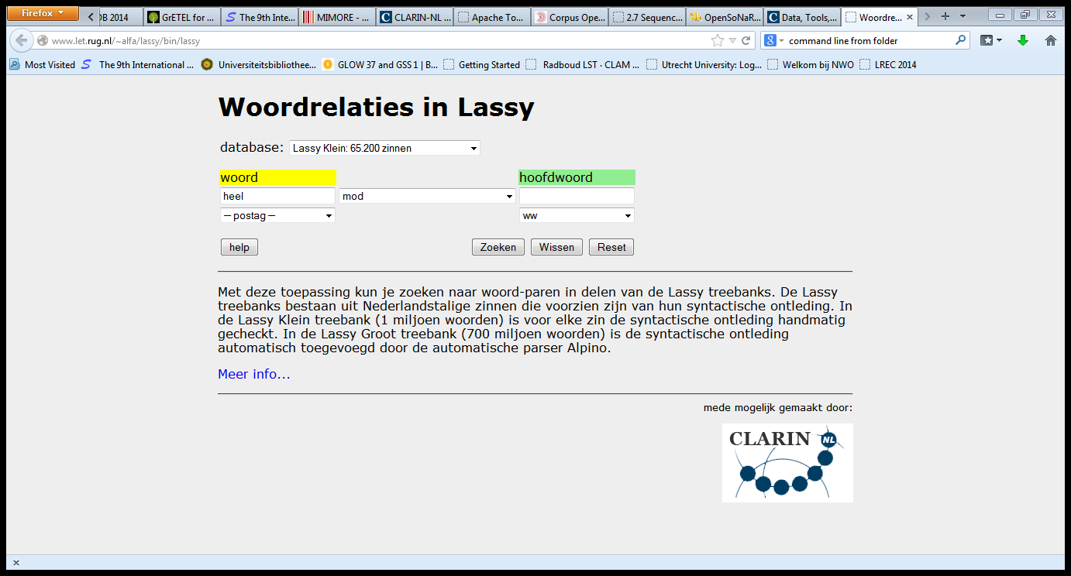
LASSY Simple Interface
Start Page

Slide 37
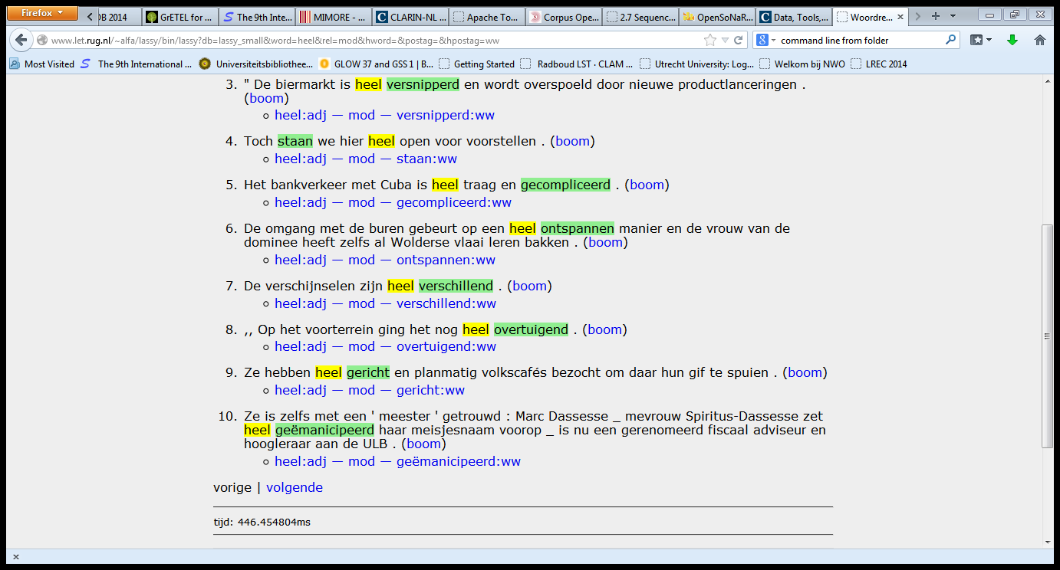
LASSY Simple Interface
Start Page

Slide 38
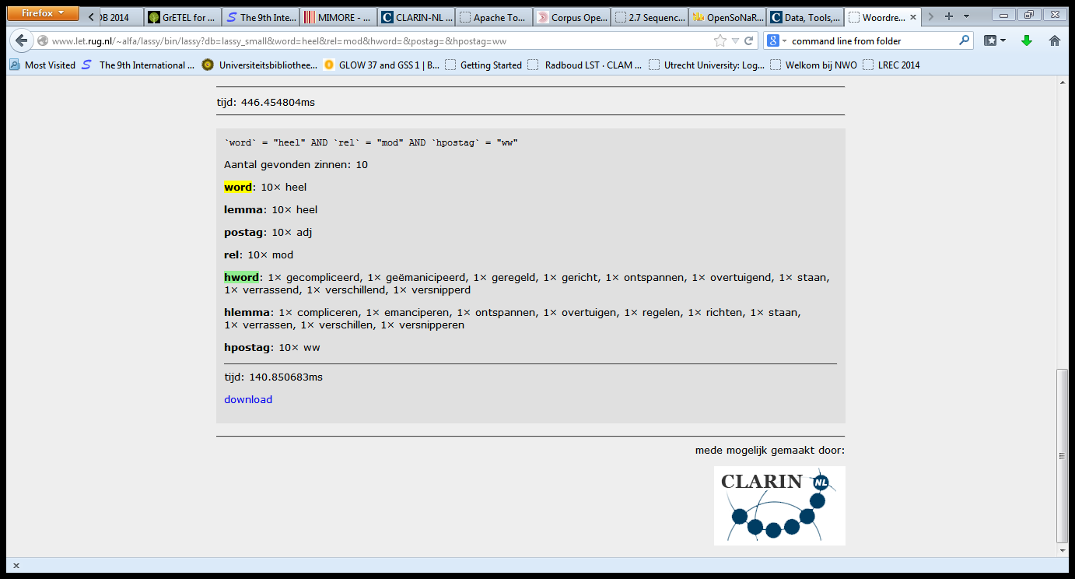
LASSY Simple Interface
Start Page

Slide 39
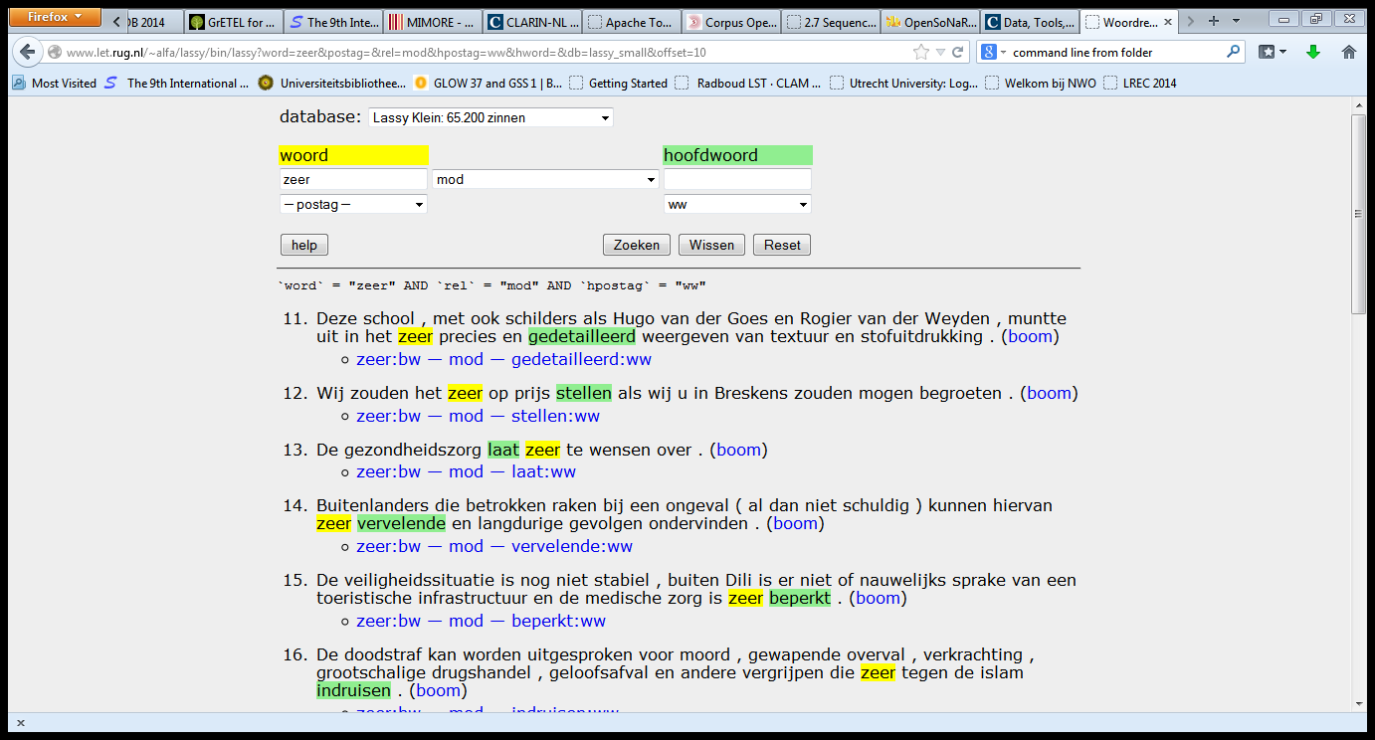
LASSY Simple Interface
Start Page

Slide 40
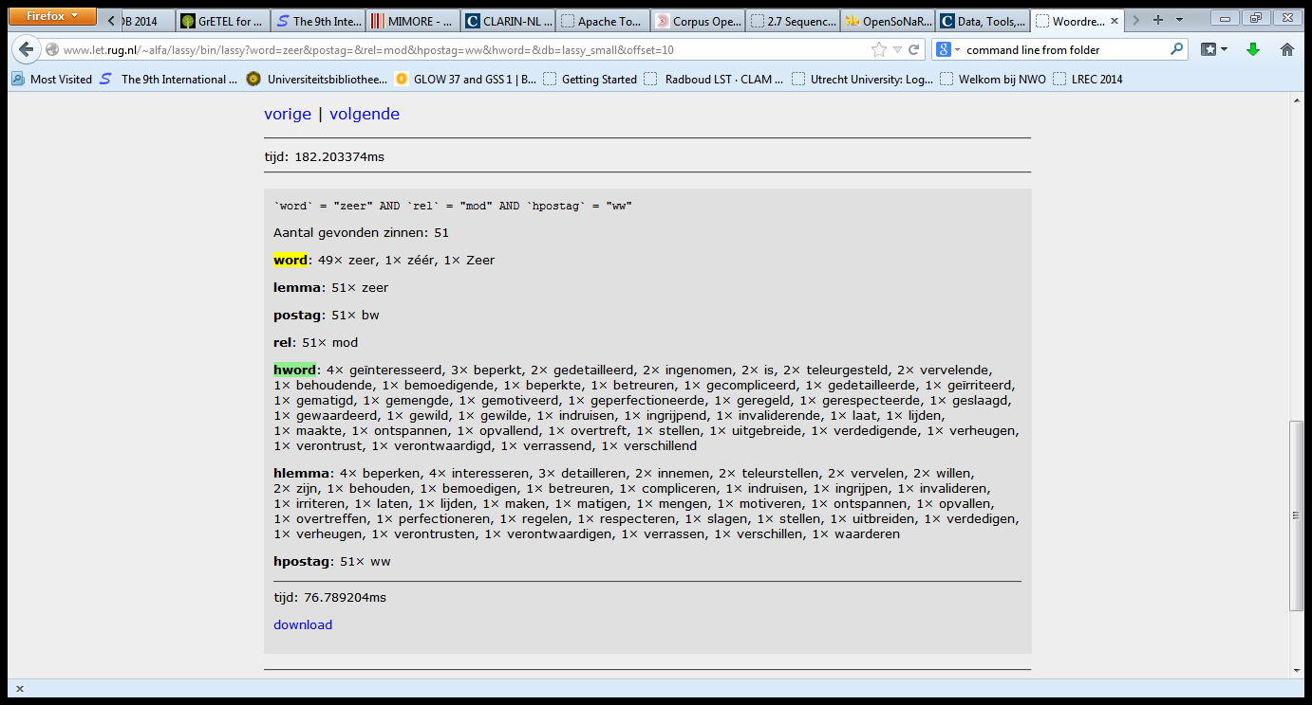
LASSY Simple Interface
Start Page

Slide 41
LASSY Simple Interface
Return Page

Slide 42
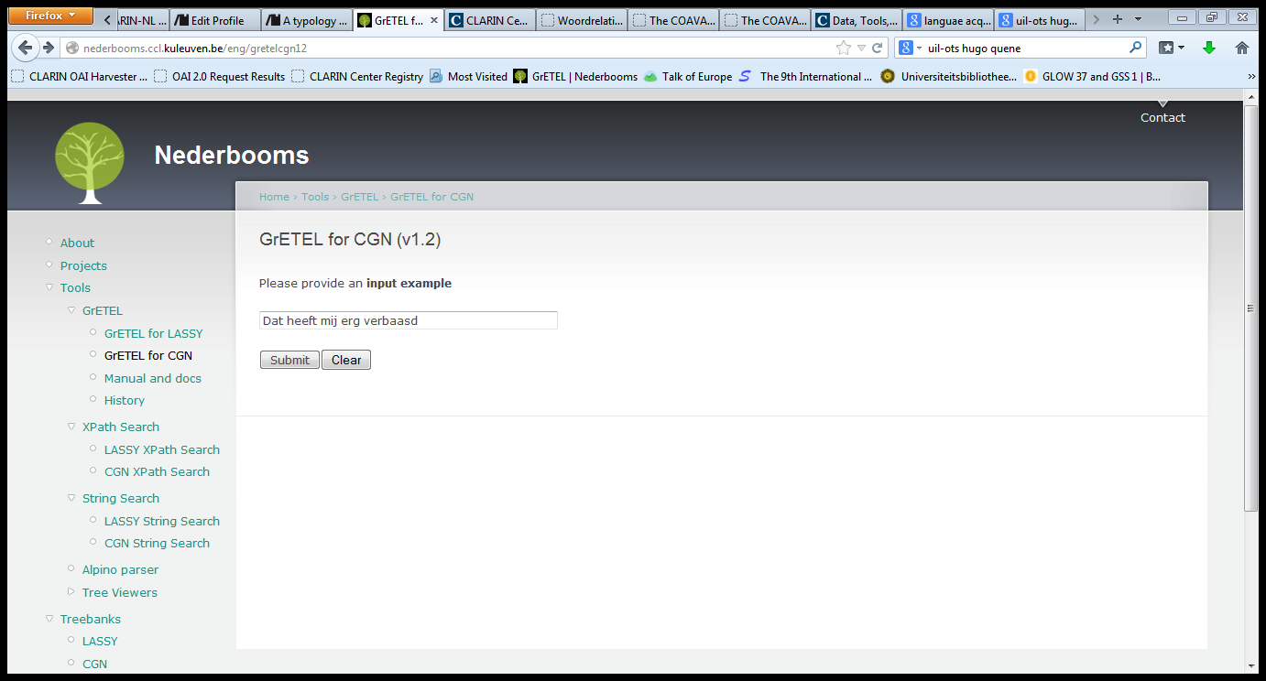
GrETEL CGN
Return Page

Slide 43
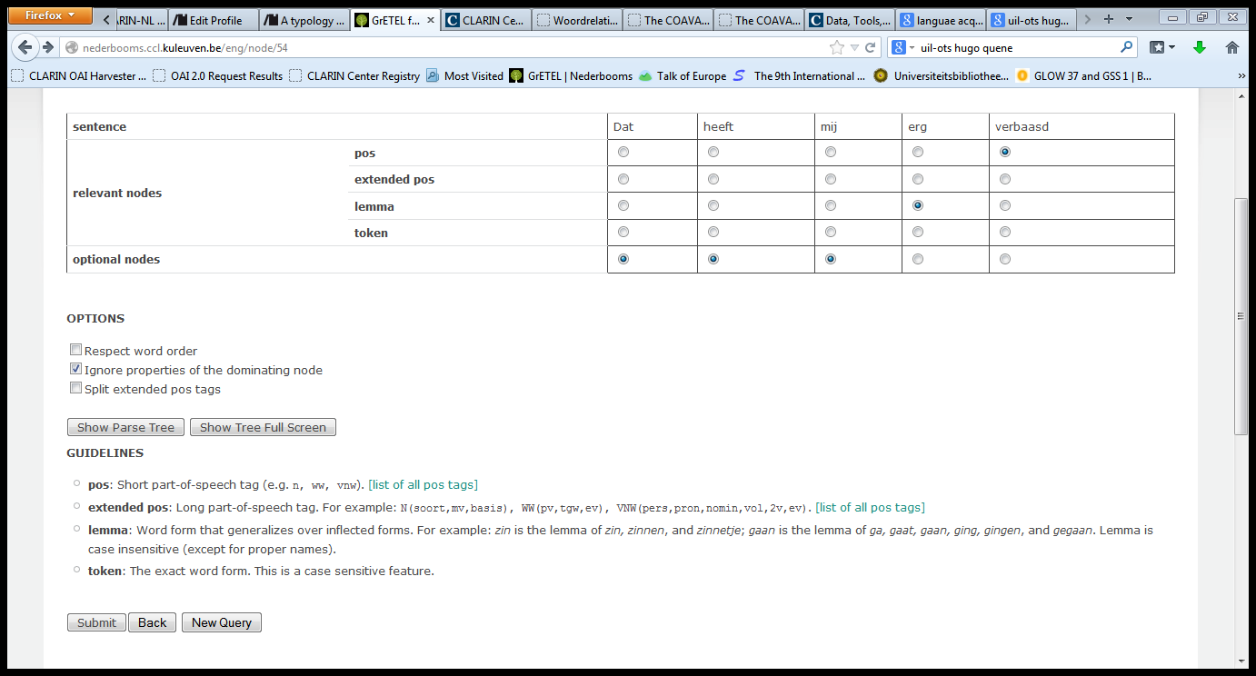
GrETEL CGN
Return Page

Slide 44
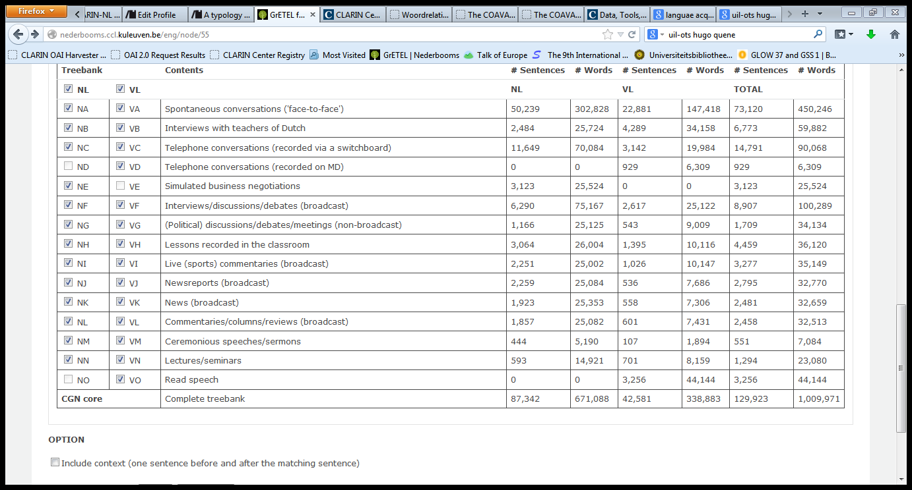
GrETEL CGN
Return Page

Slide 45
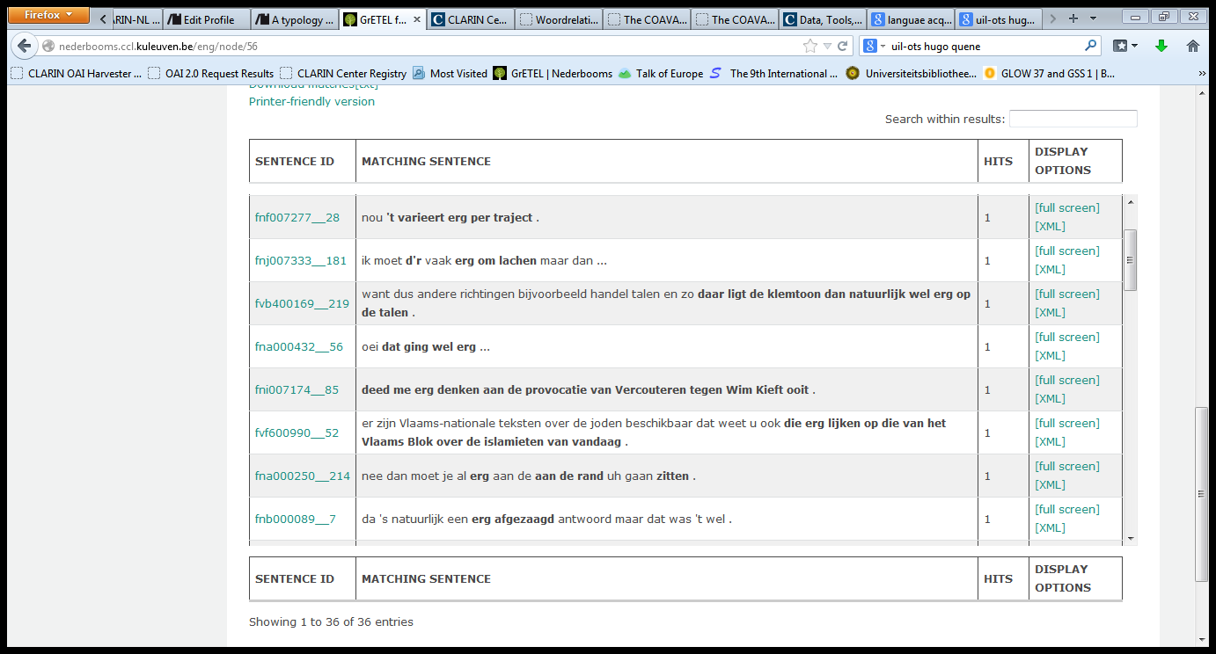
GrETEL CGN
Return Page

Slide 46
GrETEL CGN
Return Page

Slide 47
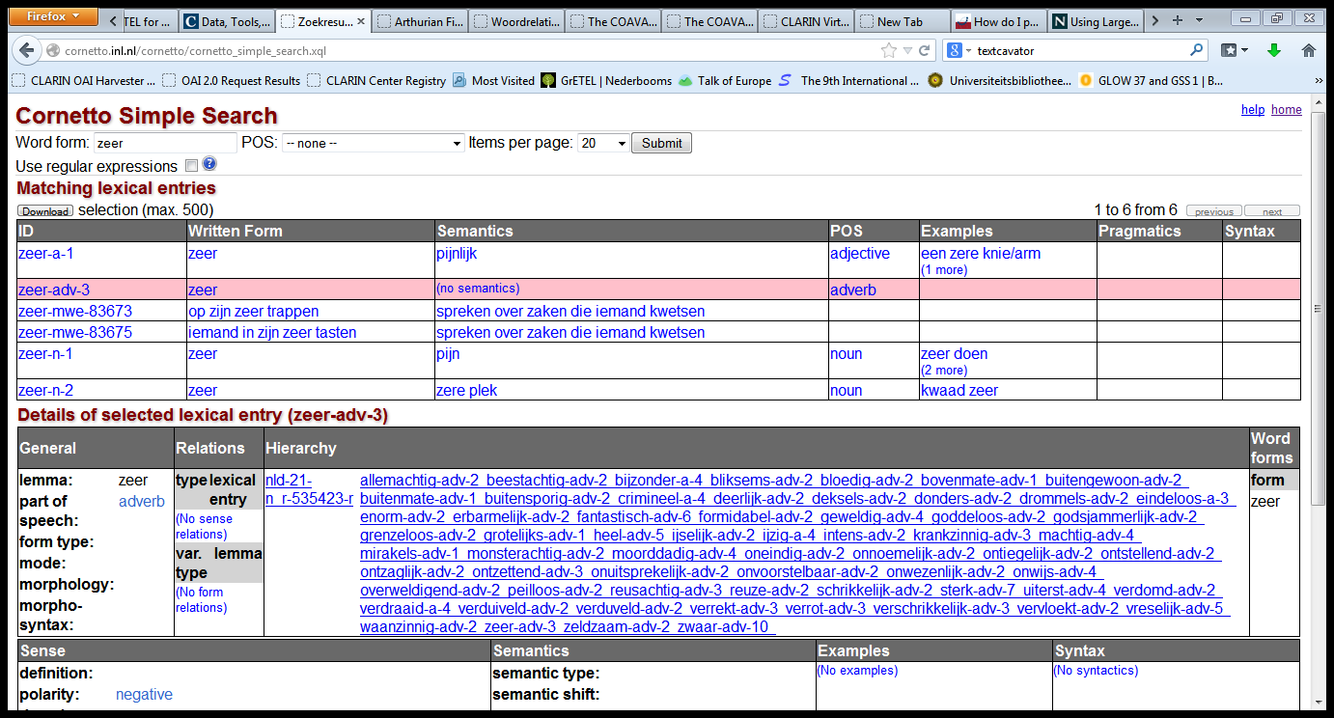
Cornetto
Return Page

Slide 48
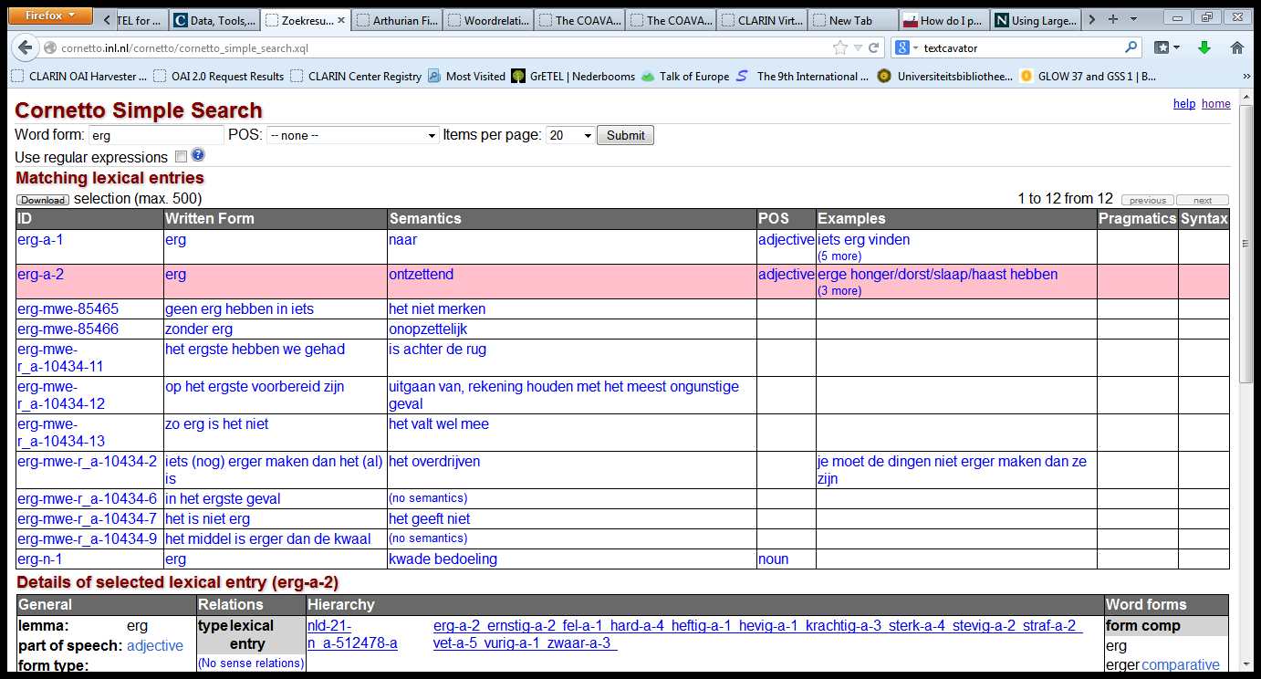
Cornetto
Return Page

Slide 49
Cornetto
Return Page

Slide 50
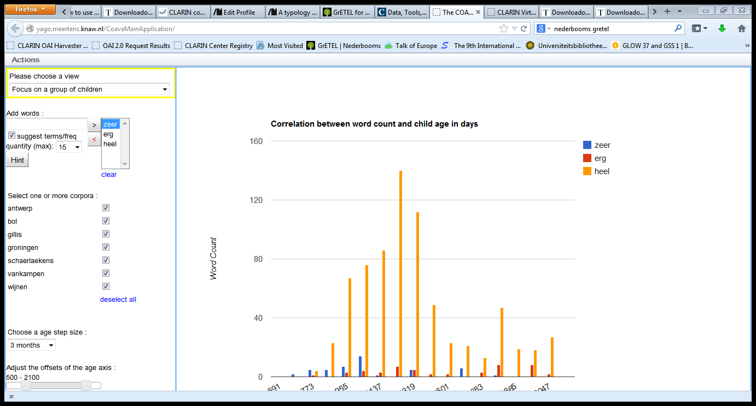
COAVA

Slide 51
COAVA
Return Page

Slide 52
GrETEL CGN
Return Page

Slide 53
Other Examples
PP/A
In zijn sas, in verwachting, tegen, voor, onder de indruk, uit de tijd
Tevreden met v. in zijn sas met
Zwanger v. in verwachting
Verward v. in de war
Modieus v. in de mode / in zwang
English: very v. very much
V:
Worden (AP, NP, *PP) v. raken (AP, *NP, PP)

Slide 54
Child-directed Speech
Heel, zeer, erg in children-addressed speech (Van Kampen only):
 | Mod A | Mod N | Mod V | Mod P | Pred | Other | Unclear
heel | 421 | 10 | 2 | 0 | 7 | 1 | 4
erg | 2 | 0 | 2 | 0 | 37 | 0 | 0
zeer | 33 | 2 | 0 | 0 | 54 | 0 | 2

