Slide 1
Linguistics with CLARIN
Concluding Overview
Jan Odijk
LOT Winterschool
Amsterdam, 2014-01-16

Slide 2
Overview
This Course
There is much more in CLARIN!
There is even more NOT yet in CLARIN

Slide 3
Overview
This Course
There is much more in CLARIN!
There is even more NOT yet in CLARIN

Slide 4
Goals of the Course
Introduction to the CLARIN infrastructure
Introduction to selected functionality within the CLARIN infrastructure
  Focus on linguistics
  Focus on results of CLARIN-NL
Hopefully make you enthusiastic to use the CLARIN infrastructure and functionality in it
  Because it improves your research
If you use it, provide feedback
  Helpdesk: helpdesk@clarin.nl
  Service-specific user group lists

Slide 5
Course programme
Introduction
General functionality
  General background and set-up of CLARIN
  Searching for data
  Searching in data
  Storing Data in CLARIN
A few specific services
  OpenSONAR for searching for words, word combinations and their morpho-syntactic properties
  MIMORE for search in micro-comparative databases and analysis of the search results
  TTNWW for automatically enriching data with linguistic annotations
  PaQu for searching in and analysis of data thus enriched
With focus on syntax and semantics

Slide 6
Overview
This Course
There is much more in CLARIN!
There is even more NOT yet in CLARIN

Slide 7
More in CLARIN
CLARIN-NL –Linguistics other subfields
Historical linguistics | Dialectology | Discourse Studies
Language Acquisition | Language Documentation | Lexicology
Morphology | Morpho-syntax | Phonetics
Phonology | Semantics | Sign Language
Typology

Slide 8
Overview
CLARIN-NL –Linguistics
  Lexical Data
  Linguistically Annotated Corpora
  Search in Lexical data
  Search in linguistically Annotated Corpora
  Annotation & Related Tools
  Processing data
CLARIN-NL other than linguistics
Data and services from other countries

Slide 9
Overview
This Course
There is much more in CLARIN!
There is even more NOT yet in CLARIN

Slide 10
Still Desired
Not all data (even some crucial data) are visible via the VLO or via Metadata Search
Very few tools and web services are currently visible via the VLO
Many tools are still prototypes or first versions
There are good search facilities for some individual resources but not for all
The search facilities so far are aimed at a single resource, or a small group of closely related resources.
Federated content search, which enables one to search with one query in multiple, quite diverse, resources, is still being worked on but difficult

Slide 11
Still Desired
TTNWW combined with analysis and search facilities
Analysis and visualisation services for large search results
Single query to search
  in all Dutch lexical resources
  In all Dutch PoS-tagged corpora
  In all Dutch treebanks
Chaining Search
Parameterized queries
Facilities to improve replicability
Fully CLARIN-compatible viewers and editors for annotated linguistic data
Automatically retrainable enrichment services
…

Slide 12
Conclusion
A successor project is needed!
CLARIAH www.clariah.nl
Proposal submitted in 2013
Approval obtained on July 1st, 2014. (12 m euro)
Project started Jan 1st, 2015 (until 1 Jan 2019)
CLARIN-NL is finishing

Slide 13
Thanks for Joining us in this Course

Slide 14

Lexical data
COAVA project Curated Dutch Dialect Dictionaries for Brabant and Limburg
DuELME project pre-CLARIN data and interface new metadata (data via the HLT-Agency)

Slide 15
Linguistically Annotated Data
Database of the Longitudinal Utrecht Collection of English Accents (D-LUCEA) curated data
DISCAN text corpus enriched with discourse Annotation and its metadata
EXILSEA project enhancements of the Corpus NGT, the world’s first open access sign language corpus, by updating the existing IMDI metadata to CLARIN-standard CMDI descriptions using bilingual ISOcat categories … expected end of 2014

Slide 16
Linguistically Annotated Data
FESLI curated specific language impairment data
INPOLDER curated data
IPROSLA project website and metadata via the VLO (license needed for access to the data)
LAISEANG language documentation data

Slide 17
Linguistically Annotated Data
MIMORE project metadata for DiDDD, Dynasand, and GTRP via Metadata Search (Use the MIMORE Search Engine to search in these data)
NEHOL project Negerhollands data (via the Virtual Language Observatory)
WIVU Hebrew Text Database curated by the SHEBANQ project

Slide 18
Linguistically Annotated Data
VALID project curated five existing, digital data sets of language pathology data collected in the Netherlands, primarily on Dutch
VU-DNC project Data and its metadata and Documentation

Slide 19
Search in Lexical Resources
COAVA application Dialect Lexicon Browser
Cornetto-LMF-RFD project Interface to Cornetto
DuELME project interface
GTB (Integrated Language Bank) including the WFT-GTB Frisian dictionary in the GTB) (Dutch interface)

Slide 20
Search in Lexical Resources
GrNe project search interface for searching in a Greek-Dutch dictionary (letter Π only), Dutch interface
SignLinc subproject enhancements to LEXUS (version 3.00 and higher) and ELAN tool (version 4.00 and higher) (SignLinC website)

Slide 21
Search in Linguistically Annotated Corpora
COAVA application CHILDES browser
Search interface (beta) to Corpus Gysseling provided by INL
FESLI Search application for search in language selective impairment acquisition data

Slide 22
Search in Linguistically Annotated Corpora
Mimore search engine through 3 Dutch dialect databases and a presentation of a demonstration scenario
OpenSoNaR tool for exploring the SoNaR-500 reference corpus
SHEBANQ web application demonstrator that enables researchers to perform linguistic queries on the curated WIVU web resource and preserve significant results as annotations to this resource

Slide 23
Search in Linguistically Annotated Corpora
SignLinc subproject enhancements to LEXUS (version 3.00 and higher) tool
  TDS-Curator project Access to the Typological Database System (TDS)

Slide 24
Annotation & Related Tools
AAM-LR CLAM Webservice supporting annotation of audio-files
Extensions of the ELAN and ANNEX applications for the annotation and display of time-based resources by the ColTime project … expected end of 2014

Slide 25
Annotation & Related Tools
EXILSEA project enhancements of ELAN and ANNEX with the multilingual features of ISOCAT … expected end of 2014
Multicon enhancements for multimodal collocations in new versions of the ELAN and ANNEX tools together with a screencast explaining the new functionality

Slide 26
Annotation & Related Tools
SignLinc subproject enhancements to ELAN tool (version 4.00 and higher) (SignLinC website)
Transcription Quality Evaluation (TQE) Tool and its CMDI metadata made by the TQE subproject

Slide 27
Processing data
@PhilosTEI open source, web-based, user-friendly workflow from textual digital images to TEI…expected in Feb 2015
Adelheid project website, web service for PoS-tagging, tokenizer, lexicon and editor/visualiser
Gabmap website for analysis of dialect variation and introduction video (by the ADEPT subproject)

Slide 28
Processing data
INPOLDER project parsing application for Historical Dutch (also includes a workflow in which it is combined with the Adelheid Tagger)
Namescape project Named Entity Tagger
TICCLops project application and demonstrator for orthographic normalisation

Slide 29
Still desired
TTNWW enables automatic enrichment of text corpora
  But that is just a first step. No researcher is interested in that in itself
  It must be followed by e.g.
    Search in the enriched data, or
    Analysis of the enriched data (statistics, etc)
  But using the TTNWW output in Search services is currently not possible yet
  Analysis is possible but only in limited ways
➔ facilities for this are desired
Initial Work on it is ongoing: PaQu and AutoSearch projects

Slide 30
Still desired
Search queries applied to large data often yields large results
  Cannot be analyzed by hand
  ➔flexible Workflows for search – analysis services – visualisation services
    Each search tool should yield output formats suitable for existing analysis software (e.g. CSV format for input to Excel, Calc, R, SPSS, …)
  (and/or) Search can apply to its own output
    Incremental refinement

Slide 31
Still desired
Full-fledged federated content search is not possible yet
But much simpler cases are not possible either
  Search with one query in multiple Dutch lexical resources:
    CGN-lexicon, CELEX, GTB, Cornetto, DuELME-LMF, …
  Search with one query in multiple Dutch pos-tagged text corpora
    CGN, D-COI, SONAR-500, VU-DNC, Childes corpora, …
  Search with one query in multiple Dutch treebanks
    CGN treebank, LASSY-Small, LASSY-Large
This might be an incremental way to get to full-fledged federated content search
[MPI’s TROVA offers some of the functionality described here]

Slide 32
Still desired
Chaining Search, e.g.
  GrETEL followed by semantic filtering (Cornetto)
    Bare noun phrases where the head noun is count
    N N constructions where first N indicates a quantity
  GrETEL followed by morphological potential filtering (CGN/SONAR/CELEX lexicon)
    Het adj-ø N where adj has no e-form potential
  GrETEL followed by phonological filtering
    Het adj-ø N where adj ends in /C+$C+$C+/

Slide 33
Still desired
Parameterized queries (batch queries)
  give me all example sentences containing any word from a given set of `synonyms’ of the adverb zeer (itself derived from Cornetto) and, for each word, statistics on the categories it modifies
  allemachtig-adv-2 beestachtig-adv-2 bijzonder-a-4 bliksems-adv-2 bloedig-adv-2 bovenmate-adv-1 buitengewoon-adv-2 buitenmate-adv-1 buitensporig-adv-2 crimineel-a-4 deerlijk-adv-2 deksels-adv-2 donders-adv-2 drommels-adv-2 eindeloos-a-3 enorm-adv-2 erbarmelijk-adv-2 fantastisch-adv-6 formidabel-adv-2 geweldig-adv-4 goddeloos-adv-2 godsjammerlijk-adv-2 grenzeloos-adv-2 grotelijks-adv-1 heel-adv-5 ijselijk-adv-2 ijzig-a-4 intens-adv-2 krankzinnig-adv-3 machtig-adv-4 mirakels-adv-1 monsterachtig-adv-2 moorddadig-adv-4 oneindig-adv-2 onnoemelijk-adv-2 ontiegelijk-adv-2 ontstellend-adv-2 ontzaglijk-adv-2 ontzettend-adv-3 onuitsprekelijk-adv-2 onvoorstelbaar-adv-2 onwezenlijk-adv-2 onwijs-adv-4 overweldigend-adv-2 peilloos-adv-2 reusachtig-adv-3 reuze-adv-2 schrikkelijk-adv-2 sterk-adv-7 uiterst-adv-4 verdomd-adv-2 verdraaid-a-4 verduiveld-adv-2 verduveld-adv-2 verrekt-adv-3 verrot-adv-3 verschrikkelijk-adv-3 vervloekt-adv-2 vreselijk-adv-5 waanzinnig-adv-2 zeer-adv-3 zeldzaam-adv-2 zwaar-adv-10
  (made possible in OpenSONAR)

Slide 34
Still desired
Replicability
  Student tried to replicate similarity measure calculations on Wordnet of Patwardhan and Pedersen (2006) and Pedersen (2010)
  in an excellent team: Piek Vossen and his research group
  With help of one the original authors: Ted Pedersen
  Using the exact same software and data
They failed to reproduce the original results!
Reason: ‘properties which are not addressed in the literature may influence the output of similarity measures’
Many experiments and Pedersen’s unpublished intermediate results to find out
  the original settings of all parameters (e.g. treatment of ties in Spearman ρ )
  Which aspects of the data had been used and how

Slide 35
Still desired
One step towards a solution for this
  All tools must allow input of metadata associated with data
  All tools must provide provenance data
  All tools must provide a list with settings of all parameters (also usable as an input parameter, ‘configuration file’) as part of the provenance data
  All tools must generate new metadata for its results based on the input metadata, the generated provenance data, and possibly some manual input of a user
Fokkens, A., M. van Erp, M. Postma, T. Pedersen, P. Vossen & N. Freire ‘Offspring from Reproduction problems: What Replication Failure Teaches Us’, Proceedings of the 51st Annual Meeting of the Association for Computational Linguistics, pages 1691–1701, Sofia, Bulgaria, 2013.

Slide 36
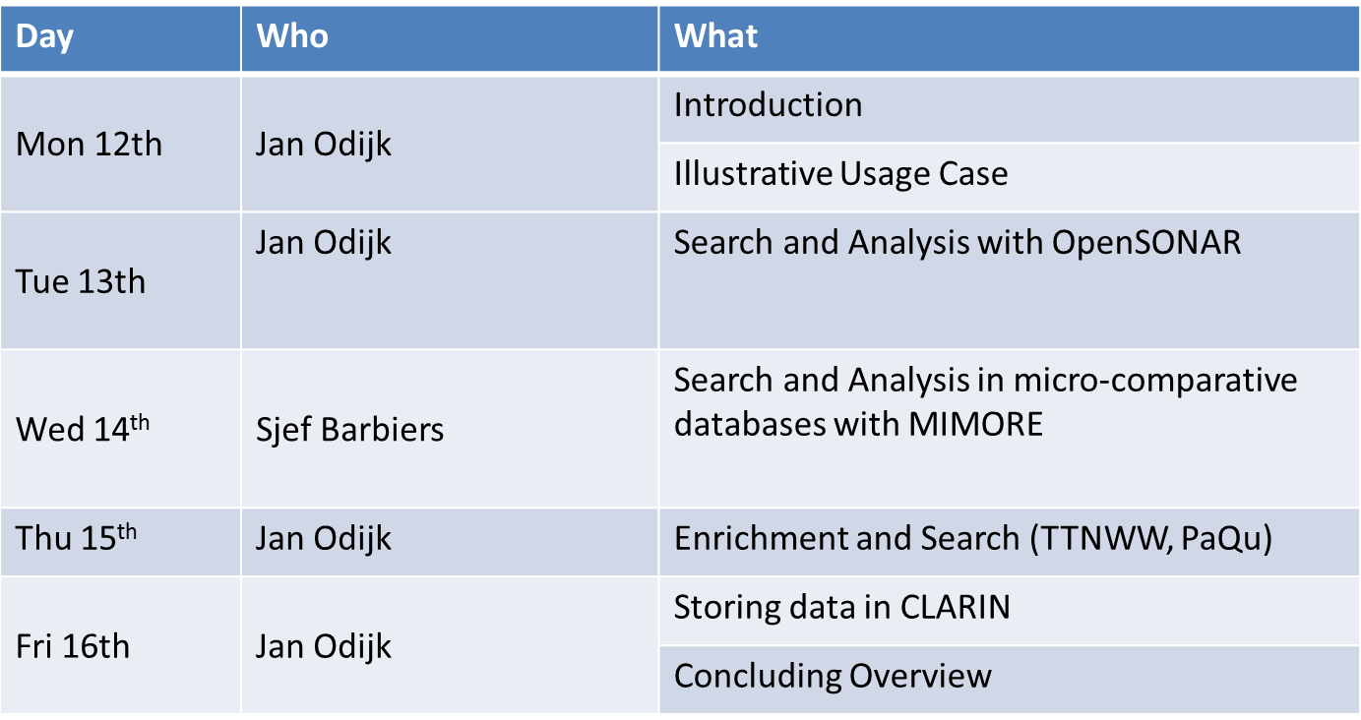
Course programme

