Slide 1
Linguistics with CLARIN TTNWW & PaQu
Jan Odijk
LOT Winterschool
Amsterdam, 2015-01-15

Slide 2
Overview
Enrich your own resources (TTNWW)
Enrich your own resources (other applications)
Search in your own enriched resources (AutoSearch)
Search in your own enriched resources (PaQu)
Conclusions

Slide 3
Overview
Enrich your own resources (TTNWW)
Enrich your own resources (other applications)
Search in your own enriched resources (AutoSearch)
Search in your own enriched resources (PaQu)
Conclusions

Slide 4
TTNWW
TTNWW
TST tools voor het Nederlands als Webservices in een Workflow (LST Tools for Dutch as web services in a work flow)
Goal: to make existing components for Dutch from previous projects (inter alia CGN and STEVIN) available as web services and combine them into work flows for use by HSS researchers with little or no technical background.

Slide 5
TTNWW
Web service: software that can exchange information with other software over the internet
(Web) application: software targeted at a specific user group with a dedicated (web) interface
Work Flow: combinations of web services

Slide 6
TTNWW
Work Flow describes the tasks, procedural steps, organizations or people involved, required input and output information, and tools needed for each step in a business process

Slide 7
TTNWW
Work Flow describes the tasks, procedural steps, organizations or people involved, required input and output information, and tools needed for each step in a business process
(sometimes called processing chain in the context of software)

Slide 8
Existing Components
Text
Orthographic Normalisation (TICCLops, UvT)
Part of Speech tagging (Frog, UvT/RUN)
Parsing (Alpino, RUG)
Named Entity Recognition (Frog, Ghent)
Semantic role labelling (MBSRL, UU)
Coreference Assignment (COREA, Antwerpen/Ghent)
Speech
(Partial) transcription of speech (SPRAAK, KUL)

Slide 9
Existing Components
For
Enrichment of text with corrections of OCR-input
Enrichment of text with linguistic annotations
Indexation of audio-visual files to make them searchable

Slide 10
Existing Components
Before TTNWW
These required local installation (most under Linux only)
Required running by the developers
After TTNWW
All available via the TTNWW web application
Most available individually as a web service / application

Slide 11
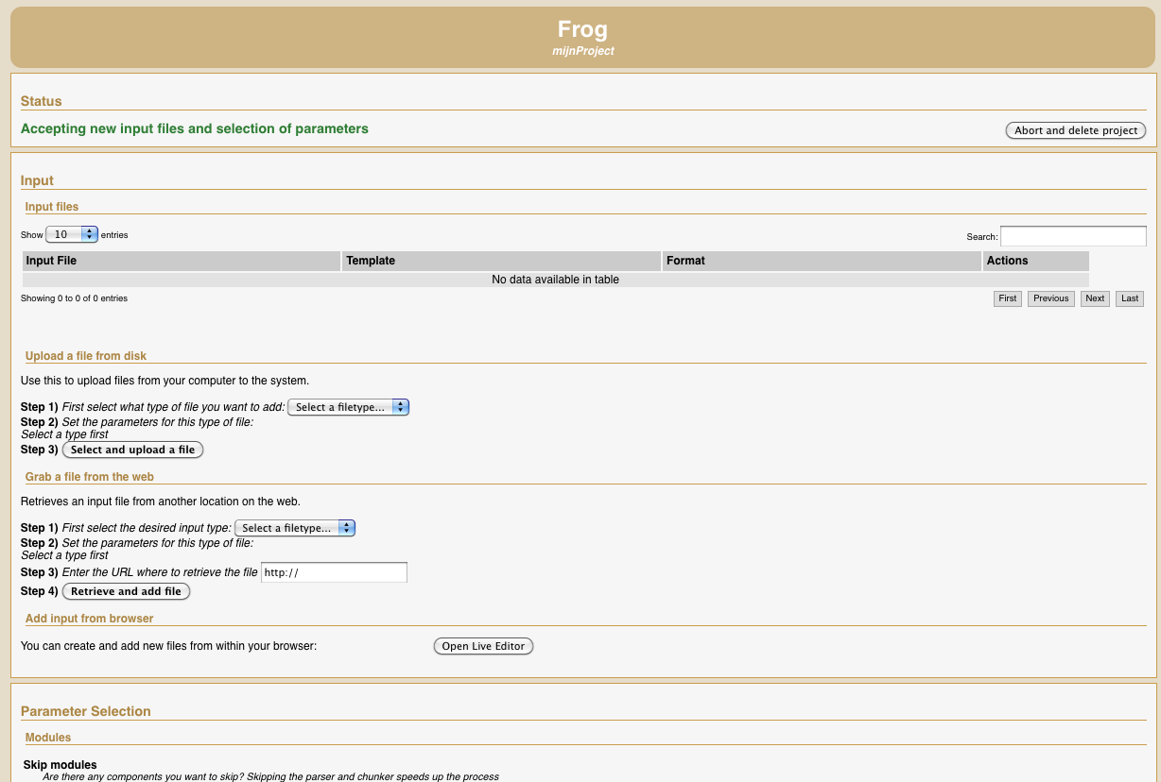
Frog Screenshot

Slide 12
Existing Components
Before TTNWW
Were command line tools
Working on a single system
No web services
CLAM
Computational Linguistics Application Mediator
Generic wrapper to turn existing software easily into a web service
Most TTNWW components use CLAM

Slide 13
Existing Components
Work flows (simplified examples)
Part of Speech tagging:
Tokenization -> sentence splitting -> Pos tagging
Parsing
Tokenization -> sentence splitting -> pos-tagging -> parsing
Named Entity Recognition
Pos-tagging -> NER
Semantic role labelling (MBSRL, UU)
Parsing -> semantic role labeling

Slide 14
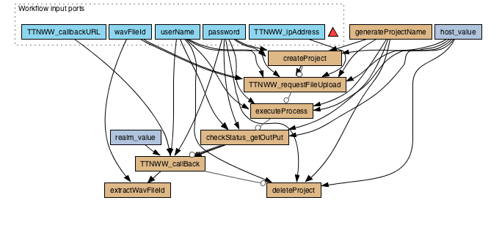
Existing Components
1. Create project
2. Upload file
3. Start execution
4. Wait for completion
5. Download file
6. Delete project

Slide 15
Existing Components
For TTNWW, the Taverna workbench is used
Taverna enables creation of one’s own work flows, but
In TTNWW only fixed, predefined work flows are available
Making your own work flow is pretty complicated
The targeted audience – humanities researchers – seldom want to do this

Slide 16
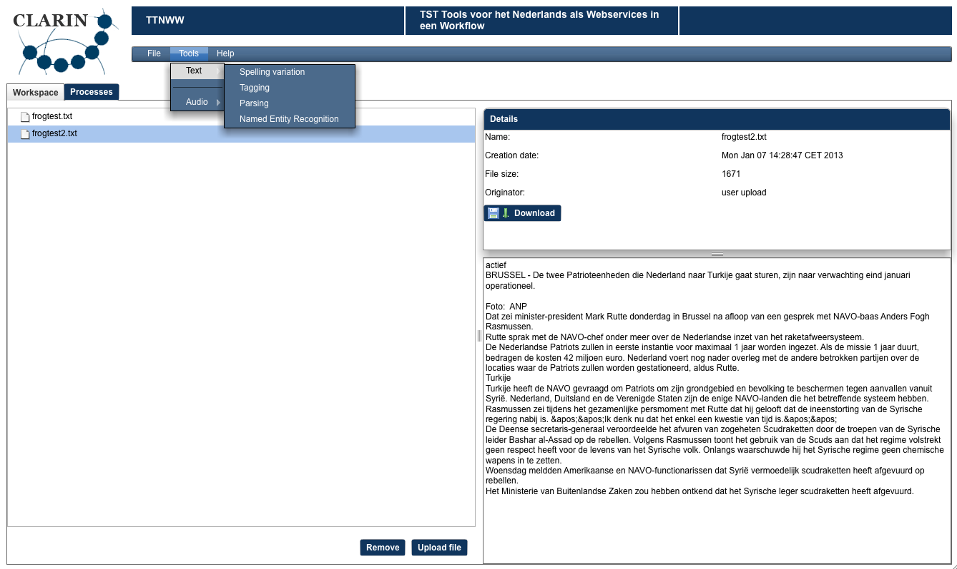
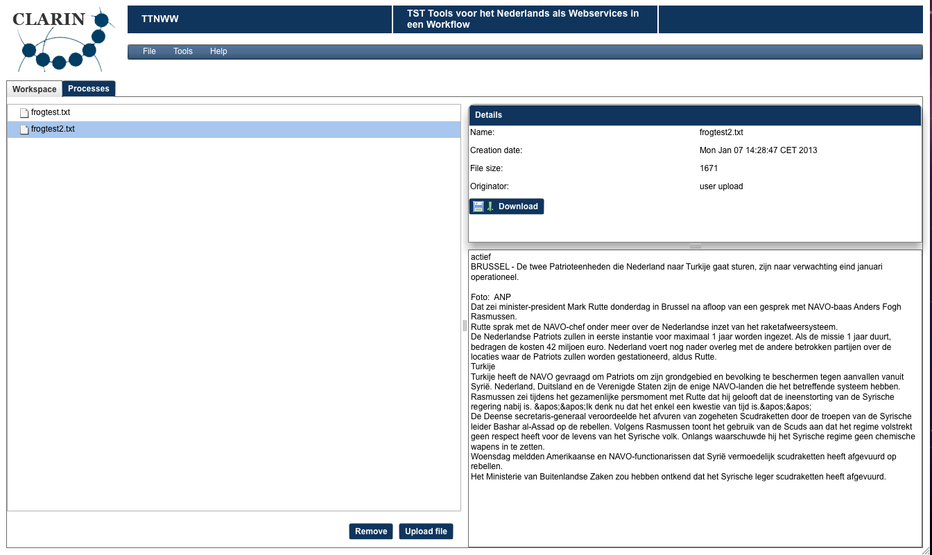
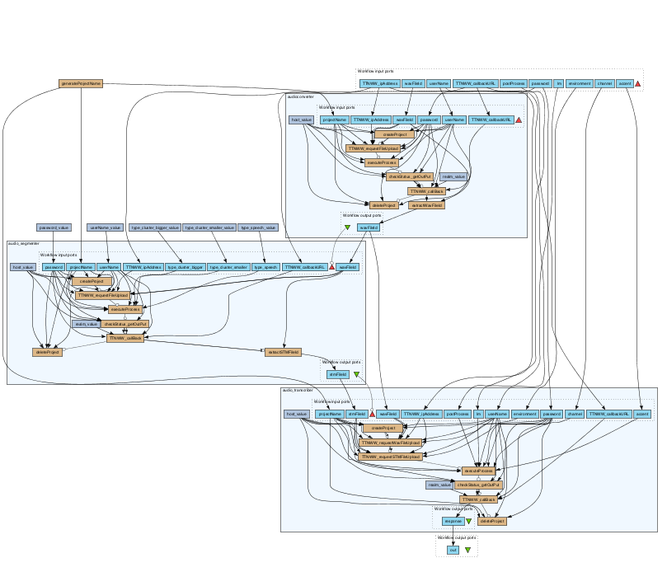
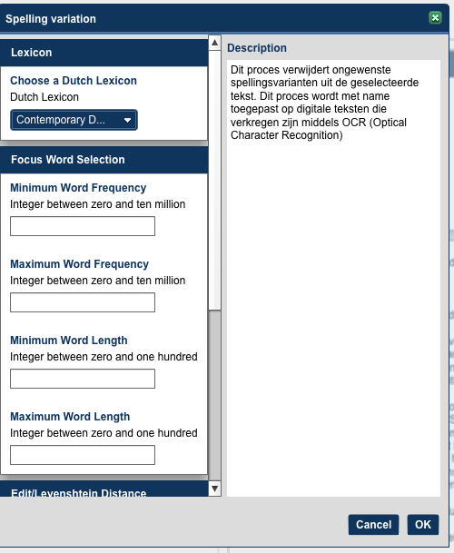
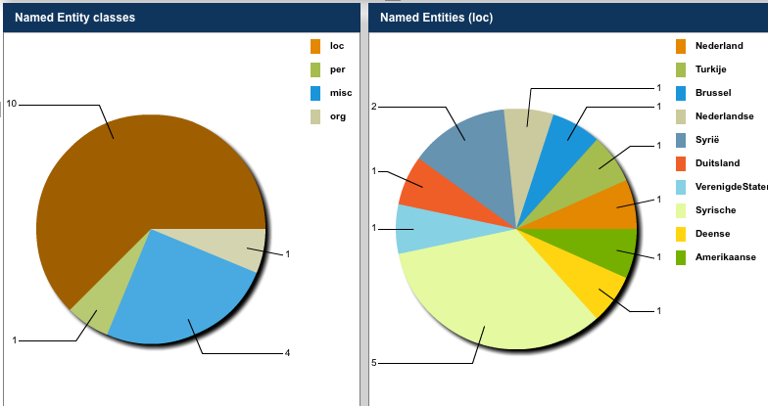
TTNWW application
Functionality
Data selection (upload/download)
Selection of processes
Calling processes
Puts results in a temporary work space
Only generic viewers

Slide 17
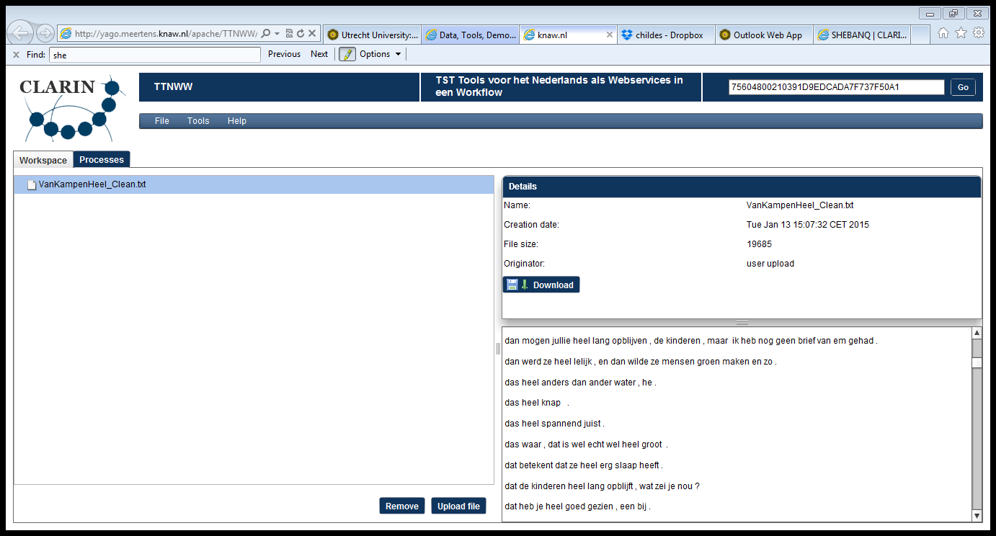
TTNWW Screen Shot

Slide 18
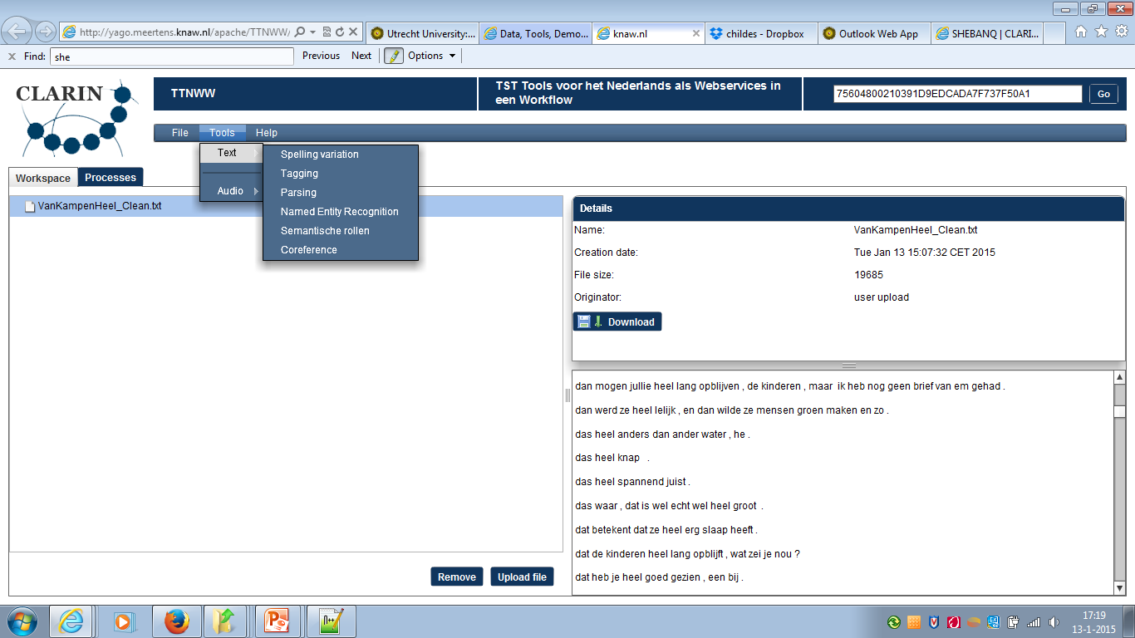
TTNWW Text

Slide 19
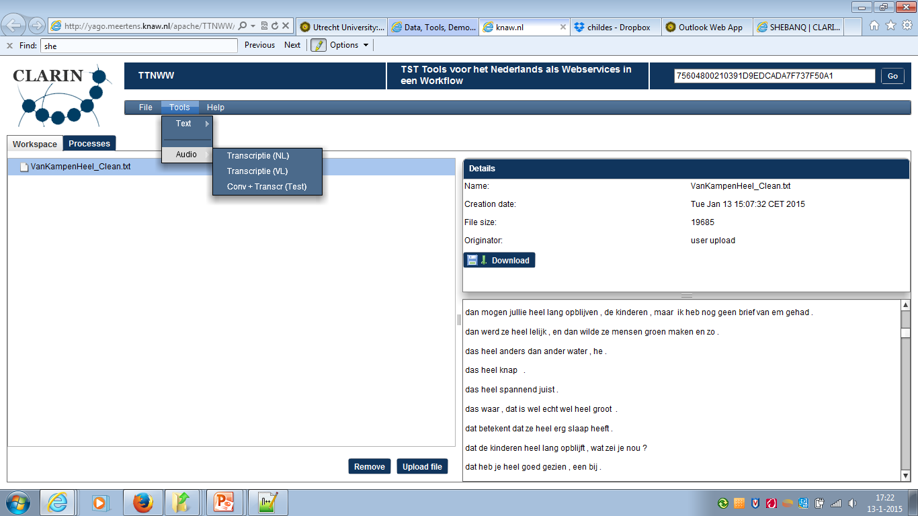
TTNWW Audio

Slide 20
Overview
Enrich your own resources (TTNWW)
Enrich your own resources (other applications)
Search in your own enriched resources (AutoSearch)
Search in your own enriched resources (PaQu)
Conclusions

Slide 21
Other approaches in the ‘CLARIN’ domain
Weblicht (login with your university account)
Easy Mode lets you choose pre-defined processing chains
Features Mode allows you to select individual features, and then choose from a selection of processing chains.
Advanced Mode allows you to build customized tool chains.
Multiple languages, mainly German

Slide 22
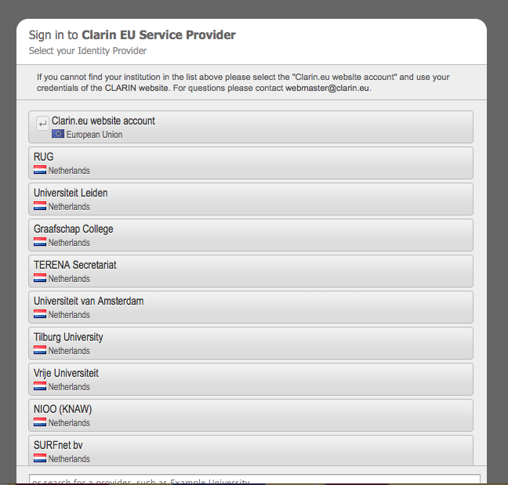
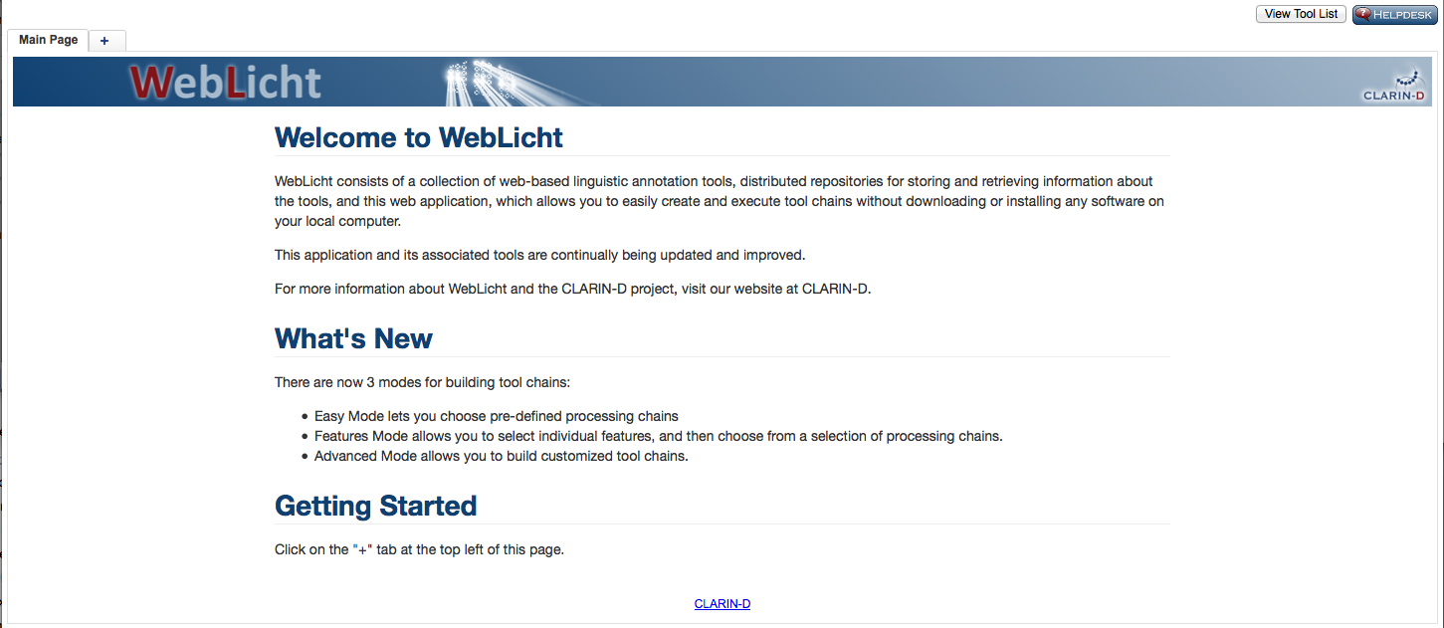
Weblicht D-Spin project
https://weblicht.sfs.uni-tuebingen.de/WebLicht-4/

Slide 23
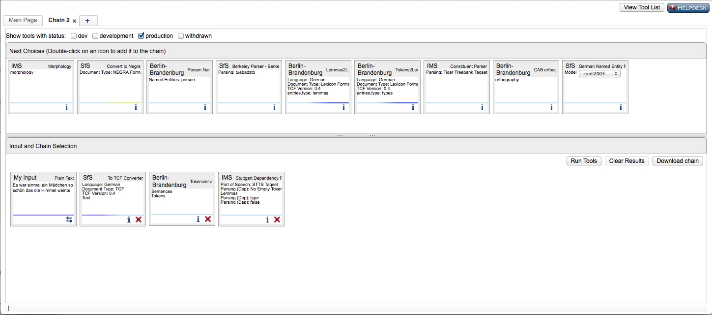
Weblicht D-Spin project
https://weblicht.sfs.uni-tuebingen.de/WebLicht-4/

Slide 24
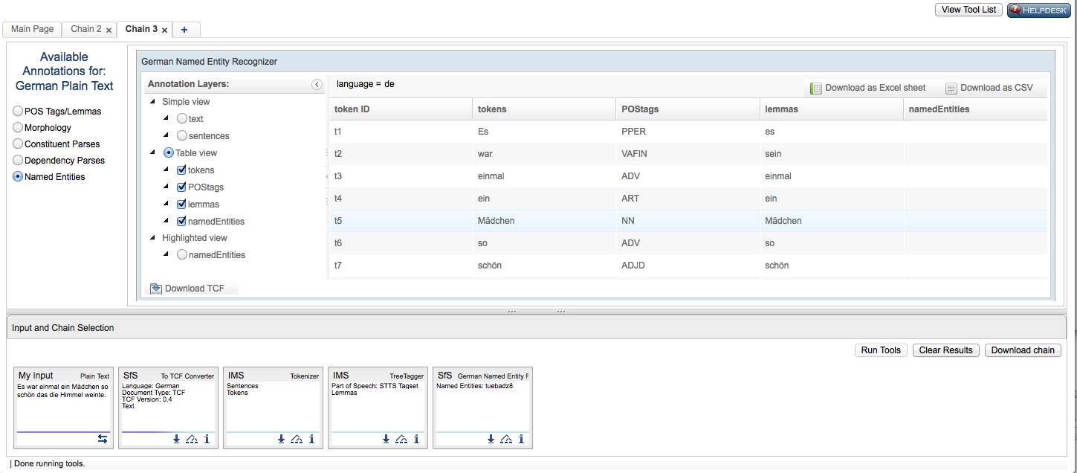
Weblicht D-Spin project
https://weblicht.sfs.uni-tuebingen.de/WebLicht-4/

Slide 25
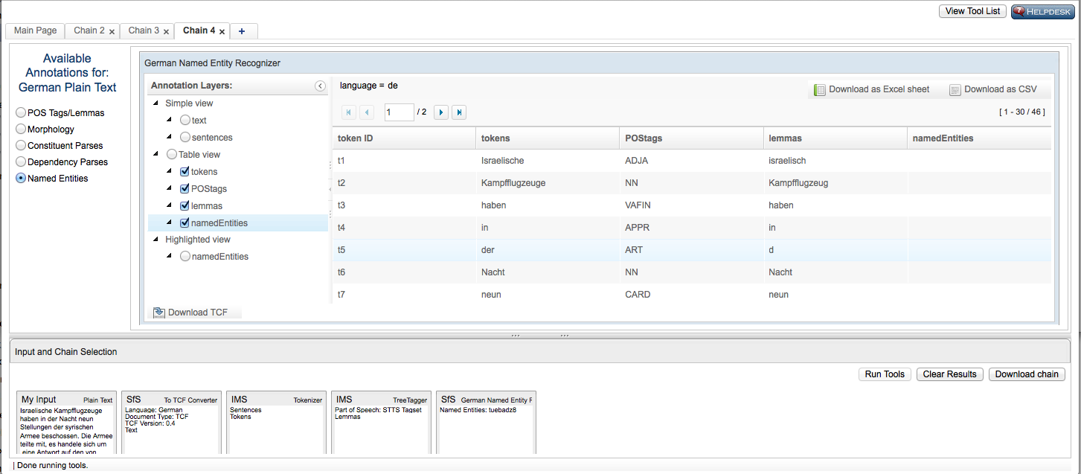
Weblicht D-Spin project
https://weblicht.sfs.uni-tuebingen.de/WebLicht-4/

Slide 26
Other approaches in the ‘CLARIN’ domain
Panacea
Taverna based workflow system
You can use find workflows
You can add your own work flows
You can use workflows
In the Taverna workbench (that you must download and install)
Multiple languages, incl Italian and Spanish
Uses Freeling (see its on-line demo)

Slide 27
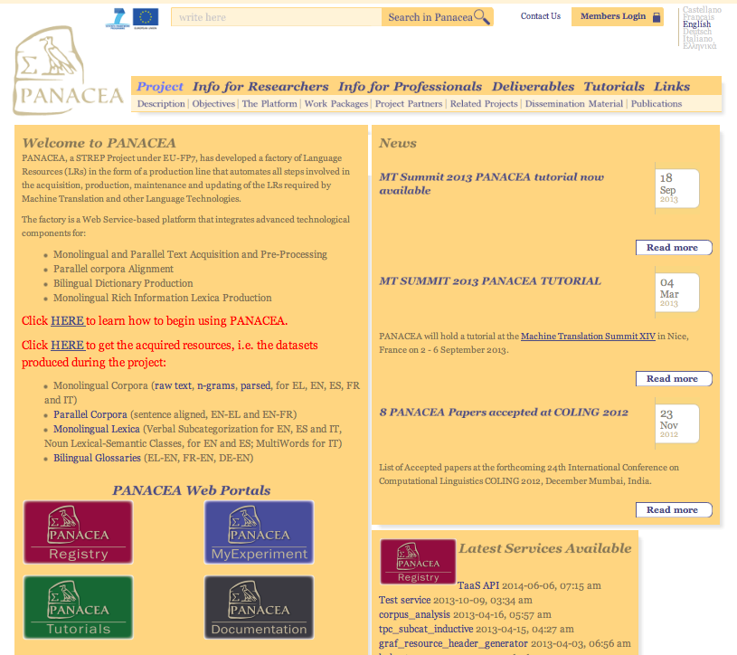
PANACEA project
http://www.panacea-lr.eu

Slide 28
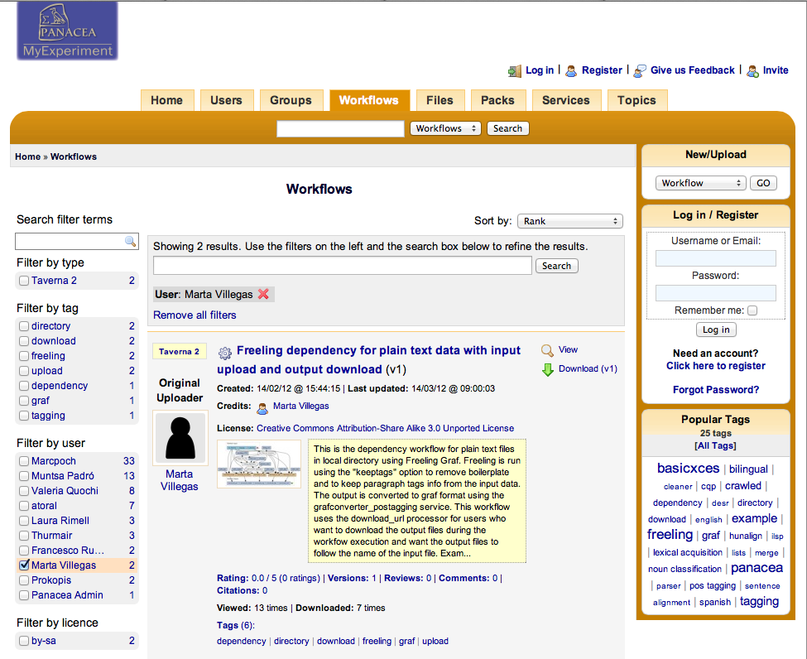
http://www.panacea-lr.eu

Slide 29
Other NLP services in the ‘CLARIN’ domain
Several services at LINDAT/CLARIN (Czech Republic), including Treex::Web (Czech, English)
Several on-line services at CLARIN-DK, multiple languages
Some services at CLARIN-PL (mainly for Polish)
Language Analysis Portal by CLARINO (under development, mainly Norwegian)
…

Slide 30
Overview
Enrich your own resources (TTNWW)
Enrich your own resources (other applications)
Search in your own enriched resources (AutoSearch)
Search in your own enriched resources (PaQu)
Conclusions

Slide 31
Search & Analysis
Enriching your data is fine but
What will you do with a (large and complex) set of XML files?
You need options to search in the data and to analyze the data
Two projects running in NL
AutoSearch (INL)
PaQu (Groningen University)

Slide 32
AutoSearch
(under development, available March 2015)
For pos-tagged data
Supported formats:
FoLia (Frog yields Folia format)
TEI
Search Interface: Corpus Hedendaags Nederlands (Corpus of Modern Dutch) interface

Slide 33
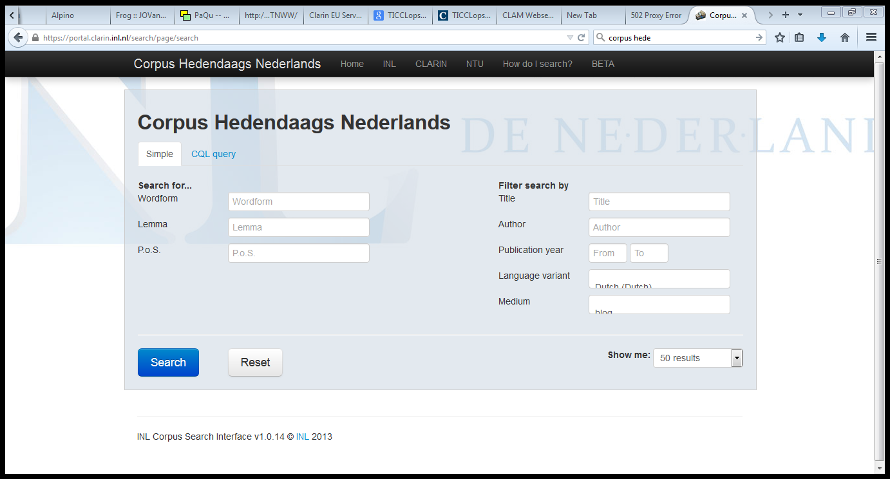
Corpus Hedendaags Nederlands

Slide 34
Overview
Enrich your own resources (TTNWW)
Enrich your own resources (other applications)
Search in your own enriched resources (AutoSearch)
Search in your own enriched resources (PaQu)
Conclusions

Slide 35
PaQu
under development
available July 2015
Preliminary version available now!
For fully parsed data
Supported formats:
LASSY XML (yielded by TTNWW)
Plain text (and PaQu does the parsing)
Search Interface: Groningen Word Relations Interface

Slide 36
PaQu
Small Experiment:
I selected the child-directed sentences containing heel, erg, zeer from the CHILDES Van Kampen corpus
Cleaned the text from annotations by a script
Loaded them to PaQu, and did an analysis.
Made a comparison with my manual annotation (see third lecture on the first day)- for the mod relation only.
Extended the manual annotation to cover multiple instances in one sentence (445 -> 452)
After comparison, I corrected the errors in my manual annotation (revised manual annotation)

Slide 37
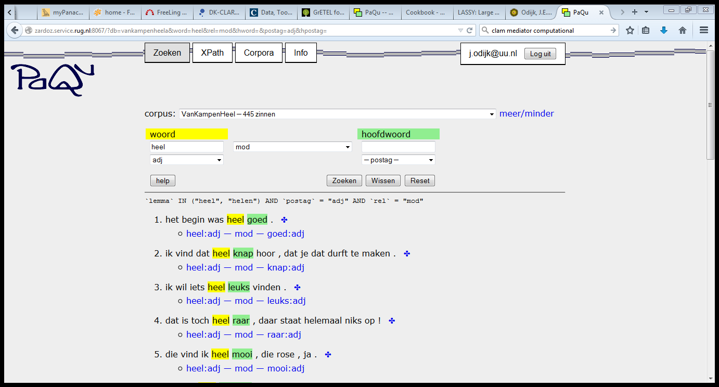
PaQu

Slide 38
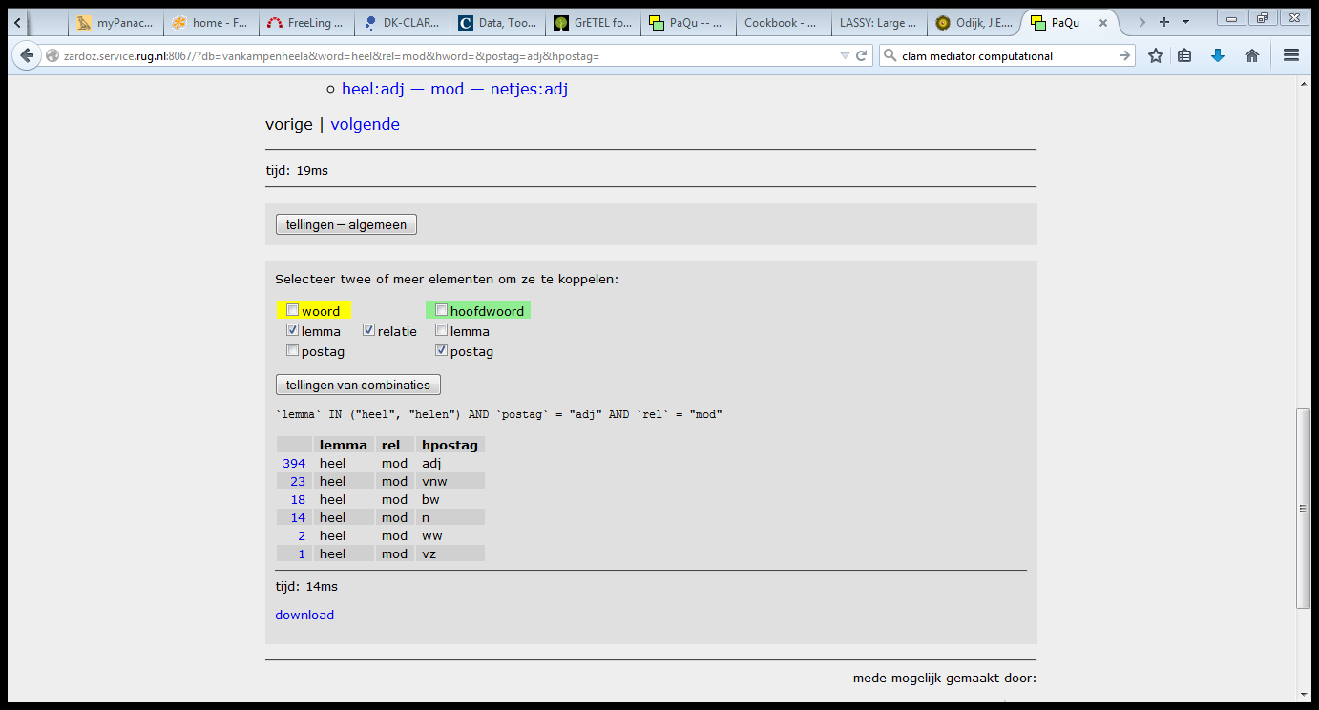
PaQu

Slide 39
PaQu
Comparison Alpino v. Manual v. Revised:
Case | Alpino | Manual | Revised
Mod adj | 394 | 428 | 426
Mod vnw | 23 | -- | --
Mod bw | 18 | -- | --
Mod n | 14 | 10 | 10
Mod ww | 2 | 2 | 1
Mod vz | 1 | 0 | 0
Predet n | 0 | 1 | 2
predicative | 0 | 7 | 8
unclear | 0 | 4 | 5

Slide 40
PaQu
Comparison Alpino v. Manual:
Count of examples | Column Labels
Row Labels | Amod | Nmod | NpreDet | pred | unclear | Vmod | Grand Total
Amod | 387 | 1 |  | 6 | 4 |  | 398
Bwmod | 16 |  |  |  |  | 1 | 17
Nmod | 6 | 6 | 1 |  |  |  | 13
Vmod | 2 |  |  |  |  |  | 2
VNWmod | 17 | 3 |  | 1 |  |  | 21
Vzmod |  |  |  |  |  | 1 | 1
Grand Total | 428 | 10 | 1 | 7 | 4 | 2 | 452

Slide 41
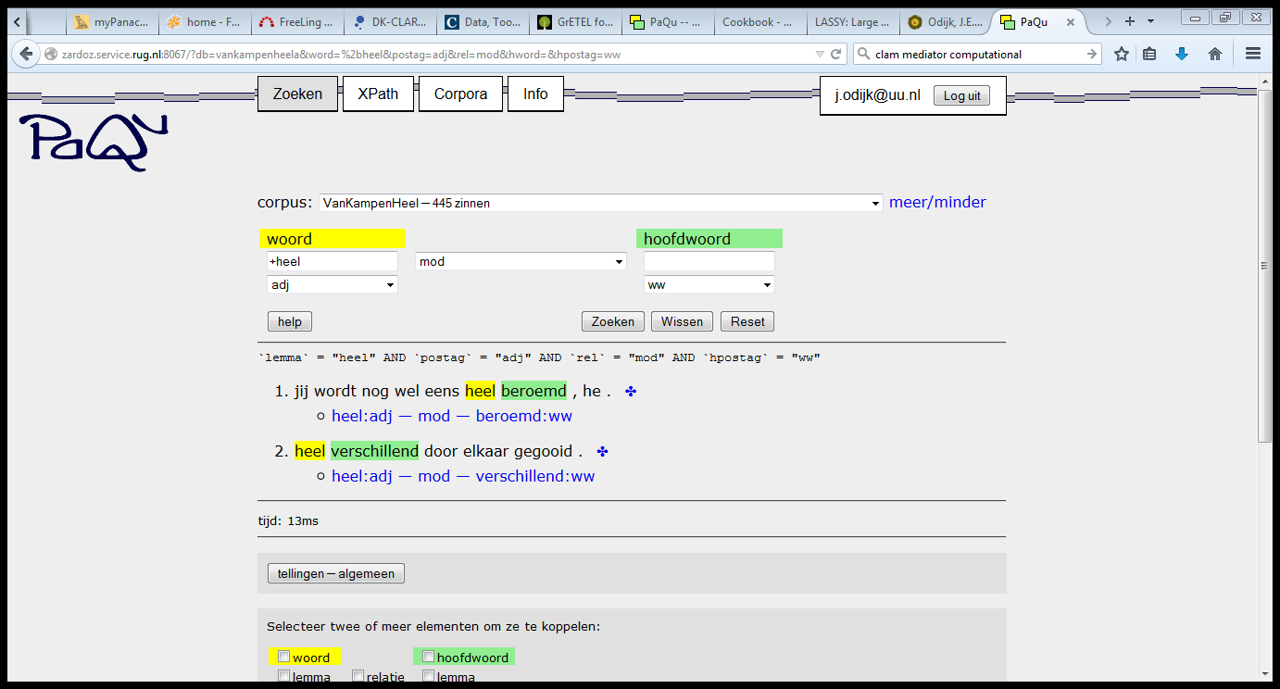
PaQu

Slide 42
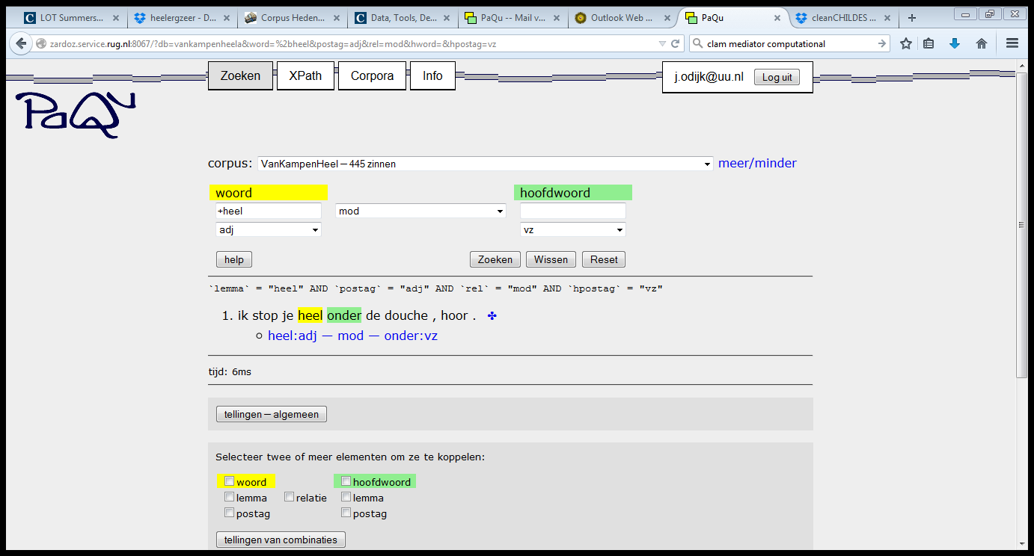
PaQu

Slide 43
PaQu
Accuracy Alpino:
TolAlpino = VNWmod and BWmod counted as Amod
Alpino v Manual | 0,87
Alpino v Revised | 0,88
TolAlpino v manual | 0,94
TolAlpino v revised | 0,96

Slide 44
PaQu
Initial Experiment is promising
Automatic parsing gives reasonable results for a small experiment involving CHILDES data
But it concerns adult speech
It mostly concerns a very local grammatical relation
Many extensions are still needed
CHILDES CHAT format (and many other formats) should be natively supported, including cleaning
Search and analysis of data and all metadata should be supported

Slide 45
Other systems
I am not aware of any, except perhaps:
TüNDRA - the Tübingen aNnotated Data Retrieval Application

Slide 46
Overview
Enrich your own resources (TTNWW)
Enrich your own resources (other applications)
Search in your own enriched resources (AutoSearch)
Search in your own enriched resources (PaQu)
Conclusions

Slide 47
Conclusions
TTNWW enables linguists to enrich their own data (for Dutch)
There is an increasing number of such applications for other languages, in large part thanks to CLARIN
Applications to upload such data into search engines are under development
Initial results of a small experiment are promising

Slide 48
Thanks for your Attention!

