Slide 1
CLARIN-NL Call 4
ISOcat follow-up

Slide 2
Topics
Data Category types
Bulk import
Beyond ISOcat
  CMDI
  SCHEMAcat
  RELcat

Slide 3
Data Category types
complex:
open
closed
constrained
writtenForm
grammaticalGender
email
string
string
string
Constraint: .+@.+
neuter
feminine
masculine
simple:

Slide 4
Data Category types
container:
lexicon
language
alphabet
entry
japanese
ipa
lemma
writtenForm

Slide 5
Which type?
Which type is appropriate depends on the place of the data category in the structure of your resource:
  Can it have a value?
    Complex Data Category with an data type
      Any of the values of the data type?
        Open Data Category
      Can you enumerate the values?
        Closed Data Category
          Fill its value domain with simple Data Categories
      Is there a rule to constrain the values?
        Constrained Data Category
          Express the rule/constraint in one of the rule languages
  Is it a value?
    Simple Data Category
  Does it group other (container or complex) Data Categories?
    Container Data Categories
If a Data Category both has a value and groups Data Categories
  Complex Data Category

Slide 6
CMDI example
CMD component relates to a container DC
CMD element relates to a complex DC
CMD value relates to a simple DC
The ISOcat search in the CMD Component Editor enforces this
  Also a DC should be public and member of the Metadata profile
However, if you link to a DC nothing of the specification is taken over into your profile ☹

Slide 7
Some examples
S
category
noun phrase
NP
VP
number
singular
agreement
Text=“John”
V
NP
person
third
Text=“hit”
Det
N
/category/ a closed DC
/noun phrase/ a simple DC
/agreement/ a container DC
/number/ a closed DC
/singular/ a simple DC
/person/ a closed DC
/third/ a simple DC
(Encoded as TEI P5 FSR the XML elements and attributes
are seen as syntactic sugar)
Text=“the”
Text=“ball”
/S/ a container DC
/NP/ an open DC
/VP/ a container DC
/V/ an open DC
/NP/ a container DC
/Det/ an open DC
/N/ an open DC
(Text is seen as syntactic sugar)

Slide 8
Bulk import: DCIF
http://www.isocat.org/forum/viewtopic.php?f=3&t=14
Create a valid DCIF XML document
  In general by converting an existing digital resource
    XSLT, Perl, …
  DCIF Schema: http://www.isocat.org/12620/schemas/DCIF.rng
    Human readable: http://www.isocat.org/12620/schemas/DCIF.html
  DCIF Validation levels:
    Structure: Relax NG validation
    Referential integrity: Schematron validation
Example: http://www.isocat.org/12620/examples/dcif-example.dcif

Slide 9
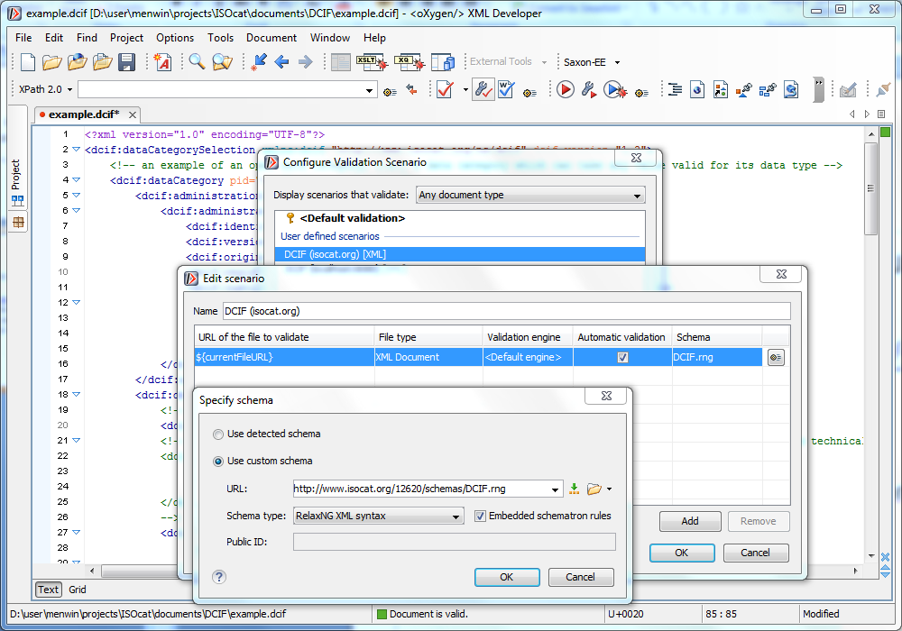
DCIF Validation Scenario in oXygen

Slide 10
What will be overwritten?
PIDs
  Just invent your own URI, e.g., my:DC-1
  Use them to relate DCs:
    Closed DC conceptual domain to simple DC
    Simple DC is-a relation to another simple DC
  Will be overwritten by ISOcat PIDs
    Unless you have ISOcat acceptable PIDs
Version -> 1:0
Registration status -> private
Creation date -> date of import

Slide 11
Contact ISOcat sysadmin
Email: isocat@mpi.nl
If you need:
  Additional languages
  Additional profiles
  Additional constraint rule languages
If you’re done:
  Send DCIF file
  Will be validated (again ☺)
  Test import cycles on the ISOcat test server
  Actual import on isocat.org
If you want to do bulk updates

Slide 12
Relationships
In ISOcat
  Between simple and closed DCs
  Simple DCs can have an is-a relationship with one super simple DC
    This can be used to hierarchically structure a value domain
  In the definition, notes or examples you can embed a link (an untyped relationship) to another DC
    “… noun (DC-1234) …”
    (in the future ISOcat will recognize the DC-nnnn pattern and make it clickable, it can’t recognize: an arbitrary ‘word’ (“noun”) as a DC identifier, or an arbitrary number (1234) as a DC key, so use the DC-nnnn pattern!)
In SCHEMAcat/CMDI Component Registry
  A schema annotated with DC references also relates these DCs together
    Depending on the schema type the type of this relationship is (un)known
In RELcat
  Typed relationships among DCs, but also with other Semantic Registries

Slide 13
Beyond ISOcat: CMDI
Tutorial in November 2013 (TBA)

Slide 14
Beyond ISOcat: SCHEMAcat
http://lux13.mpi.nl/schemacat/
Annotate your resource schema with ISOcat DC PIDs
  Use what your schema language provides to link to an external semantic specification
    ODD: <odd:equiv name=“morfl” uri=“…/DC-nnn”/>
  Use @dcr:datcat or @dcr:valueDatcat in an XML-based schema language
    RNG: <rng:element name=“morfl” dcr:datcat=“…/DC-nnn”/>
  Embed an @dcr:datcat annotation in a comment in another (text-based) schema language
    EBNF: (* @dcr:datcat MORFL …/DC-nnn *)
  Embed an @dcr:datcat annotation in a description or note or …
    MDF: \desc @dcr:datcat …/DC-nnn
  Contact isocat@mpi.nl

Slide 15
Beyond ISOcat: RELcat
http://lux13.mpi.nl/relcat/
Collect typed relationships between your new DCs and existing DCs in an Excel spreadsheet or CSV file with at least three columns
  Your ISOcat DC PID
  typed relationship
    sameAs: same semantics just different types or an uncooperative DC owner
    almostSameAs: minor, but for you important, differences
    subClassOf: yours is more specific
    superClassOf: yours is more general
    hasPart/partOf: partitive relationships
  Related ISOcat DC PID (or an URL to an entry in another persistent concept/data category registry)
http://www.isocat.org/forum/viewtopic.php?f=12&t=16

Slide 16
ISOcat user interface
Problematic:
  Simple DC selector for a closed value domain
    Too slow especially when the closed DC is a member of the Private profile, if more specific, e.g., Metadata, the number of simple DCs loaded will be much smaller
    Upcoming: replace full list by a search or selection from the basket or viewed DCS
  Links between DCs
    Upcoming: become clickable
    Later: integration with RELcat for typed relationships

