Slide 1
ISOcat: known issues

Slide 2
Known issues
ISOcat: ongoing effort
=> there are still a series of ‘loose ends’
  RELcat and SCHEMAcat
  Linking / Adopting
  Searching
  Definitions

Slide 3
RELcat
Essential for several Dutch tagsets
  N(soort, ….) comes with 2 DCs:
    Noun
    Common
  How to relate this with one of the DCs for ‘common noun’, even in case we would find the definition perfect?
  Good news: in progress!

Slide 4
RELcat
Linking DC is not just a ‘nice’ feature
  Proper noun
  Common noun
  Mass noun
  Count noun
  are all instances of ‘noun’ (i.e. have an IsA relation with it)

Slide 5
Searching
How to detect which DCs are Standardized?
Or have a Dutch language section?
How to search using the search options?
  Be aware: Profile, Match method
How to detect which DCs ‘belong together’
(unless one mentions the tag set in the definition) i.e. which ones can be combined?
Notes:
Transitive: match like tig resultaten,, match exact: geen enkele

Slide 6
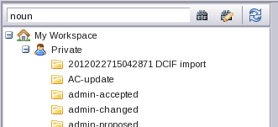
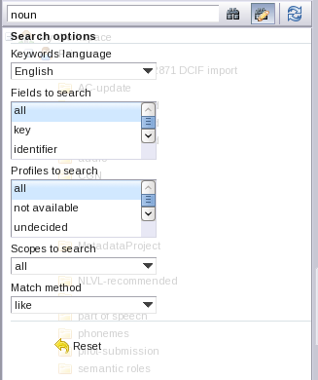
Searching
Make use of the
search options !
Notes:
Transitive: match like tig resultaten,, match exact: geen enkele

Slide 7
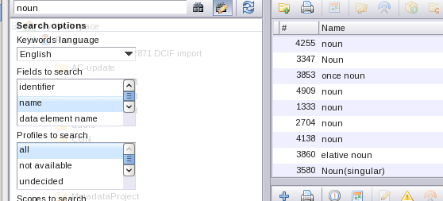
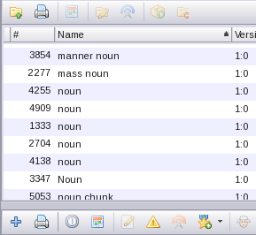
Searching
First results: (1)
(2)
Aaa ‘sort’ these results

Slide 8
Consequences of adopting
Suppose, you adopt a specific DC, and some essential changes are made to that DC
  You may no longer want to map, but how do you know? New facility: “Atom feed” of changes
Suppose there are several relevant DCs, you adopt one and just that one doesn’t get standardized
  You have to redo your work (but you first are to be aware that …) cf. above

Slide 9
Ill-defined DCs
Profile: morphosyntax
  Definition: semantic
‘concept’ in definition not defined in ISOcat , or
that concept comes with several DCs (which one was meant?)
  Example: ‘noun’

Slide 10
Too many DCs
There are too many ‘almost the same’ DCs, even within the same profile
Too vague DCs
There are many DCs with rather ‘empty’ definitions
  Proper noun: a noun that represents a unique thing or person
  Determiner: determiner
  Indefinite article: article that is indefinite
  Mother tongue: Specifies whether the language is a speakers mother tongue

Slide 11
Too specific DCs
Quite a number of DCs are too specific, cf. Polish ones, this makes it difficult to map with them
  i.e. stuff that belongs in the Polish language section is in the general, English one
Other DCs are too project/tagset related
  Mentioning the name in de definition
  Or in the name,
  Or …

Slide 12
Therefore, while for some technical issues solutions will come up
YOU should also be very careful yourself,
especially wrt the ‘soundness’ of the DCs, in particular
as far as definitions, profile, and translation are concerned!
Only in that case ISOcat can become a success story!

Slide 13
Follow-up
Contact
  Menzo for technical problems
  Ineke for content problems
Next workshop
  September or October
  Before 15 August share a first substantial selection for your project with the CLARIN-NL group, and a spreadsheet for RELcat

Slide 14
Thanks !

