Slide 1
ISOcat:
How to create a DC
(including “do’s and don’ts”)

Slide 2
Your work wrt ISOcat
Adopt an existing entry
Create an entry
Link with an existing entry
In all cases: the entries should be GOOD ones
But: what makes an entry a good one, one that you can use?

Slide 3
A good DC
20 March 2012
CLARIN-NL ISOcat tutorial
3
What defines a good DC?
  It should ‘match’ with the way you use a specific notion in the annotation scheme, application, … at hand
  It should come with the same profile
  It should handle the same phenomenon,
SpeakerID =/= SingerID

Slide 4
Speaker vs Singer
20 March 2012
CLARIN-NL ISOcat tutorial
4
SingerID and SpeakerID: siblings
SingerID is subclass of both Singer and ID (RELcat!)
String→Name→Person→Singer → Opera singer→Tenor →Tenor in La Bohème
First: too generic, last: too specific
The others are in se candidates for DCs

Slide 5
Standards
20 March 2012
CLARIN-NL ISOcat tutorial
5
Hardly any available (cf morning session)
We really should try to arrive at a series of sound DCs, useful for YOU and as many other people as possible
=> not too specific, not too general

Slide 6
What defines a good DC?
20 March 2012
CLARIN-NL ISOcat tutorial
6
Meaningful definition
Indefinite pronoun
  Not: pronoun that is indefinite
Unless
both ‘pronoun’ and ‘indefinite’ are defined elsewhere AND
it is mentioned explicitly which are involved AND
these definitions are correct (for you)

Slide 7
20 March 2012
CLARIN-NL ISOcat tutorial
7
Correct definition
Personal pronoun
  Not: pronoun referring to persons
As
That cat has five kittens. SHE …
This table was very expensive but I like IT very much
And John shook HIS head …
[Note: in a particular tagset the definition may be correct! In general it is not.]

Slide 8
Reusable definition
Personal pronoun
Not: In CGN a personal pronoun …
Not: In Dutch a personal pronoun …
Not: A personal pronoun (ik, ikke and ikzelf) is characterized by …
A definition should be as neutral (project, language) as possible, while still valid for your purposes!

Slide 9
Good DC => good name
Sometimes confused:
Identifier (=/= PID)
Data Element Name
Name
Re 1: should come in camelCaseFormat, start with alphabetical character (not 1stPerson, but firstPerson), in English, be meaningful (not EVON, but singularNeuterForm) ,…

Slide 10
Re 2: field Data Element Name (DEN) is proper place to mention abbreviations/tags used for a particular notion, and not just for English
(N, NPlur, EVON)
Re 3: In all Language Sections the correct full name(s) in the working language at hand are provided

Slide 11
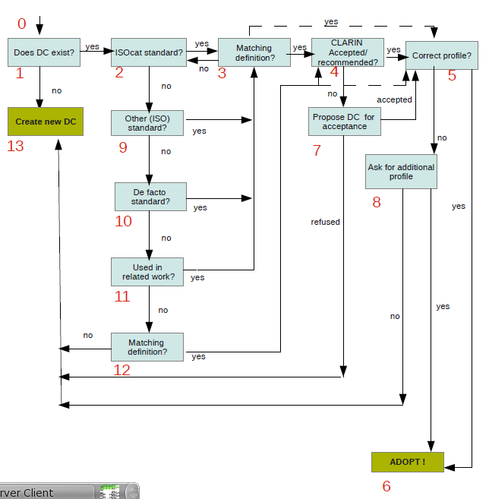
decision
process:

Slide 12
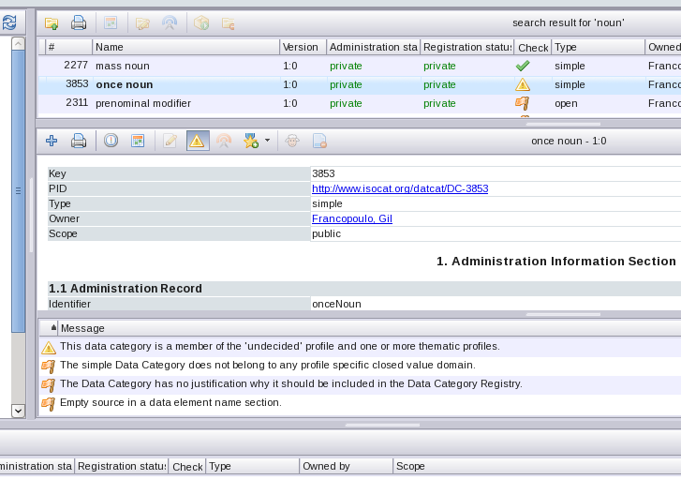
Flagged DCs
why?

Slide 13
Flagged DCs
Try to avoid linking with ‘deprecated’ or ‘superseded’ DCs !
  do not use DCs with 2 definitions!!
In other cases the flags show whether the DC specification is correct from a more technical point of view
Note that only DCs with a green marking are qualified for standardization (or CLARIN-NL/VL recommendation)

Slide 14
DC/DCS and profile
Profiles are not added automatically, a DCS may contain elements with various profiles
Profile ‘not available’: only to be used when the correct profile is not contained in the list!
In such a case, use ‘Not available’ for the time being, AND
Contact isocat@mpi.nl

Slide 15
Which elements to include?
Cf slide on SingerID/SpeakerID
In general: all linguistically meaningful notions mentioned in your schema, manual, definition PLUS the metadata (CMDI !)
Abbreviations (PST for /past tense/) are to be mentioned as Data Element Name

Slide 16
“Do’s & don’ts”
Do’s:
Create a DCS for your scheme (name project, annotation scheme, …)
Provide clear definition (short, to the point) for your scheme, application, ….
Take care not to leave concepts used in your definition undefined or vague (‘note’ section !)
Use appropriate profile (NOT: ‘undecided’)
Use appropriate vocabulary (per profile)
Check ‘adopted’ DC’s regularly till standardization !

Slide 17
Dos
When creating a DC, fill out
Justification: used in XYZ, part of tagset N
  Why existing DCs could not be reused !!!!!
Language section
  Always English language section (+ Dutch!)
  Strong recommendation: sections for object language(s), for working language (like language in which manual is written)
  Sections in the various languages should match (+/- be translations of each other)
Profile
  ‘Undecided’ is NOT correct!

Slide 18
When creating a DC, fill out
Example section
  Note that *negative* examples may be very helpful!
Identifier “foreignWord”
Dutch language section
  example section: the, house, NOT: poster
  explanation section: een woord als ‘poster’ heeft Nederlandse diminutief: postertje, itt house (*housje, *houseje)

Slide 19
Example sections
Suppose you want to illustrate a real Dutch phenomenon (‘neuter’ vs ‘non-neuter’) :
Ex.sec. in EN language section
  Dutch ex with transl in English
Ex.sec. in DE language section
  Dutch ex with transl in German
Ex.sec. in EN linguistic section
  EN example
Ex.sec. in DE linguistic section
  DE example with translation in English

Slide 20
Don’ts
Confuse Language and Linguistic section
  Latter contains language specific values for closed domains
Be (too) language specific in definition
Mention scheme in definition
Use several definitions in one DC
Circular definitions
Rely on authority
Rely on standardized status
  Definition should fit YOUR scheme, etc

Slide 21
Questions?

Slide 27
RelCat
“Linking DCs” is not just a ‘nice’ feature
  Proper noun
  Common noun
  Mass noun
  Count noun
  are all instances of ‘noun’ (i.e. have an IsA relation with it)

Slide 28
RelCat
Essential for several Dutch tag sets
  N(soort, ….) comes with 2 DCs:
    Noun
    Common
    How to relate this with one of the DCs for ‘common noun’, even in case we would find the definition perfect?
  Good news: in progress!

Slide 29
Some considerations
DC N(common) as a unit
DC Noun and DC Common
We are to take care that a definition for ‘Common’ is not seen as definition of ‘common noun’ (i.e. the whole)
We are to take care that, when a notion ‘noun’ is used in the definition of ‘common’, it gets the intended reading

Slide 30
More complex
N(soort,mv,dim)
noun(common,plural,diminutive)
More problematic to define as a whole, not just stating: a diminutive common noun used as plural
This doesn’t mean anything!
Possible solution: linking it with the intended readings of the features involved

Slide 31
Searching
How to detect which DCs are Standardized?
Or have a German language section?
How to search using the keys? And what about language of keywords?
How to detect which DCs ‘belong together’
  (unless one mentions the tag set in the definition e.g )
Notes:
Transitive: match like tig resultaten,, match exact: geen enkele

Slide 32
Searching
How to search for alternative names (Data Element Names): Konjunktion, Bindewort; Präposition/ Verhältniswort
And the results: when not using ‘exact’ match and a specific field, MANY results come up, apparently unordered,
while using ‘exact’ + specific ‘field’ or ‘profile’ may make you miss relevant entries.

Slide 33
Consequences of mapping
Suppose, you map with a specific DC, and some essential changes are made to that DC
  You may no longer want to map, but how do you know?
Suppose the are several relevant DCs, you select one and just that one doesn’t get standardized
  You have to redo your work (but you first are to be aware that …)

Slide 34
Ill-defined DCs
Profile: morphosyntax
  Definition: semantic
  Definition: too narrow/broad
  Definition unclear (and no examples available)
‘concept’ in definition not defined in ISOcat , or
That concept comes with several DCs (which one was meant?)

Slide 35
Too many DCs
There are too many ‘almost the same’ DCs, even within the same profile
Too vague DCs
There are many DCs with rather ‘empty’ definitions
  Proper noun: a noun or adjective denoting a single object
  Common noun: a noun or adjective denoting a class of objects

Slide 36
Too language-specific DCs
Quite a number of DCs are too specific, mostly Polish ones, this makes it difficult to map with them
In these cases: stuff that belongs in the Polish language section is in the general, English one
***
ISOcat: not yet perfect

Slide 37
Therefore, while for some technical issues solutions will come up/are coming up
YOU should also be very careful yourself,
especially wrt the ‘soundness’ of the DCs, in particular
as far as definitions, profile, and translation are concerned!
Only in that case ISOcat can become a success story!

Slide 38
Thanks !

