Slide 1
ISOcat introduction

Slide 2
ISOcat: a Data Category Registry
An implementation of ISO 12620:2009
  Terminology and other content and language resources — Specification of data categories and management of a Data Category Registry for language resources
    Successor to ISO 12620:1999 which contained a hardcoded list of Data Categories
A data category
  is the result of the specification of a given data field
  an elementary descriptor in a linguistic structure or an annotation scheme

Slide 3
What is a Data Category?
The result of the specification of a given data field
  A data category is an elementary descriptor in a linguistic structure or an annotation scheme.
Specification consists of 3 main parts:
  Administrative part
    Administration and identification
  Descriptive part
    Documentation in various working languages
  Linguistic part
    Conceptual domain(s for various object languages)

Slide 4
Data Category example
Data category: /grammatical gender/
  Administrative part:
    Identifier: grammaticalGender
    PID: http://www.isocat.org/datcat/DC-1297
  Descriptive part:
    English definition: Category based on (depending on languages) the natural distinction between sex and formal criteria.
    French definition: Catégorie fondée (selon la langue) sur la distinction naturelle entre les sexes ou d'autres critères formels.
  Linguistic part:
    Morphosyntax conceptual domain: /masculine/, /feminine/, /neuter/
    French conceptual domain: /masculine/, /feminine/
Notes:
/Grammatical gender/ ➔ /grammatical gender/, Morposyntax ➔ Morphosyntax

Slide 5
Data Category types
complex:
open
closed
constrained
writtenForm
grammaticalGender
email
string
string
string
Constraint: .+@.+
neuter
feminine
masculine
simple:

Slide 6
Data Category types
container:
lexicon
language
alphabet
entry
japanese
ipa
lemma
writtenForm

Slide 7
Which type to use?
Which type is appropriate depends on the place of the data category in the structure of your resource:
  Can it have a value?
    Complex Data Category with an data type
      Any of the values of the data type?
        Open Data Category
      Can you enumerate the values?
        Closed Data Category
          Fill its value domain with simple Data Categories
      Is there a rule to constrain the values?
        Constrained Data Category
          Express the rule/constraint in one of the rule languages
  Is it a value?
    Simple Data Category
  Does it group other (container or complex) Data Categories?
    Container Data Categories
If a Data Category both has a value and groups Data Categories
  Complex Data Category

Slide 8
Some examples
N(soort,mv,basis)
S
CGN
tag
category
noun phrase
NP
VP
number
singular
PoS
NTYPE
GETAL
GRAAD
agreement
Text=“John”
V
NP
person
third
N
soort
mv
basis
Text=“hit”
Det
N
/category/ a closed DC
/noun phrase/ a simple DC
/agreement/ a container DC
/number/ a closed DC
/singular/ a simple DC
/person/ a closed DC
/third/ a simple DC
(Encoded as TEI P5 FSR the XML elements and attributes
are seen as syntactic sugar)
/CGN tag/ a constrained DC
(The constraint is specified as an EBNF,
which refers to the following DCs)
/PoS/ a closed DC
/N/ a simple DC
/NTYPE/ a closed DC
/soort/ a simple DC
/GETAL/ a closed DC
/mv/ a simple DC
/GRAAD/ a closed DC
/basis/ a simple DC
Text=“the”
Text=“ball”
/S/ a container DC
/NP/ an open DC
/VP/ a container DC
/V/ an open DC
/NP/ a container DC
/Det/ an open DC
/N/ an open DC
(Text= is seen as syntactic sugar)

Slide 9
Data Category relationships
Value domain membership
Subsumption relationships between simple data categories (legacy)
Relationships between complex/container data categories are not stored in the DCR
partOfSpeech
string
pronoun
personal
pronoun

Slide 10
No ontological relationships?
Rationale:
  Relation types and modeling strategies for a given data category may differ from application to application;
  Motivation to agree on relation and modeling strategies will be stronger at individual application level;
  Integration of multiple relation structures in DCR itself could lead to endless ontological clutter.
  Solution under development:
  RELcat a Relation Registry

Slide 11
How can you use Data Categories?
wordOrder
grammaticalGender
lexicon
Language | BWO | genders
Lexicon
lexicalEntry
1..*
A (schema for a) typological database
Lexical Entry
Shared semantics!
partOfSpeech
lemma
Lemma
Explicit semantics!
writtenForm
1..*
0..*
Form
Sense
writtenForm
Word Form
grammaticalGender
0..*
lexicalType
wordForm
A (schema for a) lexicon

Slide 12

What is a Data Category Registry?
A (coherent) set of Data Categories, in our case for linguistic resources
A system to manage this set:
  Create and edit Data Categories
  Share Data Categories, e.g., resolve PID references
  Standardize Data Categories
Grass roots approach
www.isocat.org

Slide 13


Standardization
Decision Group
Submission
group
Thematic Domain
Group
Data Category Registry
Board
Stewardship
group
Evaluation
Validation
rejected
rejected
Publication

Slide 14
How can you use a Data Category Registry?
You can:
  Find Data Categories relevant for your resources and embed references to them so the semantics of (parts of) your resources are made explicit
    This can be supported by tools you use, e.g., ELAN, LEXUS and the CMDI Component Editor directly interact with ISOcat
  Interact with Data Category owners to improve (the coverage of) their Data Categories
  Create (together with others) new Data Categories and/or selections needed for your resources and share those
  (Submit (your) Data Categories for standardization)
    De facto standardization by a community, e.g., CLARIN-NL/VL
  Free of charge
  Grass roots approach
CLARIN-NL: interaction via Ineke
Notes:
in CLARIN-NL: interact via Ineke

Slide 15
ISOcat and CLARIN(-NL/VL): general remarks

Slide 16
Importance of ISOcat
Collaboration
  Human, machine, language x, language y
Essential in CLARIN, but …
Impossible when we don’t know (exactly) what we are talking about!
Transitive verb – transitief werkwoord
Transitief werkwoord – overgankelijk werkwoord

Slide 17
Importance of ISOcat
ISOcat:
  Provides us with a framework to make such things clear (is X the same as Y, does A use it the same way)
  At least, that is the intention, ISOcat still being ‘under construction’
Today’s sessions:
  How to work with ISOcat
  Which other “cats” do we have at the moment
  The future …

Slide 18
CLARIN-NL (and VL) and ISOcat
There are some 60 projects dealing with ISOcat in some sense (sometimes ‘only’ metadata (CMDI))
  55 Netherlands
  5 Flanders
  1 NL/VL pilot
  Of course, that is not the main focus of these projects, but still…
  A lot of ISOcat work needs to be done!

Slide 19
CLARIN-NL (and VL) and ISOcat
At l
At least of TTNWW (the pilot) one of the explicit goals is to signal problems and to try to remedy them (for our own good, and that of CLARIN as a whole)
In that respect, we do have some ‘success’
  Several larger and smaller issues are already being remedied

Slide 20
CLARIN-NL (and VL) and ISOcat
Many (Dutch) projects working on ISOcat issues, plus those of other national CLARINs
same concepts ?
same problems ?
very likely

Slide 21
Collaboration necessary
National (Dutch) level
  Coordinated effort
  Shared workspace under ‘shared’ (VIEW)
      USE IT
    Plus discussion platform
  Report problems to me (Ineke)
International level
  We will try to collaborate with them as well

Slide 22
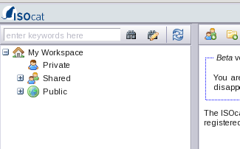
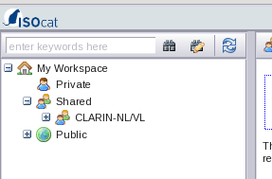
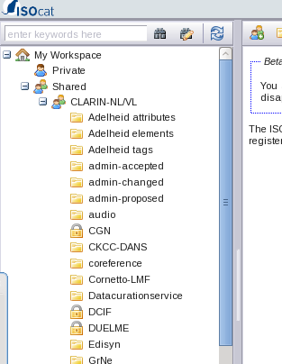
Collaboration (1)

Slide 23
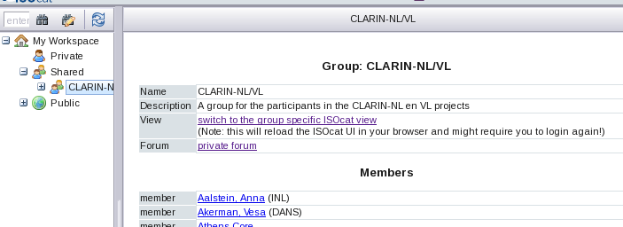
Collaboration (2)
                VIEW FORUM

Slide 24
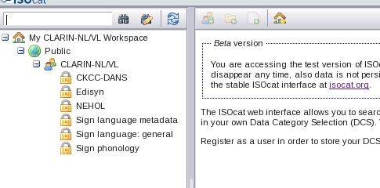
View
Searches are done in ‘our own’ part of ISOcat
  Try to reuse what is already contained in it
  If necessary, go to the full ISOcat to reuse something available there (‘house’ icon)
  Last resort: make a new DC

Slide 25
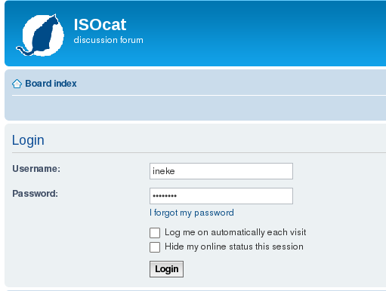
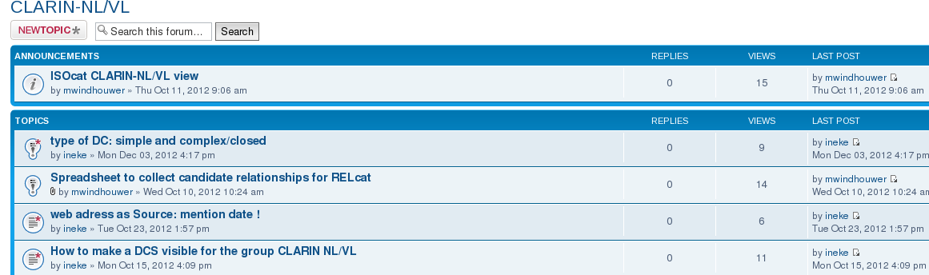
FORUM
- All kinds of information
for CLARIN NL/VL
- Regular updates !

Slide 26
Thanks !

