Slide 1
CLARIN for Linguists
Portal & Searching for Resources
Jan Odijk
LOT Summerschool
Nijmegen, 2014-06-23

Slide 2
Overview
CLARIN Portal
Find data and tools

Slide 3
Overview
CLARIN Portal
Find data and tools

Slide 4
CLARIN Portal
Finding data and tools via one portal?
  EU Portal: http://www.clarin.eu/guest-portal
  NL Portal under development: sneak preview
In the meantime, for NL:
  Use http://www.clarin.nl/node/404
  for an overview of CLARIN-NL
    Data
    Applications
    Services
    Links to the CLARIN Europe data and services

Slide 5
CLARIN Portal
EU Portal: http://www.clarin.eu/guest-portal
  Link to Virtual Language Observatory
  Deposit Your Resources
  Featured Resource
  Showcases
  Searching through Multiple Corpora
  Blog
  General information on CLARIN

Slide 6
CLARIN-NL Portal
CLARIN-NL Portal sneak preview
Intro page
[Centres]A summary of Dutch CLARIN centres
[Find Data] A selection of tools to find relevant resources using metadata and content
[Services] : An inventory of tools and services with faceted search
[CLARIN recipes] to do the most often used actions.
[Colleagues & Advice] for asking colleagues for advice

Slide 7
Overview
CLARIN Portal
Find data and tools

Slide 8
CLARIN Infrastructure
‘Can find all data and Tools’
All data are distributed over various CLARIN centres
  How can you find them?
Web pages and URLs change, disappear over time
  How do we know a link is there still tomorrow?
Searching via Google will not work
  Too many irrelevant search results

Slide 9
CLARIN Infrastructure
‘Can find all data and Tools’
CLARIN approach:
  For all data there must be metadata
      Data that describe data (resource descriptions)
  Metadata must all be in the same format
      Component-based Metadata Infrastructure (CMDI) format
  All data and metadata must be accessible via Persistent Identifiers (PID)
  Metadata must be made available according to a specific protocol (OAI-PMH) by each centre
  Some centres harvest the metadata of all centres and store them centrally
  And make available browser and search engines
More on this on Friday

Slide 10
CLARIN Infrastructure
‘Can find all data and Tools’
Virtual Language Observatory
  Faceted browsing and geographical navigation
  CLARIN-PP
  Demo
Meertens CLARIN Metadata Search
  CLARIN-NL
  Main Features

Slide 11
Thanks for your Attention

Slide 12

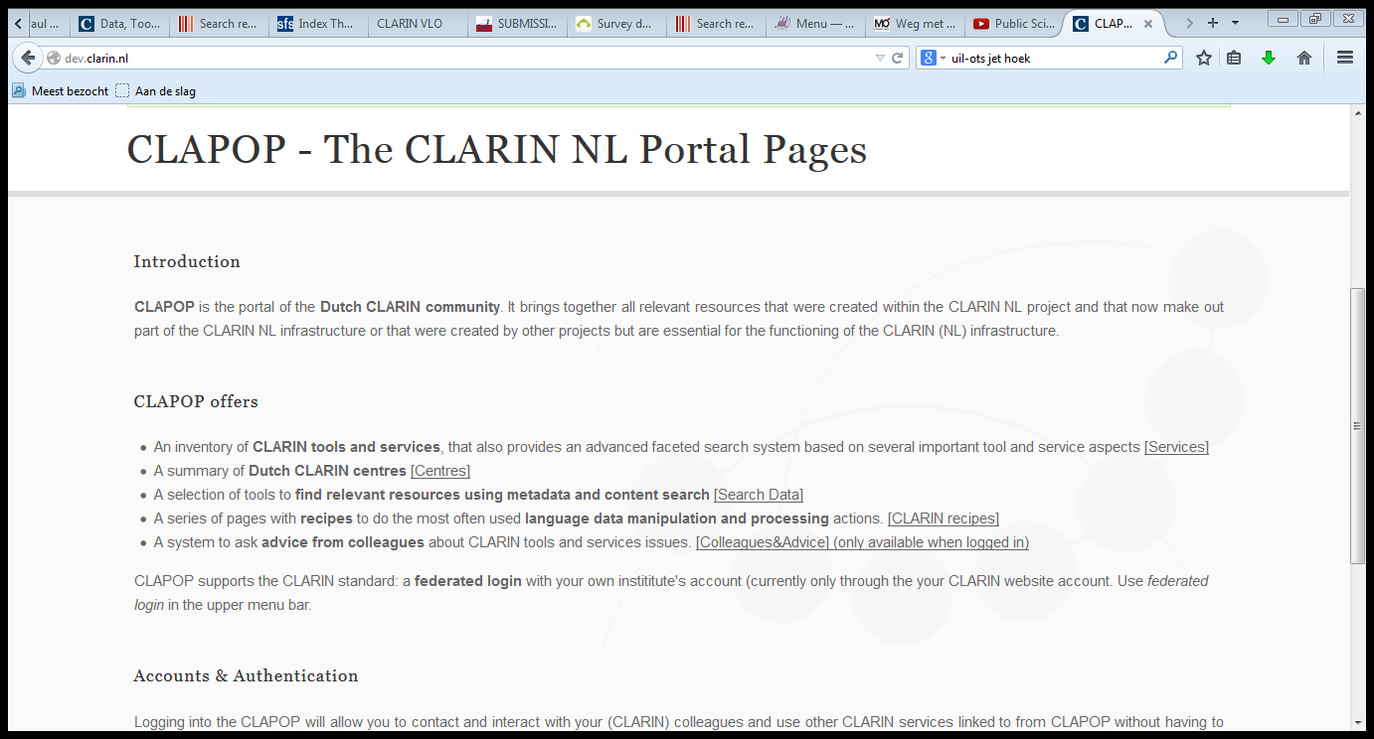
CLARIN-NL Portal

Slide 13
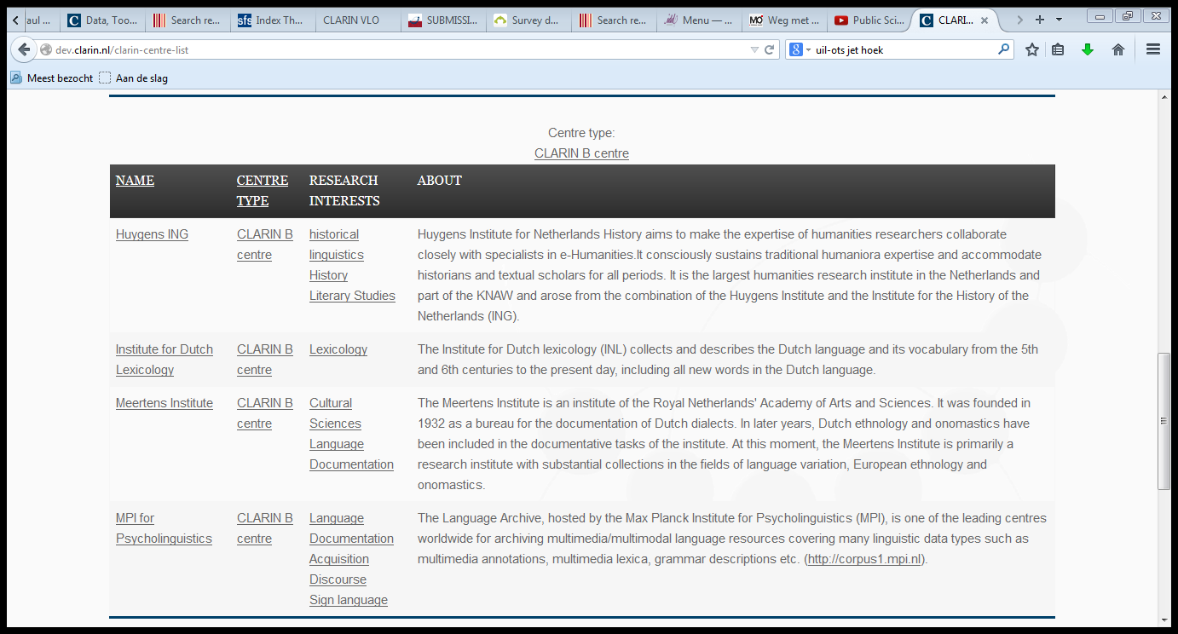
CLARIN-NL Portal

Slide 14
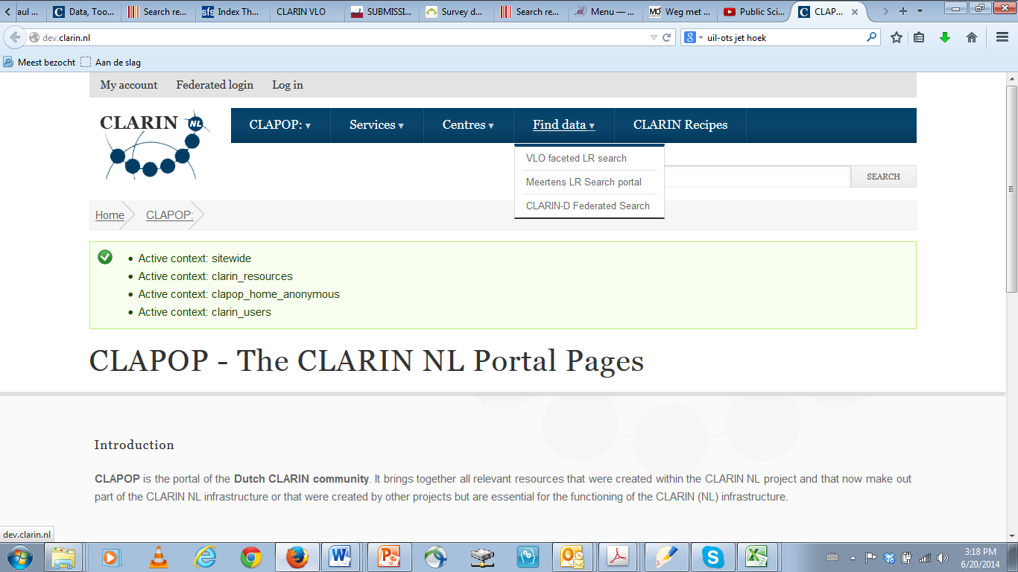
CLARIN-NL Portal

Slide 15
CLARIN-NL Portal
Services List with faceted browsing
Selection by
  Research domain (e.g. linguistics)
  Resource tags (e.g. data, service)
  Tool Task (e.g. parsing, search)
  Language (e.g. Dutch)
  CLARIN Centre (e.g. Meertens Institute)
  Country (e.g. Belgium)

Slide 16
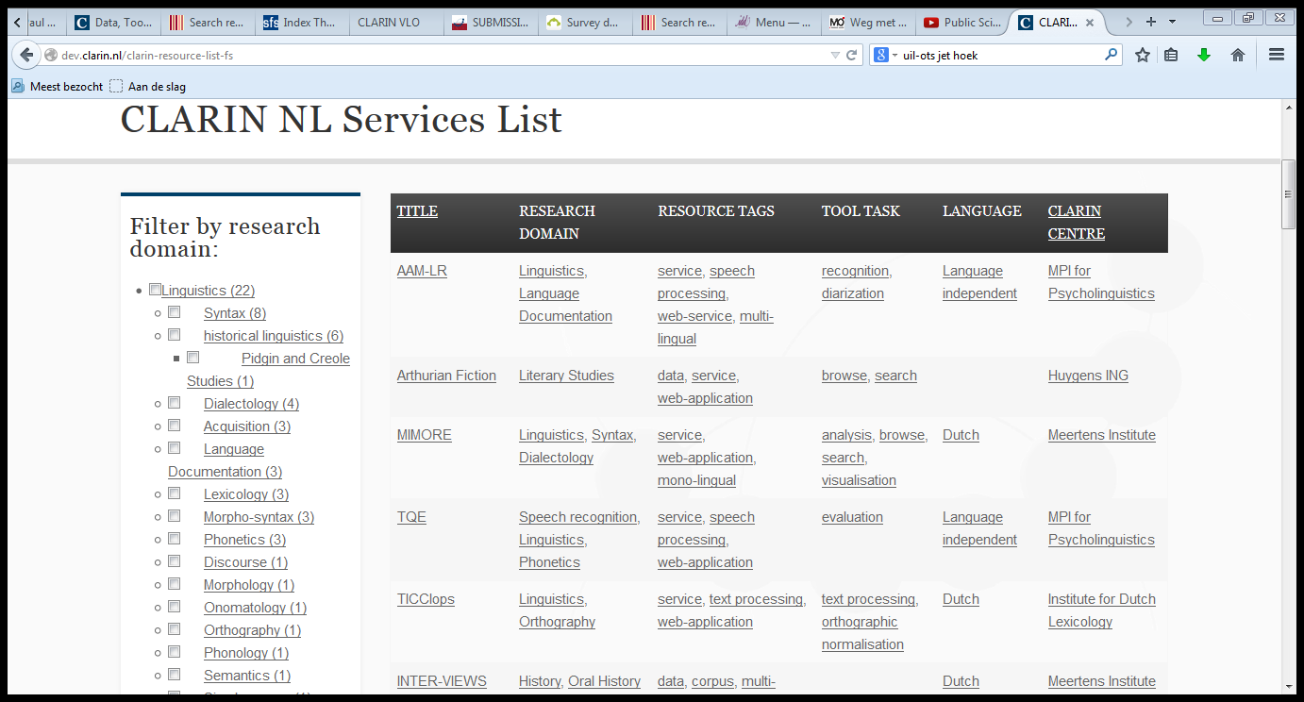
CLARIN-NL Portal
Portal

Slide 17
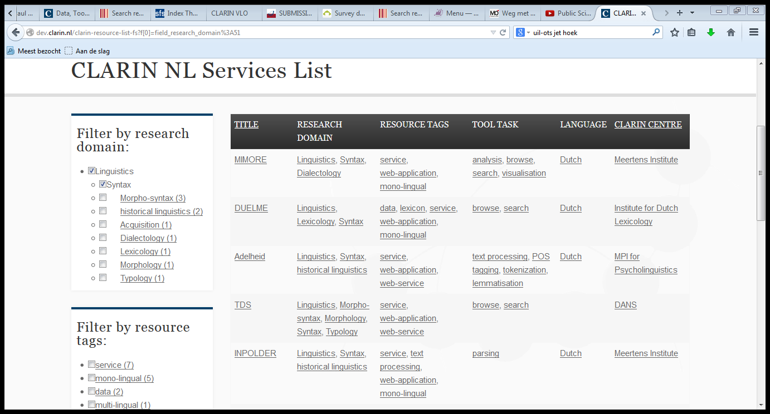
CLARIN-NL Portal
Portal

Slide 18
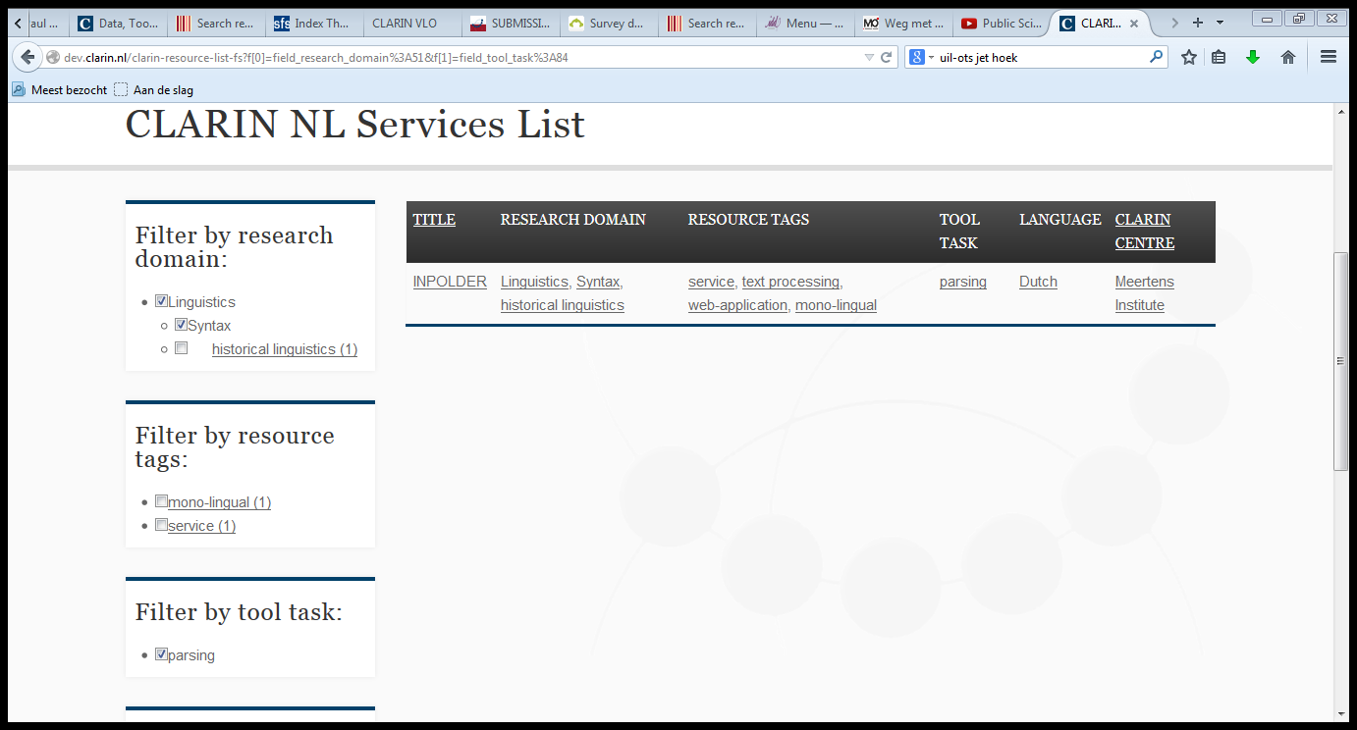
CLARIN-NL Portal
Portal

Slide 19
CLARIN-NL Portal
Portal Return Page

Slide 20
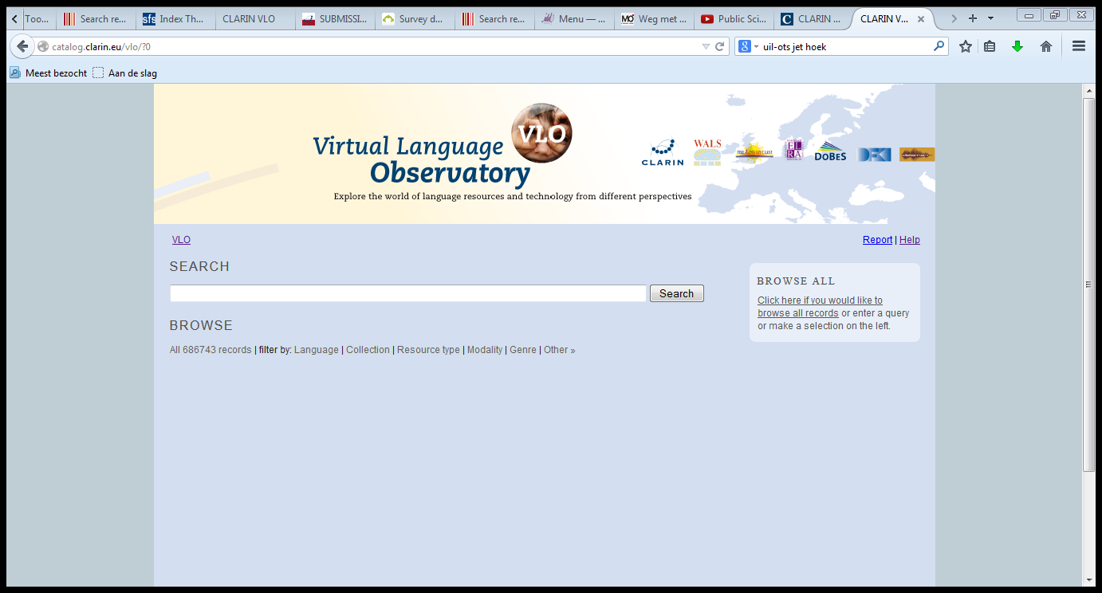
VLO
VLO

Slide 21
VLO
Faceted Browsing by
Language | Subject
Collection | Format
Resource Type | Organisation
Continent | National Project
Country | Keyword
Modality | Data Provider
Genre

Slide 22
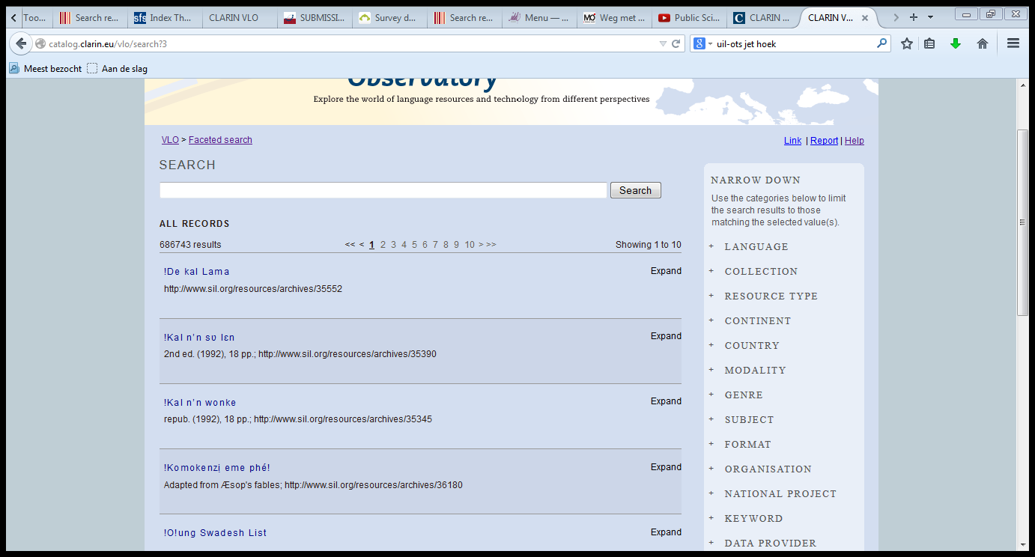
VLO
VLO

Slide 23
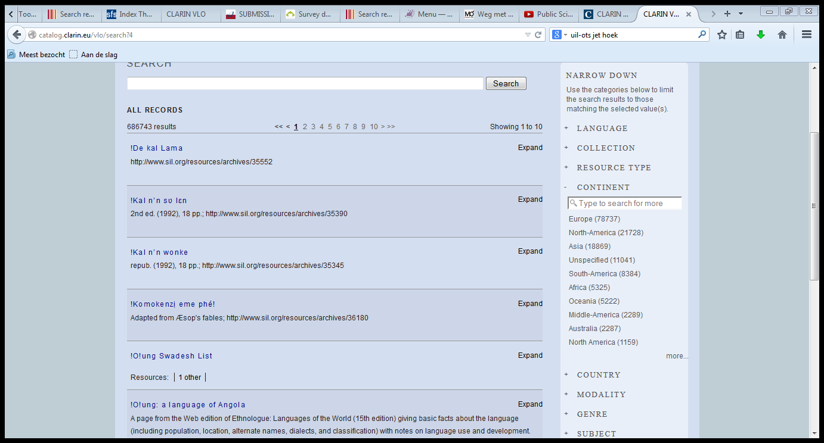
VLO
VLO

Slide 24
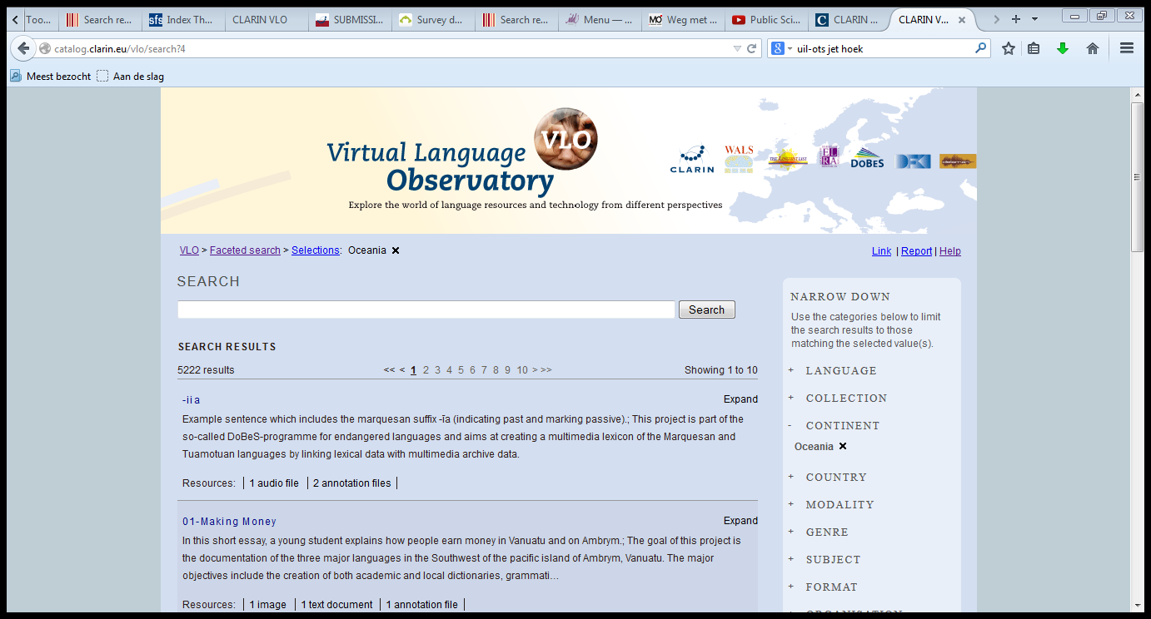
VLO
VLO

Slide 25
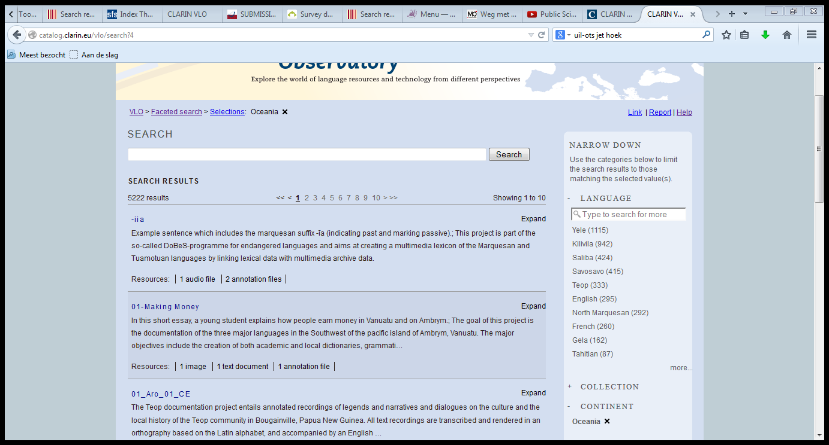
VLO
VLO

Slide 26
VLO
VLO

Slide 27
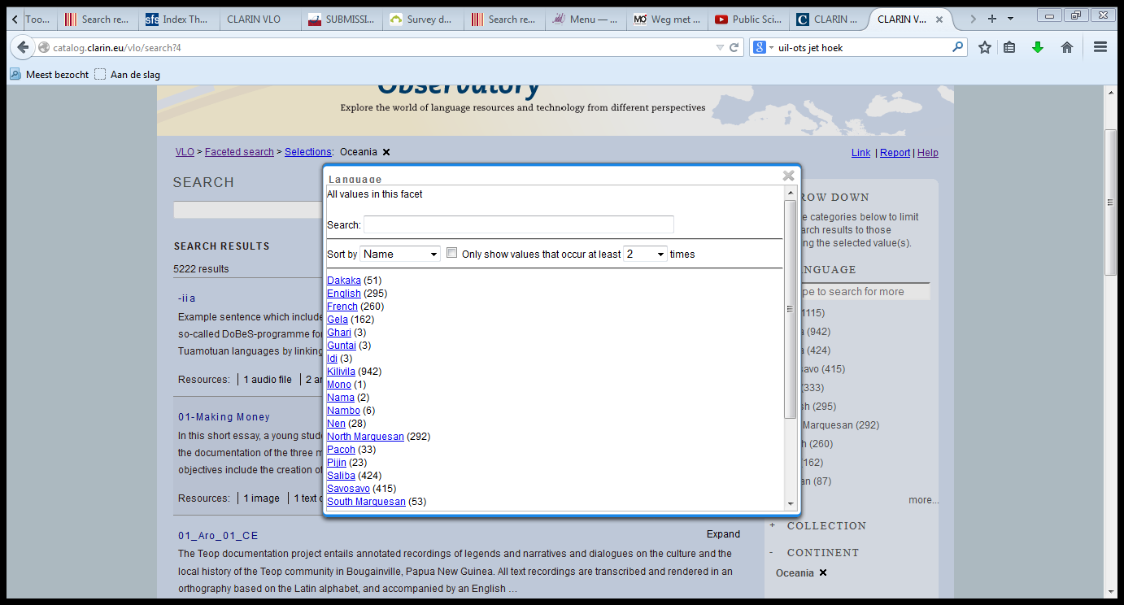
VLO
VLO

Slide 28
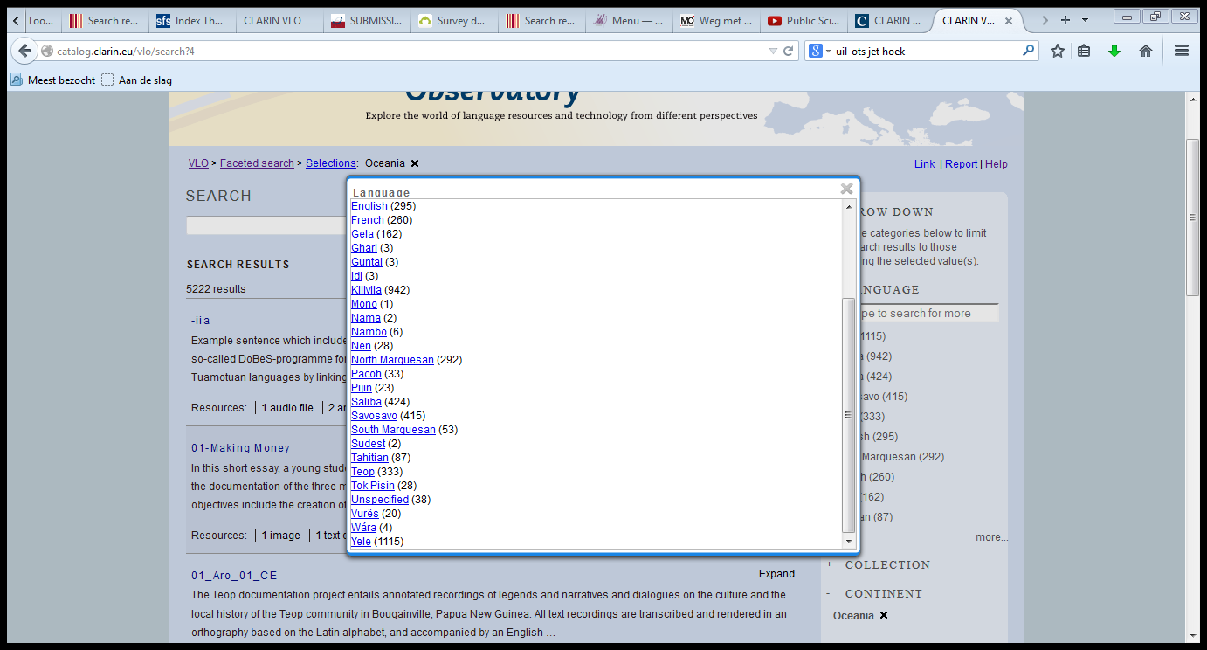
VLO
VLO

Slide 29
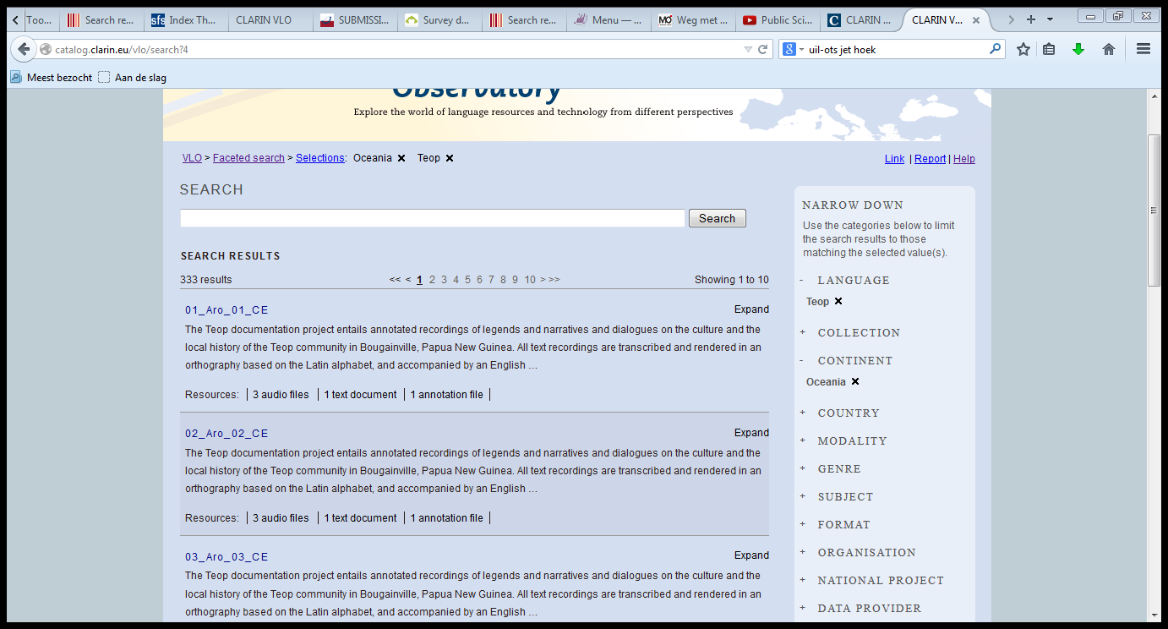
VLO
VLO

Slide 30
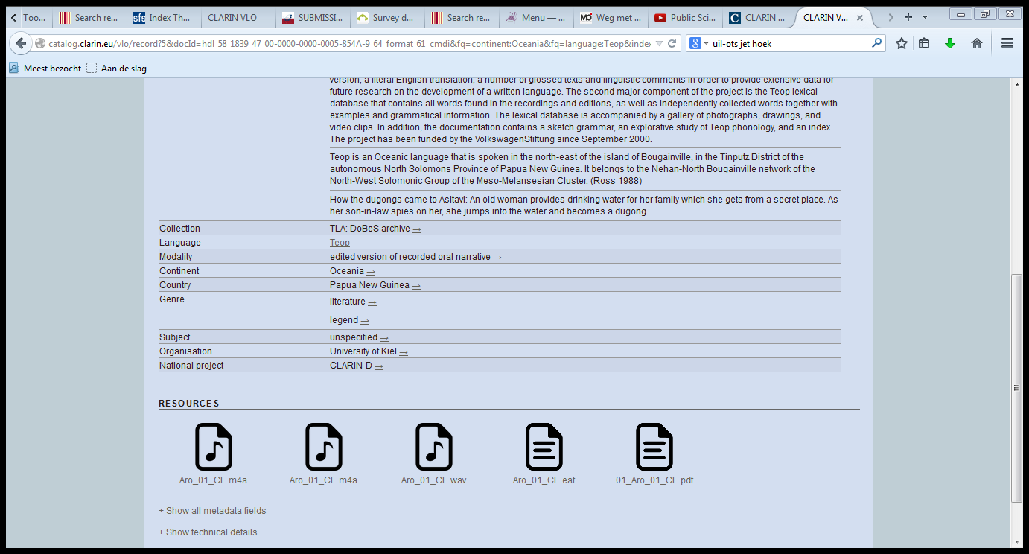
VLO
VLO
METADATA
DATA and ANNOTATIONs

Slide 31
VLO
VLO Return Page

Slide 32
Meertens Metadata Search
Query Completion
  automatic query completion + hit count + tag
Suggestions for other searches
  You could also look for...
Storing the search selection
Different Overviews of the Retrieved results
  dynamic tag cloud of the aggregated content within the metadata label

Slide 33
Meertens Metadata Search
Visualisation of aggregated search features
  Geo-referenced resources on a map
  Editable charts for displaying the date ranges of documents
Recommend related resources
  link to the metadata record
  snippet of a recommendation

Slide 34
Meertens Metadata Search
Meertens Return Page

Slide 35
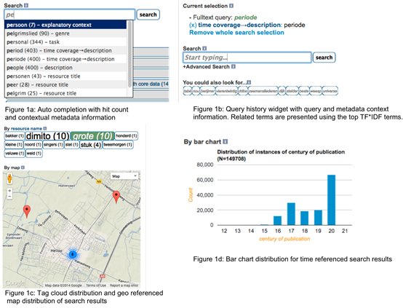
Meertens Metadata Search

Slide 36
Meertens Metadata Search

Slide 37
Meertens Metadata Search

Slide 38
Meertens Metadata Search

Slide 39
Meertens Metadata Search

Slide 40
Meertens Metadata Search

Slide 41
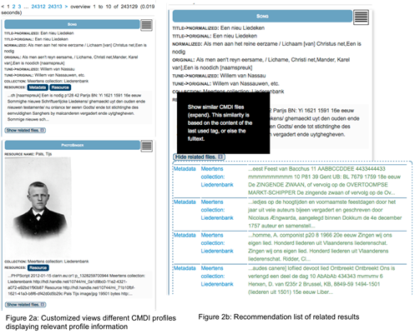
Meertens Metadata Search

Slide 42
Meertens Metadata Search
Meertens Return Page

