Slide 1
CLARIAH A Research Infrastructure for the Humanities in the Netherlands Jan Odijk Vienna, 2015-04-09

Slide 2
Overview
The Humanities are turning Digital
European Context
National context
CLARIAH CORE
Conclusions

Slide 3
Overview
The Humanities are turning Digital
European Context
National context
CLARIAH CORE
Conclusions

Slide 4
The Digital Turn
Amount of digital data is increasing exponentially

Slide 5
The Digital Turn
Also in the humanities:
Contemporary newspapers, journals, tv, radio,
New media: blogs, twitter, facebook, youtube,
Historical Newspapers: > 80 M articles
www.delpher.nl
Books:> 170 k books 18th – 20th century
Magazines: > 1.5 m pages 18th – 19th century
Texts of 1.5 m radio bulletins

Slide 6
The Digital Turn
Digital data
➔ Digital techniques can be used to analyze them
➔Hardware is enabling it
➔Basic Software is available
➔Advanced analysis techniques already often yield workable quality

Slide 7
The Digital Turn
Huge opportunities for the humanities
Broaden empirical base of the research
Investigate existing research questions in a new way
Investigate research questions that could not be addressed before
Formulate new research questions

Slide 8
The Digital Turn
But it is not going to be easy!
Involves the entire spectrum of the analytics challenge of big data:
Massively, distributed data sources – structured, unstructured, complex, noisy and incomplete
Large volumes of unstructured data in multiple formats – audio, video, text, image – requiring semantic interoperability
Globally distributed and varied users – across disciplines – speaking very different languages

Slide 9
The Digital Turn
But with broad interest from industry
Text analytics companies
Big customers of such companies, e.g. Philips
Language technology companies
Publishers
Big players such as Microsoft and IBM
IBM: cf. Watson
The challenges faced by the Art & Humanities are highly representative and synergistic with the broader challenges IBM is solving across other industries – from law enforcement to health care and beyond
And public Digital Heritage organisations

Slide 10
Industrial Interest

Slide 11
The Digital Turn
But it is not going to be easy
Big differences within humanities
Technical knowledge and expertise
Willingness to embrace digital techniques
➔the digital turn must be facilitated by research infrastructures for the humanities

Slide 12
Overview
The Humanities are turning Digital
European Context
National context
CLARIAH CORE
Conclusions

Slide 13
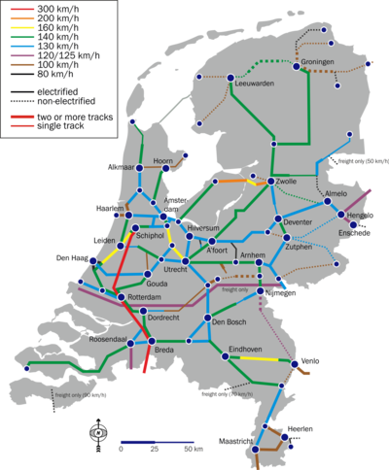
European Context
Infrastructure:
(Usually large-scale) basic physical and organizational resources, structures and services needed for the operation of a society or enterprise
Railway network, road network, electricity network, …
eduroam

Slide 14
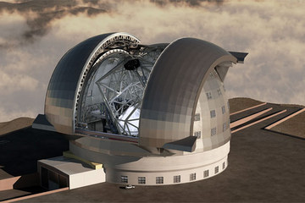
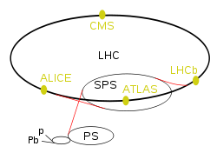
European Context
Research infrastructure
Infrastructure intended for carrying out research: facilities, resources and related services used by the scientific community to conduct top-level research
Famous ones: Chile large telescope, CERN Large Hadron Collider

Slide 15
European Context
humanities researcher
Linguists, historians, literary scholars, philosophers, religion scholars, ….
And a little bit in the social sciences: e.g. political sciences researchers

Slide 16
European Context: CLARIN
CLARIN (Common Language Resources and Technology Infrastructure)
Digital language-related resources
Data in natural language (texts, lexicons, grammars)
Databases about natural language (typological databases, dialect databases, lexical databases, …)
Audio-visual data containing (written, spoken, signed) language (e.g. pictures of manuscripts, av-data for language description, description of sign language, interviews, radio and tv programmes, …)

Slide 17
European Context: CLARIN
Language in various functions
As object of inquiry
As carrier of cultural content
As means of communication
As component of identity

Slide 18
European Context: CLARIN
The CLARIN infrastructure
Is distributed: implemented in a network of CLARIN centres
Is virtual: it provides services electronically (via the internet)

Slide 19
European Context: CLARIN
Prepared by CLARIN preparatory project (2008-2011)
coordinated by Utrecht University
From Feb 2012 coordinated by CLARIN-ERIC, hosted by the Netherlands
ERIC: a legal entity at the European level specifically for research infrastructures
Other ERIC members: Austria, Bulgaria Czech Republic, Denmark, Dutch Language Union, Estonia, Germany, Lithuania, Norway, Poland, Portugal, Sweden and growing

Slide 20
European Context: DARIAH
DARIAH (Digital Research Infrastructure for the Arts and Humanities)
aims to enhance and support digitally-enabled research and teaching across the humanities and arts
is a network of people, expertise, information, knowledge, content, methods, tools and technologies coming from various countries

Slide 21
European Context: DARIAH
Prepared by DARIAH preparatory project (2008-2011)
coordinated by DANS (NL)
From Aug 2014 coordinated by DARIAH-ERIC, hosted by France
Founding DARIAH members:
Austria, Belgium, Croatia, Cyprus, Denmark, France, Germany, Greece, Ireland, Italy, Luxembourg, Malta, The Netherlands, Serbia and Slovenia
And growing: Switzerland

Slide 22
Overview
The Humanities are turning Digital
European Context
National context
CLARIAH CORE
Conclusions

Slide 23
National Context: CLARIN-NL
CLARIN-NL: 2009-2015
Main results
RI implemented in multiple certified CLARIN centres
Many curated digital data
Many user-friendly web applications
Multiple functions: search, enrich, analyze, visualize, …

Slide 24
National Context: CLARIN-NL
Main results (cont.)
Easily accessible via CLARIN-NL Portal
Faceted search for services and data
Covering many humanities disciplines
Linguistics, literary studies, history, political sciences, religion studies, philosophy, communication and media studies, …
With 6 educational packages and other educational material incl 9 short movies and multiple screencasts

Slide 25
National Context: CLARIN-NL
Faceted search
By research discipline
By tool task
And other facets
Select result, introduction + link to application
Examples
Syntax, parsing => PaQu
Art History => RemBench
Notes:
The PaQu web service makes it possible to search in syntactically annotated corpora in Dutch. You can parse your own Dutch text corpus or use one of two corpora provided by the developers.
RemBench enables one to search and browse for works of art, artists, primary sources and library sources related to Rembrandt

Slide 26
National Context: DARIAH-NL
DARIAH-NL not awarded funding in 2008
Joint CLARIN-NL / DARIAH-NL proposal in 2011: CLARIAH
Common Lab Infrastructure for the Arts and Humanities
➔CLARIAH-SEED project
2012-2014

Slide 27
National Context: CLARIAH-SEED
Why together?
Plus
Many commonalities
Partially complementary
CLARIN strong on technical infrastructure
DARIAH strong on knowledge infrastructure
Minus
But there are also many differences
Danger of losing focus

Slide 28
National Context: CLARIAH-SEED
Focus on 3 disciplines
Linguistics
Social economic history
Media studies
And corresponding main data types
(natural language) text
Structured (mainly quantitative) data
Audio-visual data

Slide 29
National Context: CLARIAH-SEED
Linguistics
Building on CLARIN-NL
And Nederlab
Social economic history
Building on Clio-Infra and HSN
Media studies
Building on CLARIN-NL, CATCH, and EU-Screen(-XL)

Slide 30
National Context: CLARIAH-SEED
Nederlab
Independent project, co-financed by CLARIN-NL and CLARIAH-SEED
Dutch historical text corpora with CMDI metadata and all kinds of linguistic annotations
Access via browse, search and analysis interface
Initial version (limited access)
Aimed to support the longitudinal study of the Dutch language and culture

Slide 31
National Context: CLARIAH-SEED
Clio-Infra
aims to research the long-term development of worldwide economic growth and inequality
Has set up a set of interconnected databases containing worldwide data on social, economic, and institutional indicators for the past five centuries

Slide 32
National Context: CLARIAH-SEED
Clio-Infra
Examples
GDP per capita,1270-2000
Average years of education per capita, 1880 and 2000
Income per capita and life expectancy in China, Congo and NL, 1800-2007

Slide 33
National Context: CLARIAH-SEED
HSN
Historical Sample of the Netherlands
offers a representative sample of life courses of 78,000 people born in the Netherlands (1812-1922)
a unique tool for research in Dutch history and demography.

Slide 34
National Context: CLARIAH-SEED
EU-Screen(-XL)
offers free online access to thousands of items of audiovisual heritage
a resource for educators, researchers and media professionals searching for new audiovisual content from across Europe

Slide 35
National Context: CLARIAH-SEED
CATCH (Continuous Access to Cultural Heritage) and CATCHplus
make the (digital) collections of museums, archives and historical associations more accessible.
Improve efficiency of heritage management

Slide 36
National Context: CLARIAH-SEED
CLARIAH-SEED: Major Results
New CLARIAH proposal, awarded funding
NL DARIAH activities in EU and NL
Dissemination
Website
Short movies
Dutch Overview of the Digital Humanities
Course and project registries

Slide 37
National Context: CLARIAH-SEED
CLARIAH-SEED: Major Results
Demonstrators
TrOve (Transmedia Observatory )
search engine to analyse the distribution of information throughout time across different media as broadcast television, print media, social media and blogs
Mini Research pilot into the relation between media and Eastern European migration

Slide 38
National Context: CLARIAH-SEED
CLARIAH-SEED: Major Results
Demonstrators
OHT and OHT+ (Oral History Today)
supports the workflow of working with unstructured audio-visual content (esp. Oral History): archival search, browsing, playing fragments, making notes, visualization of patterns and publication.
CLIO-DAP (CLIO Data Availability Policy)
a demonstrator service for enhanced publications

Slide 39
National Context: CLARIAH-SEED
CLARIAH-SEED: Major Results
Demonstrators
Nederlab + De Gids
Search & Analysis interface to historical Dutch text corpora
Mini research pilot on author distribution in journal De Gids

Slide 40
National Context: CLARIAH-SEED
CLARIAH-SEED: Major Results
Data
Stakingsdata (‘Strike Data’)
links labour conflicts micro and macro level
visualizes them in dynamic historical maps.
HLZ (HSN Links Zeeland)
HSN Zeeland and LINKS database combined
Athena
Design for historical database on flora and fauna species in cultural and natural contexts for NL

Slide 41
Overview
The Humanities are turning Digital
European Context
National context
CLARIAH CORE
Conclusions

Slide 42
CLARIAH CORE
2015-2018
National project for CLARIN & DARIAH
Technical Infrastructure
Linguistics
Social Economic History
Media Studies
Research Pilots
(Education, dissemination, management)

Slide 43
CLARIAH-CORE
Technical Infrastructure
Facilities for shared vocabularies
Facilities for (mainly meta)data as Linked Data
Search in the linked data(LD)
Linking CMDI – LD: Durco /Windhouwer (2014)
Access Control
OCR / Text Correction Pipeline
Standardization
Performance and Availability

Slide 44
CLARIAH-CORE
Linguistics
Support for the researcher in each stage of a research project
New / improved functionality
(to the extent that the budget allows it)
Cooperation projects with Soc Econ & Media Studies

Slide 45
CLARIAH-CORE
Research project stages:
Data / Tool creation, collection, crowd-sourcing
Browsing / Searching for and selecting data / tools
Enrich data
Browse and search in (enriched) data + metadata; enrich, analyse, visualise search results
Incorporate data / tools in CLARIAH
Create enhanced publications

Slide 46
CLARIAH-CORE
Social Economic History
Databases
Macro (national/international)
Meso (trade unions, organisations)
Micro (individual / family )
All structured differently
Different vocabularies
Integrate these using the Linked Data paradigm
To investigate connections / relations

Slide 47
CLARIAH-CORE
Media Studies
Support the researcher: improved versions of
CoMerDA
Aggregated Search interface for AV-data
AVResearcherXL
Exploring audiovisual metadata in historical context
TrOve (see above)

Slide 48
CLARIAH-CORE
Media Studies
Support the researcher: improved versions of
DIVE
Presentation of collection items in context and ‘intuitive’ browsing
OHT (see above)

Slide 49
CLARIAH-CORE
Research Pilots
Small research projects
Aimed at testing infrastructure (elements)
Leads to
Improved tools and/or
Successfully concluded research, and/or
New Requirements for tools
Call will be launched in 2016

Slide 50
Overview
The Humanities are turning Digital
European Context
National context
CLARIAH CORE
Conclusions

Slide 51
Conclusions
NL is actively participating in CLARIN and DARIAH
Has a leading role in CLARIN
Successful in securing funding for RIs
CLARIN is yielding new research in NL
Many improvements still needed
CLARIAH-CORE just starting
Focusing on 3 core disciplines

Slide 52
Thank you for your attention
For more information
www.clariah.nl

Slide 53
DO NOT ENTER HERE!

Slide 54
Faceted SEARCH

Slide 55
Faceted SEARCH: Syntax

Slide 56
Faceted SEARCH: Parse

Slide 57
Faceted SEARCH: PaQu

Slide 58
Faceted SEARCH: Art History

Slide 59
Faceted SEARCH: Rembench

Slide 60
Clio-Infra: historical data on world-wide economic growth & inequality
Notes:
Science case on quantitative data: Spinoza premium winner Jan Luiten van Zanden is a world acclaimed economic historian doing research on the “Big Question” of how come that some countries get rich while others stay behind, connecting the success story of mankind with perhaps our dramatic failure. Our species has been very successful in creating wealth, but not so successful in distributing the wealth that we created. Few people have attempted, and even fewer succeeded, in studying the processes of long-term economic growth quantitatively. The graph shows one of the results of van Zanden’s work: a reconstruction and comparison of income growth from the Middle Ages to our day.

Slide 61
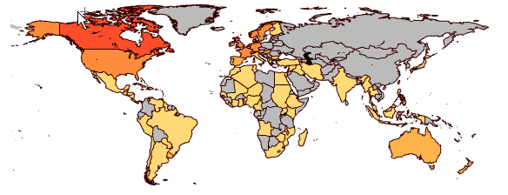
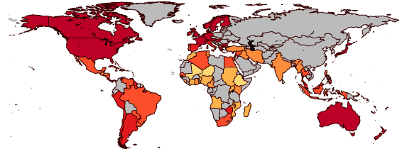
Long-term trends and comparisons after reconstruction
Average years of education per capita, 1880 (reconstruction) and 2000
1880
 | 0-2
 | 2-4
 | 4-6
 | 6-8
 | 8-10
 | >10
2000
Notes:
After cleaning, harmonizing, and so on, the reconstructed data can be used for the analysis of long-term trends and geographic comparisons. Here we see a reconstruction of educational attainment in 1880 compared to 2000, a year for which systematic data are of course much better available.

Slide 62
Income per capita and life expectancy in China, Congo and NL, 1800-2007
Notes:
In this graph we see the comparison of selected countries over time: the Gapminder software is used here to follow the dynamic trajectories of the development of GDP of NL, China and Congo, starting around 1800, compared to life expectancy. Note how the life expectancy in the early 19th century does not differ so much, although NL (orange) has a higher GDP per capita. The pattern of China (red) is nevertheless roughly similar to the Dutch development, but Congo (blue) never reaches a higher life expectancy than around 45 years, and its position is clearly deteriorating in the last two decades…
These are just a few examples of the types of potential analyses that will be supported by the development of CLARIAH.

Slide 63
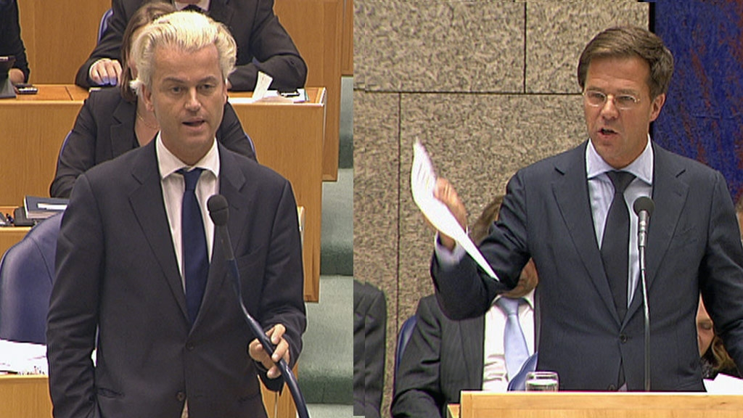
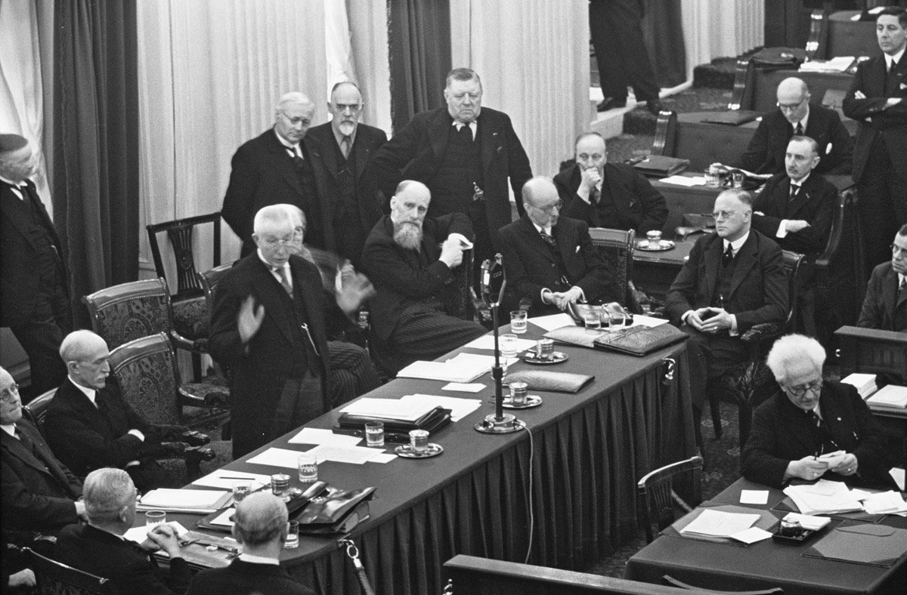
analysis of parliamentary debates in text and audiovisual data
Who says what to whom, when, and why?

Slide 64
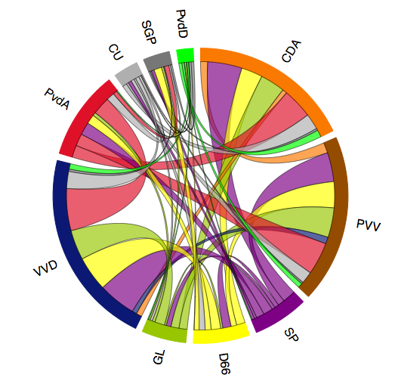
analysis of parliamentary debates in text and audiovisual data
Which party interrupted which other party and how often?
Notes:
Automatische interruptie analyse: welke partij interrupeerde welke partij hoe vaak (Maarten Marx, UvA)

Slide 65
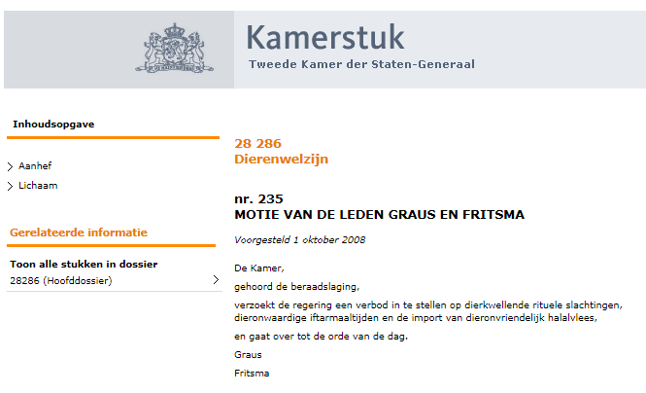
analysis of parliamentary debates in text and audiovisual data
Who referred to whom and/or what? Named entity detection
Notes:
Automatisch annoteren van Named Entities in de handelingen van de Tweede Kamer

