Slide 1
CLARIN Concept Registry:
the new semantic registry
Ineke Schuurman, Menzo Windhouwer, Oddrun Ohren, Daniel Zeman
ccr@clarin.eu
www.clarin.eu/ccr
www.clarin.eu/conceptregistry
CLARIN Annual Conference
October 15-17 2015
Wroclaw, Poland

Slide 2
Background
In the tools and resources offered by CLARIN many (de facto) standards are being referred to, concerning both metadata and content data, but …
  What do they mean?
  Do they mean the same in the various tools and resources?
CMDI (CLARIN Metadata Infrastructure)
  Makes use of several registries

Slide 3
Clear metadata
The metadata provided in CMDI should be clear, i.e., unambiguous, in order to be useful.
The building blocks, components, elements, attributes and values, of a CMDI profile should be clearly defined in a Concept or, for value ranges, Vocabulary registry.
Registries used:
- Dublin Core
- ISOcat (in the past)
- CLARIN Concept Registry (CCR)
- CLAVAS (in the future, CMDI 1.2)

Slide 4
Drawbacks ISOcat
Too much proliferation
  everybody could enter stuff
  entries quite often not meeting our standards
  entries were out of control
Too complex
  data category type, data type
  while several ‘problematic’ fields were not useful for our (CLARIN) purposes
In addition: last year ISOcat had to be migrated (decision Registration Authority) and became static
CLARIN decided to look for another solution.

Slide 5
New approach: CCR
    CCR (CLARIN Concept Registry)
SIMPLIFIED
CONTROLLED
Simplified: several ‘fields’ not adopted from ISOcat
Controlled: national CCR-coordinators will filter the input
http://www.clarin.eu/conceptregistry/

Slide 6
Characteristics CCR
Browser:
  Accessible for everybody
Editor:
    Just for CCR-coordinators to insert new entries
API:
  For tools, e.g., the Component Registry
Browser: easy search for
Label (name)
Definition
Other text fields (example, history, …)

Slide 7
High quality concepts
Definitions should be ‘as general as possible, as specific as necessary’, therefore they should be
Unique
Meaningful
Reusable
Concise
Unambiguous
Also in other fields characteristic nr 5 is to be obeyed!

Slide 8
Entries are ‘for ever’
Trust and reliability
Issue in ISOcat!
CCR ➔ controlled
  Definitions cannot be updated in a way that changes their meaning
      Only typos etc can be corrected
  Preferred label (name) will not be changed
  Instead a new entry will be created, the old one being expired if necessary
  what can be added: examples, alternative labels, ‘higher’ status, notes, additional scheme and/or collection

Slide 9
OpenSKOS
Existing OpenSKOS infrastructure was adapted.
  Already available
    API to access, create, share thesauri and vocabularies
    Editor
  New
    Concepts have a handle as Persistent Identifier
    Faceted browser
    Support for SKOS collections
    Shibboleth-based access

Slide 10
From ISOcat to the CCR
Imported in CCR
Entries used in CLARIN, e.g., in CMDI
Entries recognized as belonging to a standard
Entries selected by the national CCR coordinators
ISOcat: over 5000 entries
CCR: 3139 entries (for CLARIN)
We will perform a clean-up action before adding new entries, in order to remove duplications, project or language specific definitions, empty definitions, misspellings (organization vs organisation), …

Slide 11
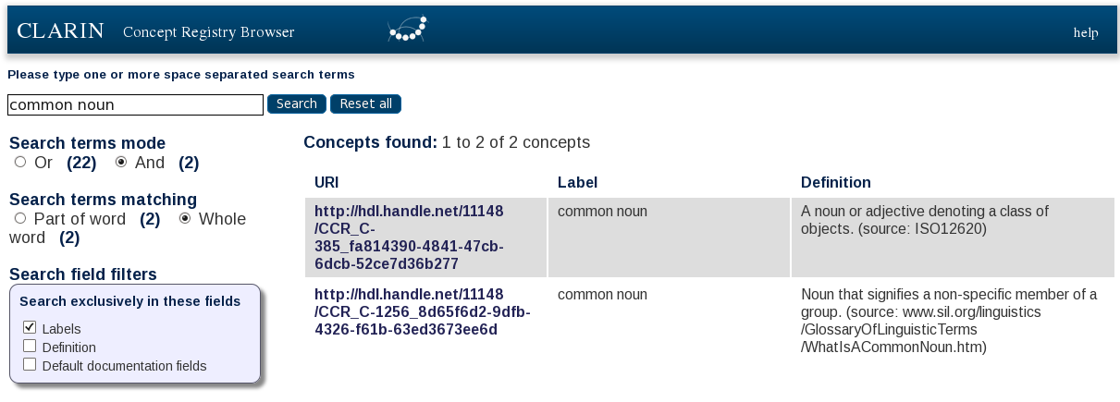

Slide 12
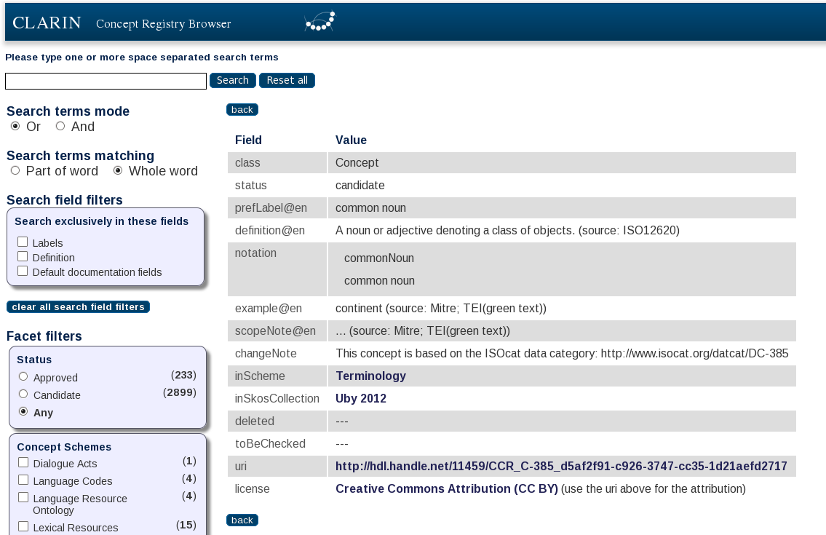
More details …

Slide 13
CCR Coordinators
If you need
  a new concept, or
  want to change an existing concept
contact your CCR coordinator:
http://clarin.eu/content/concept-registry-coordinators
If no CCR coordinator is appointed for your country:
ccr@clarin.eu
For information on the CCR, the coordinators and the (upcoming) procedures see
http://www.clarin.eu/ccr

Slide 14
Decision procedure
All ‘ERIC countries’ appointed a CCR content coordinator
Wrt decisions about entries
All CCR content coordinators (or deputies) are involved
We aim for unanimity
If necessary we will vote
  A change in CCR (like adding specific new entry) is accepted when 70% or more of the coordinators represented agree
All changes are recorded in the CLARIN CCR-section

Slide 15
Correction current entries, new entries
There still are ‘incorrect’ entries, i.e., entries not meeting our demands
We are working on these.
In the future we will have 2 weeks to come to an agreement on a batch of entries,
The same holds wrt proposals for new entries
Exceptions: holiday season, and the initial period (=now!)

Slide 16
Moving to the CCR
If you
  have resources that contain references to ISOcat data categories which you want to replace by their CCR concept handles (if available), or
  want to know which ISOcat data categories are imported into the CCR
Visit https://github.com/TheLanguageArchive/ISOcat2CCR
where you can find
  mapping files, and
  a tool to use those files to replace ISOcat data category references by CCR concent handles
If you run into problems contact your national CCR coordinator or, if necessary, ccr@clarin.eu

Slide 17
Thank you for your attention !
(There will be a demo later today)

