Slide 1

e-Humanities within the KNAW
Sally Wyatt (sally.wyatt@ehumanities.knaw.nl)
CLARIN meeting, Amsterdam, 30 August 2012

Slide 2
virtual
cyber-
data-driven
e (electronic)
e (enhanced)
i (interactive)
computer (mediated)
online
distance
tele-
computational
p (personalised)
digital
science
research
knowledge
scholarship
social sciences
humanities
infrastructure
methods
tools
models
objects
publications
Notes:
Put any of the white in front of any of the yellow -
Fashions change
Cyber very fashionable in mid-late 90s during first dot com boom
E seems to be more common with web 2.0 hype
Sometimes simply descriptive – often normative – positive – new, new thing, innovative, progress or negative – sad people in facebook who don’t have real friends, less than real
Focus here is on Virtual knowledge – includes variety of modes of doing research – all of which are supported by digital technologies – and not only computational modes of doing research – so includes sharing, communication,

Slide 3
KNAW e-Humanities Group
KNAW initiative to provide focus for e-Humanities across its own institutes, in collaboration with universities (total budget of approx. €4m, 2011-2016)
Four projects in computational humanities funded by KNAW itself – CEDAR, Tunes & Tales, Riddle of Literary Quality, Elite Network Shifts (more details at http://ehumanities.nl/projects)
Other national initiatives: NL eScience Center; CLARIAH Roadmap; UvA-VU-KNAW cooperation

Slide 4
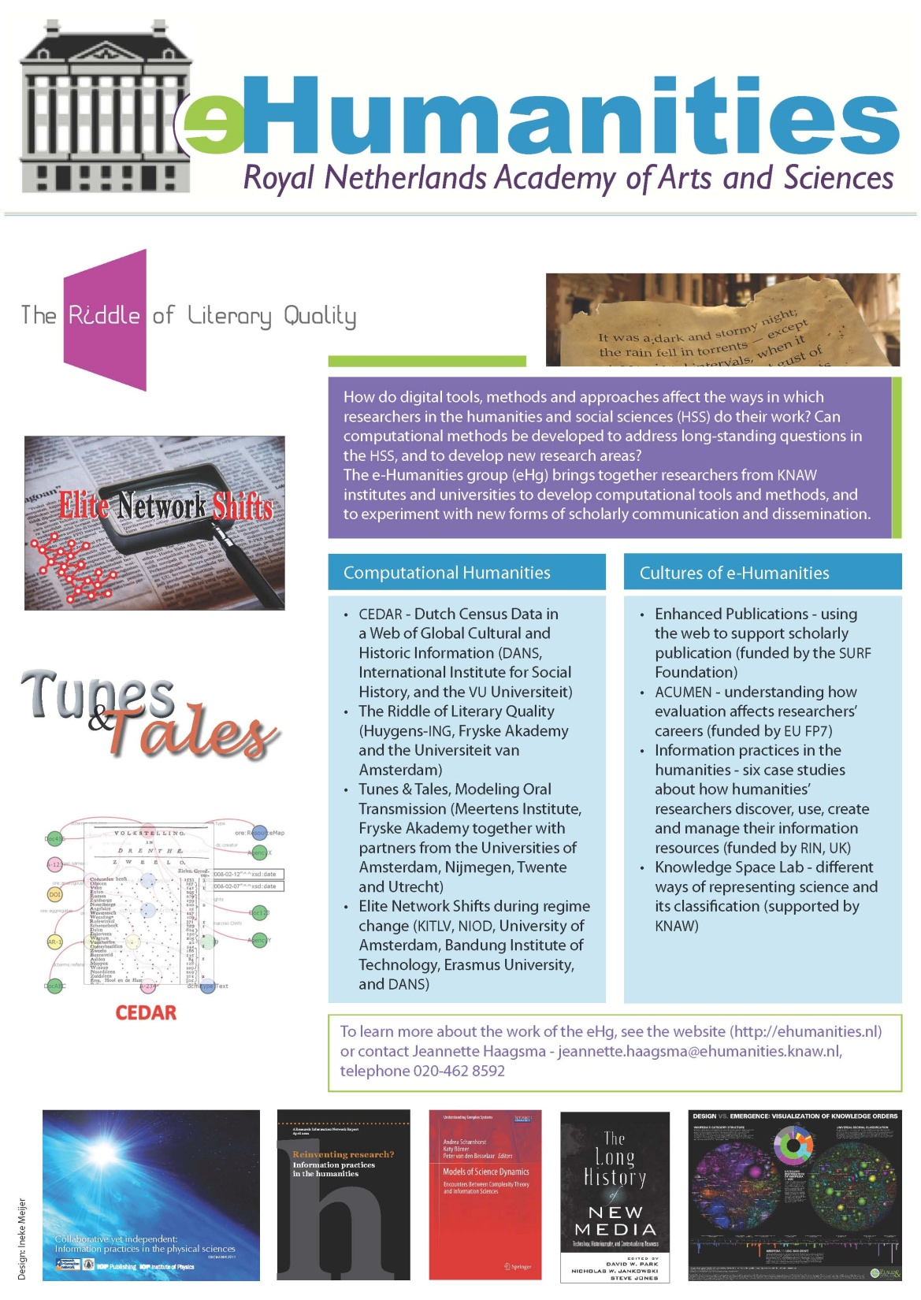
In 2025, the field of humanities finds itself in a strong and integrated position among the sciences. Scholars in 2025 looking back 15 years, see a less integrated set of academic disciplines with substantial differences…. The significant breakthrough, that happened both nationally and internationally, was a result of the effective integration of information science and information technology in the humanities... During the past 15 years humanities not only benefited from information science and technology but made significant contributions to these fields…
(KNAW, Computation Humanities Programme, 2010)

Slide 5
Cultures of e-humanities
Information practices
Career paths
Enhanced publications
Open data
Changing nature of humanities & social sciences

Slide 6
Barriers to use
Lack of awareness of tools, and of the potential of standard software
Lack of standardisation of databases & archives
Inadequate annotation tools
Difficult and unstable access to remote resources
Lack of institutional training and support
Irregular use – repeated learning curves
source: M Bulger et al 2011, Reinventing research? Information practices in the humanities. London: RIN www.rin.ac.uk

Slide 7
Styles of Scientific Thinking/
Styles of Reasoning
Deductive
(classical Greece)
Experimental
Taxonomical
Analogical-hypothetical
(2,3,4 – Renaissance)
Statistical
Historical-evolutionary
(5,6 – 19th century)
Every style introduces a new ‘world’ in the form of possibilities, objects, criteria for truth & falsity
Styles transcend microsocial contexts
Framework for doing historical & philosophical research
Possibilities for merging & splitting

Slide 8
A computational style in the HSS?
▶ Data driven ▶ Mathematical
▶ Computational ▶ Black boxed
▶ Quantitative ▶ Commercial
▶ Collaborative
Is it always necessary to transform the object of research into digital form in order to do e-research? If so, what is the relationship between the digital and physical worlds? And what does this mean for research questions, methods, and results?

Slide 9
Stage in research process | Digital application or tool | Critical questions
Literature review | Search engines & databases | Effects of (secret) algorithms on availability of information
Identifying participants | Search engines, social networking sites | Gathering information about respondents without their knowledge (& respondents gathering information about researchers)
Data collection | From games, online forums, web 2.0, etc. | Lurking as research strategy, public/private, ‘contextual integrity’
Data analysis | Data mining tools, computational methods | Reducing complexity

Slide 10
Stage in research process | Digital application or tool | Critical questions
Data sharing | Distributed databases | Categorisation – making (in)visible; Intellectual property
Representation | Visualisation tools; enhanced publications | (in)visibility of underlying data & algorithms
Authorship & acknowledgement | Authoring software, distributed databases, enhanced publications | Acknowledging technical input; Work & data of online participants (are they authors or respondents?)
Archiving & curation | Tagging, semantic web | Confidentiality; Informed consent; Decontextualised data; Sustainability

