Slide 1
Searching for Constructions with GrETEL
Jan Odijk
Syntax Interface Meetings
Utrecht, 2014-03-31

Slide 2
Overview
Context
GrETEL and Treebanks
Example Parse
Searching in treebanks
Searching with GrETEL
Searching with GrETEL: Limitations
Comparison with Google
Conclusions and Invitation

Slide 3
Overview
Context
GrETEL and Treebanks
Example Parse
Searching in treebanks
Searching with GrETEL
Searching with GrETEL: Limitations
Comparison with Google
Conclusions and Invitation

Slide 4
CLARIN Infrastructure
A research infrastructure for humanities researchers who work with digital language-related resources

Slide 5
CLARIN Infrastructure
The CLARIN infrastructure offers services so that a researcher
Can find all data relevant for the research
Can find all tools and services relevant for the research
Can apply the tools and services to the data without any technical background or ad-hoc adaptations
Can store data and tools resulting from the research
via one portal

Slide 6
CLARIN Infrastructure
CLARIN-NL Portal
under construction
This page brief overview CLARIN-NL results:
http://www.clarin.nl/node/404
for (morpho-)syntactic search also in this ppt
CLARIN Data and tools (from all over Europe):
Virtual Language Observatory
Browsing and faceted search for data
Geographical navigation over data

Slide 7
Overview
Context
GrETEL and Treebanks
Example Parse
Searching in treebanks
Searching with GrETEL
Searching with GrETEL: Limitations
Comparison with Google
Conclusions and Invitation

Slide 8
GrETEL
Greedy Extraction of Trees for Empirical Linguistics
Greedy – technical notion, see later
Extraction: selection from a large text corpus
Trees: syntactic structures for each sentence in the corpus
Empirical Linguistics: ?? (pleonasm, imho)

Slide 9
GrETEL
Web application for intelligent searching in treebanks
Web: on the world wide web, accessible via internet
Application: software with a user interface targeted at a specific user group: for GrETEL: linguists
Intelligent searching: searching in a more sophisticated way than just searching for strings (sequences of characters), as Google does
Treebank: a text corpus with for each sentence a syntactic parse (Dutch: ontleding)
Syntactic parse is usually in the form of a tree (hence treebank)
GrETEL applies to the LASSY-Small and CGN treebanks
http://nederbooms.ccl.kuleuven.be/eng/aboutgretel

Slide 10
Treebanks
LASSY-Small: treebank for written Dutch
CGN treebank: for spoken Dutch
CGN= Corpus Gesproken Nederlands
Size: app. 1m tokens each
Both are encoded in XML
XML= eXtensible Mark-up Language
W3C standard for the exchange of data

Slide 11
Overview
Context
GrETEL and Treebanks
Example Parse
Searching in treebanks
Searching with GrETEL
Searching with GrETEL: Limitations
Comparison with Google
Conclusions and Invitation

Slide 12
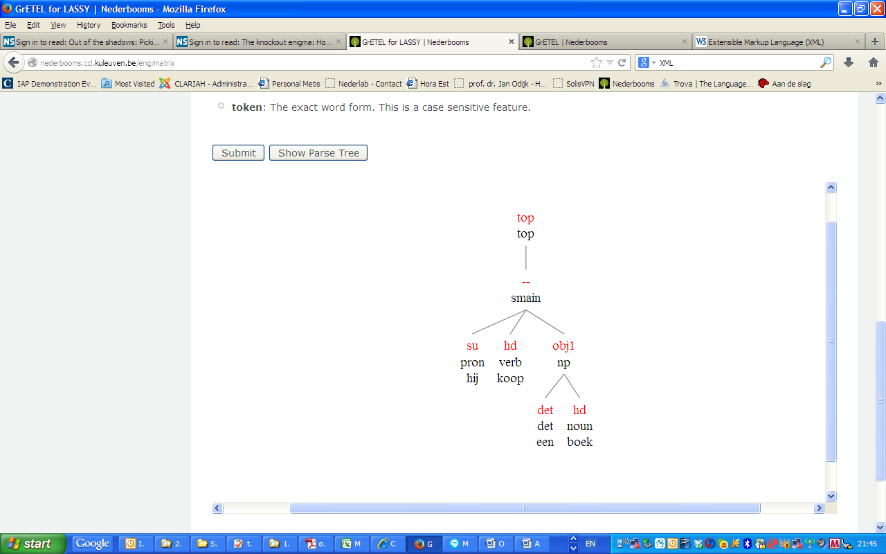
Example Parse
LASSY-Small: treebank for written Dutch
CGN treebank: for spoken Dutch
CGN= Corpus Gesproken Nederlands
Both are encoded in XML
XML= eXtensible Mark-up Language
W3C standard for the exchange of data

Slide 13
Example Parse (XML)
In XML (simplified):
<node rel = "top" cat="top">
<node rel = "--" cat="smain">
<node rel="su" pos="pron" root="hij"/>
<node rel="hd" pos="verb" root="koop"/>
<node rel="obj1" cat="np">
<node rel="det" pos="det" root="een"/>
<node rel="hd" pos="noun" root="boek"/>
</node>
</node>
</node>

Slide 14
PARSING
‘taalkundige ontleding’ (‘dependency analysis’)
Grammatical relation (rel) of constituents: subject (su), direct object (obj1), head (hd), determiner (det), ….
‘redekundige ontleding’ (‘categorial analysis’)
Part of Speech (pos): pronoun (pron), verb (verb), determiner (det), noun (noun), …
Syntactic category (cat) : utterance (top), main clause (smain), noun phrase (np), …
Order in the Lassy and CGN trees is NOT significant. Order is encoded by attributes
(not represented in the simplified example)

Slide 15
Overview
Context
GrETEL and Treebanks
Example Parse
Searching in treebanks
Searching with GrETEL
Searching with GrETEL: Limitations
Comparison with Google
Conclusions and Invitation

Slide 16
Searching in Treebanks
Usually formulated in a programming language for queries (query language)
Query languages to search in XML documents:
Xpath, Xquery
Simple Example query in Xpath:
//node[@cat="ap" and node[@rel="mod" and @pos="adj"] and node[@rel="hd" and @pos="adj"]]

Slide 17
Searching in Treebanks
XPath | Meaning
// | Find Anywhere in the tree
Node[ | A node
@cat="ap" | In which feature ‘cat’ has value ‘ap’
and node[ | And that contains a node
@rel="mod" and @pos="adj“ ] | In which feature ‘rel’ has value ‘mod’ and feature ‘pos’ has value ‘adj’
and node[ | And a node
@rel="hd" and @pos="adj"]] | In which feature ‘rel’ has value ‘hd’ and feature ‘pos’ has value ‘adj’

Slide 18
Searching in Treebanks
More difficult example:
//node[@cat="ppart" and node[@rel="obj2" and @cat="pp" and node[@rel="hd" and @pos="prep" and @root="aan" and @word="aan" and @begin < ../../node[@rel="obj1" and @cat="np"]/node[@rel="hd" and @pos="noun"]/@begin]] and node[@rel="obj1" and @cat="np" and node[@rel="hd" and @pos="noun" and @begin < ../../node[@rel="hd" and @pos="verb"]/@begin]] and node[@rel="hd" and @pos="verb"]]
This is too difficult!
Even after making use of better lay-out:
http://bramvanroy.be/projects/xpath-beautifier/

Slide 19
Searching in Treebanks
Problems
One must learn the Xpath language
One must know exactly what the structure of the document is
Even simple queries get quite complex rather fast

Slide 20
Overview
Context
GrETEL and Treebanks
Example Parse
Searching in treebanks
Searching with GrETEL
Searching with GrETEL: Limitations
Comparison with Google
Conclusions and Invitation

Slide 21
Searching with GrETEL
GrETEL Approach
Desired query: Give me (sentences that contain) adverbs that modify adjectives
Provide an example of this construction in natural language: dat is erg groot
Parsed automatically by Alpino parser
Mark which aspects of the example are important.
In this case Pos (part of speech) of erg and groot
Automatically includes the dependency relation between these two words

Slide 22
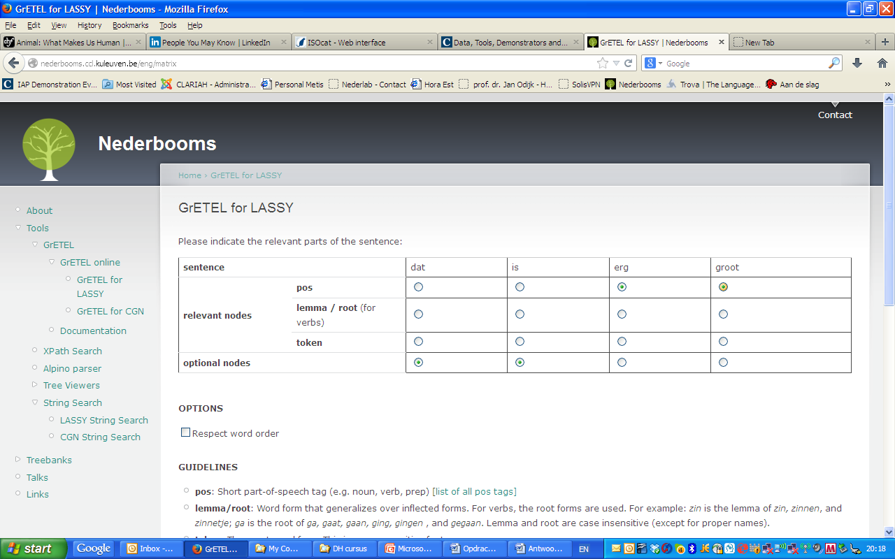
Searching with GrETEL

Slide 23
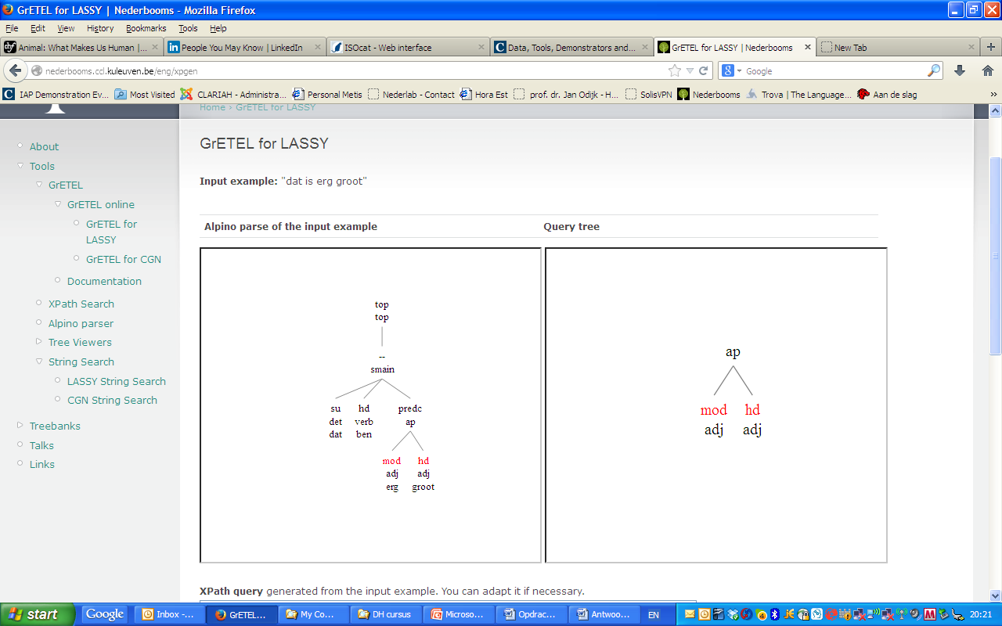
Searching with GrETEL

Slide 24
Searching with GrETEL
Query is now automatically generated:
//node[@cat="ap" and node[@rel="mod" and @pos="adj"] and node[@rel="hd" and @pos="adj"]] (= the query of this slide)
Applied to LASSY-Small yields 2474 hits
Greedy: it finds sentences that at least contain and adjective modifying an adverb in an AP, but the sentence and also the AP node can contain many other elements as well

Slide 25
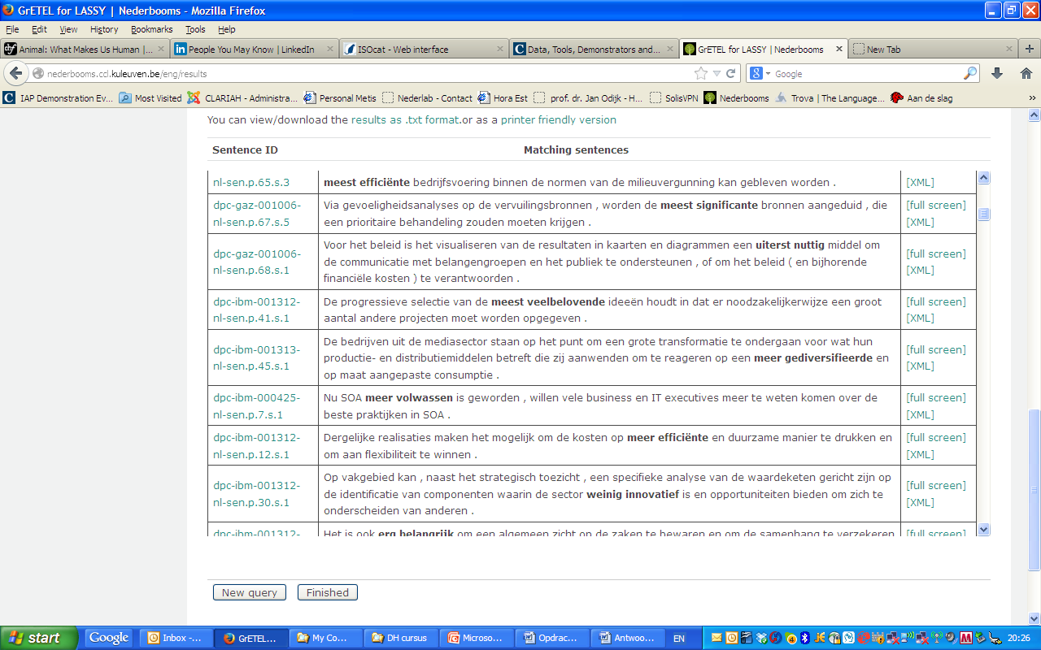
Searching with GrETEL

Slide 26
Searching with GrETEL
Causative ‘doen’
Het bijvoeglijk naamwoord
Circumpositions (op de man af)
Krijgen passive
*Bare nouns (attempt)
**Modified Bare Nouns
**Object topicalisation

Slide 27
Searching with GrETEL
Try these at home:
Two or more attributive adjectives (mooie blauwe ogen)
De medisch specialist
*‘hun’ as subject in (1) CGN, and (2) LASSY
Indirect object with aan (1) before the direct object; (2) after the direct object but before the verb; (3) after the direct object and after the verb
Binominal NPs: een kudde olifanten
Substantivised infinitives: het doden van dieren

Slide 28
Overview
Context
GrETEL and Treebanks
Example Parse
Searching in treebanks
Searching with GrETEL
Searching with GrETEL: Limitations
Comparison with Google
Conclusions and Invitation

Slide 29
Searching with GrETEL Limitations
‘Performance’ (actually used) data
Including errors, hesitations, fillers, etc
Good for certain research questions
Less good for other research questions
No `negative’ data
Linguists sometimes want to know what is NOT possible in language
More difficult to find non-standard examples (examples not covered by the Alpino grammar)

Slide 30
Searching with GrETEL Limitations
Danger of circularity
‘Which verbs occur with a predicative adjective?’
➔the verbs that have been specified as such in the Alpino grammar
Can be avoided by globally knowing how the Alpino grammar works
No controlled experiments
Minimal pairs seldom occur naturally
BUT: GrETEL can be used to construct minimal pairs on the basis of really occurring examples

Slide 31
Searching with GrETEL Limitations
User friendly interface implies limitations:
NOT: ‘give me nouns that occur with any determiner’ (de, het, deze, die, een, enkele…)
NOT: ‘give me nouns that occur with a definite determiner (de, het, deze, die, ... but not een, geen enkele, …)
NOT: ‘give me verbs that occur with a predicative complement’

Slide 32
Searching with GrETEL Limitations
Simple cases can be solved by small adaptations in the Xpath query,e.g.
Verbs that take a predicative complement of pos adjective:
//node[@cat="ssub" and node[@rel="predc" and @pos="adj"] and node[@rel="hd" and @pos="verb"]]
1044 hits
Verbs that take a predicative complement:
//node[@cat="ssub" and node[@rel="predc" and @pos="adj"] and node[@rel="hd" and @pos="verb"]]
3429 hits
Try this at home!

Slide 33
Overview
Context
GrETEL and Treebanks
Example Parse
Searching in treebanks
Searching with GrETEL
Searching with GrETEL: Limitations
Comparison with Google
Conclusions and Invitation

Slide 34
Searching with GrETEL v. Google
Property | Google | GrETEL
String search | yes | yes
Relation between strings | nearness | Grammatical relation
Search for function words | No / unreliable | yes
Search for morpho-syntactic and syntactic properties | no | yes
Construction search | no | yes
Dutch only | unreliable | yes
Size | huge | Currently: Small (2x 1M) Soon: Large (700M)

Slide 35
Searching with GrETEL Your examples:
*Martin’s example: Topic Drop
Lotte’s examples
Bert’s examples
Henriette’s examples
Heidi/Franca’s examples
Jolien’s examples

Slide 36
Overview
Context
GrETEL and Treebanks
Example Parse
Searching in treebanks
Searching with GrETEL
Searching with GrETEL: Limitations
Comparison with Google
Conclusions and Invitation

Slide 37
Conclusions
GrETEL makes formulation of queries significantly simpler than Xpath
You do not have to know Xpath or the exact structure of the treebank
The simple user interface however implies limitations
Some queries cannot be formulated

Slide 38
Conclusions
Some limitations can be overcome
by making small modifications in a generated Xpath query
This also makes the researchers more familiar with query languages (educational effect)
It is complementary to other methods of obtaining empirical evidence
And can be used to support these other methods
Is it really useful despite its limitations?
Try it and provide feedback!

Slide 39
Invitation
Use GrETEL or other elements from the CLARIN infrastructure
(Questions? Problems? CLARIN-NL Helpdesk!)
Join user groups of specific services:
gretel@ccl.kuleuven.be
Provide feedback so that we can further improve CLARIN
So that you can improve your research

Slide 40
Further Exploration
LASSY website
DACT Manual
LASSY Annotation manual (in Dutch)

Slide 41
References
GrETEL:
Liesbeth Augustinus, Vincent Vandeghinste, Ineke Schuurman, and Frank Van Eynde. (2013). "Example-Based Treebank Querying with GrETEL – now also for Spoken Dutch" In: Proceedings of the 19th Nordic Conference of Computational Linguistics (NODALIDA 2013). NEALT Proceedings Series 16. Oslo, Norway. pp. 423-428. Liesbeth Augustinus and Frank Van Eynde (2012). "A Treebank-based Investigation of IPP-triggers in Dutch" Digital Humanities Workshop, Leuven. [poster]
Liesbeth Augustinus, Vincent Vandeghinste, and Frank Van Eynde (2012). "Example-Based Treebank Querying" In: Proceedings of the 8th International Conference on Language Resources and Evaluation (LREC-2012). Istanbul, Turkey.
LASSY:
Gertjan van Noord, Gosse Bouma, Frank Van Eynde, Daniël de Kok, Jelmer van der Linde, Ineke Schuurman, Erik Tjong Kim Sang, and Vincent Vandeghinste. (2013). "Large Scale Syntactic Annotation of Written Dutch: Lassy." In: Peter Spyns and Jan Odijk (eds.) Essential Speech and Language Technology for Dutch, Theory and Applications of Natural Language Processing. Springer, pp. 147-164.
CGN
Oostdijk, N., Goedertier, W., Van Eynde, F., Boves, L., Martens, J.-P Moortgat, M., and Baayen, H. (2002). "Experiences from the Spoken Dutch Corpus Project." In: Proceedings of the 3rd International Conference on Language Resources and Evaluation (LREC-2002) Las Palmas, Spain, pp. 340–347.
Alpino
Gertjan van Noord (2006). "At Last Parsing Is Now Operational" In: TALN 2006, pp. 20-42.
LASSY Annotatie
Gertjan van Noord, Ineke Schuurman, and Gosse Bouma. (2011). "Lassy Syntactische Annotatie"

Slide 42
Thanks for your attention!

Slide 43
DO NOT ENTER HERE

Slide 44
Lotte’s examples:
Lotte’s examples
examples of intrusion in verb clusters
I did a subcase V X V
Statistics for cluster intrusion/non-intrusion
I did a specific subcase X Vf V v. Vf X V
Mostly in CGN

Slide 45
Lotte’s examples
Lotte’s examples (all in CGN, 6=5)
*(Ik hoop dat ik er) mag in kijken. ****(Bz, 1-X-2)
*(Ik zie dat Jan) kan een schuur bouwen. (Bz, 1-X-2)
*(Ik denk dat Jan Marie) had op willen bellen.(Bz, 1-X-2-3)
(Ik hoop dat Jan) zal gaan naakt zwemmen. (Bz, 1-2-X-3)
(De bakker moet) gaan brood bakken. (Hz, 1-2-X-3)
(Een leraar moet goed) kunnen les geven. (Hz, 1-2-X-3)

Slide 46
Lotte’s Examples
Lotte: nonintrusion: X Vf V v. Vf X V
CGN (130k sent) | X V V | V X V
obj/N (bare) | 140(138) | *10(10)
Mod/Adj | 144(143) | *7(7)
Predc/adj | 73(70) | *11(11)
Prt | 137 | *1(1) V XV: ???
Prt (LASSY) | 94(91) | *4(4) V XV: **600(596)
Prep | 38(38) | 14(14)
Notes:
Almost all V X V examples (except when X=Prt) are from Flemish speakers

Slide 47
Heidi/Franca’s examples:
Wie komt er?
*Wie denk je dat er komt?
***Wie komt?
***Wie denk je dat komt?

Slide 48
Improvement Suggestions
Actual use of the search facilities leads to suggestions for improvements, e.g.
Selection of inflection (extended PoS) in GrETEL was originally not possible (and is still not possible) for LASSY-Small but has been added for search in CGN
In the Dutch CGN/SONAR (de facto standard ) PoS tagging system one cannot easily express ‘definite determiner’ (only as a complex regular expression over PoS tags): a special facility for this is required
The Dutch CGN/SONAR (de facto standard ) Pos tagging system uses, for adjectives, the ø-form tag for cases where the distinction between e-form and ø-form is neutralized. This is not incorrect but a facility to distinguish the two would be very desirable (and this is possible by making use of the CGN lexicon and/or the CELEX lexicon
Idem for adjectives that have an e-form identical to a ø-form because of phonological reasons (adjectives ending in two syllables headed by schwa)
Zero-inflection in MIMORE is represented by absence of an inflection tag. That makes search for such examples very difficult and requires either a NOT-operator (which is not there) or explicit tagging of absence of inflection

Slide 49
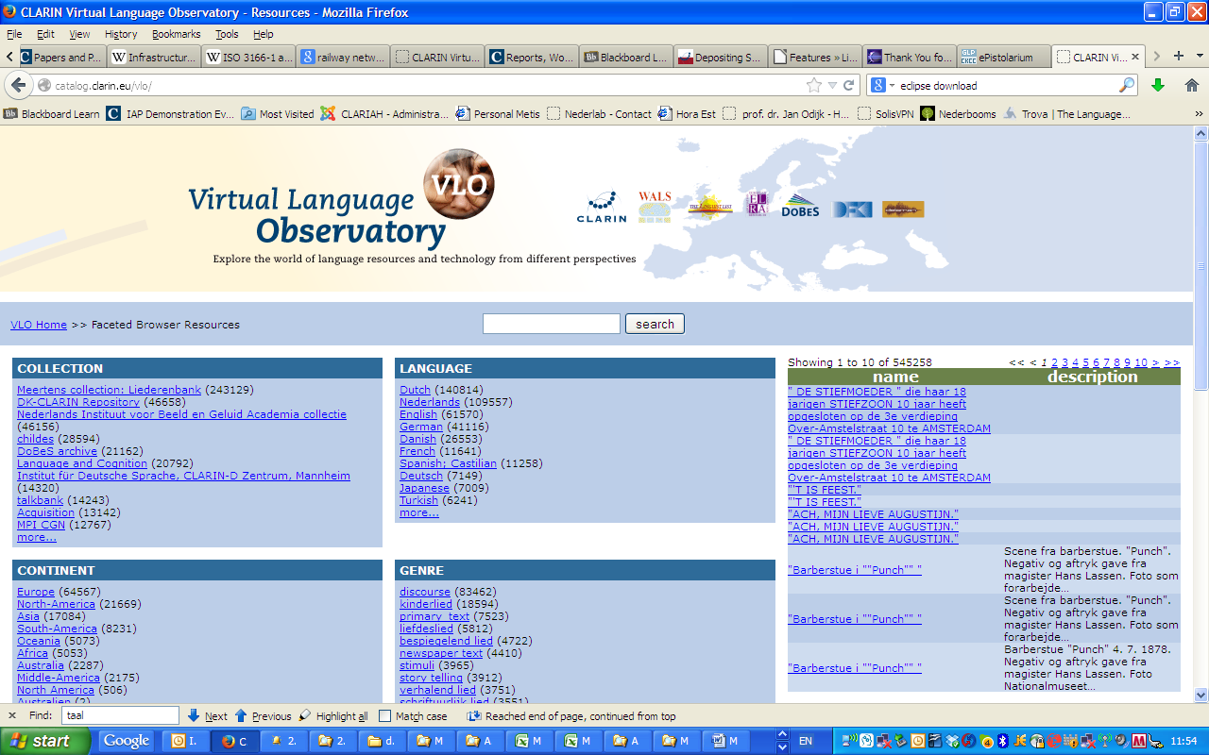
Improvement Suggestions

Slide 50
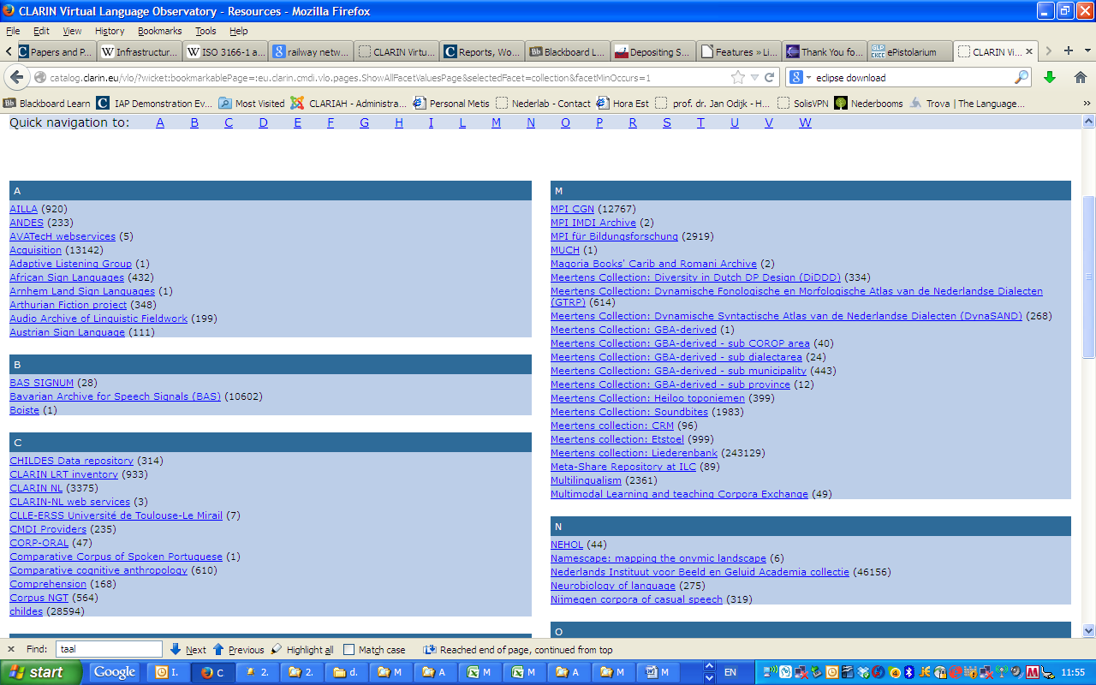
Improvement Suggestions

Slide 51
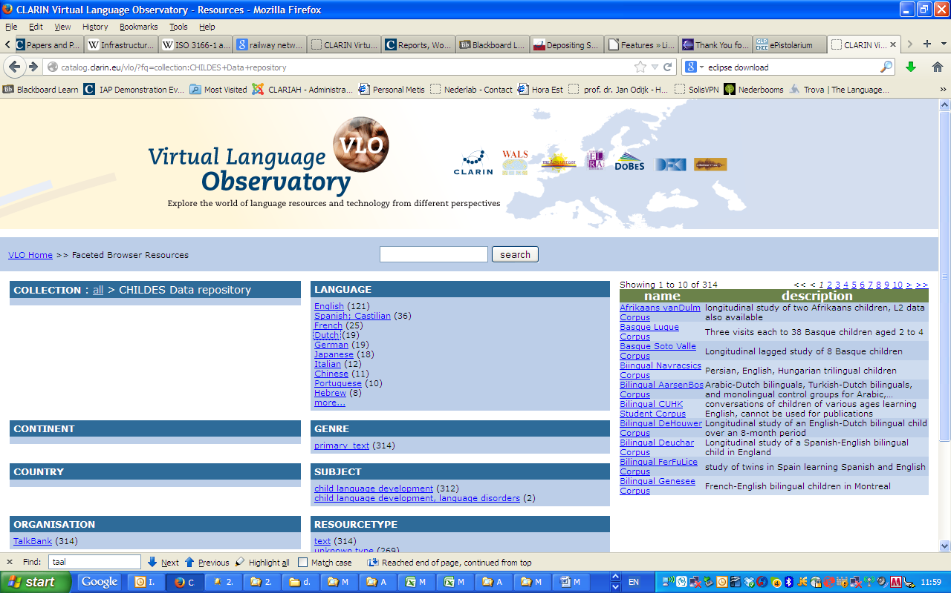
Improvement Suggestions

Slide 52
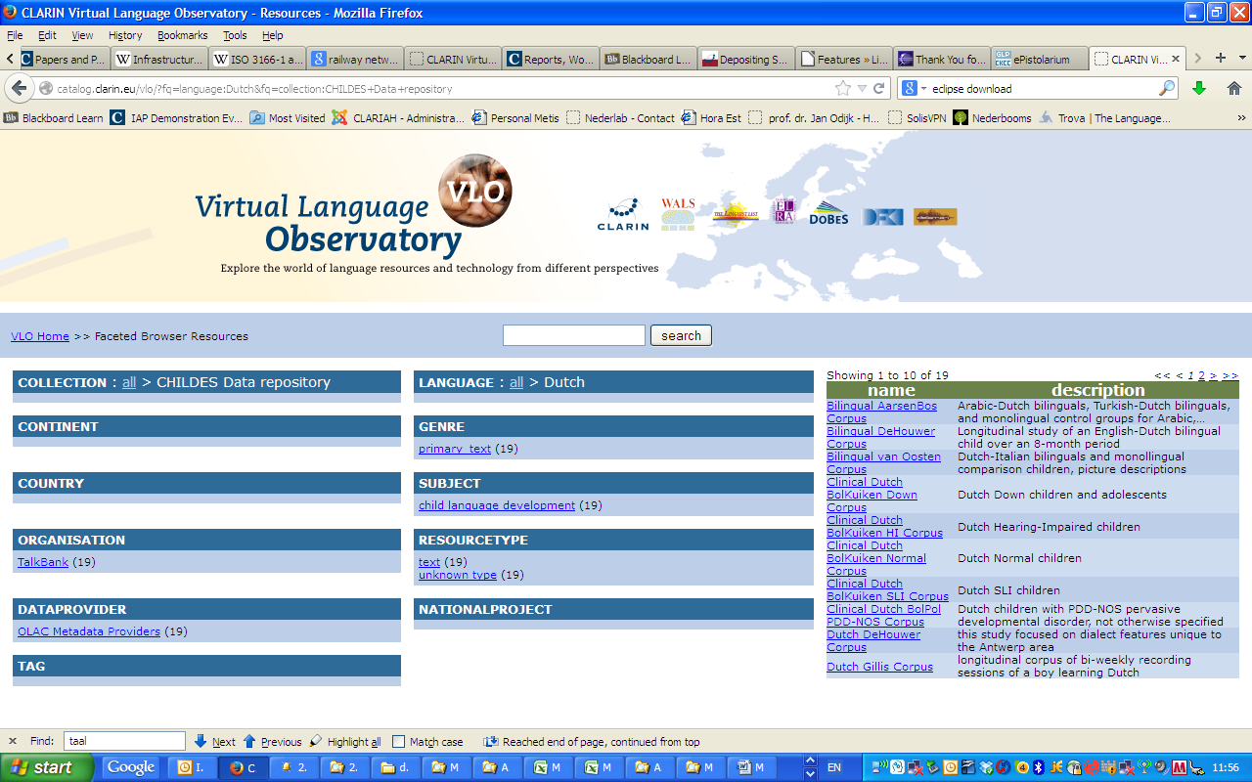
Improvement Suggestions

Slide 53
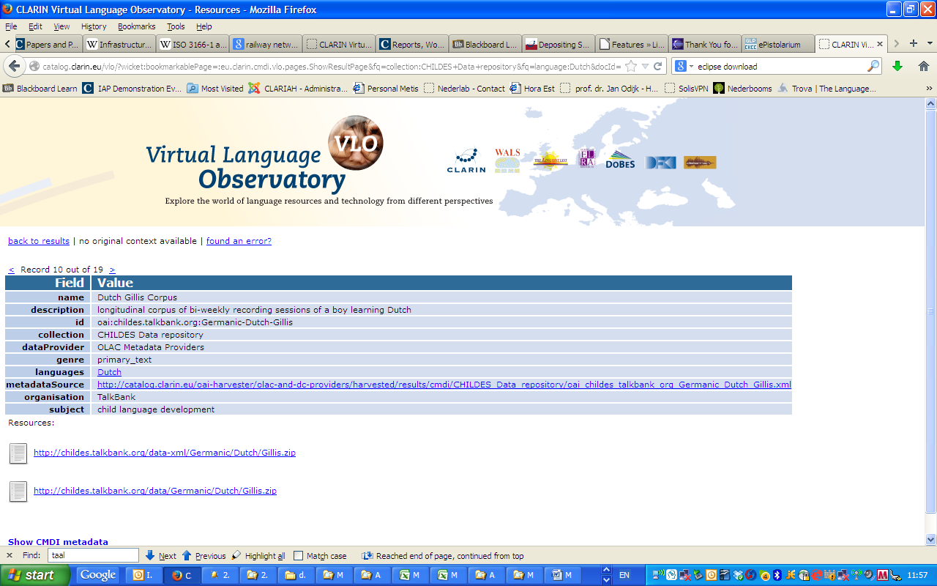
Improvement Suggestions

Slide 54
VLO
RETURN Page

Slide 55
Doen Causative

Slide 56
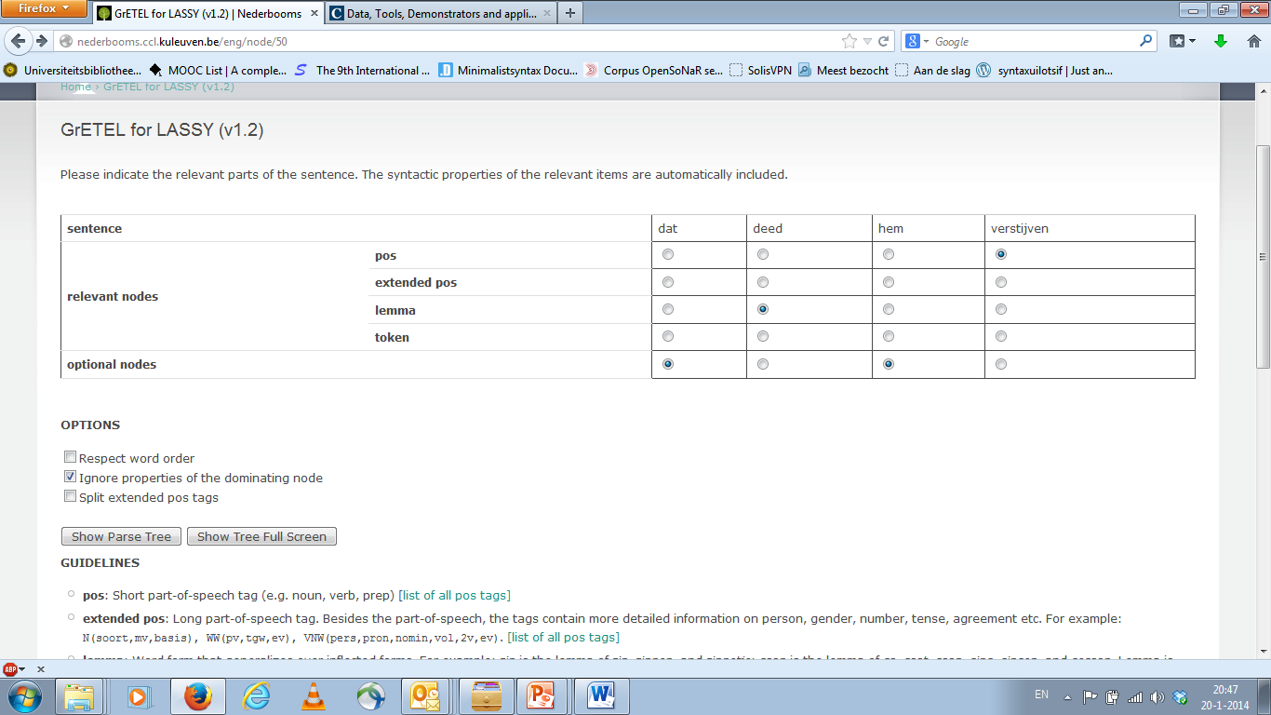
Doen Causative
RETURN Page

Slide 57
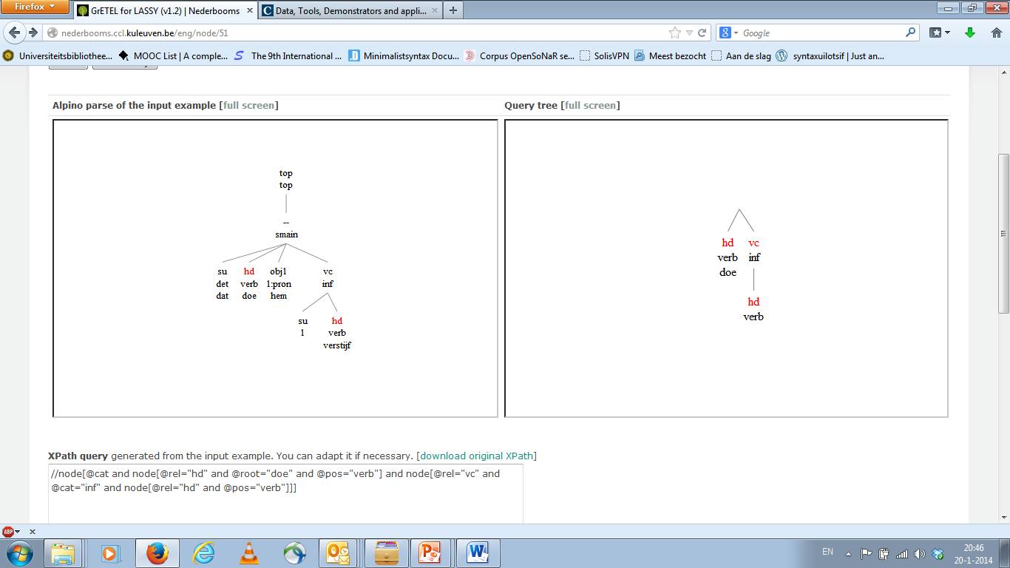
Doen Causative
RETURN Page

Slide 58
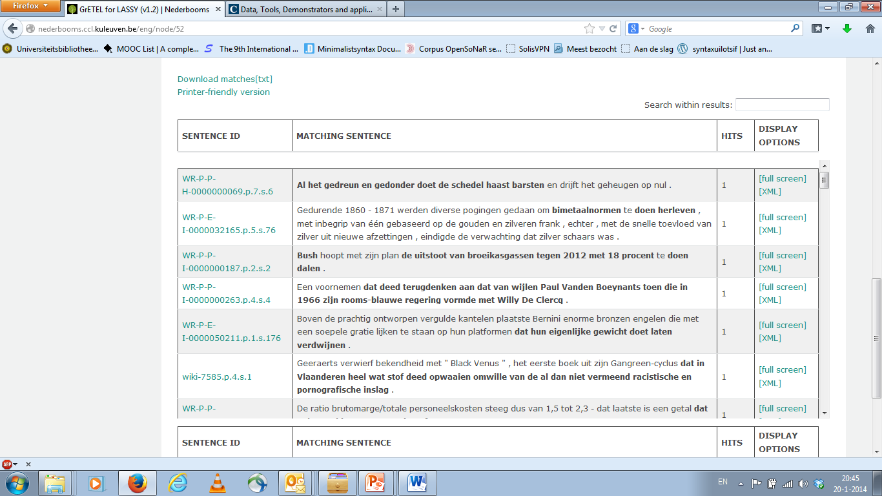
Doen Causative
RETURN Page

Slide 59
Doen Causative
RETURN Page

Slide 60
Het bijvoeglijk naamwoord

Slide 61
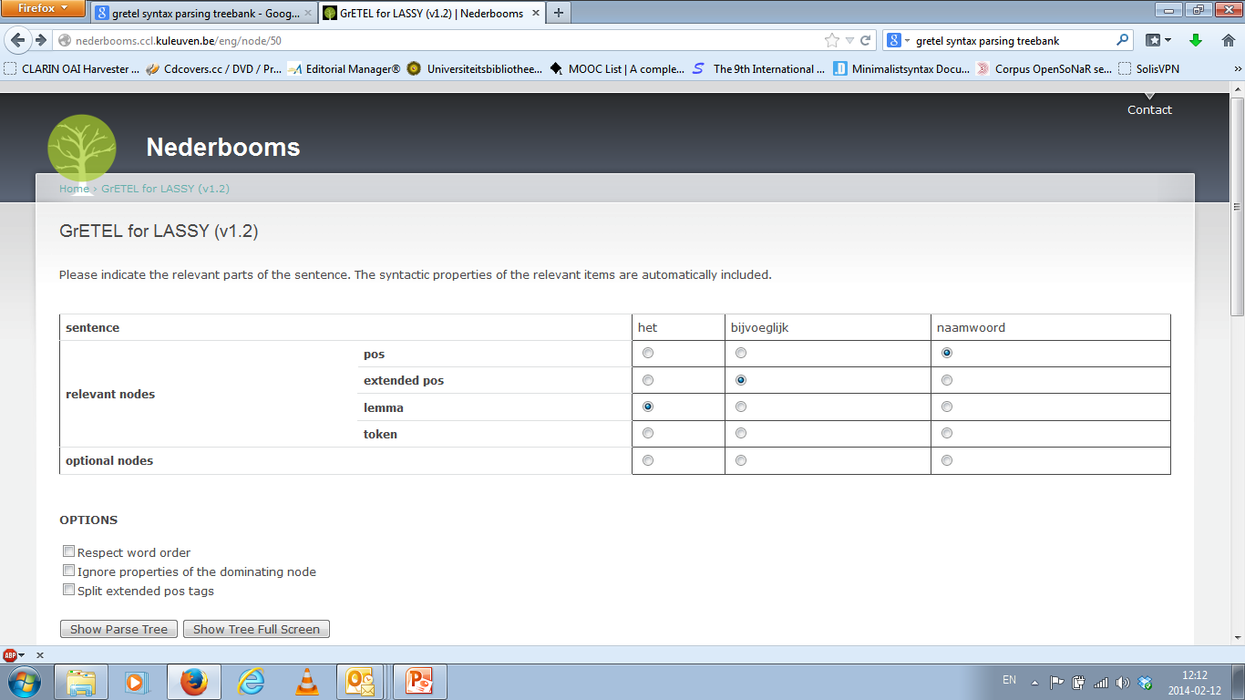
Het Bijvoeglijk naamwoord
RETURN Page

Slide 62
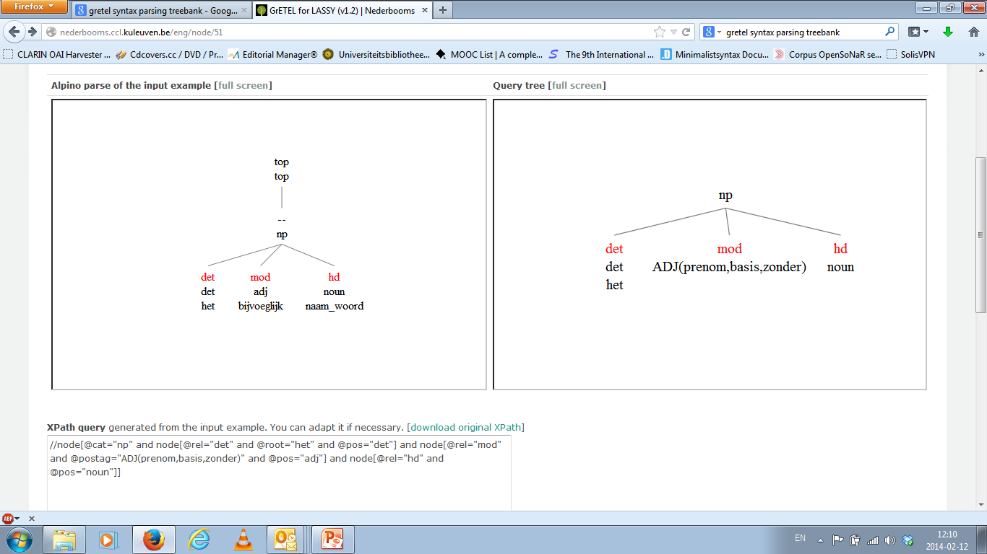
Het Bijvoeglijk naamwoord
RETURN Page

Slide 63
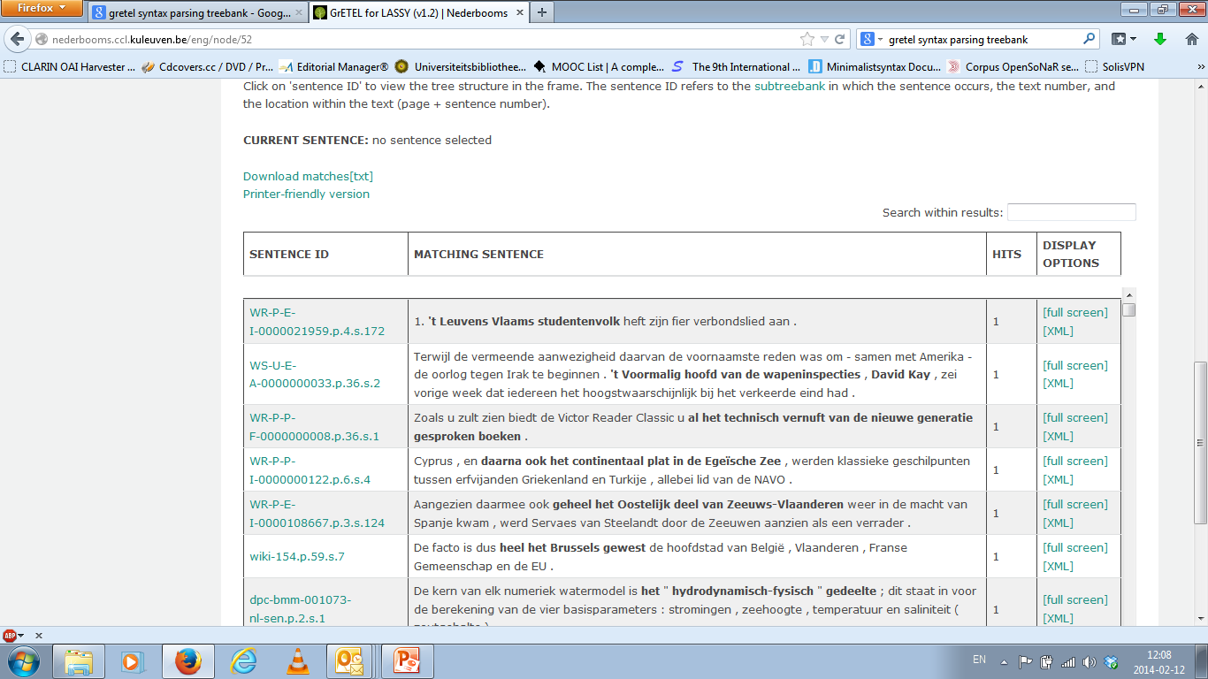
Het bijvoeglijk naamwoord
RETURN Page

Slide 64
Het Bijvoeglijk naamwoord
RETURN Page

Slide 65
Circumpositions
Start

Slide 66
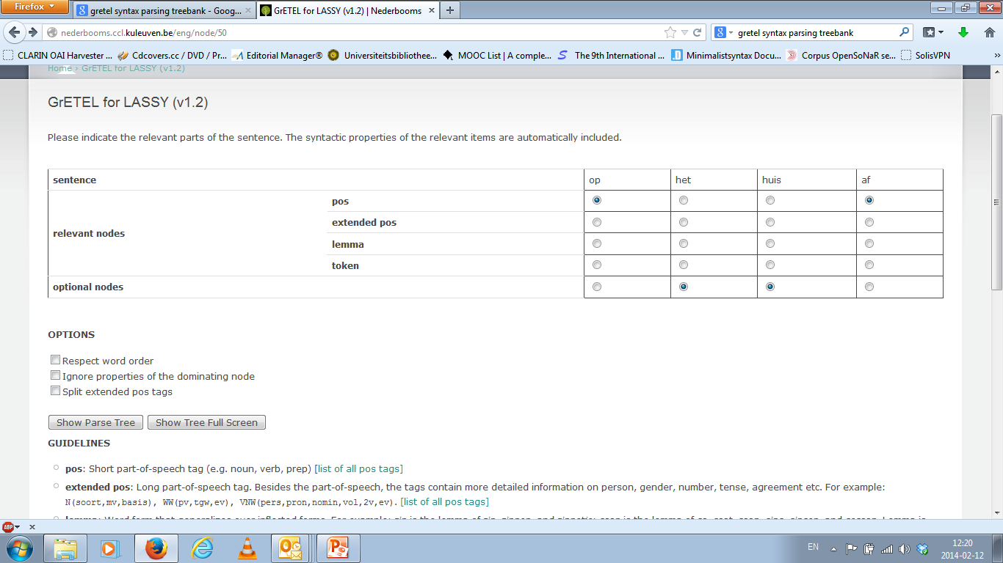
Circumpositions
RETURN Page

Slide 67
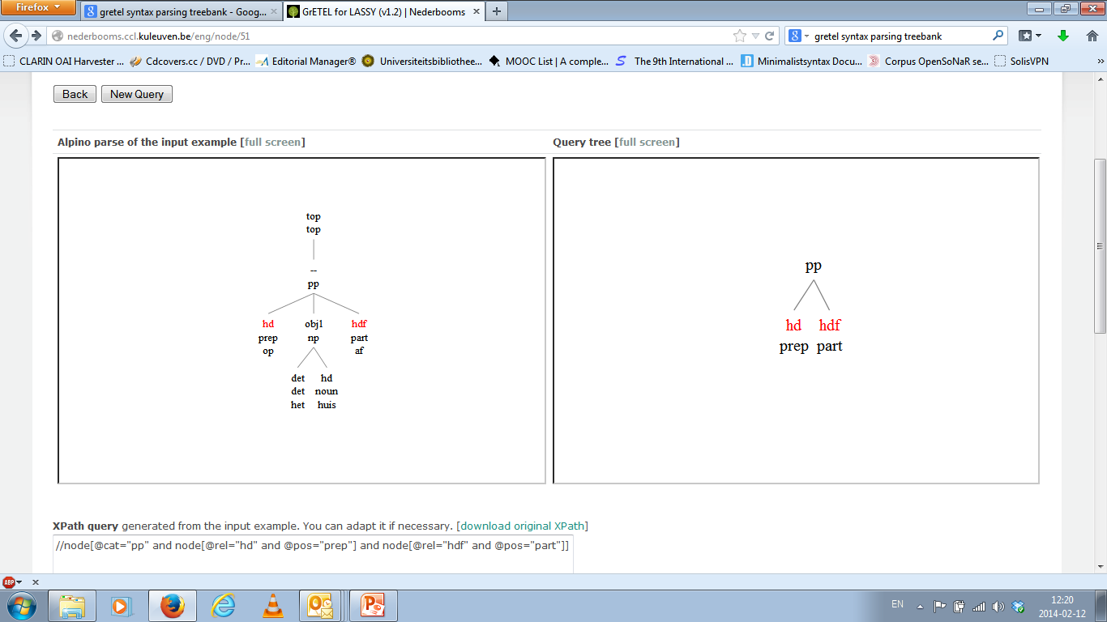
Circumpositions
RETURN Page

Slide 68
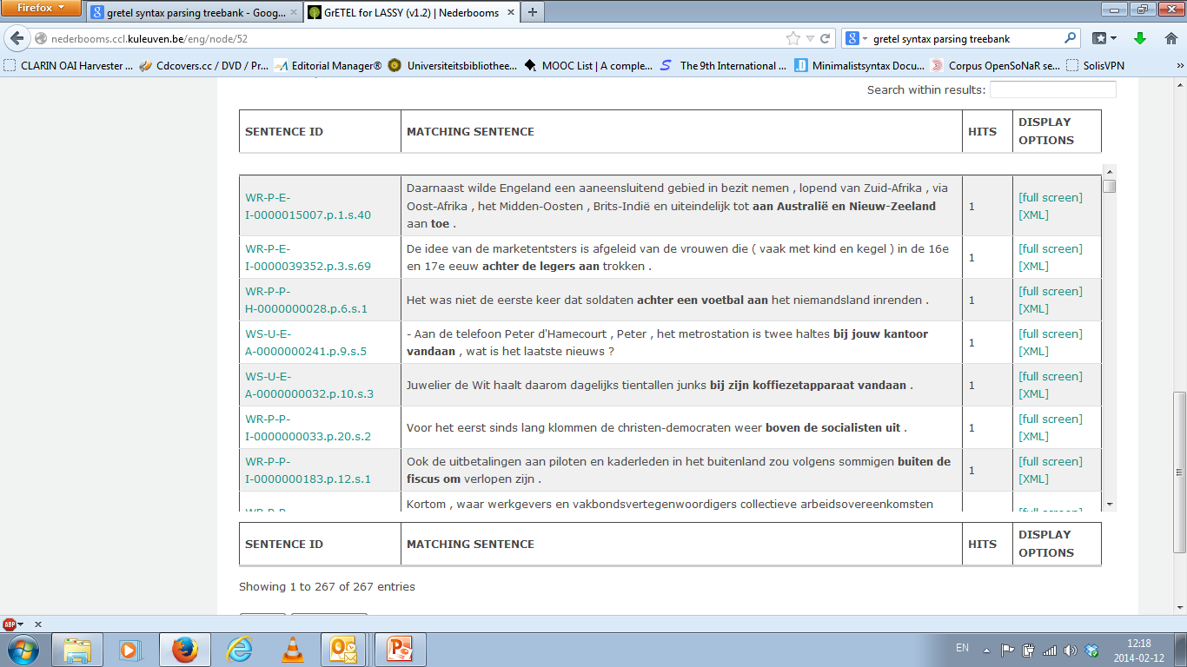
Circumpositions
RETURN Page

Slide 69
Circumpositions
RETURN Page

Slide 70
Krijgen-passive
Start Page

Slide 71
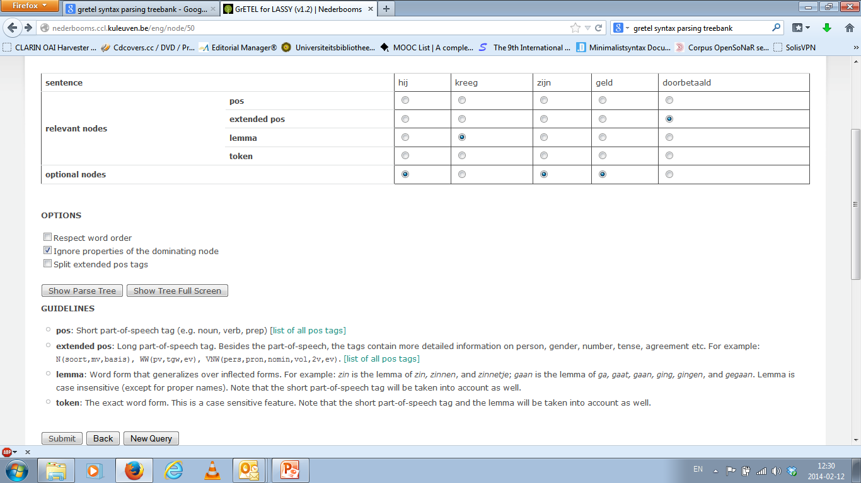
Krijgen-passive
RETURN Page

Slide 72
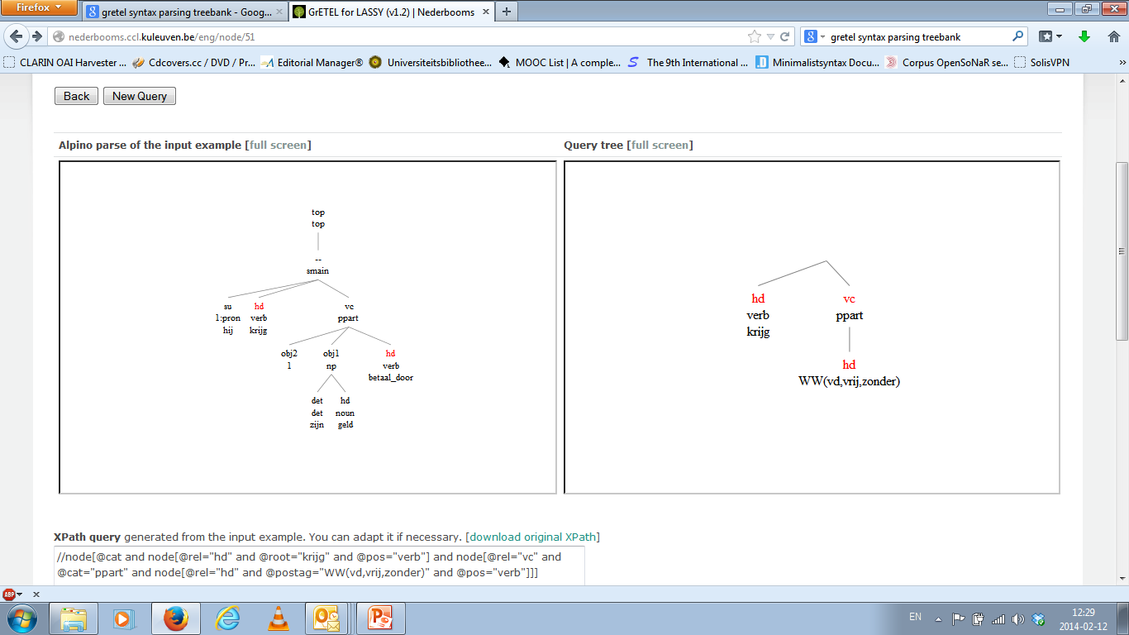
Krijgen-passive
RETURN Page

Slide 73
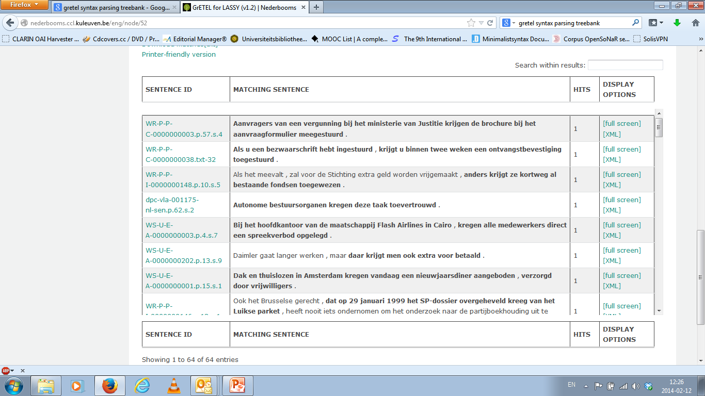
Krijgen-passive
RETURN Page

Slide 74
Krijgen-passive
RETURN Page

Slide 75
Bare Nouns
Start Page

Slide 76
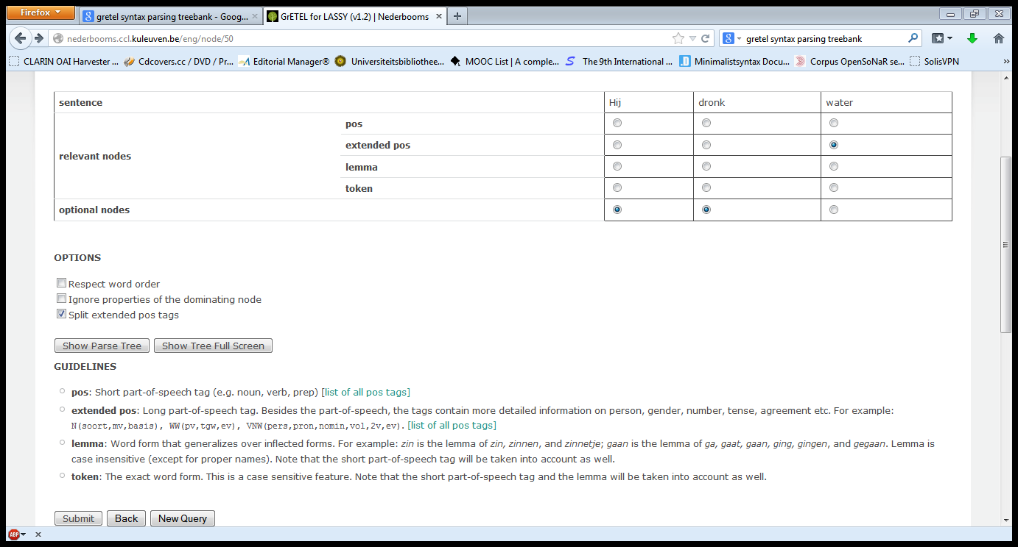
Bare Nouns
RETURN Page

Slide 77
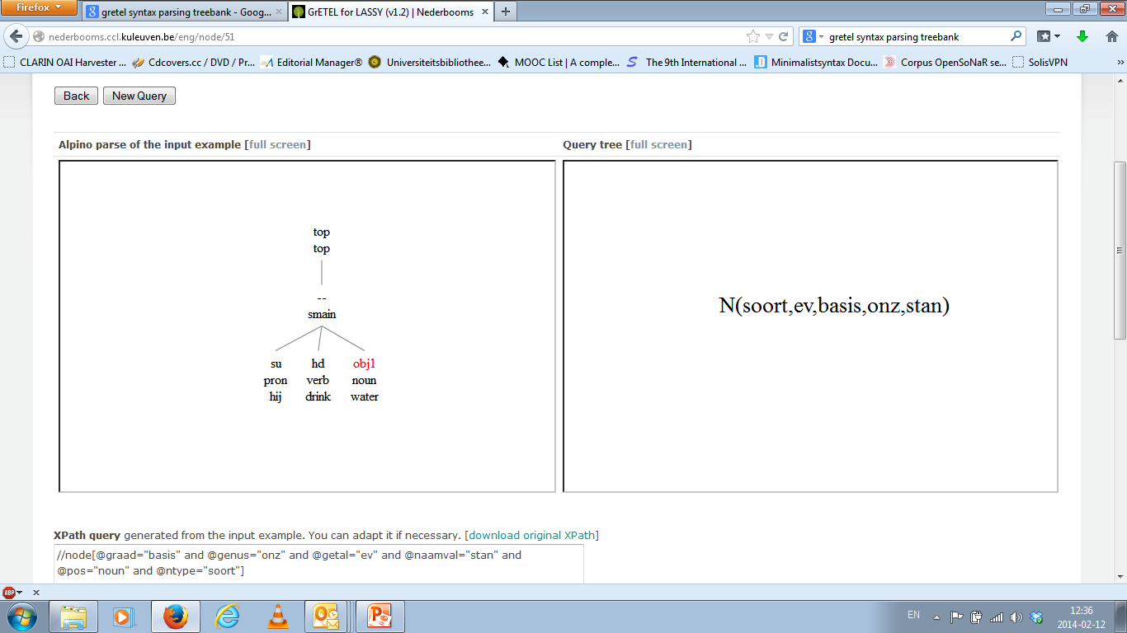
Bare Nouns
RETURN Page

Slide 78
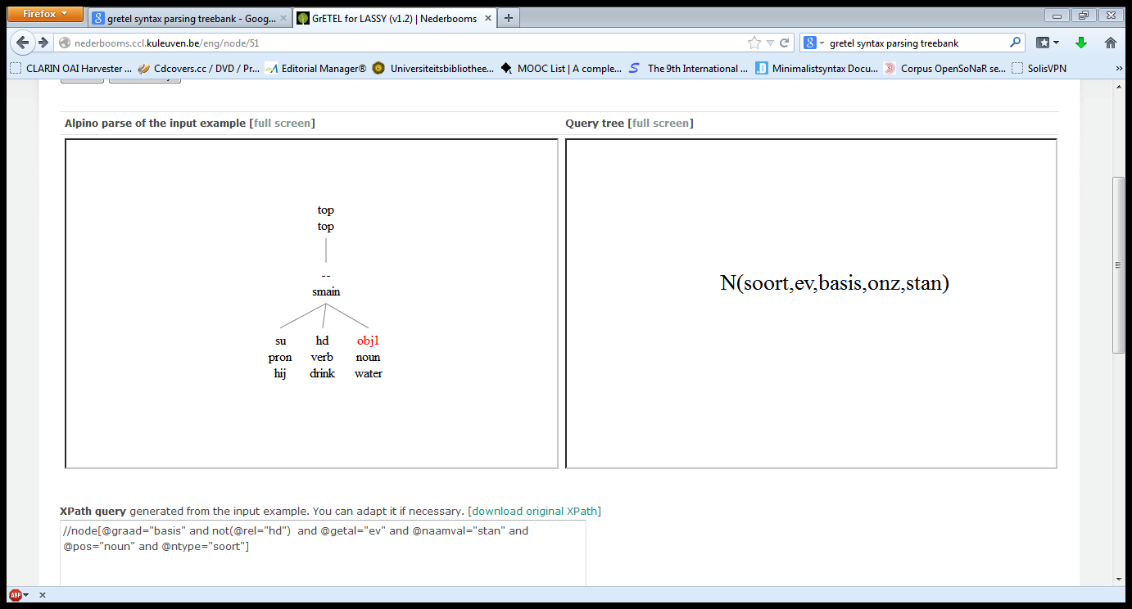
Bare Nouns
RETURN Page

Slide 79
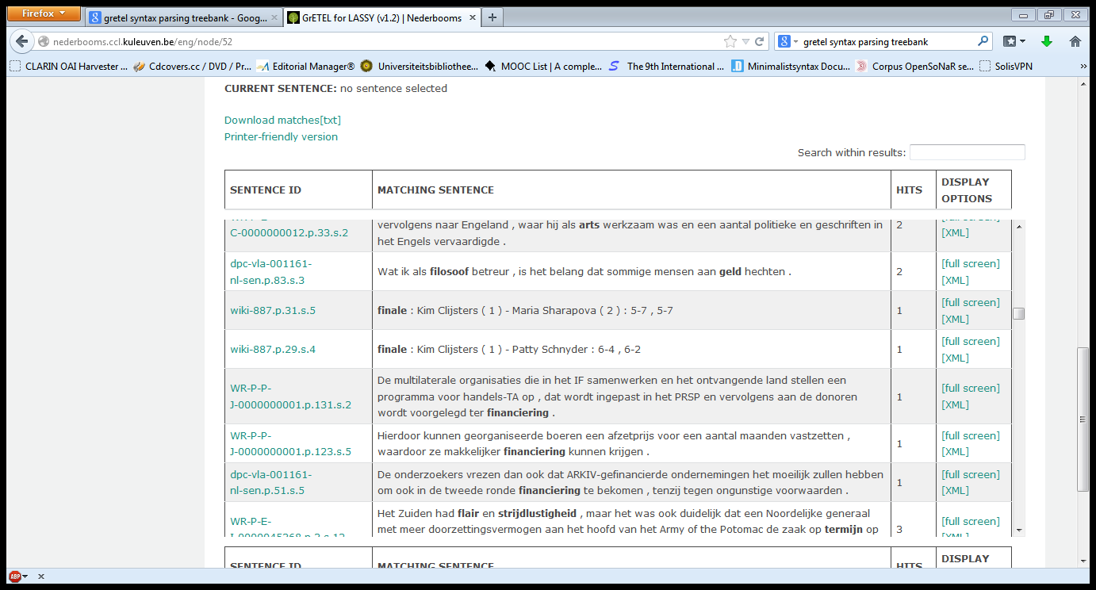
Bare Nouns
RETURN Page

Slide 80
Bare Nouns
RETURN Page

Slide 81
Object Topicalisation
Start Page

Slide 82
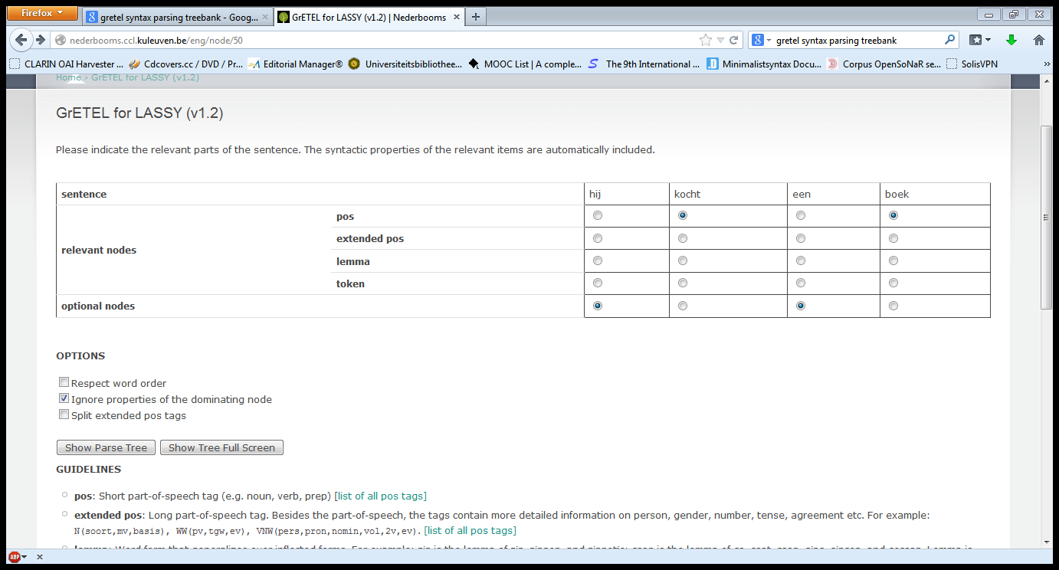
Object Topicalisation
RETURN Page

Slide 83
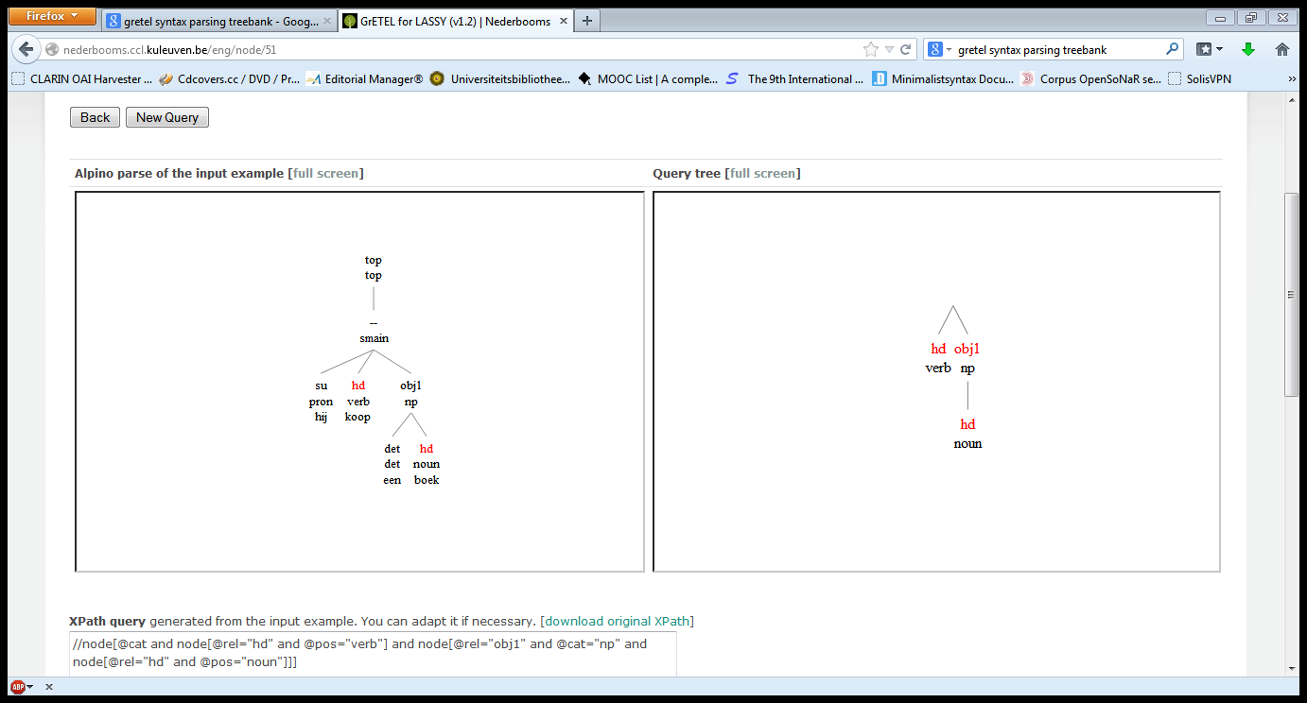
Object Topicalisation
RETURN Page

Slide 84
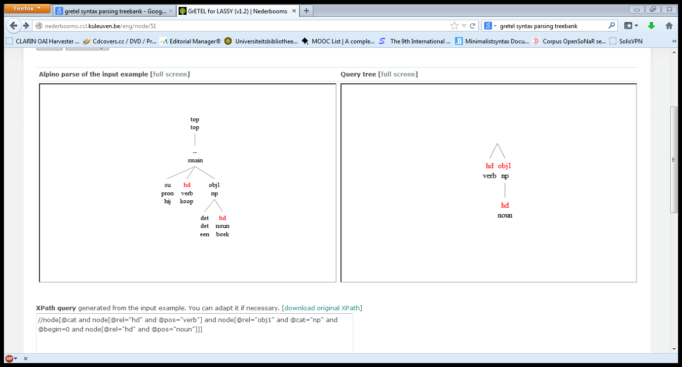
Object Topicalisation
RETURN Page

Slide 85
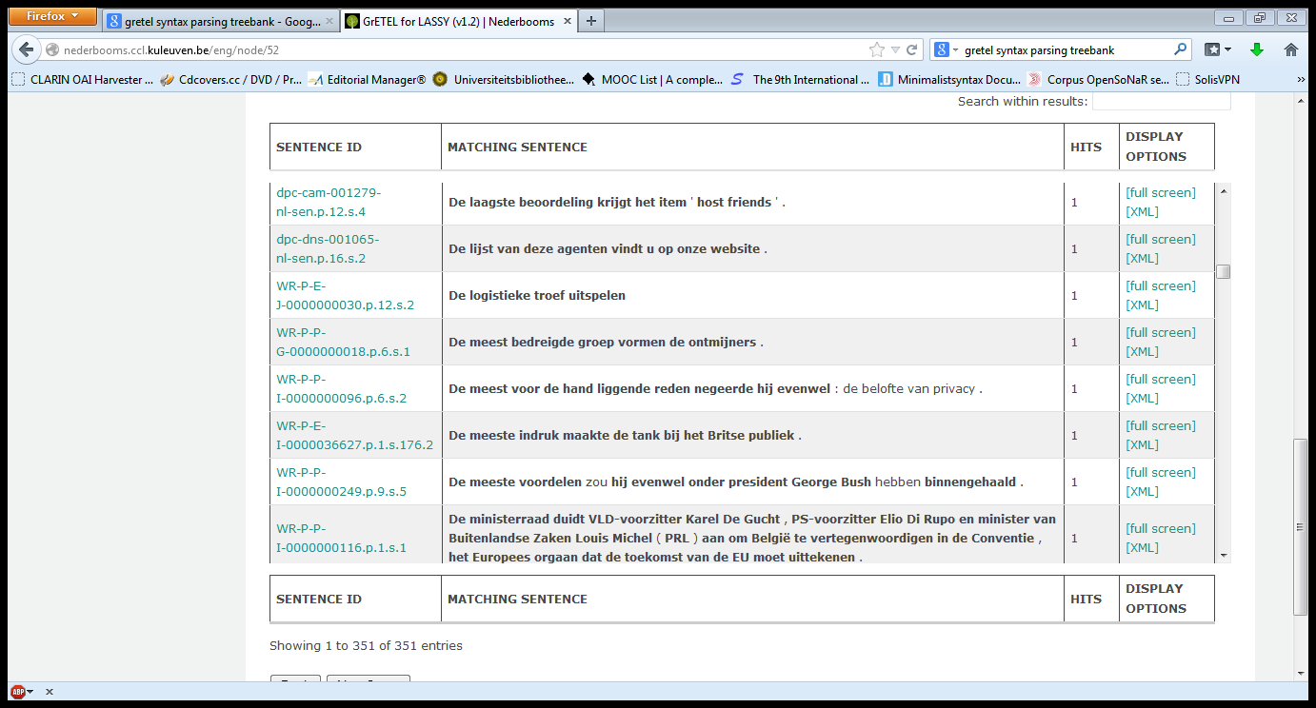
Object Topicalisation
RETURN Page

Slide 86
Object Topicalisation
RETURN Page

Slide 87
Modified Bare Noun
Start Page

Slide 88
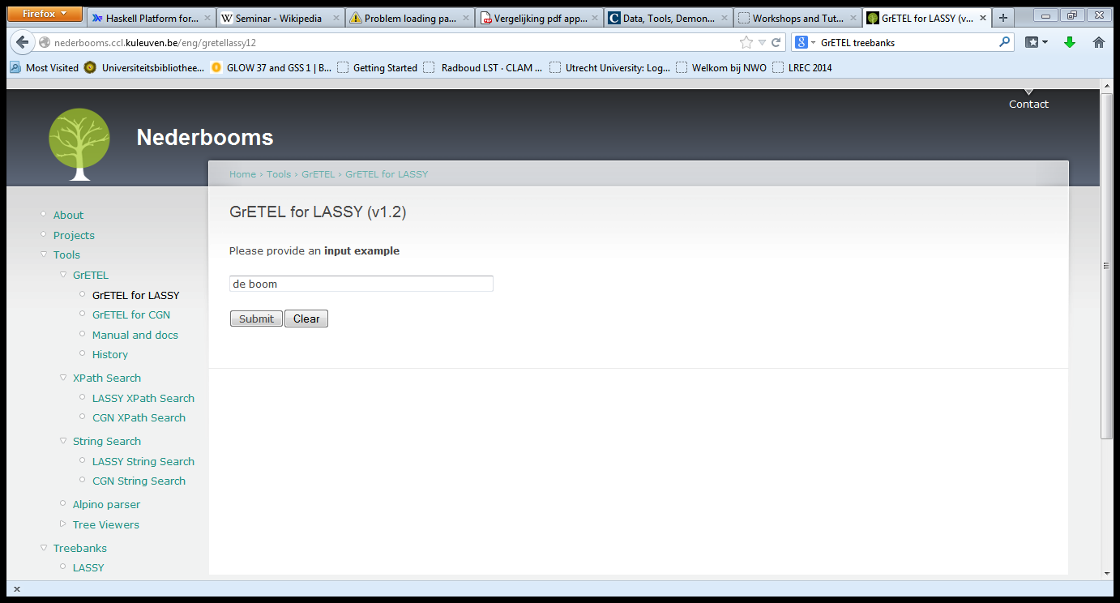
Modified Bare Noun
Start Page

Slide 89
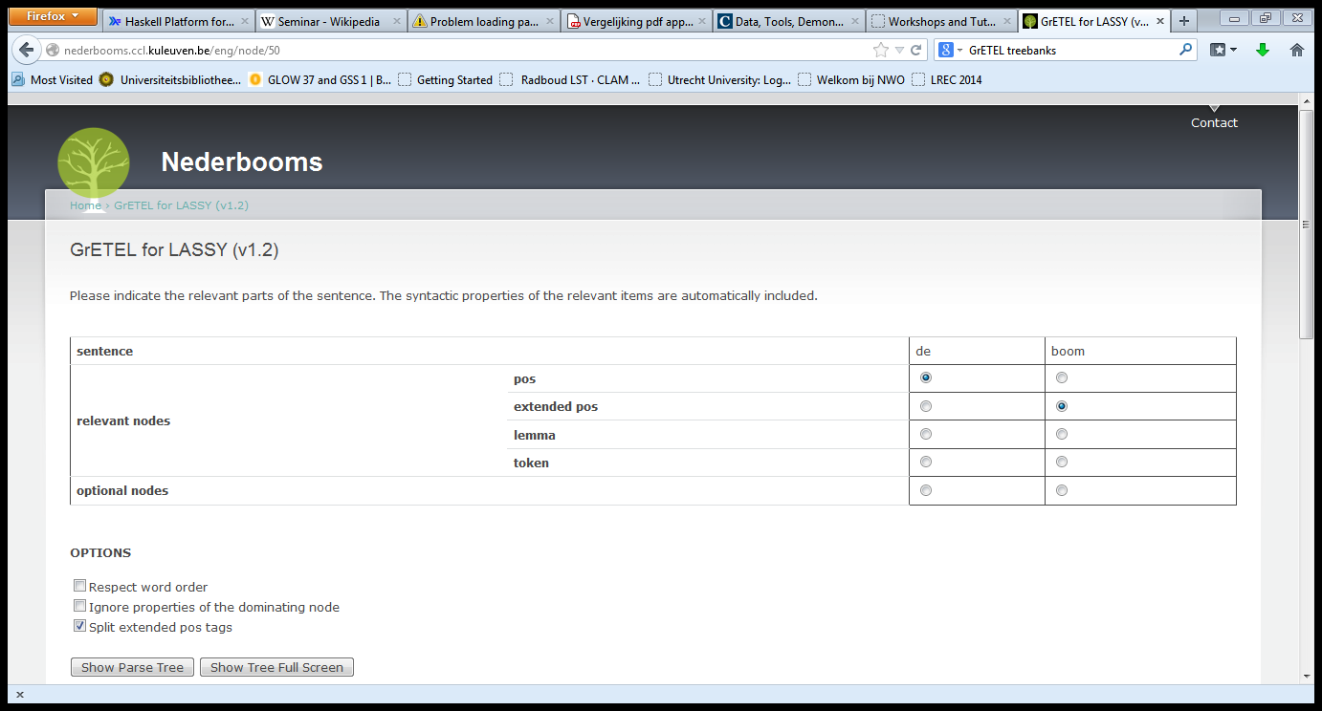
Modified Bare Noun
Start Page

Slide 90
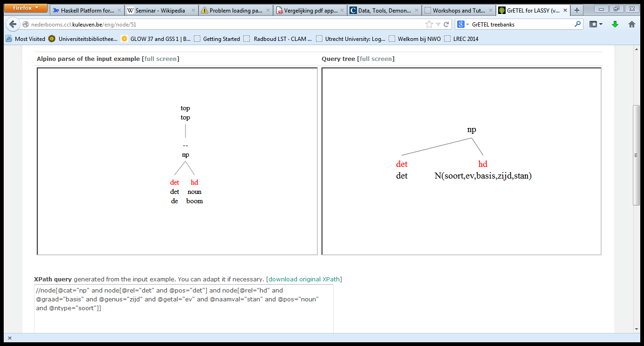
Modified Bare Noun
Start Page

Slide 91
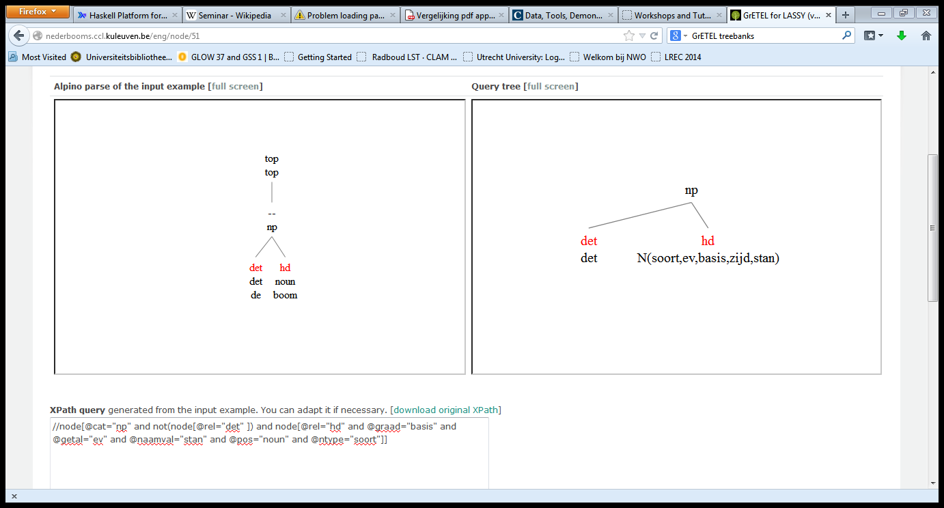
Modified Bare Noun
Start Page

Slide 92
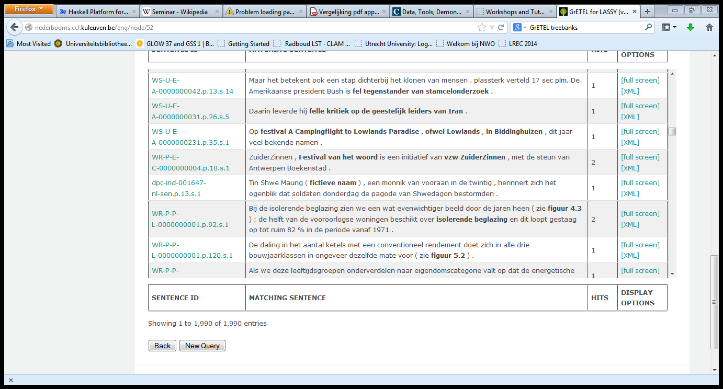
Modified Bare Noun
Start Page

Slide 93
Modified Bare Noun
Return Page

Slide 94
V P V
Start Page

Slide 95
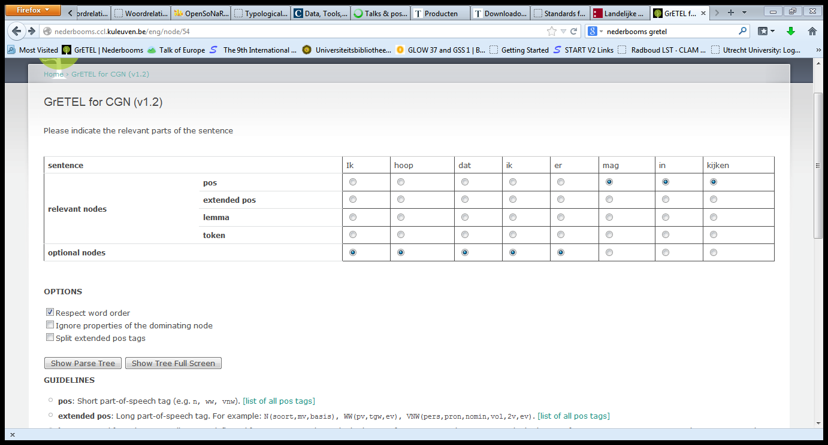
V P V
Start Page

Slide 96
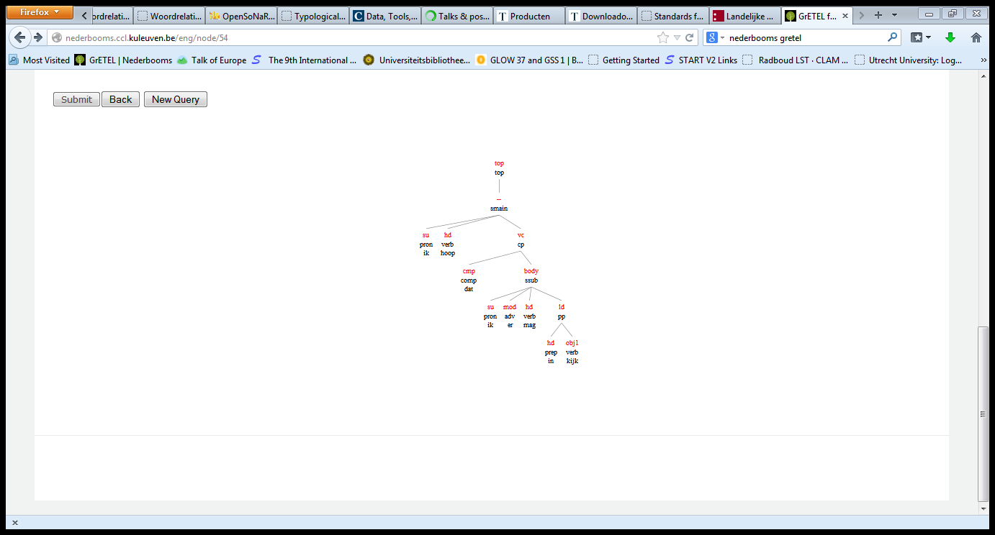
V P V
Start Page

Slide 97
V P V
The parse tree is wrong, so it is unclear what results we can expect
Starting from ik denk dat hij er gisteren op wilde wachten, retaining word order among the bold faced elements gives a problem (bug). See this slide

Slide 98
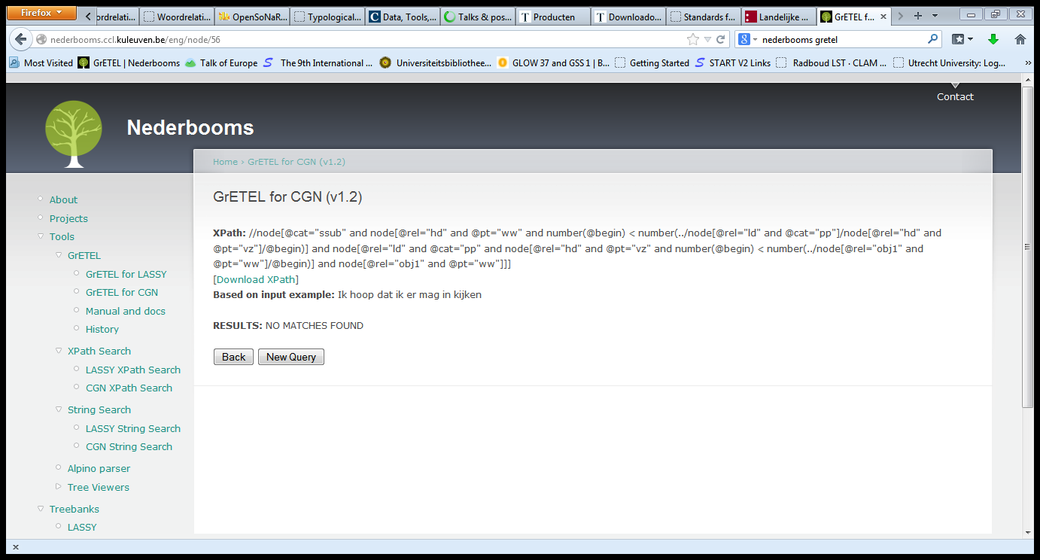
V P V
Start Page

Slide 99
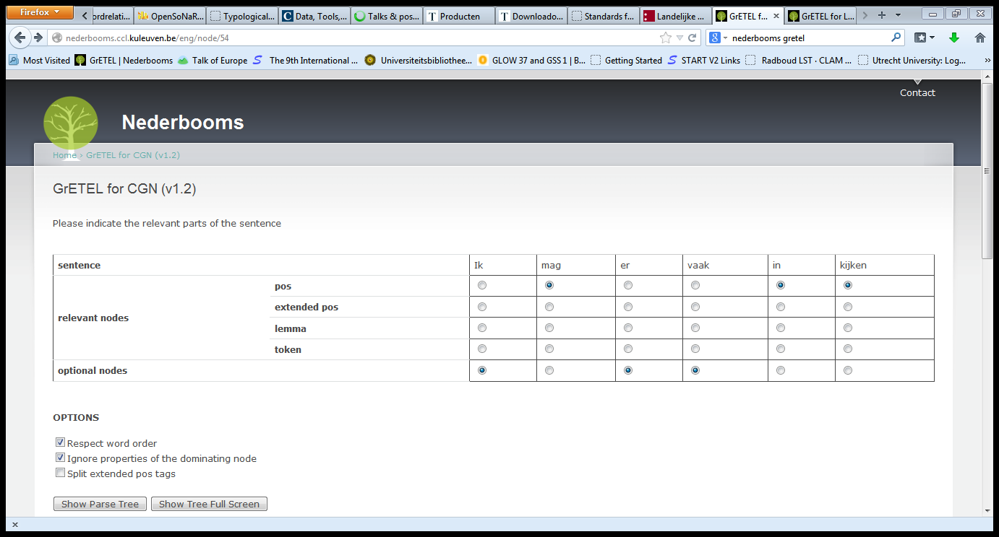
V P V
Start Page

Slide 100
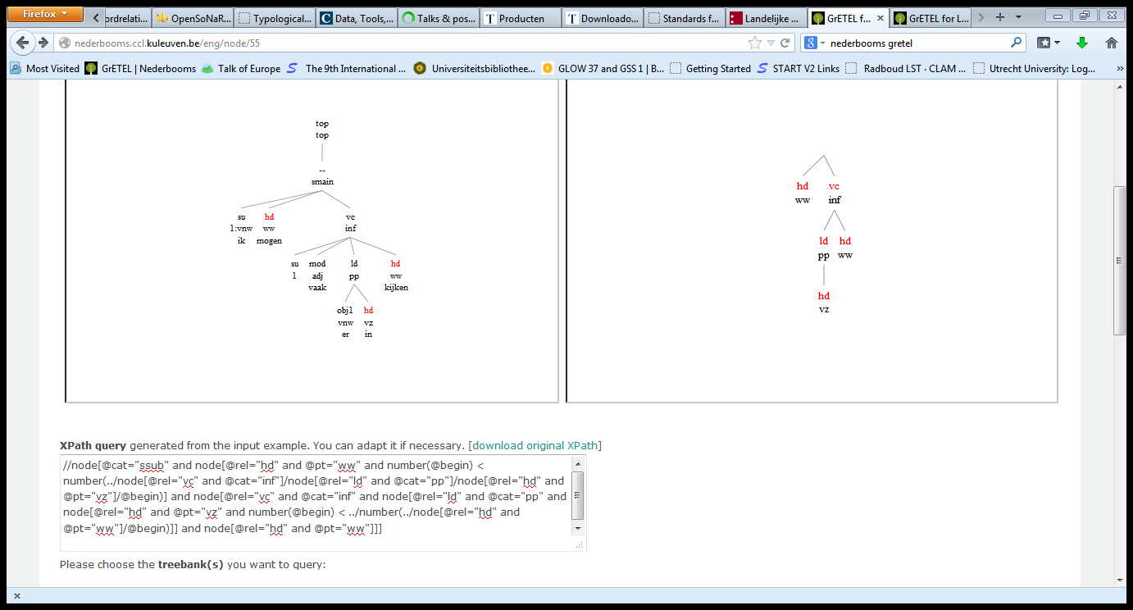
V P V
Start Page

Slide 101
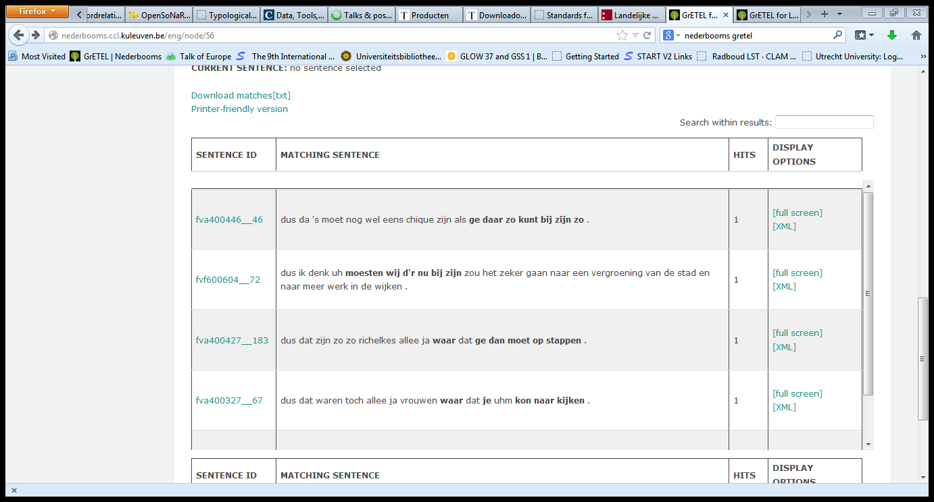
V P V
Start Page

Slide 102
V P V
Return Page

Slide 103
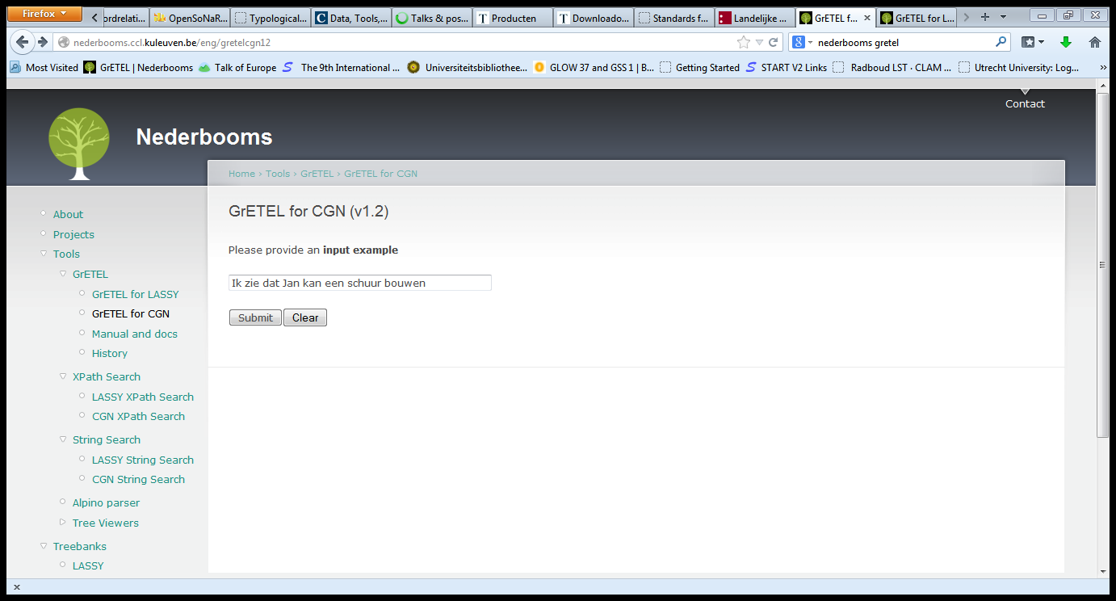
V N V
Start Page

Slide 104
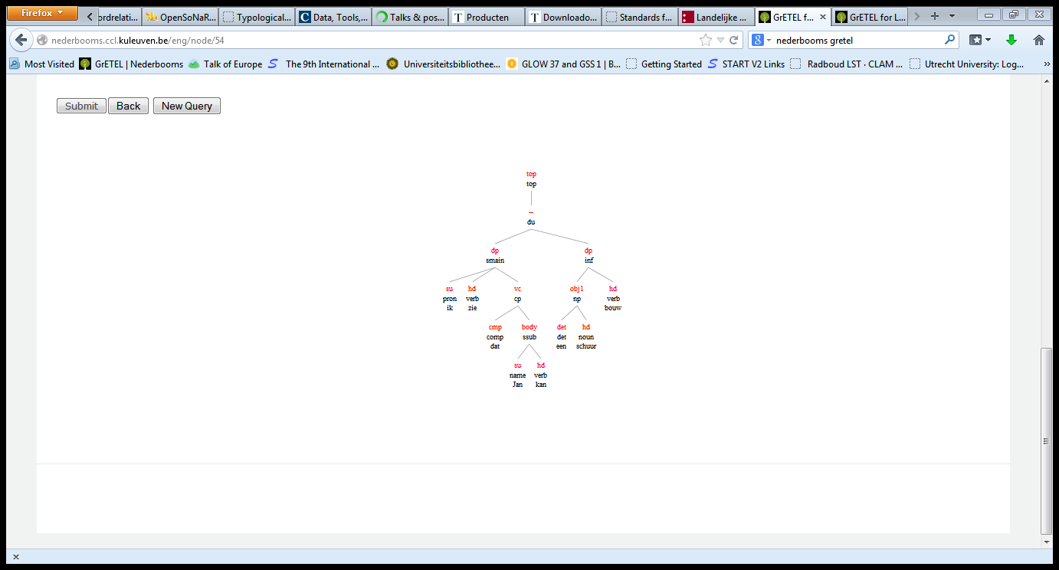
V N V
Start Page

Slide 105
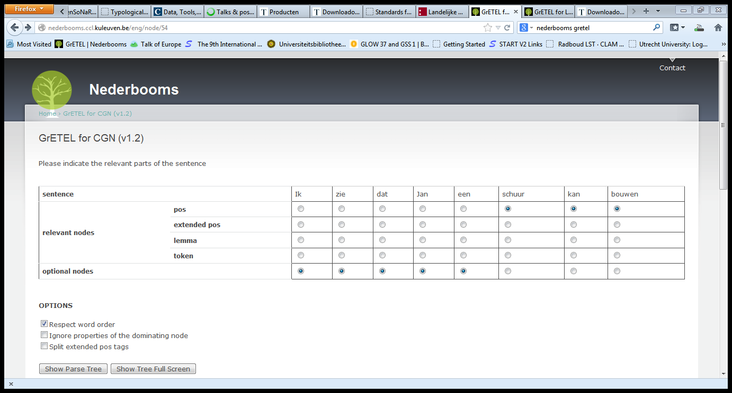
V N V
Start Page

Slide 106
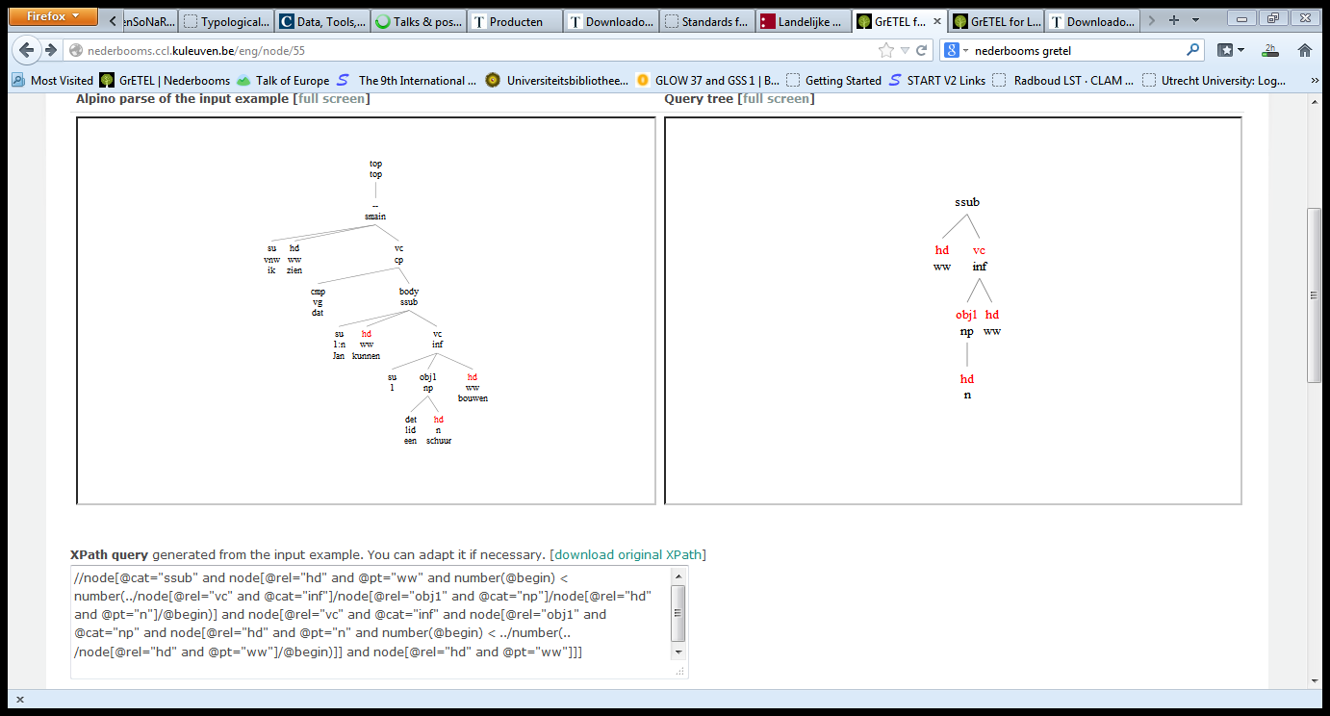
V N V
Start Page

Slide 107
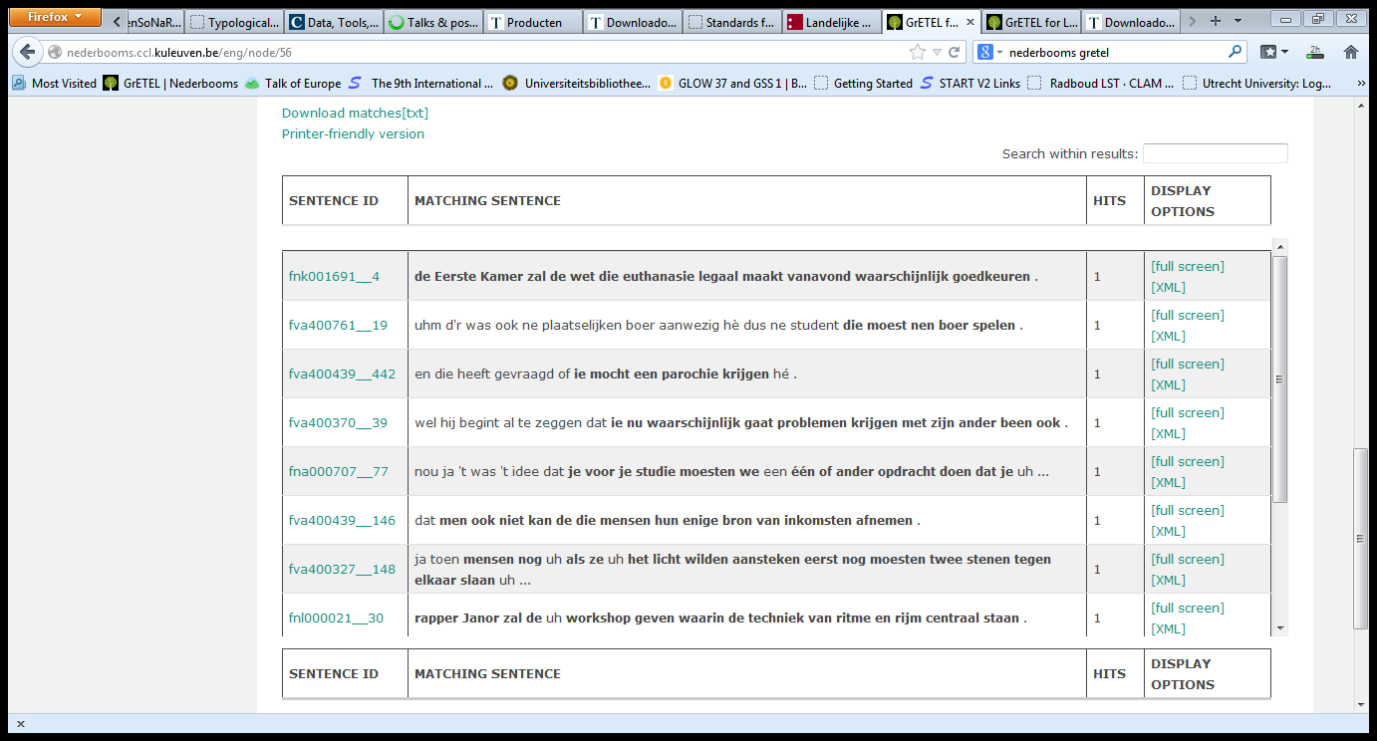
V N V
Return Page

Slide 108
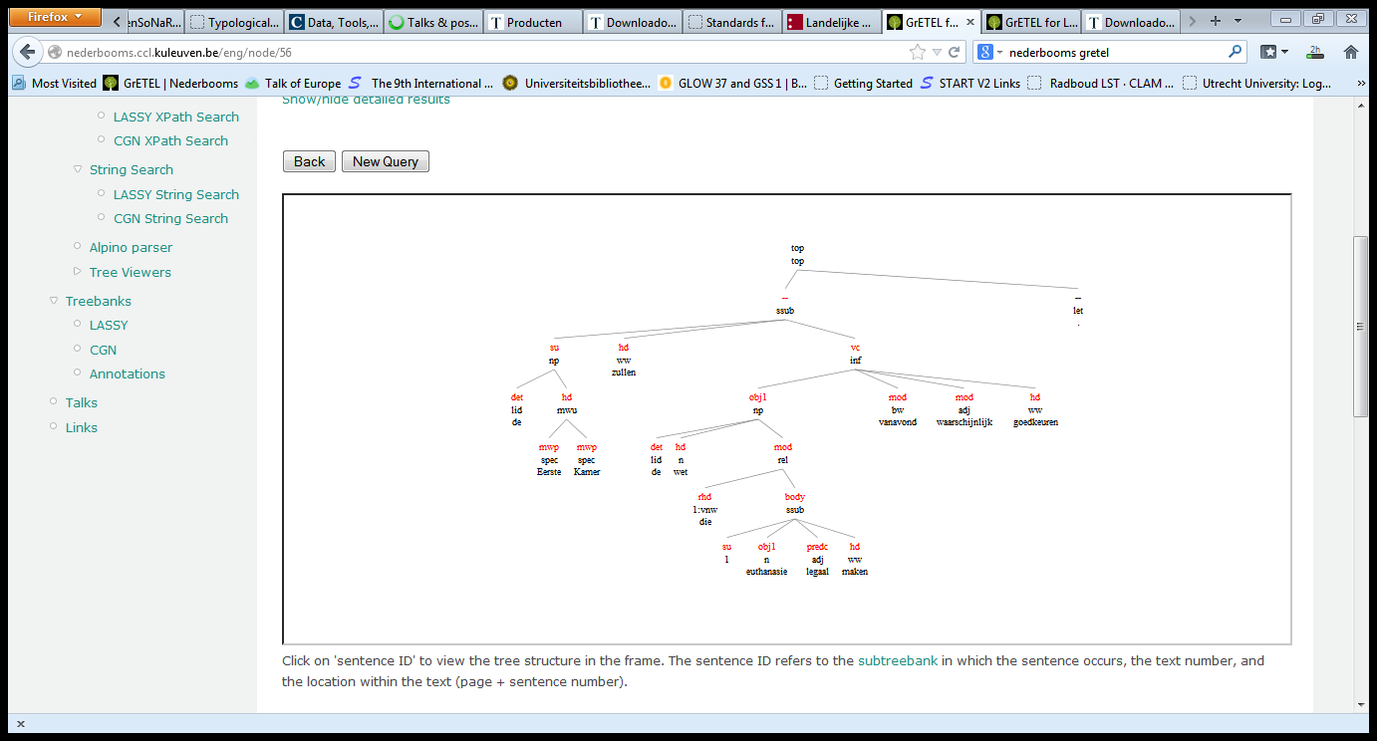
V N V
Some examples are incorrectly included because they are wrongly marked as subordinate clauses

Slide 109
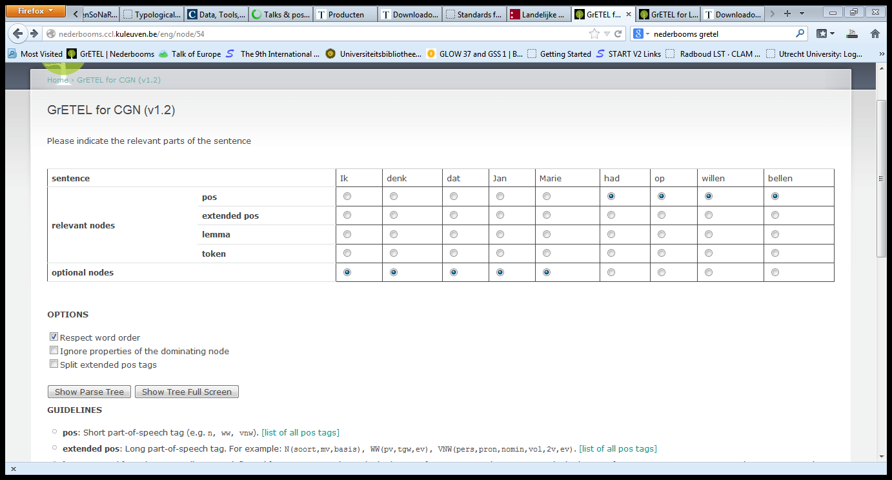
V Prt V V
Start Page

Slide 110
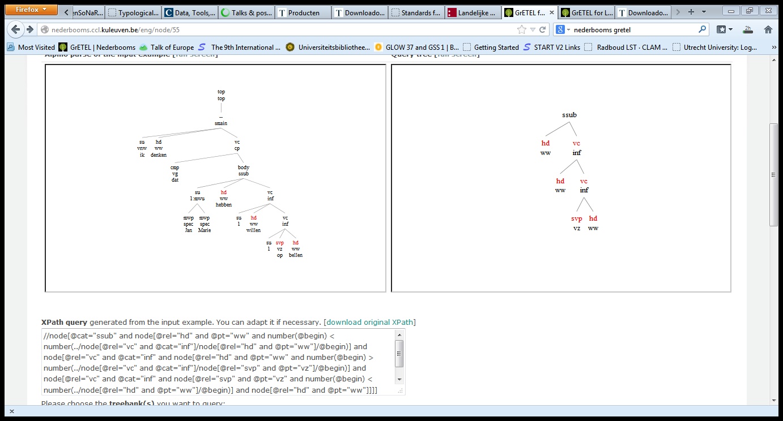
V Prt V V
Start Page

Slide 111
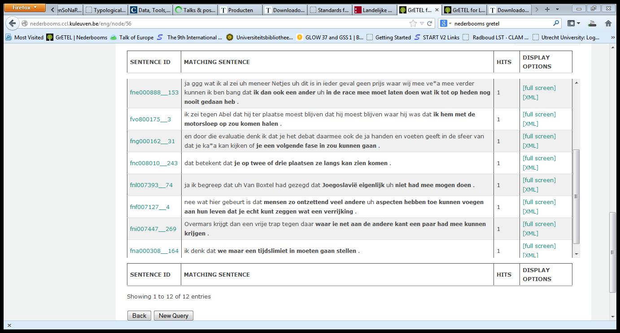
V Prt V
Start Page

Slide 112
V Prt V
There is a bug here wrt `respect word order’ (I reported it)
Of the 12 examples, 9 have order Prt V V V, 3 have order V Prt V V:
Had mee mogen doen
Hebben toe kunnen voegen
Had mee kunnen krijgen

Slide 113
Mod/A V V
Start Page

Slide 114
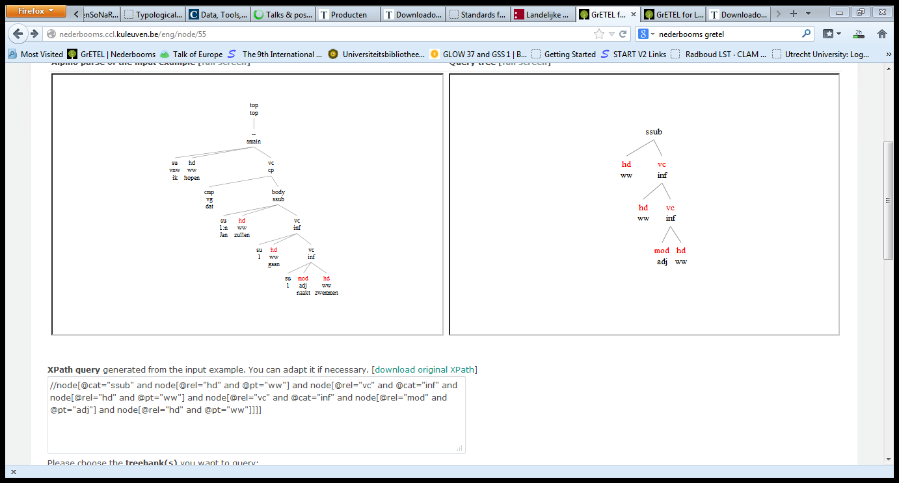
Mod/A V V
Start Page

Slide 115
Mod/A V V
Start Page

Slide 116
Mod/A V V
With no order restrictions: 13 matches
Distinction between adverb and secondary predicate is not made: most if not all are adverbs
No examples with the order: V Adj V V except
terwijl we op het einde van 't jaar tijdens uh de examenreeks moesten we mondeling komen toelichten wat we hadden gedaan .
But this is a different construction with probably a transition from subordinate to main clause (see resumed subject)
With order restriction Adj V V V : also 13 matches
With order restriction V Adj V V: no matches

Slide 117
Mod/A V V
Return Page

Slide 118
V N V
Return Page

Slide 119
V N V
Return Page

Slide 120
V N V
//node[@cat="inf" and node[@rel="hd" and @pt="ww" and number(@begin) < number(../node[@rel="vc" and @cat="inf"]/node[@rel="obj1" and @pt="n"]/@begin)] and node[@rel="vc" and @cat="inf" and node[@rel="obj1" and @pt="n" and number(@begin) < number(../node[@rel="hd" and @pt="ww"]/@begin)] and node[@rel="hd" and @pt="ww"]]]

Slide 121
V N V
Return Page

Slide 122
V N V
Return Page

Slide 123
Predc/A V V
Return Page

Slide 124
Predc/A V V
Return Page

Slide 125
Predc/A V V
Return Page

Slide 126
Predc/A V V
Return Page

Slide 127
V Predc/A V
Return Page

Slide 128
V Predc/A V
Return Page

Slide 129
V Predc/A V
Return Page

Slide 130
PREP V V & V PREP V
Return Page

Slide 131
PREP V V & V PREP V
Return Page

Slide 132
PREP V V & V PREP V
Return Page

Slide 133
PREP V V & V PREP V
There is a bug here:
Order restrictions are included in the query for
ER < HEADV
ER < PREP
PREP < Compverb
But lacking is:
PREP < Headverb
Manual Count: P V V: 38(38); V P V: 14(14)

Slide 134
PREP V V & V PREP V
Return Page

Slide 135
V Prep V
//node[@cat="ssub" and
node[@rel="hd" and @pt="ww" and number(@begin) > number(../node[@rel="vc" and @cat="inf"]/node[@rel="ld" and @cat="pp"]/node[@rel="obj1" and @pt="vnw"]/@begin)] and
node[@rel="vc" and @cat="inf" and
node[@rel="ld" and @cat="pp" and
node[@rel="obj1" and @pt="vnw" and number(@begin) < number(../node[@rel="hd" and @pt="vz"]/@begin)] and
node[@rel="hd" and @pt="vz" and number(@begin) > ../number(../node[@rel="hd" and @pt="ww"]/@begin)]
] and
node[@rel="hd" and @pt="ww"]
]
]

Slide 136
V Prep V
Return Page

Slide 137
V Prep V
Return Page

Slide 138
Topic Drop
Return Page

Slide 139
Topic Drop
Return Page

Slide 140
Topic Drop

Slide 141
Topic Drop
Just an approximation, some noise
Use “.” to avoid yes-no questions (transcribed speech)
and especially to include top node
Leads to 3054 hits in CGN (spoken Dutch)
Many are restarts of sentences
Modify the query to avoid such cases

Slide 142
Topic Drop
//node[@cat="top" and node[@rel="--" and @cat="sv1" and node[@rel="hd" and @pt="ww" and @begin=0]] and node[@rel="--" and @pt="let" and @word="." and @lemma="."]]

Slide 143
Topic Drop
Return Page

Slide 144
Topic Drop
Leads to 2547 hits in CGN
In CGN mostly Topic Drop examples, some imperatives
In LASSY (Try this at home!) mostly imperatives

Slide 145
Prt V V
Return page

Slide 146
Prt V V
Return page

Slide 147
Prt V V
Return page

Slide 148
Prt V V
Return page

Slide 149
V Prt V
Return page

Slide 150
V Prt V
Return page

Slide 151
V Prt V
Starting from the query for
Ik denk dat hij op wilde bellen
//node[@cat="ssub" and node[@rel="hd" and @pt="ww" and number(@begin) > number(../node[@rel="vc" and @cat="inf"]/node[@rel="svp" and @pt="vz"]/@begin)] and node[@rel="vc" and @cat="inf" and node[@rel="svp" and @pt="vz" and number(@begin) < number(../node[@rel="hd" and @pt="ww"]/@begin)] and node[@rel="hd" and @pt="ww"]]]
Change > into <

Slide 152
V Prt V
Return page

Slide 153
V Prt V
The only found example has te incorrectly labeled as svp/vz
So the actual number is 0(0)

Slide 154
V Prt+V (LASSY)

Slide 155
V Prt+V
//node[@cat="ssub" and node[@rel="hd" and @pos="verb"] and node[@rel="vc" and @cat="inf" and node[@rel="hd" and @pos="verb" and contains(@root,"_")] and not(node[@rel="svp"])]]

Slide 156
V Prt+V

Slide 157
V Prt+V
Works in LASSY because @root contains an “_” for verbs with a separable particle
Does not work in CGN (should be changed!)

Slide 158
LASSY: PRT V V

Slide 159
LASSY: PRT V V

Slide 160
LASSY: PRT V V

Slide 161
LASSY: PRT V V
Return Page

Slide 162
LASSY: V PRT V
//node[@cat="ssub" and node[@rel="hd" and @pos="verb" and number(@begin) < number(../node[@rel="vc" and @cat="inf"]/node[@rel="svp" and @pos="part"]/@begin)] and node[@rel="vc" and @cat="inf" and node[@rel="svp" and @pos="part" and number(@begin) < number(../node[@rel="hd" and @pos="verb"]/@begin)] and node[@rel="hd" and @pos="verb"]]]

Slide 163
LASSY: V PRT V

Slide 164
LASSY: V PRT V
Return page

Slide 165
Mod/A V V
Return page

Slide 166
Mod/A V V
Return page

Slide 167
Mod/A V V
Return page

Slide 168
Mod/A V V
Return page

Slide 169
V Mod/A V
Starting from query as for MOD/A V V
//node[@cat="ssub" and node[@rel="hd" and @pt="ww" and number(@begin) > number(../node[@rel="vc" and @cat="inf"]/node[@rel="mod" and @pt="adj"]/@begin)] and node[@rel="vc" and @cat="inf" and node[@rel="mod" and @pt="adj" and number(@begin) < number(../node[@rel="hd" and @pt="ww"]/@begin)] and node[@rel="hd" and @pt="ww"]]]
Change `verb’ “>” `adj’ into `verb’ “<“ `adj’

Slide 170
V Mod/A V
//node[@cat="ssub" and node[@rel="hd" and @pt="ww" and number(@begin) < number(../node[@rel="vc" and @cat="inf"]/node[@rel="mod" and @pt="adj"]/@begin)] and node[@rel="vc" and @cat="inf" and node[@rel="mod" and @pt="adj" and number(@begin) < number(../node[@rel="hd" and @pt="ww"]/@begin)] and node[@rel="hd" and @pt="ww"]]]

Slide 171
V Mod/A V
Return page

Slide 172
V Mod/A V
Return page

Slide 173
N V V
Return page

Slide 174
N V V
Return page

Slide 175
N V V
Return page

Slide 176
N V V
Return page

Slide 177
V N V
//node[@cat="ssub" and node[@rel="hd" and @pt="ww" and number(@begin) < number(../node[@rel="vc" and @cat="inf"]/node[@rel="obj1" and @pt="n"]/@begin)] and node[@rel="vc" and @cat="inf" and node[@rel="obj1" and @pt="n" and number(@begin) < number(../node[@rel="hd" and @pt="ww"]/@begin)] and node[@rel="hd" and @pt="ww"]]]

Slide 178
V N V
Return Page

Slide 179
V N V
Return Page

Slide 180
Wie komt er
Return Page

Slide 181
Wie komt er
Return Page

Slide 182
Wie komt er
Return Page

Slide 183
Wie komt er
Wie komt er (result: 15 examples)
One should also do
Wie is er gekomen (result: 3 examples)
Wie zal er komen (result: 5 examples)
Because their syntactic structures differ from Wie komt er

Slide 184
Wie denk je dat er komt
Return Page

Slide 185
Wie denk je dat er komt
Return Page

Slide 186
Wie denk je dat er komt
Return Page

Slide 187
Wie denk je dat er komt
With the query based on Wie denk je dat er komt
There is no guarantee that `wie’ originates in the subordinate clause
So you will encounter irrelevant cases
Not so important here, since you only get one example (which is irrelevant)
Wie denk je dat er gekomen is (1 , irrel.)
Wie denk je dat er zal komen (0 )

Slide 188
Wie komt
Attempt 1
You want er to be absent. Start from an example with er.
So we can start from the query for “wie komt er”
//node[@cat="whq" and node[@rel="whd" and @pos="pron"] and node[@rel="body" and @cat="sv1" and node[@rel="mod" and @root="er" and @pos="adv"]]]
Now simply use not() around er:
//node[@cat="whq" and node[@rel="whd" and @pos="pron"] and node[@rel="body" and @cat="sv1" and not(node[@rel="mod" and @root="er" and @pos="adv"])]]

Slide 189
Wie komt
Return Page

Slide 190
Wie komt
Return Page

Slide 191
Wie komt
Problems
We do not prevent er from occurring deeper in the tree
We are not sure that `wie’ is a subject
Result: 192 examples, most of non-subjects
Several examples that contain er:
En in het bijzonder , wat gaat er later gebeuren ?
Wat gaat er nu verder gebeuren ?

Slide 192
Wie komt
Can we prevent `er’ from occurring deeper?
Er will be in a node with @rel=“vc”
Attempt: require that no such node is present
//node[@cat="whq" and node[@rel="whd" and @pos="pron"] and node[@rel="body" and @cat="sv1" and not(node[@rel="mod" and @root="er" and @pos="adv"]) and not(node[@rel=“vc”])]]
Result: 124 examples
But is probably too strict (restrict to infinitival and participial @rel=“vc” nodes)

Slide 193
Wie komt
Wie is gekomen: 5 examples, 2 relevant ones
Wie zal komen: 40 examples, at least 5 relevant
(both based on variant with er and with not() added
Can we select pre-posed wh-phrases that act as a subject?
Yes! Because LASSY trees contain (things that looks like ) traces!

Slide 194
Wie komt

Slide 195
Wie komt
//node[@cat="whq" and node[@rel="whd" and @pos="pron"] and node[@rel="body" and @cat="sv1" and node[@rel="su" and @index=../../node[@rel="whd" and @pos="pron"]/@index] and node[@rel="vc" and @cat="ppart" and not(node[@rel="mod" and @word="er" and @root="er" and @pos="adv"])]]]

Slide 196
Wie komt

Slide 197
Wie komt
By using the index attribute on `traces’we reduce the examples exactly to the two relevant ones for `wie is gekomen’
We can do the same for `wie zal komen’

Slide 198
Wie komt
Return Page

Slide 199
Wie komt
//node[@cat="whq" and node[@rel="whd" and @pos="pron"] and node[@rel="body" and @cat="sv1" and node[@rel="su" and @index=../../node[@rel="whd" and @pos="pron"]/@index ] and node[@rel="vc" and @cat="inf" and not(node[@rel="mod" and @word="er" and @root="er" and @pos="adv"])]]]

Slide 200
Wie komt
Return Page

Slide 201
Wie komt
Return Page
By adding the subject `trace’ and checking for identity of its index with the wh-word, we restrict the examples found exactly to the 8 relevant ones!

Slide 202
Wie denk je dat komt
Start from: Wie denk je dat er komt
Add not() around ‘er’
No guarantee that wie originates from subordinate clause
No guarantee that er does occur lower (in a vc group)

Slide 203
Wie denk je dat komt

Slide 204
Wie denk je dat komt

Slide 205
Wie denk je dat komt
Result: 5 examples, none relevant
Wie denk je dat gekomen is (1 example, irrelevant)
Wie denk je dat zal komen (0 examples)

Slide 206
Bare plural < NIET
Return page

Slide 207
Bare plural < NIET
Return page

Slide 208
Bare plural < NIET
Return page

Slide 209
Bare plural < NIET
5 examples, 4 with topicalized nouns
Hij heeft boeken niet gelezen: the same 5 examples
Hij zal boeken niet lezen: the same 5 examples

Slide 210
Met+ adj+ Nsg (no DET)

Slide 211
Met+ adj+ Nsg (no DET)

Slide 212
Met+ adj+ Nsg (no DET)
//node[@cat="pp" and node[@rel="hd" and @root="met" and @pos="prep"] and node[@rel="obj1" and @cat="np" and not(node[@rel="det" and @pos="det"])and node[@rel="mod" and @pos="adj"] and node[@rel="hd" and @postag="N(soort,ev,basis,onz,stan)" and @pos="noun"]]]

Slide 213
Met+ adj+ Nsg (no DET)

Slide 214
Met+ adj+ Nsg (no DET)
Found examples: 64
Count v. mass is not represented in LASSY/CGN so these have to be distinguished by hand
Many contain mass nouns and are therefore not special
There are some count nouns

Slide 215
Henriette’s Examples
Met+adj+Nsg
P1/p3 with past/perfect (LASSY):
Subject | past | Hebben + part | Zijn + part | Proportion Past : perfect
ik | 359(306) | 113(109) | 22(20) | 75%:25%
Wij | 29(27) | 22(20) | 5(5) | 52%:48%
1 Total | 388 | 135 | 27 | 75%:25%
Hij/zij/het | *2448(2173) | *306(299) | *117(117) | 85%:15%
Zij (pl) | 203(196) | *70(70) | *22(22) | 69%:31%
NP | 10835(9465) | 689(687) | 2438(2382) | 78%:22%
3 Total | 13486 | 1065 | 2577 | 79%:21%

Slide 216
Henriette’s Examples
We cannot exclude perfect passives
But did not include past passives (werd + part)
Played around with different query options
Maybe some are not `minimal pair queries’

Slide 217
Ik zwom
Return Page

Slide 218
Ik zwom
Return Page

Slide 219
Ik zwom
Return Page

Slide 220
Ik zwom
Return Page

Slide 221
Wij zwommen
Return Page

Slide 222
Wij zwommen
Return Page

Slide 223
Wij zwommen
Return Page

Slide 224
Wij zwommen
Return Page

Slide 225
Ik heb gezwommen
Return Page

Slide 226
Ik heb gezwommen
Return Page

Slide 227
Ik heb gezwommen
Return Page

Slide 228
Ik heb gezwommen
Return Page

Slide 229
Wij hebben gezwommen
Return Page

Slide 230
Wij hebben gezwommen
Return Page

Slide 231
Wij hebben gezwommen
Return Page

Slide 232
Wij hebben gezwommen
Return Page

Slide 233
Ik ben gekomen
Return Page

Slide 234
Ik ben gekomen
Return Page

Slide 235
Ik ben gekomen
Return Page

Slide 236
Ik ben gekomen
Return Page

Slide 237
Wij zijn gekomen
Return Page

Slide 238
Wij zijn gekomen
Return Page

Slide 239
Wij zijn gekomen
Return Page

Slide 240
Wij zijn gekomen
Return Page

Slide 241
Hij/zij/het zwom
Return Page

Slide 242
Hij/zij/het zwom
Return Page

Slide 243
Hij/zij/het zwom
//node[@cat and node[@rel="su" and @status="vol" and @genus="masc" and @vwtype="pers" and @getal="ev" and @persoon="3" contains(@persoon,”3”) and @naamval="nomin" and @pos="pron" and @pdtype="pron"] and node[@rel="hd" and @pvtijd="verl" and @wvorm="pv" and @pos="verb" and @pvagr="ev"]]

Slide 244
Hij/zij/het zwom
Return Page

Slide 245
Hij/zij/het zwom
Return Page

Slide 246
Hij/zij/het heeft gezwommen
Return Page

Slide 247
Hij/zij/het heeft gezwommen
Return Page

Slide 248
Hij/zij/het heeft gezwommen
//node[@cat and node[@rel="su" and @status="vol" and @genus="masc" and @vwtype="pers" and @getal="ev" and @persoon="3" contains(@persoon,"3“) and @naamval="nomin" and @pos="pron" and @pdtype="pron"] and node[@rel="hd" and @root="heb" and @pos="verb"] and node[@rel="vc" and @cat="ppart" and node[@rel="hd" and @pos="verb"]]]

Slide 249
Hij/zij/het heeft gezwommen
Return Page

Slide 250
Hij/zij/het heeft gezwommen
Return Page

Slide 251
Hij/zij/het is gekomen
Return Page

Slide 252
Hij/zij/het is gekomen
Return Page

Slide 253
Hij/zij/het is gekomen
//node[@cat and node[@rel="su" and @status="vol" and @genus="masc" and @vwtype="pers" and @getal="ev" and @persoon="3" contains(@persoon,"3“) and @naamval="nomin" and @pos="pron" and @pdtype="pron"] and node[@rel="hd" and @root="ben" and @pos="verb"] and node[@rel="vc" and @cat="ppart" and node[@rel="hd" and @wvorm="vd" and @pos="verb" and @positie="vrij" and @buiging="zonder"]]]

Slide 254
Hij/zij/het is gekomen
Return Page

Slide 255
Hij/zij/het is gekomen
Return Page

Slide 256
Zij zwommen
Return Page

Slide 257
Zij zwommen
Return Page

Slide 258
Zij zwommen
Return Page

Slide 259
Zij zwommen
Return Page

Slide 260
Zij hebben gezwommen
Return Page

Slide 261
Zij hebben gezwommen
Return Page

Slide 262
Zij hebben gezwommen
//node[@cat and node[@rel="su" and @status="vol" and @vwtype="pers" and @persoon="3p" and @npagr="mv" and @naamval="nomin" and @pos="pron" and @pdtype="pron"] and node[@rel="hd" and @root="heb" and @pos="verb"] and node[@rel="vc" and @cat="ppart" and node[@rel="hd" and @wvorm="vd" and @pos="verb" and @positie="vrij" and @buiging="zonder"]]]

Slide 263
Zij hebben gezwommen
Return Page

Slide 264
Zij hebben gezwommen
Return Page

Slide 265
Zij zijn gekomen
Return Page

Slide 266
Zij zijn gekomen
Return Page

Slide 267
Zij zijn gekomen
//node[@cat and node[@rel="su" and @status="vol" and @vwtype="pers" and @persoon="3p" and @npagr="mv" and @naamval="nomin" and @pos="pron" and @pdtype="pron"] and node[@rel="hd" and @root="ben" and @pos="verb"] and node[@rel="vc" and @cat="ppart" and node[@rel="hd" and @wvorm="vd" and @pos="verb" and @positie="vrij" and @buiging="zonder"]]]

Slide 268
Zij zijn gekomen
Return page

Slide 269
Zij zijn gekomen
Return page

Slide 270
De man zwom
Return Page

Slide 271
De man zwom
Return Page

Slide 272
De man zwom
//node[@cat and node[@rel="su" and @cat="np" and node[@rel="hd" and @pos="noun"]] and node[@rel="hd" and @pvtijd="verl" and @wvorm="pv" and @pos="verb" and @pvagr="ev"]]

Slide 273
De man zwom
Return Page

Slide 274
De man zwom
Return Page

Slide 275
De man heeft gezwommen
Return Page

Slide 276
De man heeft gezwommen
Return Page

Slide 277
De man heeft gezwommen
Return Page

Slide 278
De man heeft gezwommen
Return Page

Slide 279
De man is Gekomen
Return Page

Slide 280
De man is Gekomen
Return Page

Slide 281
De man is Gekomen
Return Page

Slide 282
De man is Gekomen
Return Page

Slide 283
Jolien’s examples
Ik heb de band lek : 3
Ik heb het water nodig: 3

Slide 284
Ik heb de band lek
Return Page

Slide 285
Ik heb de band lek
Return Page

Slide 286
Ik heb de band lek
Return Page

Slide 287
Ik heb de band lek
`definite determiner’ is difficult to express in CGN/LASSY Pos-tag set
Easy to find examples with de
There are not many
And they all lack a crucial property: de is interpreted as bound by the subject

Slide 288
Ik heb het water nodig
Return Page

Slide 289
Ik heb het water nodig
Return Page

Slide 290
Ik heb het water nodig
Return Page

Slide 291
Ik heb het water nodig
Return Page

Slide 292
CLARIN-NL Morpho-syntactic search
Application | Resource | Size | Pos-Codes | Dependencies | Order | Suited for | Syntax
(Open SONAR) | SONAR-500 | 500m | auto | No | Yes | Modern Standard Dutch | local
LASSY Relations | LASSY-Small; LASSY-LARGE/wiki | 1m; 127m | checked | checked | No | Modern Standard Dutch | 2 words rels
GrETEL | LASSY-SMALL; CGN; Soon: LASSY-LARGE | 1m; 1m; 700m | Checked; Checked; auto | Checked; Checked; auto | Yes Yes yes | Modern Standard Dutch | Constructions
COAVA | CHILDES Dutch | ?? | Nouns auto? | no | Yes | L1A, lexical dialect variation | Word search, L1A

Slide 293
CLARIN-NL Morpho-syntactic search
Application | Resource | Size | Pos-Codes | Dependencies | Order | Suited for | Syntax
FESLI | UvA SLI data | ?? | auto | no | Yes | SLI | Local
MIMORE | DiDDD, GTRP, Dynasand | ?? | auto | no | yes | Micro-comp research | Local
INPOLDER / Adelheid | Any 13th century Dutch texts |  | yes | yes | yes | 13th century Dutch | Local, dependecies
And more: INL corpora, Typological Database System, …

