Slide 1
CLARIN for Linguists Introduction
Jan Odijk
LOT Summerschool
Nijmegen, 2014-06-23

Slide 2
Overview
CLARIN: Introduction
CLARIN Infrastructure (focus on NL part)
CLARIN Portal
Find data and tools
Apply tools to data
Store data and tools
Goals and Outline of this course

Slide 3
Overview
CLARIN: Introduction
CLARIN Infrastructure (focus on NL part)
CLARIN Portal
Find data and tools
Apply tools to data
Store data and tools
Goals and Outline of this course

Slide 4
CLARIN Infrastructure
A research infrastructure for humanities researchers who work with digital language-related resources

Slide 5
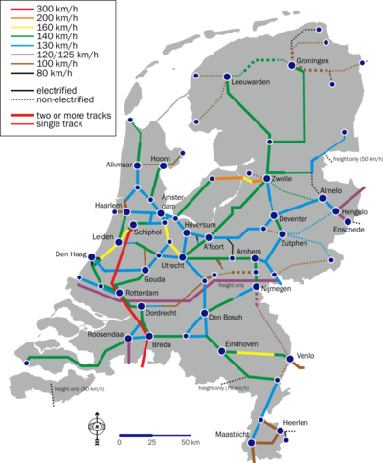
CLARIN Infrastructure
Infrastructure:
(Usually large-scale) basic physical and organizational resources, structures and services needed for the operation of a society or enterprise
Railway network, road network, electricity network, …
eduroam

Slide 6
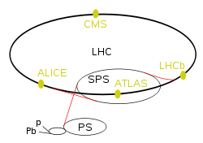
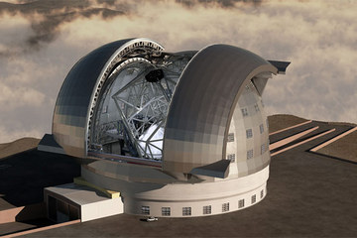
CLARIN Infrastructure
Research infrastructure
Infrastructure intended for carrying out research: facilities, resources and related services used by the scientific community to conduct top-level research
Famous ones: Chile large telescope, CERN Large Hadron Collider

Slide 7
CLARIN Infrastructure
humanities researcher
Linguists, historians, literary scholars, philosophers, religion scholars, ….
And a little bit in the social sciences: e.g. political sciences researchers
Focus here on linguists

Slide 8
CLARIN Infrastructure
Digital language-related resources
Data in natural language (texts, lexicons, grammars)
Databases about natural language (typological databases, dialect databases, lexical databases, …)
Audio-visual data containing (written, spoken, signed) language (e.g. pictures of manuscripts, av-data for language description, description of sign language, interviews, radio and tv programmes, …)

Slide 9
CLARIN Infrastructure
Language in various functions
As object of inquiry
As carrier of cultural content
As means of communication
As component of identity

Slide 10
CLARIN Infrastructure
CLARIN
Has not created any new data
Has mainly adapted existing data and tools
Has created new easy and user-friendly tools for searching, analysing and visualising data

Slide 11
CLARIN Infrastructure
The CLARIN infrastructure
Is distributed: implemented in a network of CLARIN centres
Is virtual: it provides services electronically (via the internet)
The CLARIN infrastructure
Is still under construction
Highly incomplete
Fragile in some respects
But you can use many parts already

Slide 12
CLARIN in Europe
Prepared by CLARIN preparatory project (2008-2011)
coordinated by Utrecht University
From Feb 2012 coordinated by the CLARIN-ERIC, hosted by the Netherlands
ERIC: a legal entity at the European level specifically for research infrastructures
Other ERIC members: AT BG CZ DK DLU EE DE NO PL (SV) and growing

Slide 13
CLARIN in Europe
CLARIN ERIC: www.clarin.eu
National Consortia
Austria: CLARIN+DARIAH Austria
Bulgaria:
Czech Republic: LINDAT CLARIN
Denmark: CLARIN Denmark
Dutch Language Union: CLARIN DLU CLARIN Flanders
Estonia: CLARIN Estonia
Germany: CLARIN-D
Netherlands: CLARIN-NL
Norway: CLARINO
Poland: CLARIN Poland
(Sweden)
…

Slide 14
Overview
CLARIN: Introduction
CLARIN Infrastructure (focus on NL part)
CLARIN Portal
Find data and tools
Apply tools to data
Store data and tools
Goals and Outline of this course

Slide 15
CLARIN Infrastructure
The CLARIN infrastructure offers services so that a researcher
Can find all data and tools relevant for the research
Can apply the tools and services to the data without any technical background or ad-hoc adaptations
Can store data and tools resulting from the research
via one portal

Slide 16
Overview
CLARIN: Introduction
CLARIN Infrastructure (focus on NL part)
CLARIN Portal
Find data and tools
Apply tools to data
Store data and tools
Goals and Outline of this course

Slide 17
CLARIN Infrastructure
Portal
See next presentation

Slide 18
Overview
CLARIN: Introduction
CLARIN Infrastructure (focus on NL part)
CLARIN Portal
Find data and tools
Apply tools to data
Store data and tools
Goals and Outline of this course

Slide 19
CLARIN Infrastructure ‘Can find all data and Tools’
Searching for Data: See next Presentation

Slide 20
Overview
CLARIN: Introduction
CLARIN Infrastructure (focus on NL part)
CLARIN Portal
Find data and tools
Apply tools to data
Store data and tools
Goals and Outline of this course

Slide 21
Apply Tools to Data
Illustration 1 (Search): Today, 2nd hour
Illustration 2 (Search, Syntax): Tue 24th (GrETEL)
Illustration 3 (Enrichment): Wed 25th (TTNWW)
Illustration 4 (Search, Lexical Semantics): Thur 26th (Cornetto)

Slide 22
Overview
CLARIN: Introduction
CLARIN Infrastructure (focus on NL part)
CLARIN Portal
Find data and tools
Apply tools to data
Store data and tools
Goals and Outline of this course

Slide 23
CLARIN Infrastructure ‘Can store the data & tools’
What about your research data /software?
Make them CLARIN-compatible
➔CLARIN tools and services apply to them
For analysis, improvement, creation
Others can use them more easily
Store them at a CLARIN Centre
For long term preservation
For easy access by you and others (e.g. via the VLO)
For verifiability and replicability of your research
More details: Fri 27th.

Slide 24
Overview
CLARIN: Introduction
CLARIN Infrastructure (focus on NL part)
CLARIN Portal
Find data and tools
Apply tools to data
Store data and tools
Goals and Outline of this course

Slide 25
Goals of the Course
Introduction to the CLARIN infrastructure
Introduction to selected functionality within the CLARIN infrastructure
Focus on linguistics
Focus on results of CLARIN-NL
Hopefully make you enthusiastic to use the CLARIN infrastructure and functionality in it
Because it improves your research
If you use it, provide feedback
Helpdesk: helpdesk@clarin.nl
Service-specific user group lists

Slide 26
Course programme
Day | Who | What
Mon 23rd | Jan Odijk | Introduction
 |  | Illustrative Usage Case
Tue 24th | Liesbeth Augustinus | Treebank Mining By Example
 | Frank Van Eynde | Number agreement in copular constructions
Wed 25th | Marc Kemps-Snijders | Enriching your data with grammatical information using TTNWW
Thu 26th | Piek Vossen & Isa Maks | Cornetto
Fri 26th | Jan Odijk | Storing data in CLARIN
 |  | Concluding Overview

Slide 27
Course programme
For more details, see
http://www.clarin.nl/node/2016
http://www.lotschool.nl/link.php?url=http://www.lotschool.nl/files/schools/2014_Summerschool_Nijmegen/

Slide 28
Thanks for your Attention
And
Enjoy the Course!

